Slide 1



Pacific Maritime Boundaries
Geoscience Energy & Maritime (GEM)
Pacific Community (SPC)
Andrick Lal
Oceania Geospatial Symposium 2022
Noumea - New Caledonia.
Notes:
“For 75 years SPC has proudly worked for the wellbeing of all Pacific people through the application of science and knowledge for development”

Slide 2
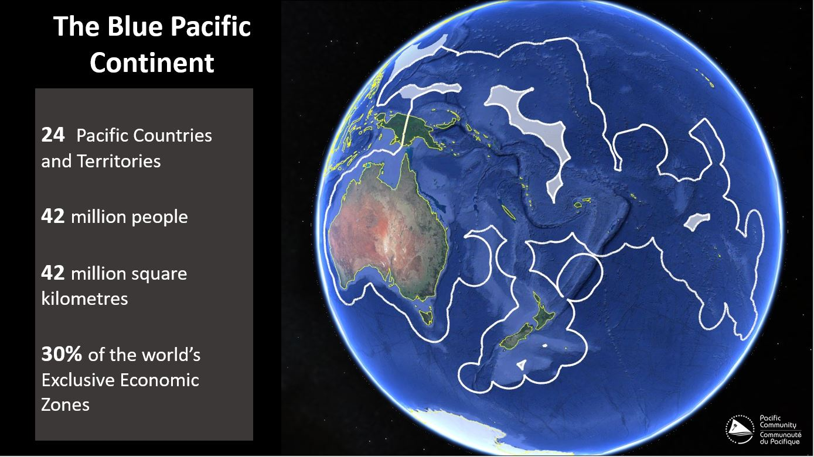
24 Pacific Countries and Territories
42 million people
42 million square kilometres
30% of the world’s Exclusive Economic Zones (EEZ)
Notes:
Does not mean that member states are not doing
Samoa – have started
Fiji/SB – finalizing

Slide 3


























Theory of Change for Pacific Boundaries
FRAMEWORK FOR A PACIFIC OCEANSCAPE
Priority 1
TARGET 14.C
Implement international law:
UN Convention on the Law of the Sea
Notes:
Does not mean that member states are not doing
Samoa – have started
Fiji/SB – finalizing

Slide 4
Shared boundaries under negotiation
Technical Advice and Support
Capacity Building
Data Stewardship & Accessibility
Coordination & Project Development
Technical backstopping for in-country basepoint surveys
Mapping and delimitation support
Extended Continental Shelf submissions support
Advising on UN submissions process
Organising annual Working Sessions at UniSydney
Hosting attachments
National workshops
Comprehensive dataset hosting on behalf of countries
MB Dashboard in development
Improving accessibility of published info on Pacific Data Hub
Host monthly Consortium partner meetings
Develop project proposals
Home of Pacific Geospatial and Surveying Council Partnership Desk
Organising relevant training, webinars, and other development opportunities
Supporting negotiations
Communications and engagement strategy
Notes:
Does not mean that member states are not doing
Samoa – have started
Fiji/SB – finilizing

Slide 5
Our success - Design and delivery through fostered cooperation
Building a community of practice
Sense of community built over time
National leads with political connections have been vital
Regular working sessions
The Consortium approach
Continued momentum
Complementary skills and expertise
The value of champions
Country teams drive priorities
Technical and legal country team approach
Harmonised regional approach
Facilitated multiple joint ECS submissions
Common understanding and practice of data sharing
Expedited conclusion of shared boundaries
Commitment of individuals to conclude national boundaries
Supporting countries at technical, legal, and political stages
Reinforced by attachments and national workshops

Slide 6
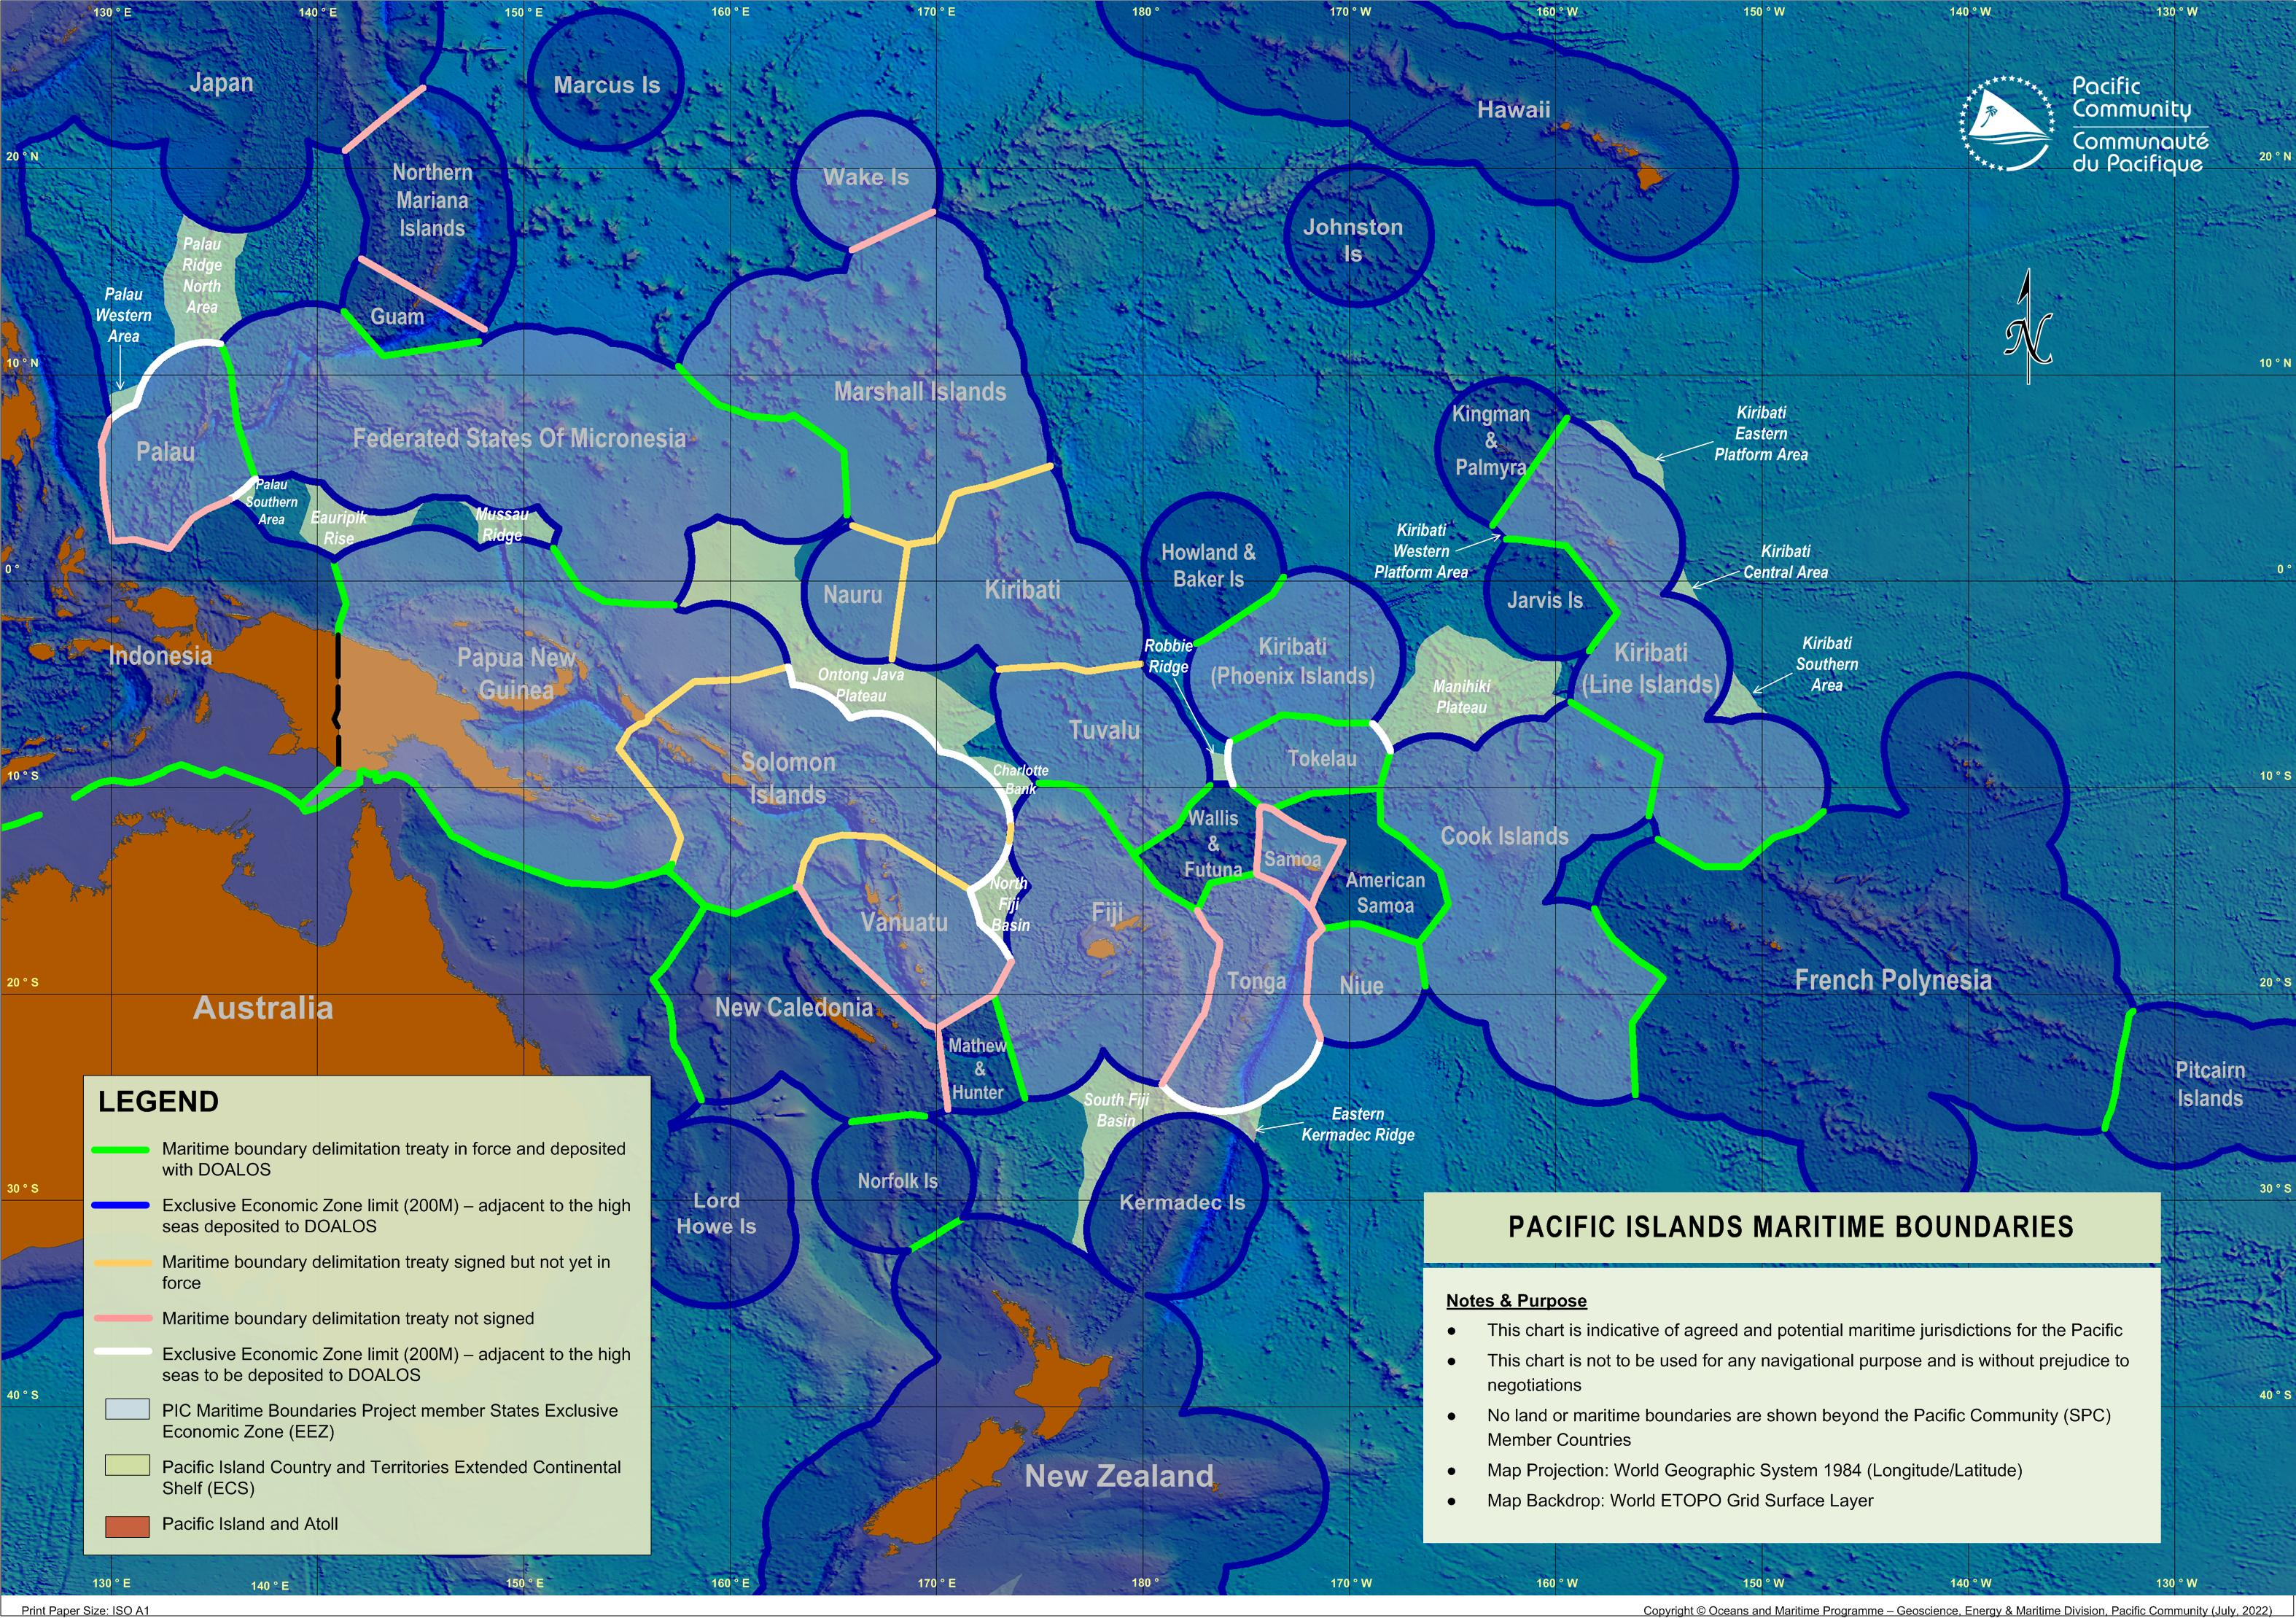
Maritime Boundaries & ECS Map
Status Update:
Boundaries:
36 out of 48 shared boundaries are under treaty (75% completed, 12 remaining)
5 high seas limits have yet to be declared
Extended Continental Shelf:
2 out of 17 ECS submissions has been recommended (15 remaining)

Slide 7
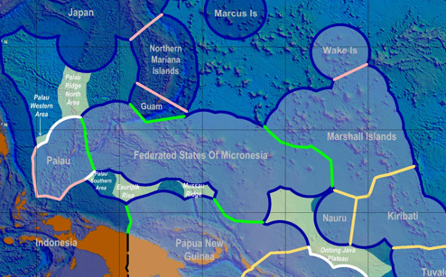
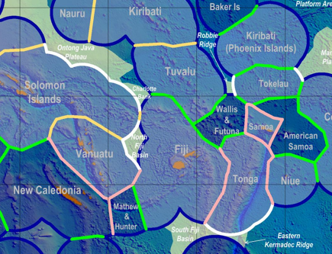
Shared boundaries under negotiation
No. | Boundary
1 | Palau – Indonesia
2 | Palau – Philippines
3 | Republic of Marshall Islands – United States of America (Wake Island)
No. | Boundary
4 | Fiji – Tonga
5 | Fiji – Vanuatu
6 | Samoa – France (Wallis and Futuna)
7 | Samoa – New Zealand (Tokelau)
8 | Samoa – United States of America (American Samoa)
9 | Samoa – Tonga
10 | Tonga – Niue
11 | Tonga – United States of America (American Samoa)
12 | Vanuatu – France (New Caledonia)
Notes:
Does not mean that member states are not doing
Samoa – have started
Fiji/SB – finilizing

Slide 8
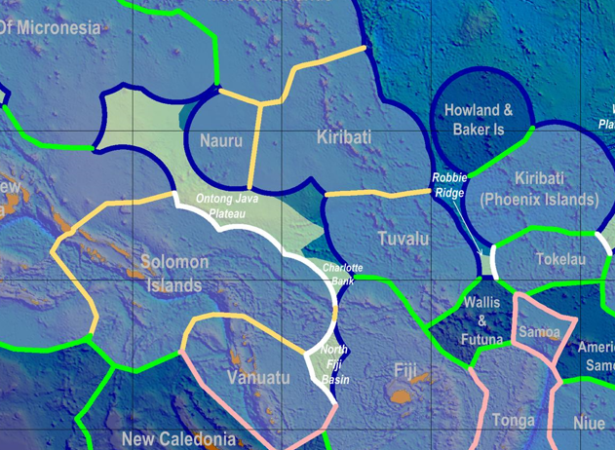

Treaties to be entered into force

Slide 9

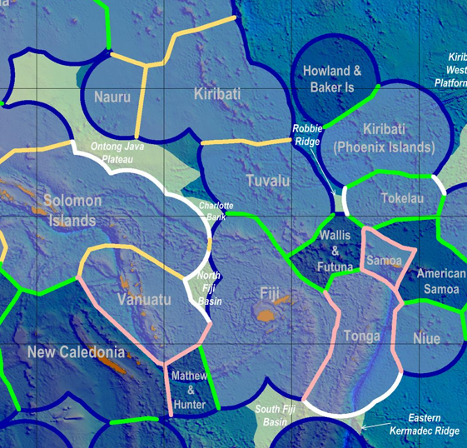
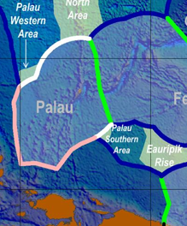
High Seas to be deposited with UN-DOALOS
No. | Countries yet to deposit High Seas Boundary | No. High Seas Boundaries
1 | Palau | 2
2 | Solomon Islands | 2
3 | Vanuatu | 1
4 | Tonga | 1
5 | New Zealand (Tokelau) | 2

Slide 10
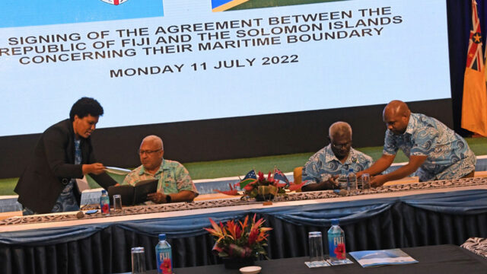
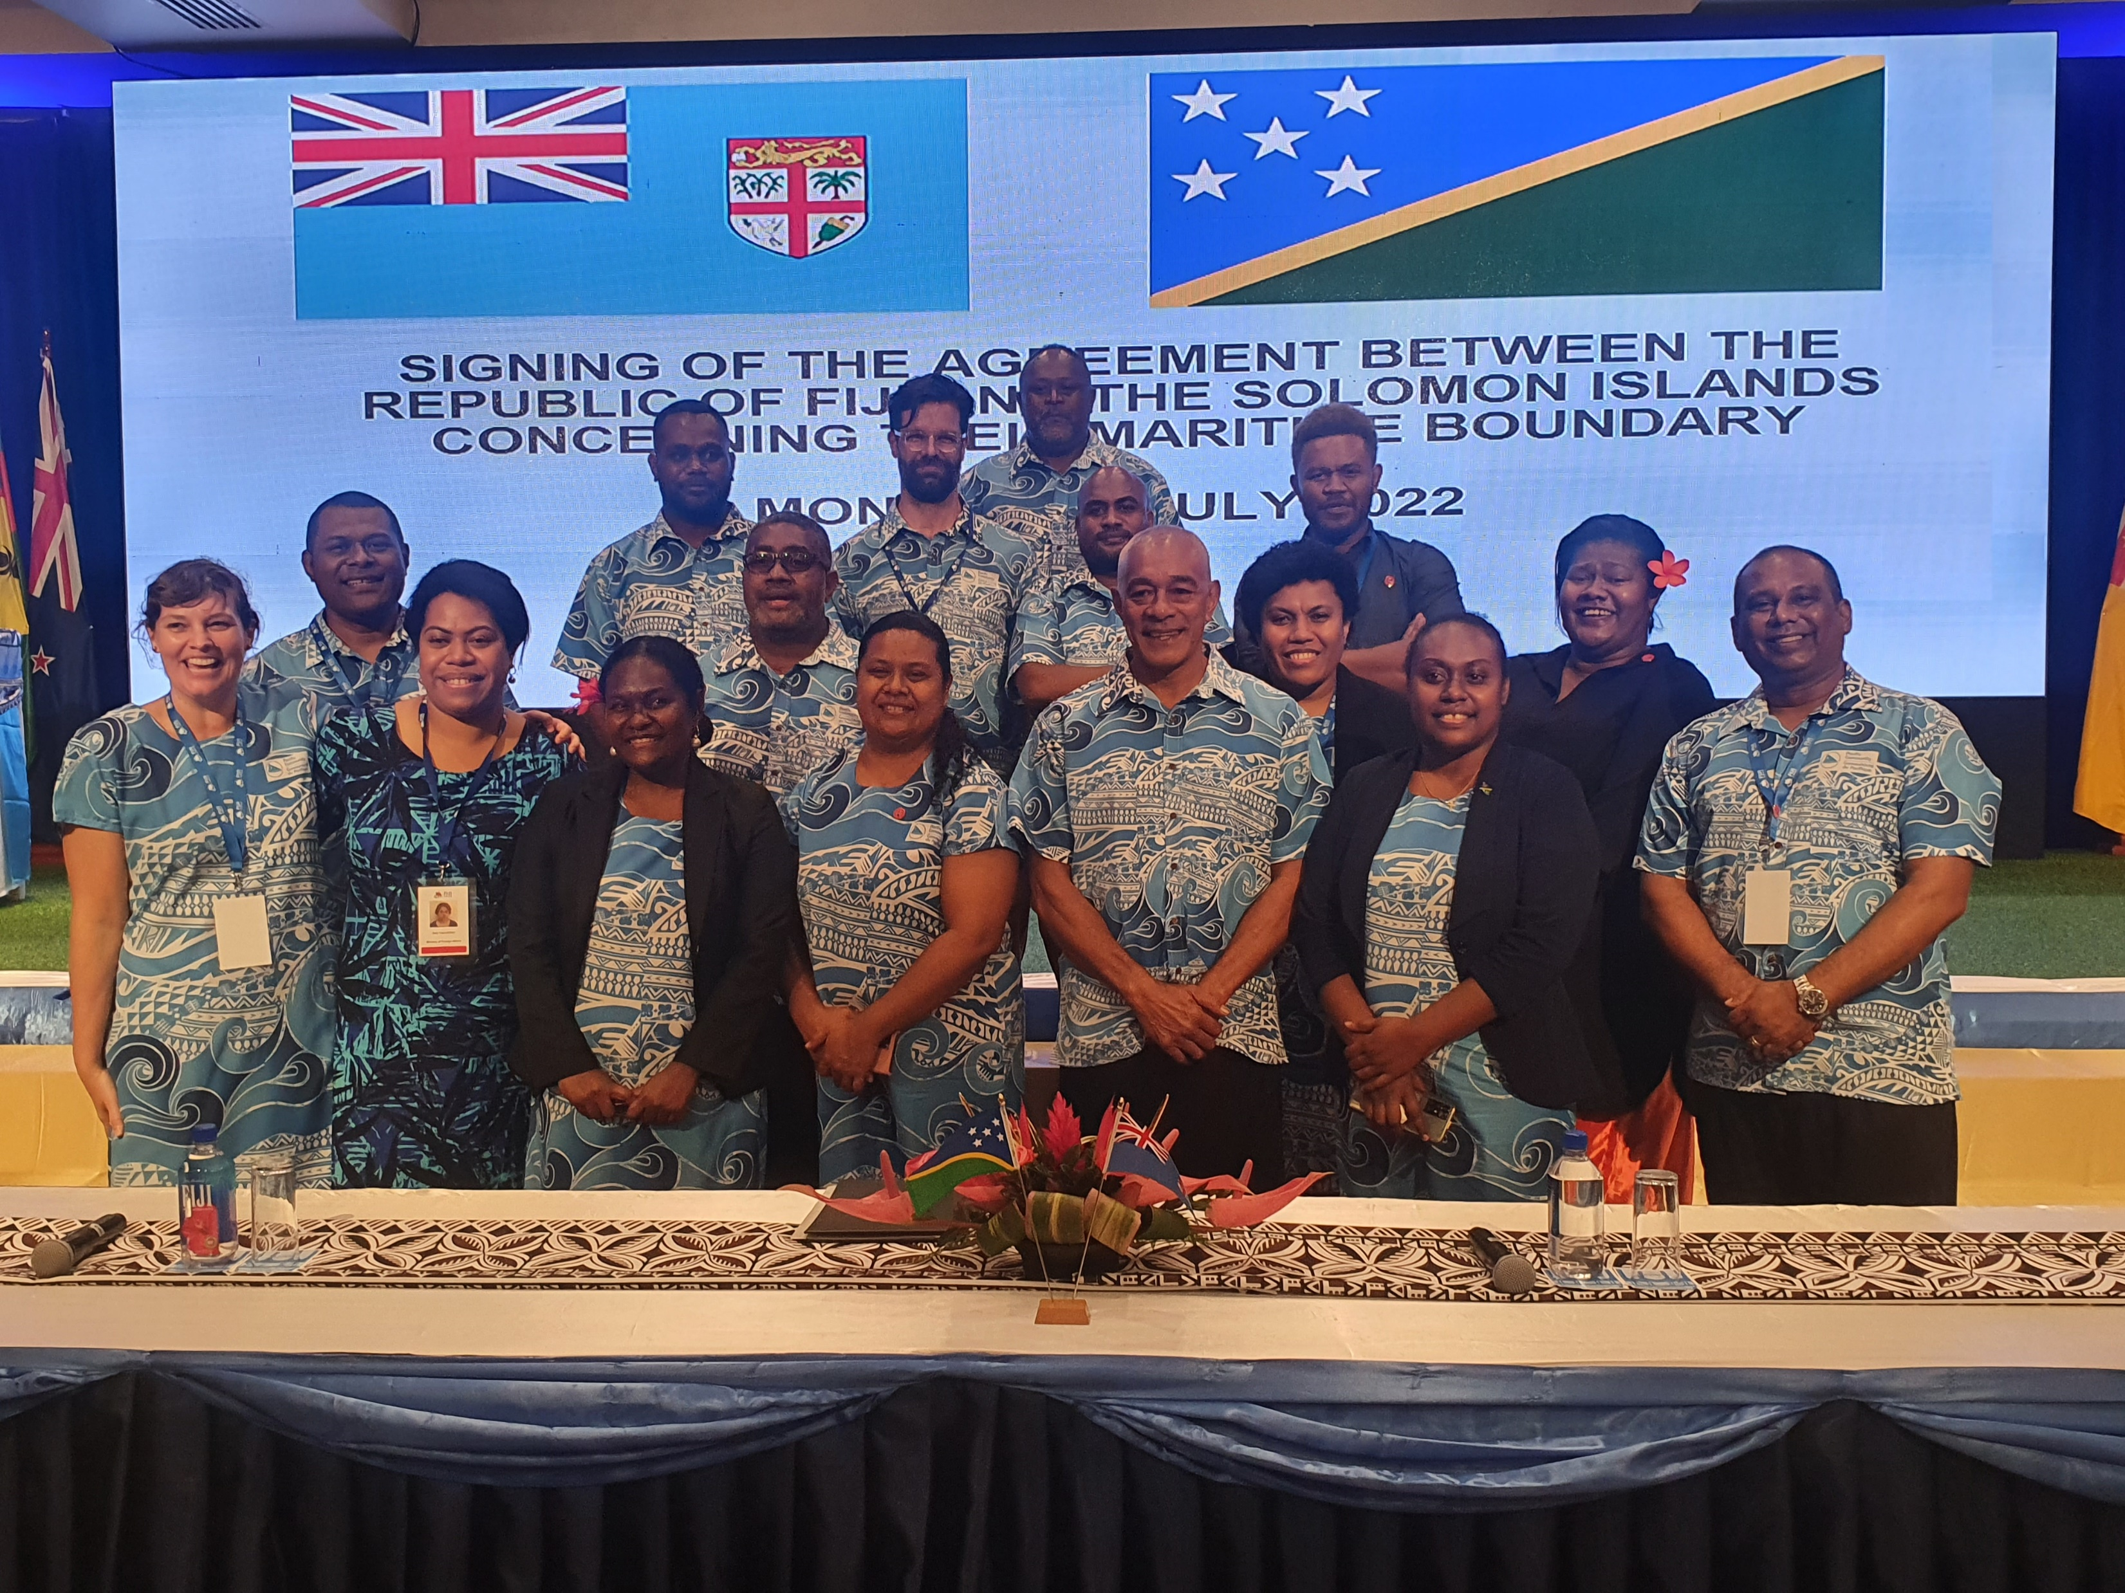
Fiji/Solomon Islands Treaty signing
Hon. PM Fiji Mr Voreqe Baininarama with Hon. PM Solomon Islands Mr Manaseh Sogovere
During the ambit of the 51st PIFS Leaders meeting in Suva
Notes:
Next process is to have the country rectify the treaty (entry into force)

Slide 11
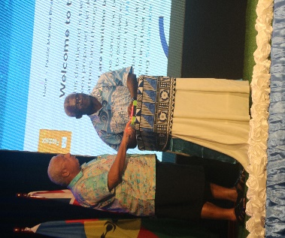
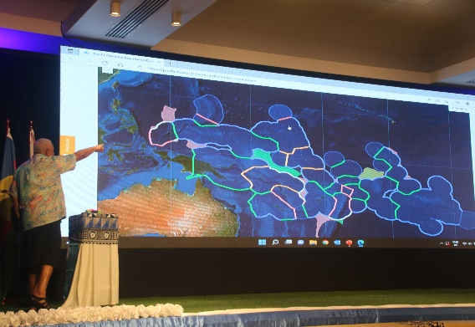
Official Launch of Pacific Maritime Boundaries Interactive Dashboard
https://pacificdata.org/dashboard/maritime-boundaries

Slide 12
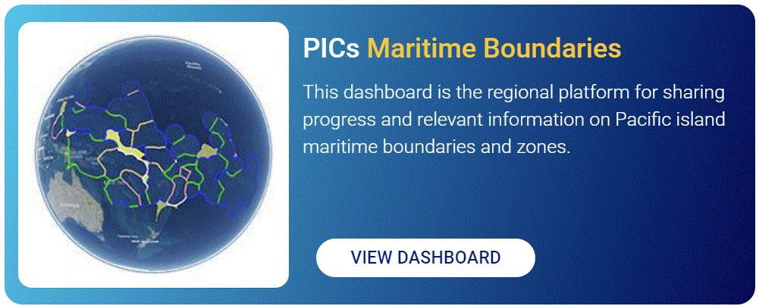
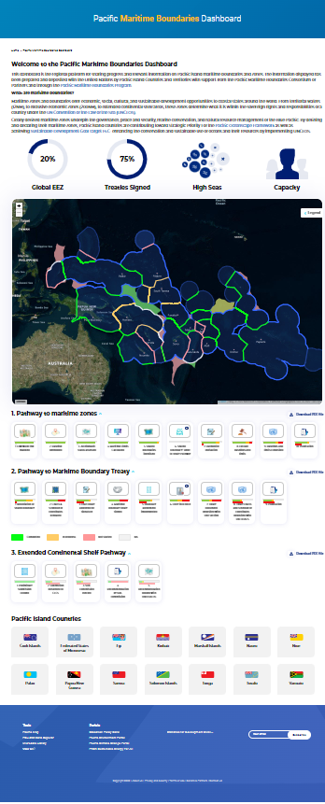
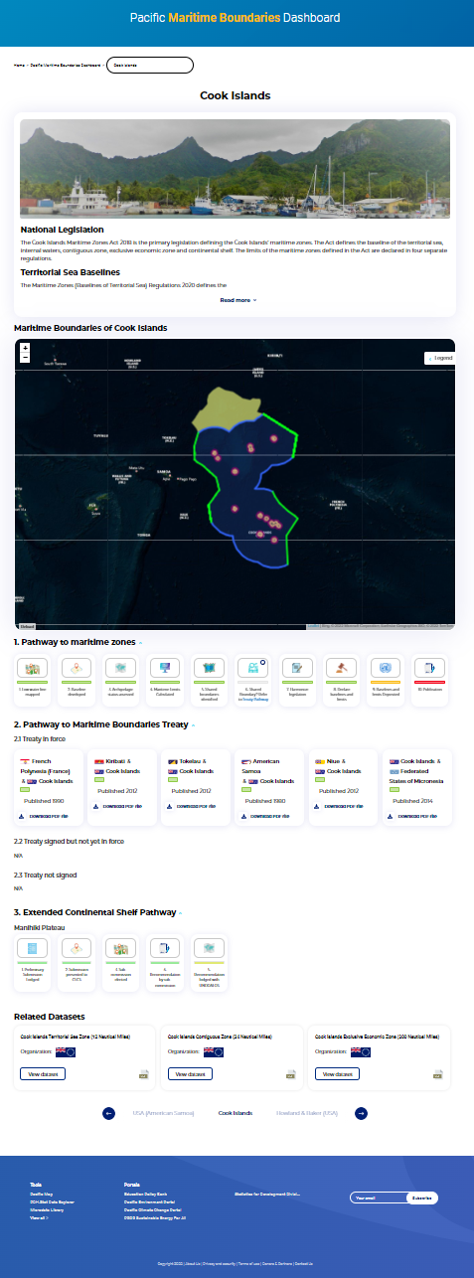
Maritime Boundaries Dashboard
Soft launch of the Pacific Islands Maritime Boundaries interactive dashboard
https://pacificdata.org/dashboard/maritime-boundaries
https://pacificdata.org/dashboard/maritime-boundariesS
Notes:
https://pacificdata.org/ find PIC MB icon

Slide 13
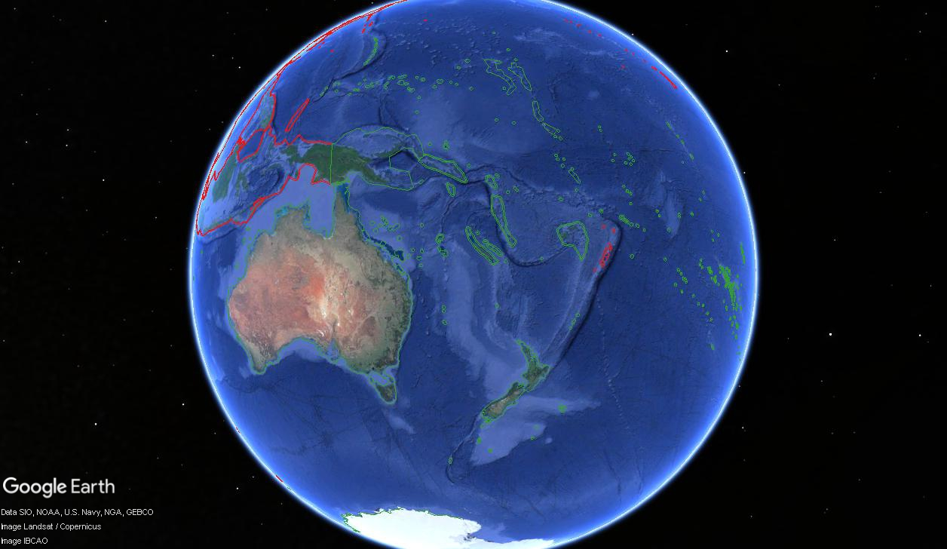
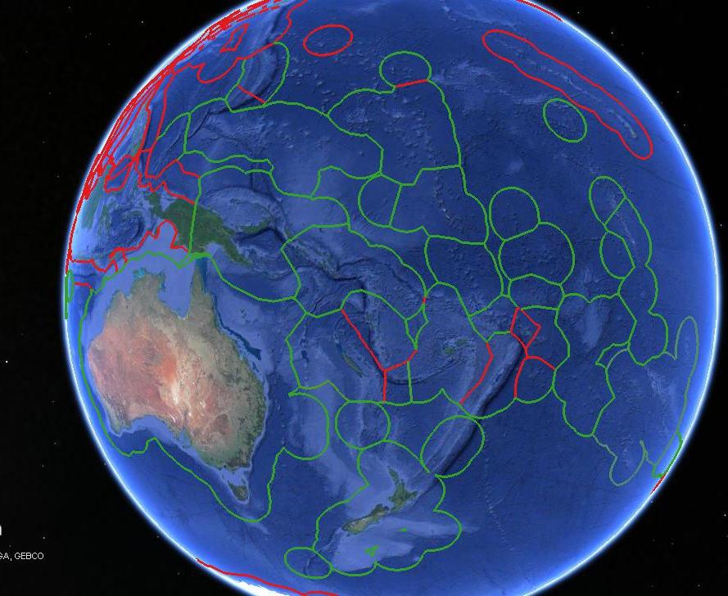
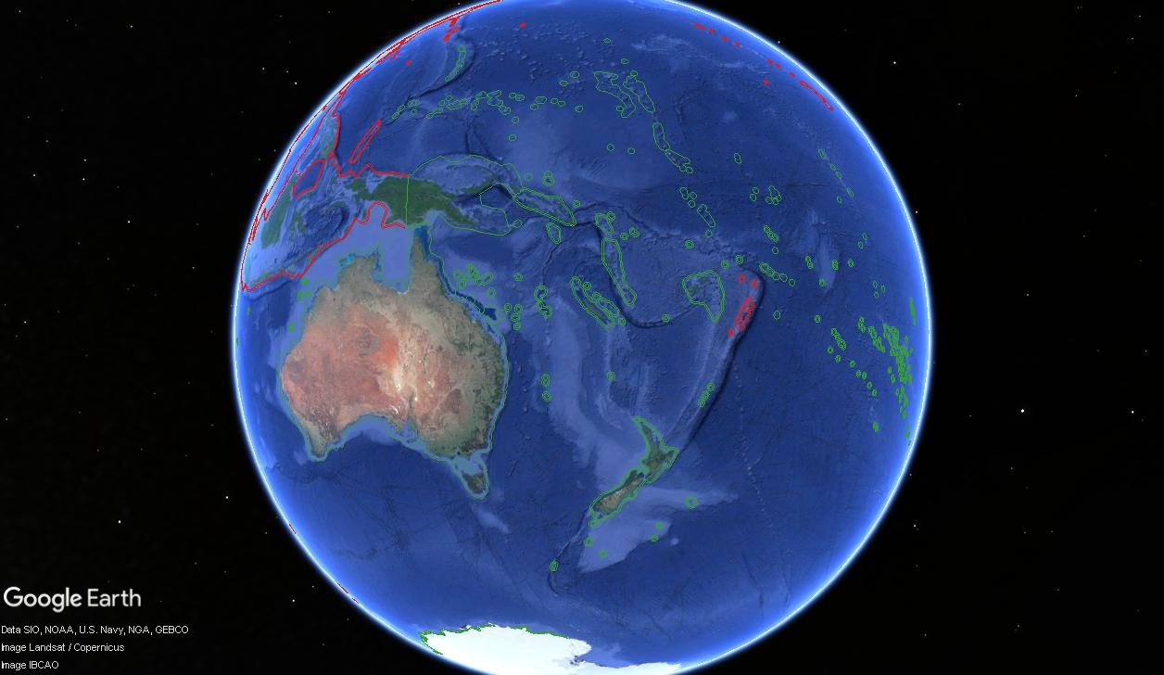
FFA/SPC - SLA
Updated 24 nautical miles (kml & .shp)
Updated 12 nautical miles (kml & .shp)
Updated 200 nautical miles (kml & .shp)
Notes:
New SLA signed on 28th October, 2022
Monthly meetings – updated
Update 12M,24M & 200M - .kml & .shp

Slide 14
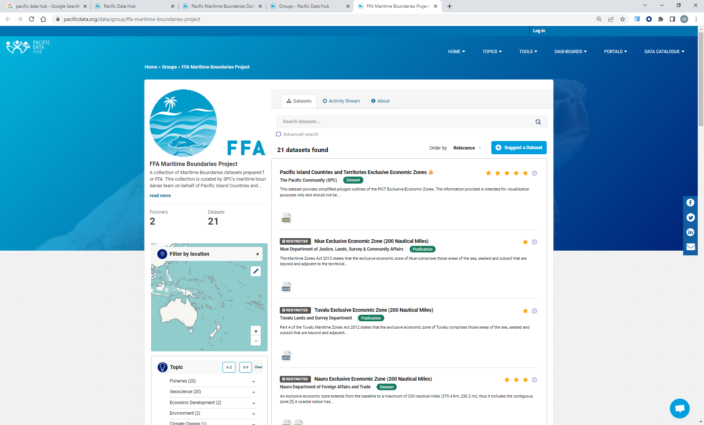
FFA/SPC – SLA – Pacific Data Hub
Notes:
New SLA signed on 28th October, 2022
Monthly meetings – updated
Data available as polygon, line in both shapefile and kml generated and uploaded to PDH
Treaty lines uploaded to PDH as well as the baselines/basepoints
The line layer had to be redone to include information on the treaty and other agreements between boundaries.

Slide 15




Research project that is looking to understand any potential effects that climate change may have on the maritime zones in the region from the scientific, technical and legal perspectives
Present options to countries, which combines all these 3 areas of work, to maintain their maritime zones
Countries can make informed adaptation decisions

Slide 16
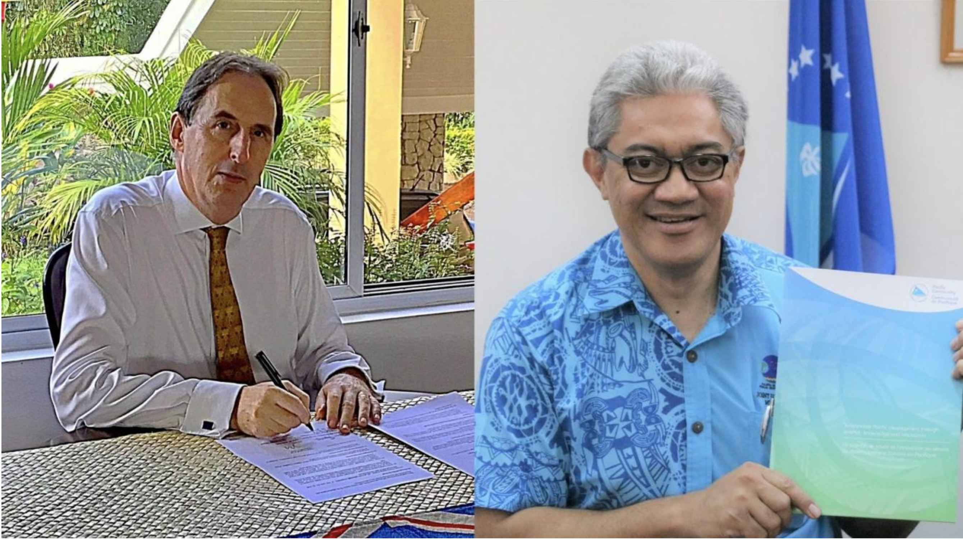
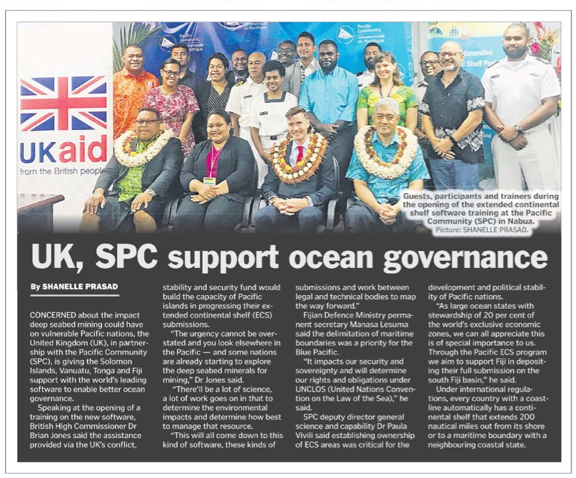
PICs Extended Continental Shelf Project
UK Government supports Pacific Islands progress on Extended Continental Shelf submission.
https://www.spc.int/updates/news/joint-release/2021/08/uk-government-supports-pacific-island-progress-on-extended
Notes:
MOU signing July 2021 – under the British Government’s Conflict, Stability and Security Fund (CSSF) (purchase of extended continental shelf software and training for 4 countries FJ,VU,SB & TO)
Phase II is in PROGRESS
As I speak – ECS software training (blended)
Next training Vanuatu, SB and Tonga
GBP 263,000 that

Slide 17

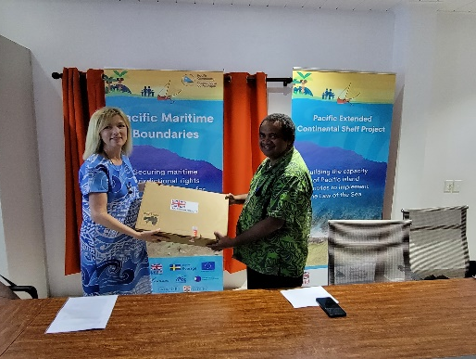


Extended Continental Shelf – Geocap Software
Notes:
Vanuatu training – 15th – 19th August (3 male participants)
Solomon training – 26th – 30th Sept (10 male participants)

Slide 18
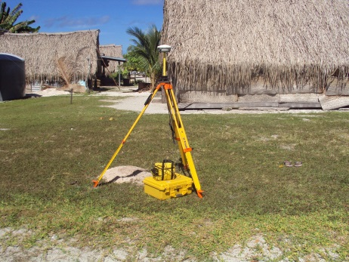
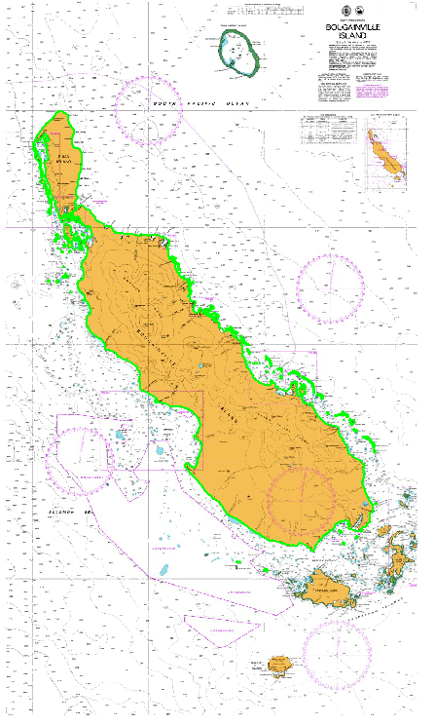
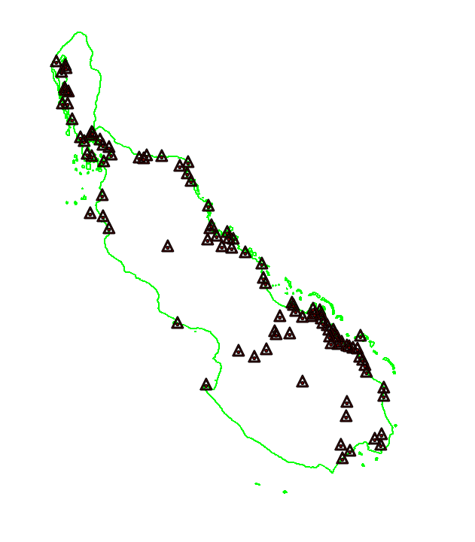
Coastal Waters Project (PNG)
Notes:
PNG

Slide 19
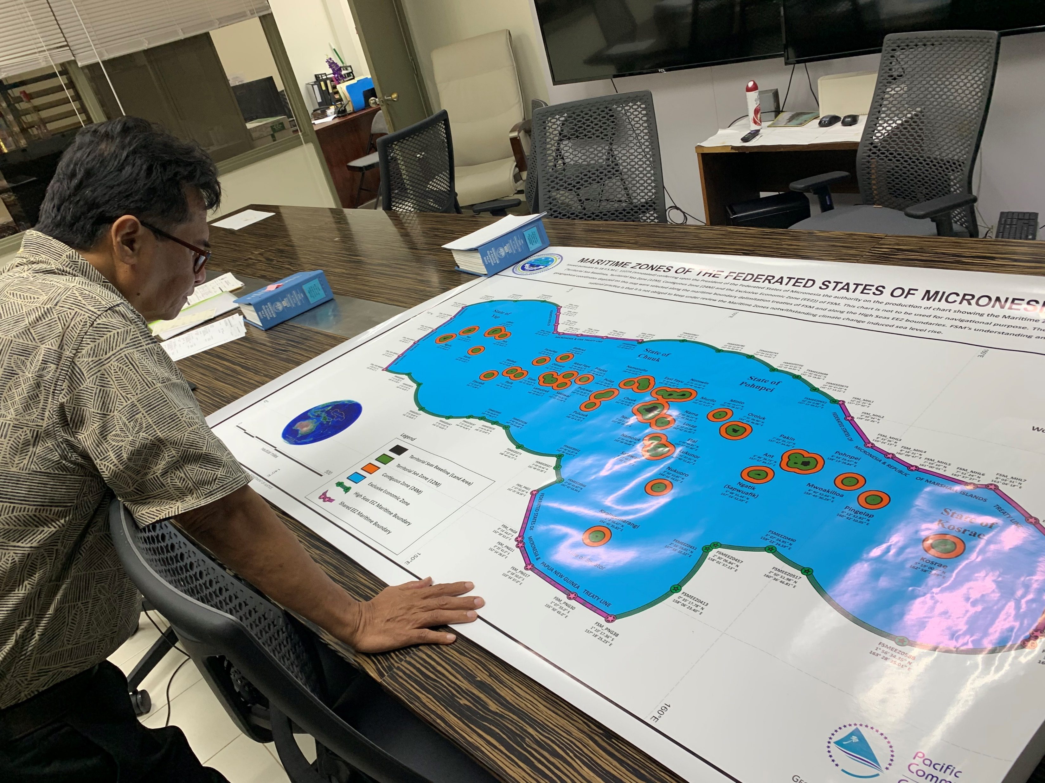
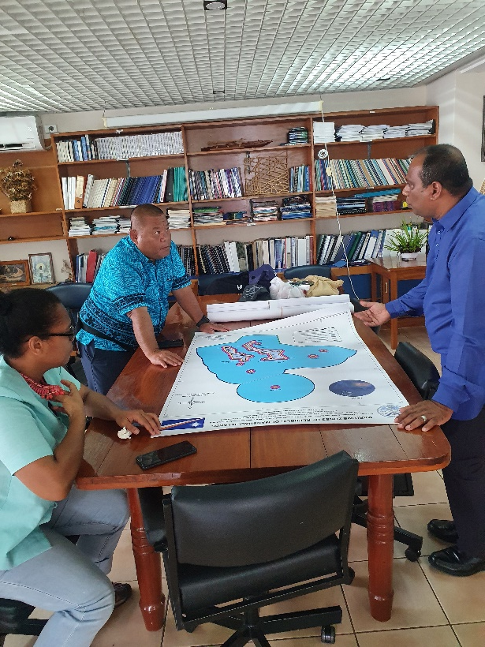
National EEZ Charts
Notes:
FSM
RMI

Slide 20
Thank you

