Slide 1

Oceania Geospatial Symposium
28 Nov. – 04 Dec. 2022
Nouméa , New Caledonia
D I N A M I S
The French National Facility for
Institutional VHR Satellite Imagery
J-F. Faure (IRD)
Executive Secretary

Slide 2
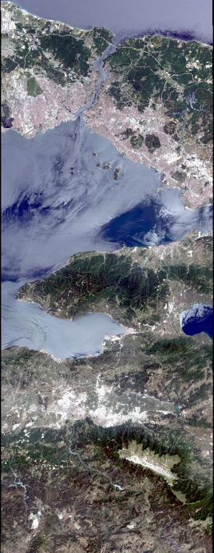
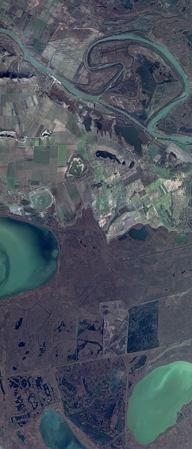

Very High Resolution satellite imagery
Expensive
data & processes
→ Difficult access
Institutional users: growing needs & expectations
→ dedicated
National Facility
Pléiades@CNES, 2015, Distribution Airbus DS
Spot @Airbus DS
Pléiades@CNES, 2015, Distribution Airbus DS

Slide 3
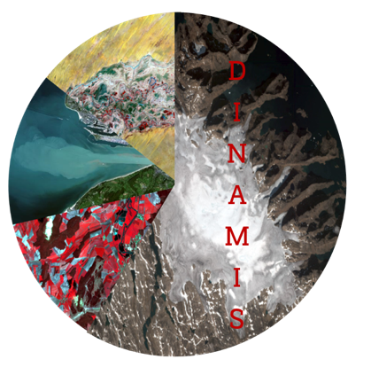
Who are we ?
French Facilitiy giving access to VHR resources and services,
dedicated to scientific, R&D and public users
Created in 2017
Consortium of 6 Partners
Create a unified access point to Earth Observation VHR imageries Pleiades and Spot 6-7 for institutional users: data dowloading, data ordering, data pre-processing
Feed scientific applications, territorial and environmental management planning, research and development projects: benefiting EO usage and innovation in France and abroad for scientific Partners
Offer enduser technical support in expressing needs, ordering new acquisitions, accessing and using data
CNES
CNRS
IGN
IRD
INRAE
CIRAD
Collaboration with AFD

Slide 4

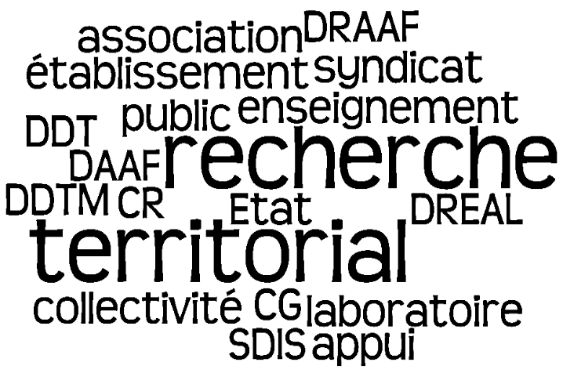



Our endusers
French Scientists: all Public Organizations
French Public Sector : all Organizations
Non French Scientists: under conditions, limited services
Private Sector: French corporations for R&D Projects only, limited services
Authorized DINAMIS Users
Total pool of endusers
Visits to the Facility (june - sept. 2022)
692 Organizations
(Membership)
1 429 Endusers
(Personal accounts)
400 Ordering requests / year
Endusers requests, average
1 500 visits
2 200 sessions
1 400 visits
180 / week (average)
1 204 Followers
869 impressions

Slide 5


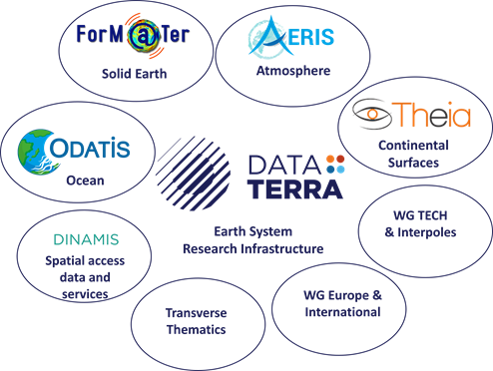



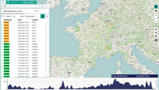

Our operational environment
Thematic Products
On-line
DEM
processing
ISIS
Land data center
Heritage
DINAMIS
Data Terra
National Research Infrastructure

Slide 6
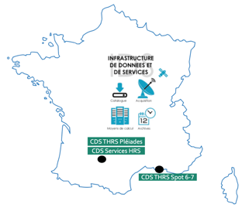


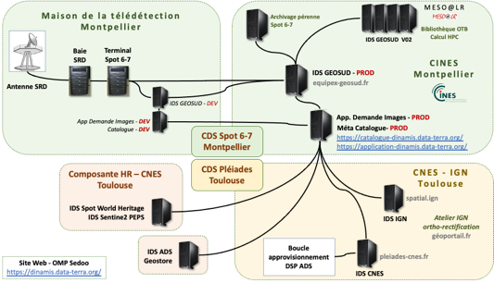
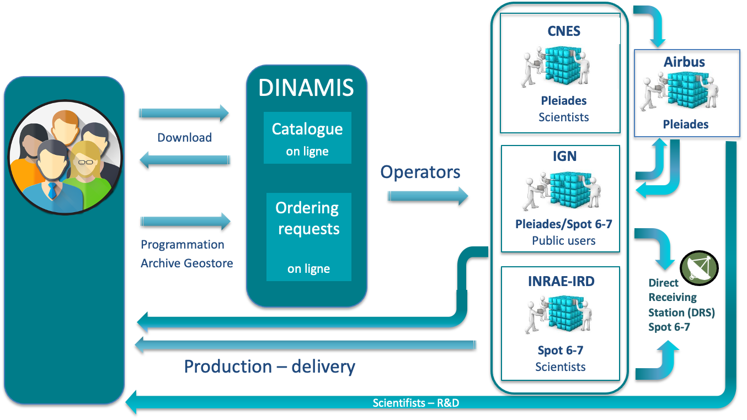
A collaborative transverse infrastructure
DINAMIS : distributed infrastructures
Direct Receiving Station(s)
Infrastructures hosting data & services
Metadata & services Catalogue
Enduser management tools
French Guiana

Slide 7
A collaborative transverse infrastructure
DINAMIS : distributed infrastructures
Direct Receiving Station(s)
Infrastructures hosting data & services
Metadata & services Catalogue
Enduser management tools
French Guiana
Key word: mutualization
3 Sites including overseas site, 7 infrastructures connected
Interoperable protocols, metadata standardization
Staff of 25 collaborative contributors (equivalent 8 full time jobs) in the 6 Consortium institutions
3 human resources dedicated to Enduser support and assistance
Industrial partners / contractors (ADS, Thales, Geomatys…)

Slide 8

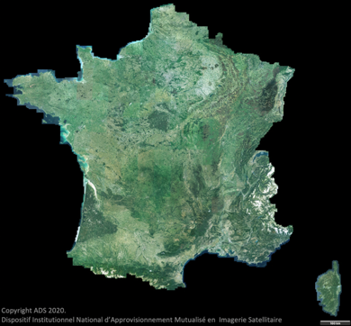
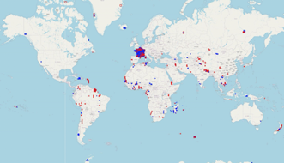

The VHR data sets: Pleiades, Spot 6-7
Pleiades 50 cm - Spot 6/7 1.5 m
Recurrent or specific Areas of Interest, Worldwide
End-user On demand requests, Worldwide
Spot 6/7 1.5 m
Yearly recurrent National Coverage,
French metropolitan Territory
2014 – 2015 – 2016 – 2017 – 2018 – 2019 – 2020 - 2021
SPOT 2021
Cayenne
Pléiades ©CNES 2020, distribution ADS
On demand acquisitions - Spot 6-7 2016-2020

Slide 9
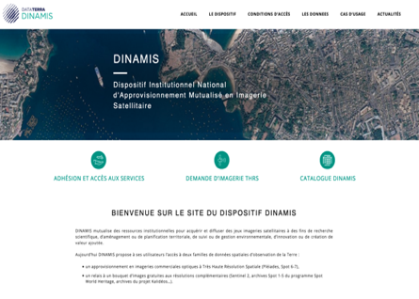
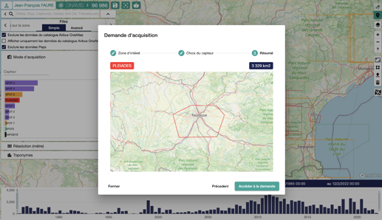
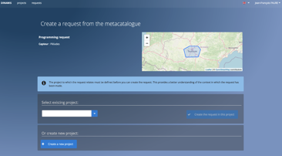



On-line data access services
Website
On-line Catalogue: browse, visualise, download
Ordering request Forms (Project submission)
Enduser Application dedicated to Project management & submission
Continuous development
+ 1 M km² per Year (average)
Information – Membership Form
Account Form
Spatial & temporal Filters
Data filters
Back-Office: Procurement
Dowload or on-line processing
  Web v02, Social media 2.0
  On-line Membership Forms
  English FR/EN
  Stereo / Tri-stereo Filter (Pleiades)
  On-line DEM processing (Pleiades)
  Multiple download cart
  On-line Ordering requests from Catalogue (first steps)
  Relay Global SWH database
  Back-Office Service monitoring tool, Metadata simplification, STAC API
2022

Slide 10
On-line data access services
Website
On-line Catalogue: browse, visualise, download
Ordering request Forms (Project submission)
Key word: Mutualization
Any given DINAMIS acquisition is immediately made available to all Endusers via our Catalogue
Licensing Terms harmonized between all products
Catalogue: 54 706 references (nov. 2022)
Pleiades - 37 770
Spot 6/7 - 17 436
Enduser Application dedicated to Project management & submission
Continuous development
+ 1 M km² per Year (average)
Information – Membership Form
Account Form
Spatial & temporal Filters
Data filters
Back-Office: Procurement
Dowload or on-line processing
  Web v02, Social media 2.0
  On-line Membership Forms
  English FR/EN
  Stereo / Tri-stereo Filter (Pleiades)
  On-line DEM processing (Pleiades)
  Multiple download cart
  On-line Ordering requests from Catalogue (first steps)
  Relay Global SWH database
  Back-Office Service monitoring tool, Metadata simplification, STAC API
2022

Slide 11
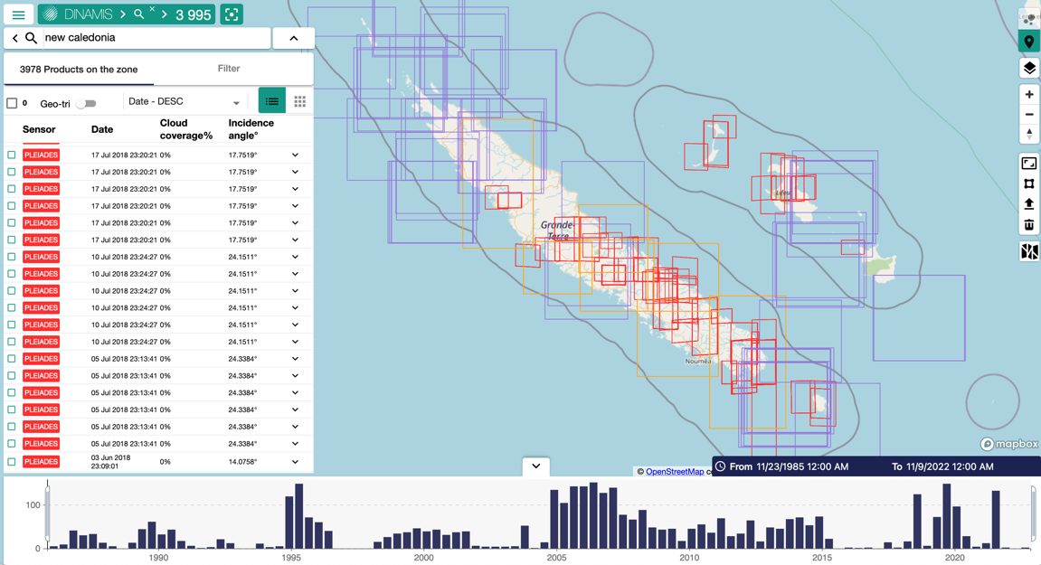
On-line data access services
Focus on New Caledonia
Search result: 3 978 products
Pléiades - 628
Spot 6/7 - 40
Spot 1 to 5 - 3 308
Airbus archive products
Spot 6/7 - 1 844
Pleiades - 6 090

Slide 12
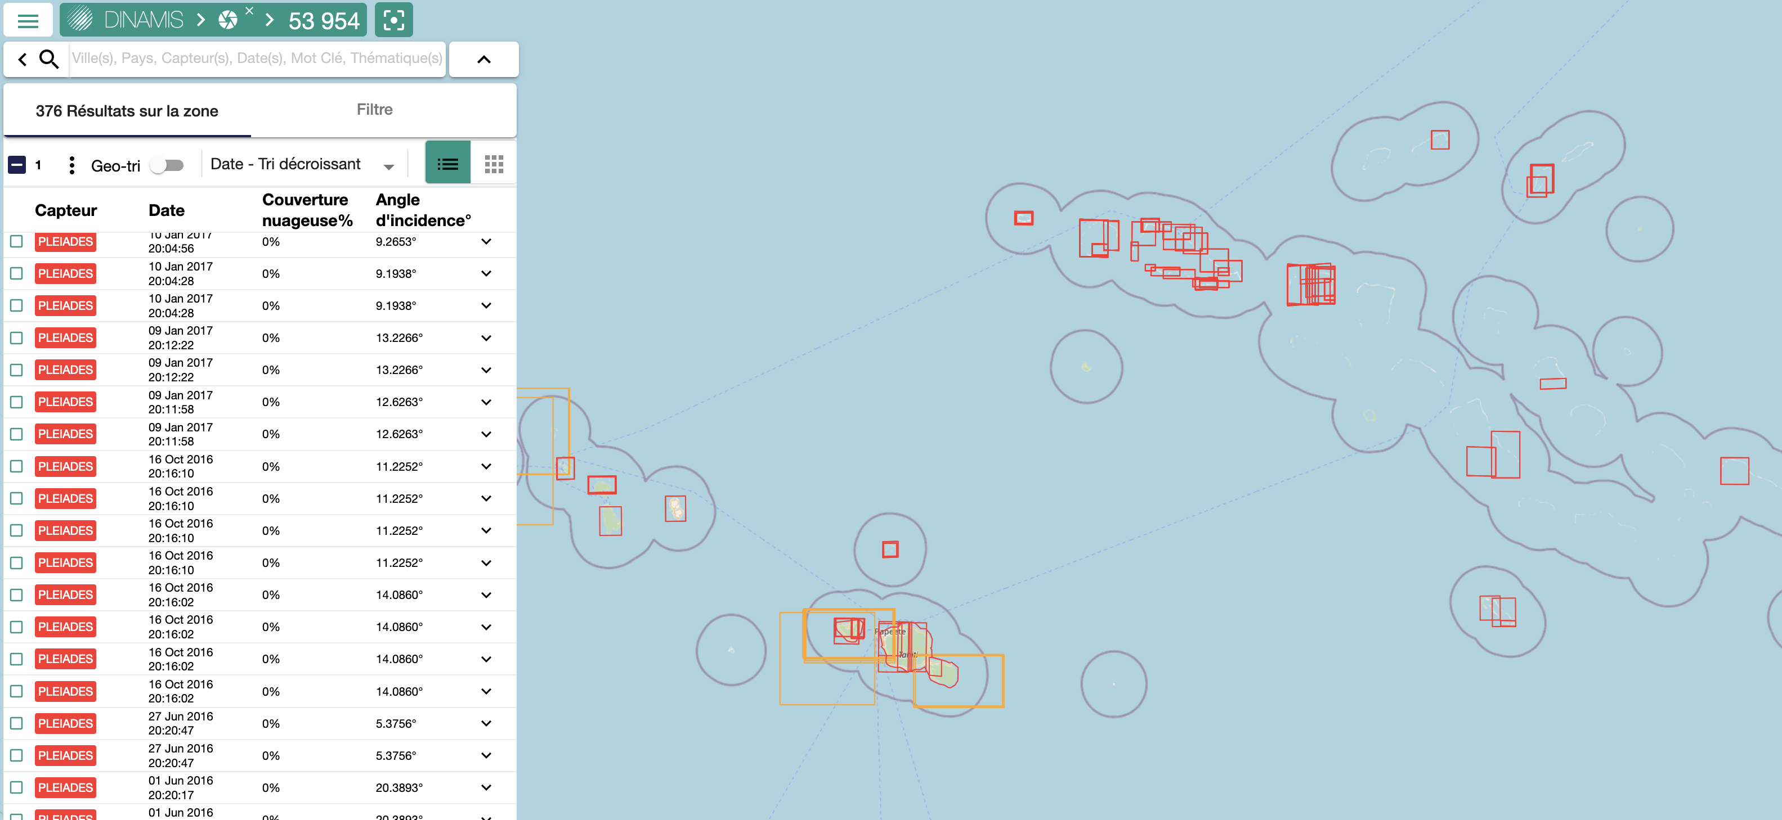
On-line data access services
Focus on French Polynesia (extract)
Search result: 842 products
Pléiades - 350
Spot 6/7 - 26
Spot 1 to 5 - 466
Airbus archive products
Spot 6/7 - 2 014
Pleiades - 6 460

Slide 13
Enduser support and networking
Information
Communication
Tutorials
Helpdesk
Eligibility requirements & On-line Forms
Technical assitance using Tools & Applications, Data sets and Formats
Individual follow-up on Project submission & Ordering requests
News, Workshops, Social media, Events

Slide 14
Acess DINAMIS: how does it work ?
1
2
3*
Become Member (Organization)
Create account (Enduser)
Access Catalogue
Select & download or process data
Submit Project
Order requests: submit Project
Fill out membership Form
Accept Charter Terms
Accept Licencing Terms
Indicate Organization Referent Contact
Personal Enduser Account
Personal Enduser Account
Log in
Authentification
Submit Project
Log in
Authentification
Download available data
Use services
Membership granted
→ Create personal account
Project granted
→ Order new data
Personal Enduser Account
* French Organizations and E. Union Labs.

Slide 15
What are the costs for authorized Endusers ?
Access to DINAMIS Catalogue & download data without costs
Enduser requests for new imageries
Tasking or Archives (Airbus)
→ Quotas without costs
per Enduser/Request
Pleiades
Spot 6-7
Scientists : 5 500 km²
Public Sector : 4 000 km²
10 Telemetry credits
(= 36 000 km²)
    → Tasking attempts
    → Archives referenced by Airbus
  Final product after tasking
  Archives referenced by Airbus
Above Free Quotas
Scientist FR
1 € / km²
  Institutionnal FR
  Public Sector FR
  R&D FR
  Scientist E. Union
1,4 € / km² archive
1,8 € / km² progr
20 credits : 20 k€
50 credits : 50 k€

Slide 16
DINAMIS tomorrow
Scaling-up to meet emerging needs
Provide new data sets to foster new services, feed new use-cases, sustain new on-line applications
Adapt to growing community of endusers and to large-scale demands
→ Contribute to a new generation of VHR geo-commons originating from satellite data, useful to French territorial public policy making

Slide 17
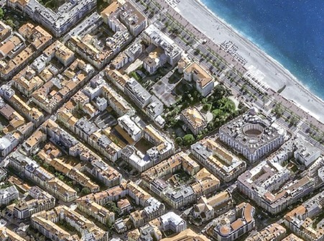
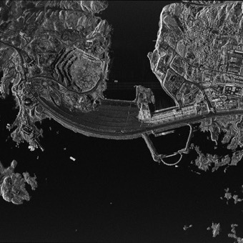
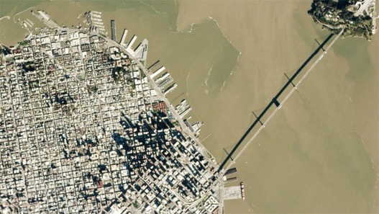
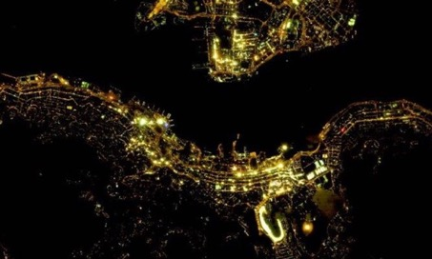
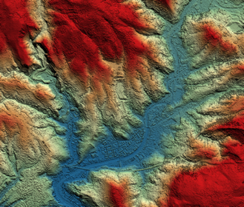
Examples of orientations currently studied
Up-grade VHR offer in optical sensors
First institutional products arriving in DINAMIS
Open to night-time and radar products, to very high revisit rates, to standard DEM products….
Pléiades-Neo 30 cm
Planet 0,6-3m
TerraSarX 25 cm à 40 m
Planned 2023
Develop services to adress new on-line processing needs
Jilin 0,5-3m
CO3D – DEM 1m

Slide 18
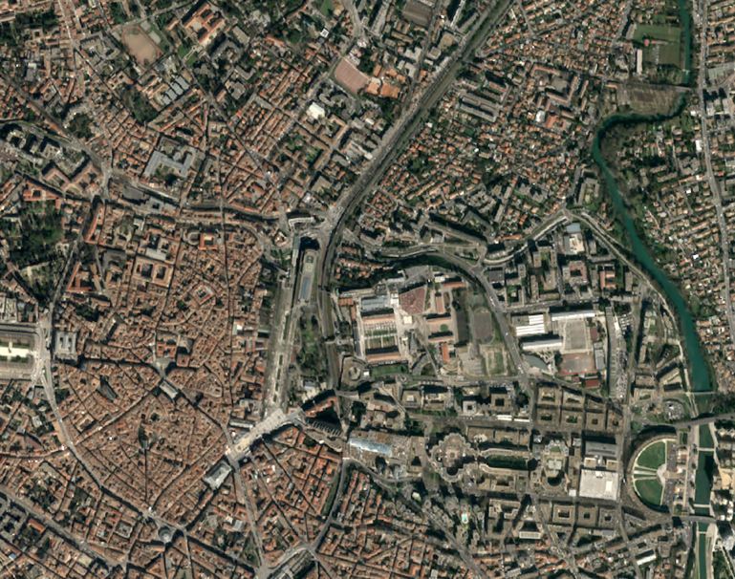

To keep in touch
Website
https://dinamis.data-terra.org
Catalogue
https://catalogue-dinamis.data-terra.org
Social media
https://www.linkedin.com/company/dataterra-dinamis
https://www.youtube.com/channel/UC5uatLlrr4s3lc38TYQbIug
Montpellier. Pléiades © CNES 2020, distribution Airbus DS

