Slide 1



Pacific Data Hub and the Nexus Platform
Spatial Data Infrastructure as a Regional Public Good
Sachindra Singh, Sioeli Tonga, Stan Ozier
Pacific Community (SPC)

Slide 2
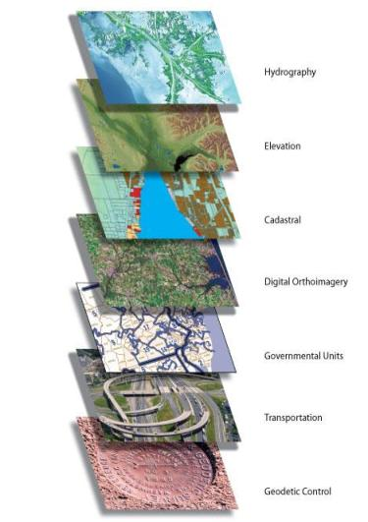
Spatial Data Infrastructure
The term “Spatial Data Infrastructure” (SDI) is often used to denote the relevant base collection of technologies, policies and institutional arrangements that facilitate the availability of and access to spatial data. The SDI provides a basis for spatial data discovery, evaluation, and application for users and providers within all levels of government, the commercial sector, the non-profit sector, academia and by citizens in general.”
– SDI Cookbook
http://www.gsdi.org/gsdicookbookindex
An inter-connected set of systems that enables easy management, exposure & usage of information across all spatial data themes.

Slide 3
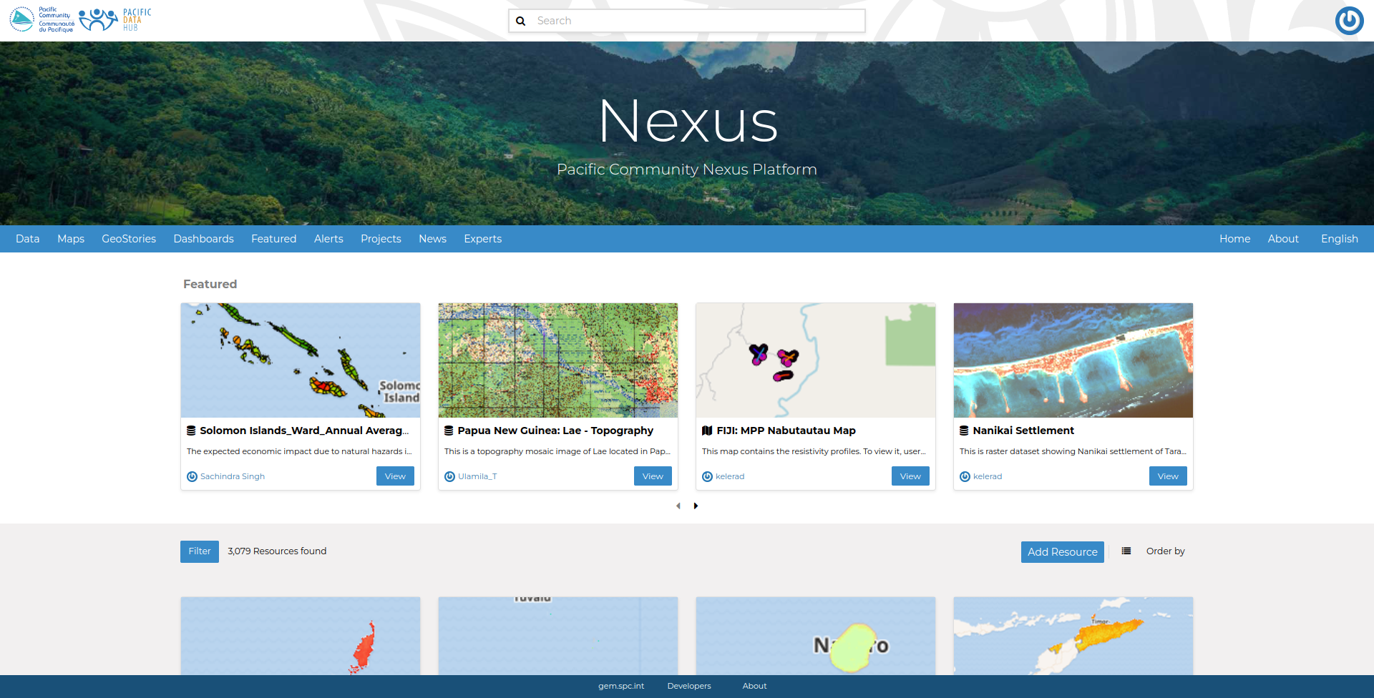
nexus.pacificdata.org
unification and strengthening of SPC data including disaster, risk and climate related data and knowledge hubs

Slide 4
Technical Concept
An SPC-managed integrated IT infrastructure that will support and enhance the discovery and analysis of disaster, risk and climate related data and assets in a consolidated manner.
Ingest, upload, manage, disseminate and visualize, the following types of disaster, risk and climate related data sets existing within SPC -
    Geospatial Data incl. Field Survey Data Workflows
    Temporal and Statistical Data
Related Documents and Media Assets, real-time Disaster Alerts
Information about Projects and People acting within DRM/CC space in the region
Focus on data visualisation by the way of Dashboards and Geostories
Deep integration with Pacific Data Hubs, Geoportals and Open Source GIS Ecosystem

Slide 5
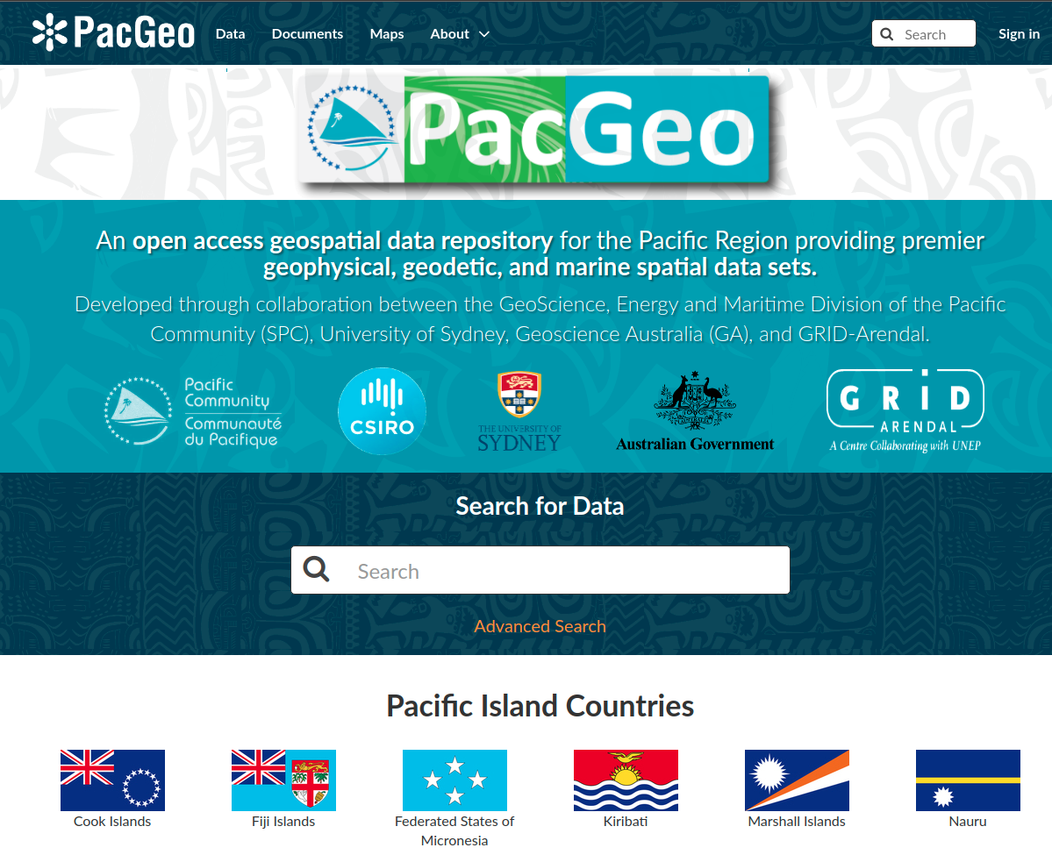
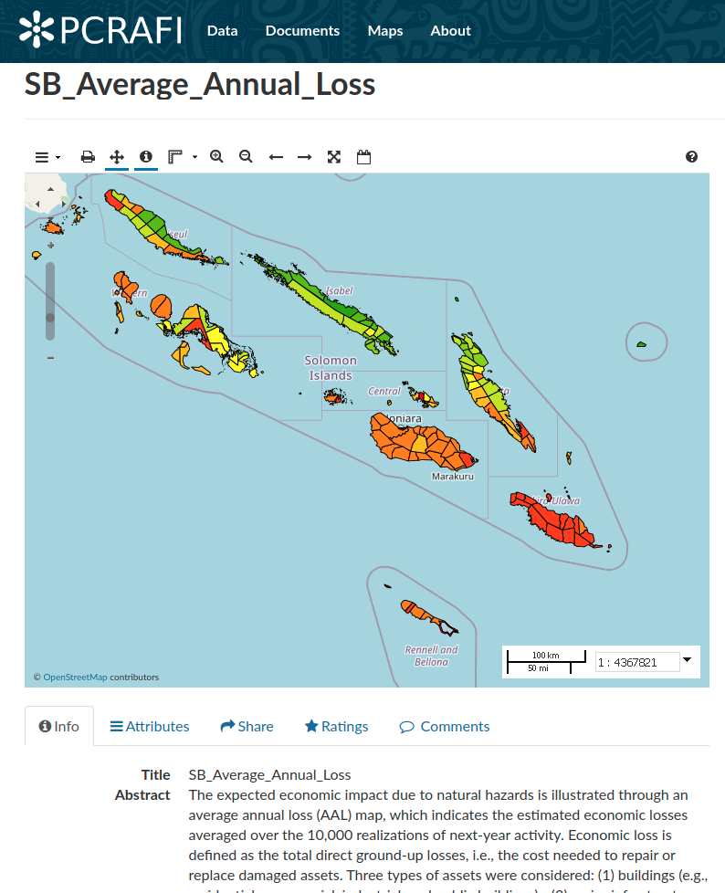
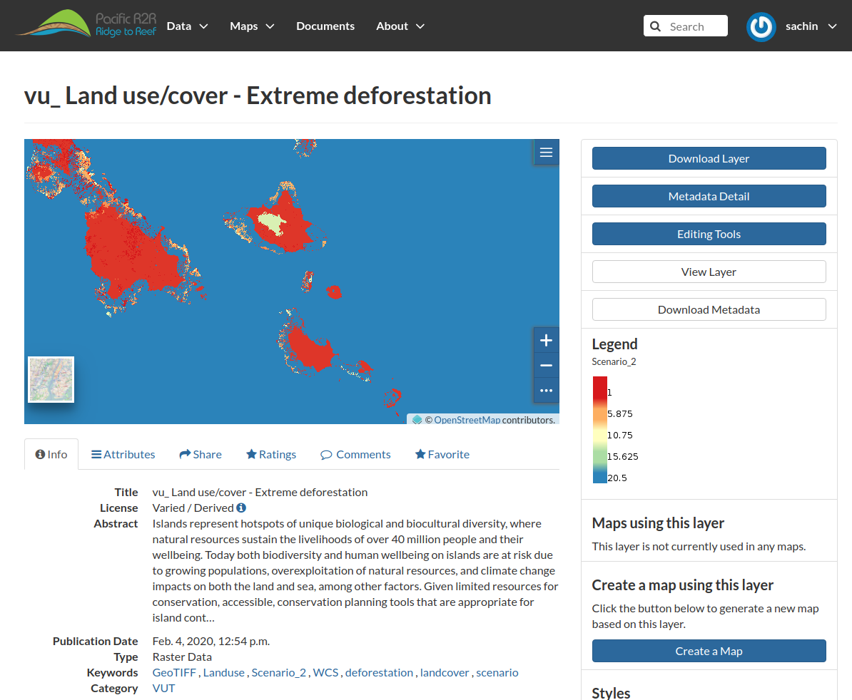
Legacy Platforms
Multiple Spatial Data Infrastructures within SPC and the Pacific deployed and maintained by GEM eg : Pacific Risk Information System, Ridge to Reef State of Coast Platform, PacGeo, along with 15 local government deployments across countries since 2010.
https ://risk.spc.int
http ://r2r.spc.int

Slide 6
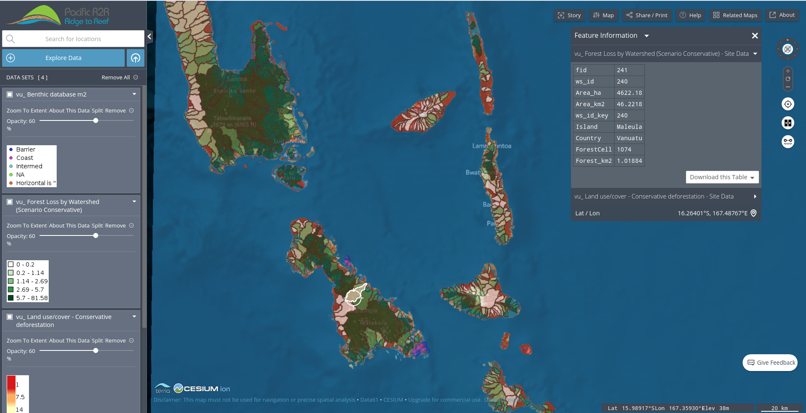
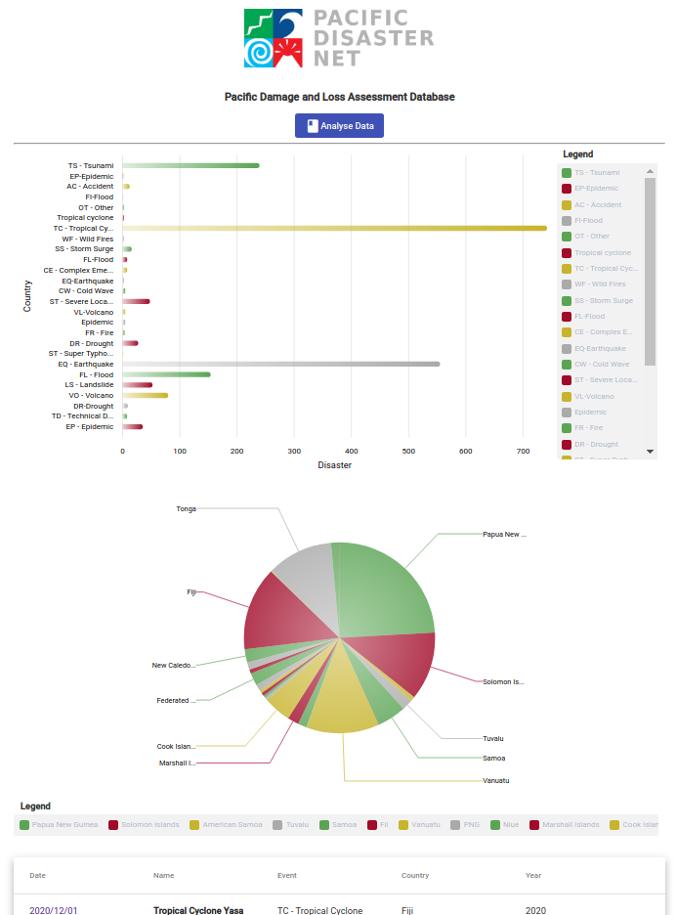
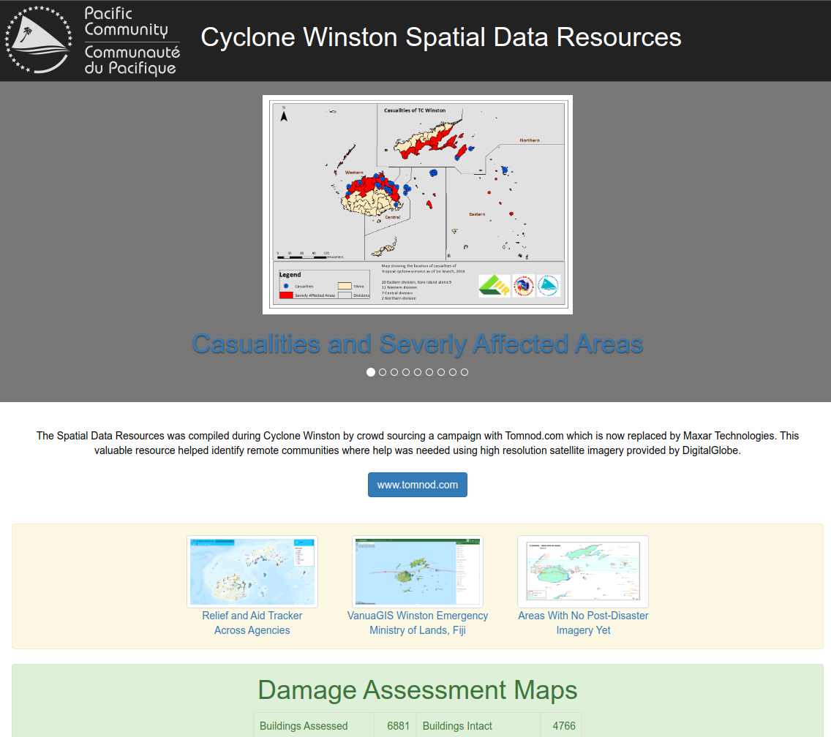
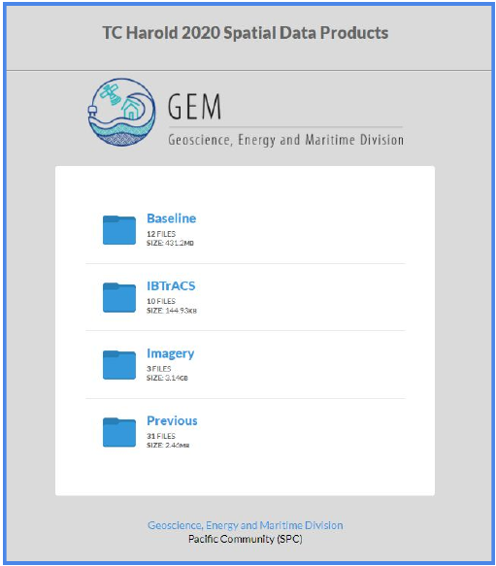
Legacy Issues
Multiple regional, national and project-specific SDI’s proved difficult and too cost-intensive to maintain.
High turnover within ministries/agencies of trained technical staff meant lack of personnel resources for sustainability of platforms.
SPC’s regional mandate to align data platforms with Pacific Data Hub.

Slide 7
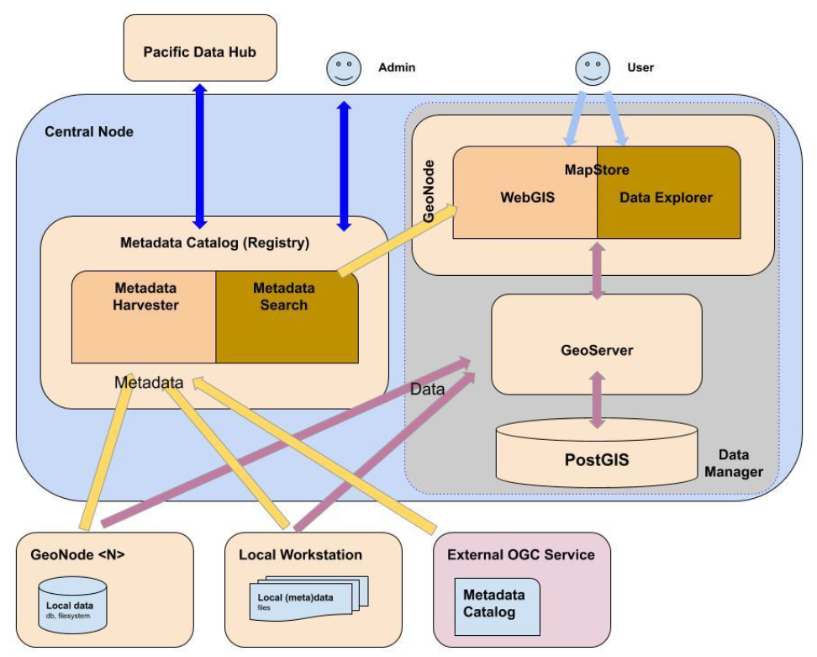
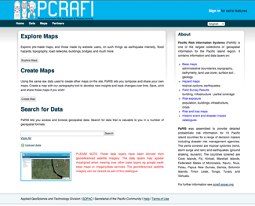
Architecture
Based on GeoNode Platform
GEM has standardised on Geonode as it's Spatial Data Infrastructure since 2009. Prior to this GEM was using MapServer and Geonetwork from early 2000's
GEM is a Geonode Contributor and was part of it's steering committee with World Bank in 2010s.
GEM has deployed national govt-wide level Geonode instances in SB, VU, FJ, TO along with internal ministry level deployments across 14 countries.
First Deployment of Geonode in 2009, Second Global-wide Deployment

Slide 8
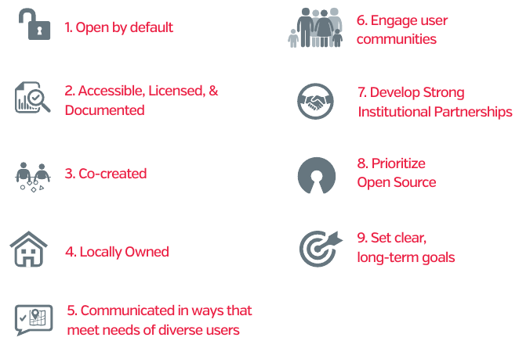

Adopted Policy
Open Data for Disaster Risk and Resilience Initiative
(OpenDRI)
Policy Notes and Principles: OpenDRI by GFDRR, World Bank, May 2016
https://opendri.org/

Slide 9
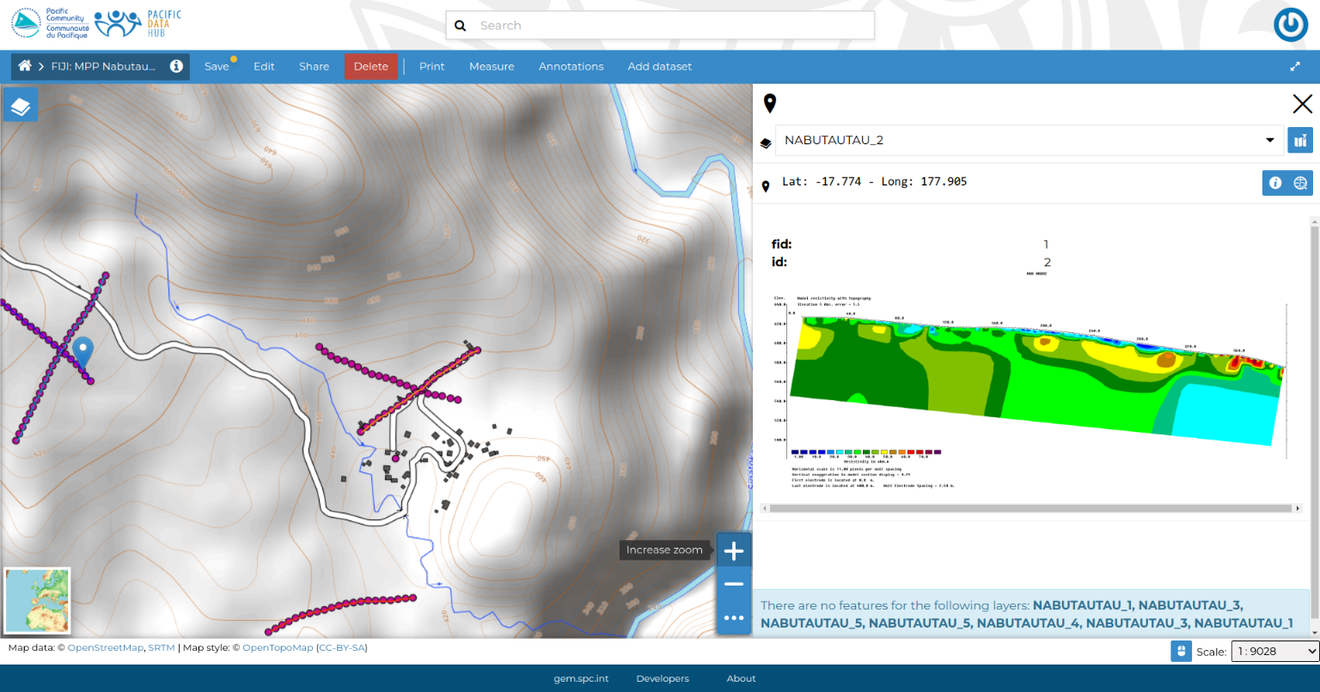
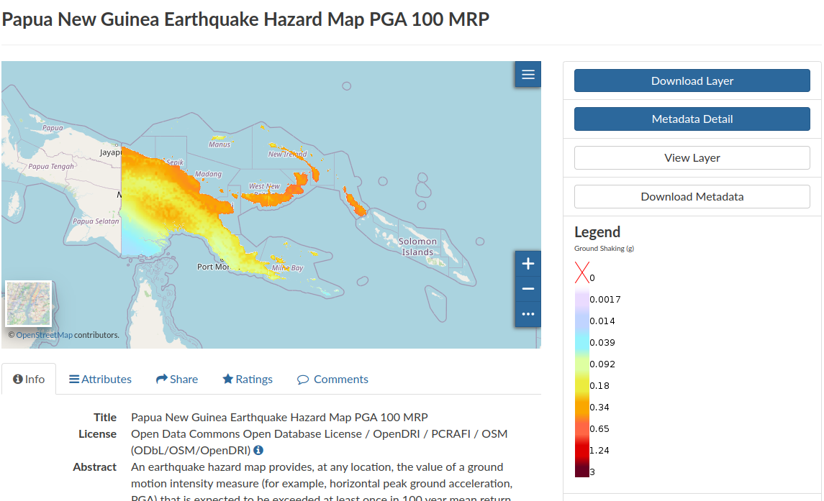
Harvested Data
Assets and Exposure data (from PCRAFI Project, Open Street Maps, Field Surveys etc)
Hazards Models and Maps (Floods, Tsunamis, Tropical Cyclones, Earthquakes etc)
Population Grids (SPC Statistics for Development Division, UN Humanitarian Data Exchange etc)
Environmental Data (Ridge to Reef, MFAT/NIWA Environmental Exposure Assessment Project etc)
Disaster Statistics and Damage Loss Assessments Data
Water Security (Resistivity Lines)
Bathymetric Data (Multibeam Surveys)

Slide 10
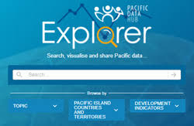
Pacific Data Hub Integration
Nexus Platform has deep integration with Pacific Data Hub (PDH):
The Pacific Data Hub (PDH), is a central repository of data about the Pacific and from the Pacific. The platform serves as a gateway to the most comprehensive collection of data and information about the Pacific across key areas including population statistics, fisheries science, climate change adaptation, disaster risk reduction and resilience, public health surveillance, conservation of plant genetic resources for food security and human rights.
Deployed on same cloud infrastructure
Shares core spatial component (Geoserver)
PDH can injest (meta)/data to/from Nexus (CKAN integration)
Nexus can display data on PDH Map Viewer – map.pacificdata.org
Infrastructure for both is maintained by same service provider
Sustainable funding avenues explored by PDH programme

Slide 11
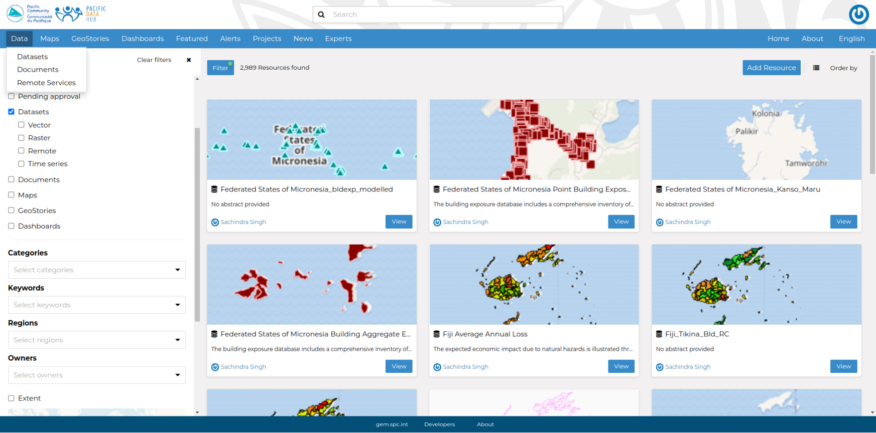
Features: Layers and Maps
Layers are publishable resources representing a raster or vector spatial data source. Datasets also can be associated with metadata, ratings, and comments.
Maps are comprised of various datasets and their styles. Maps can have both local datasets in GeoNode as well as remote datasets either served from other WMS servers or by web service datasets.

Slide 12
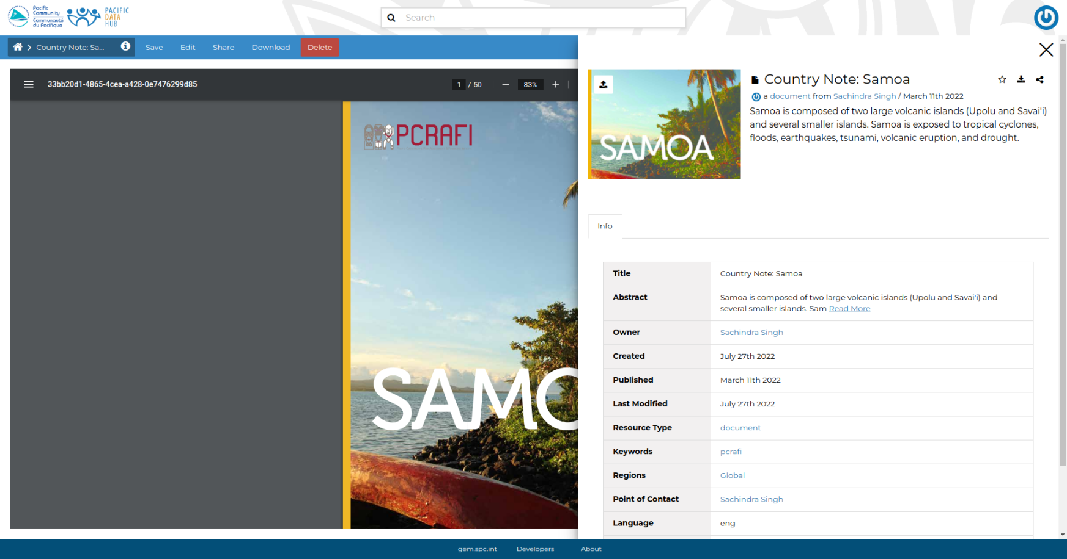
Features: Documents

Slide 13
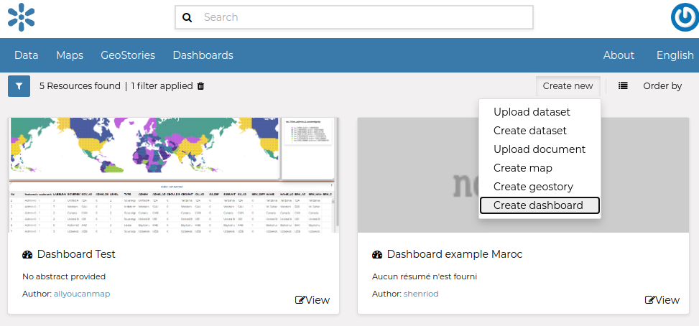
Features: Dashboards
Dashboard is a tool integrated in GeoNode that provides the user with a space to add many Widgets, such as charts, maps, tables, texts and counters, and can create connections between them in order to : Provide an overview to better visualize a specific data context, Interact spatially and analytically with the data by creating connections between widgets, perform analysis on involved data/layers

Slide 14
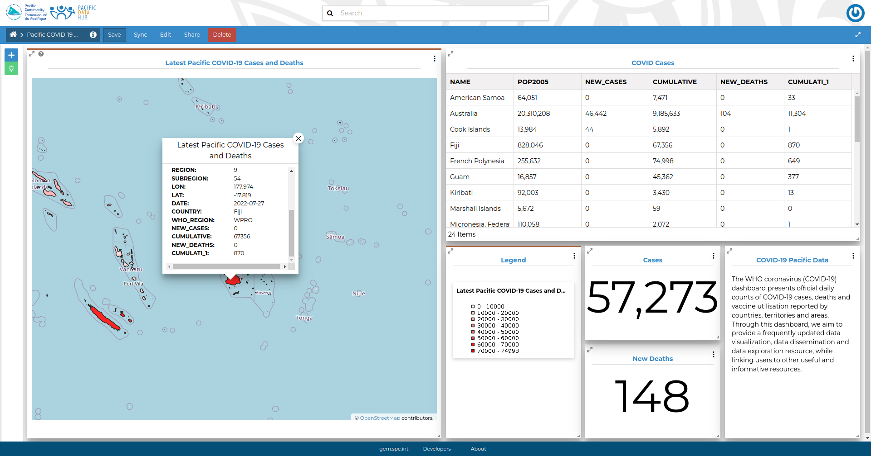
Features: Dashboards

Slide 15
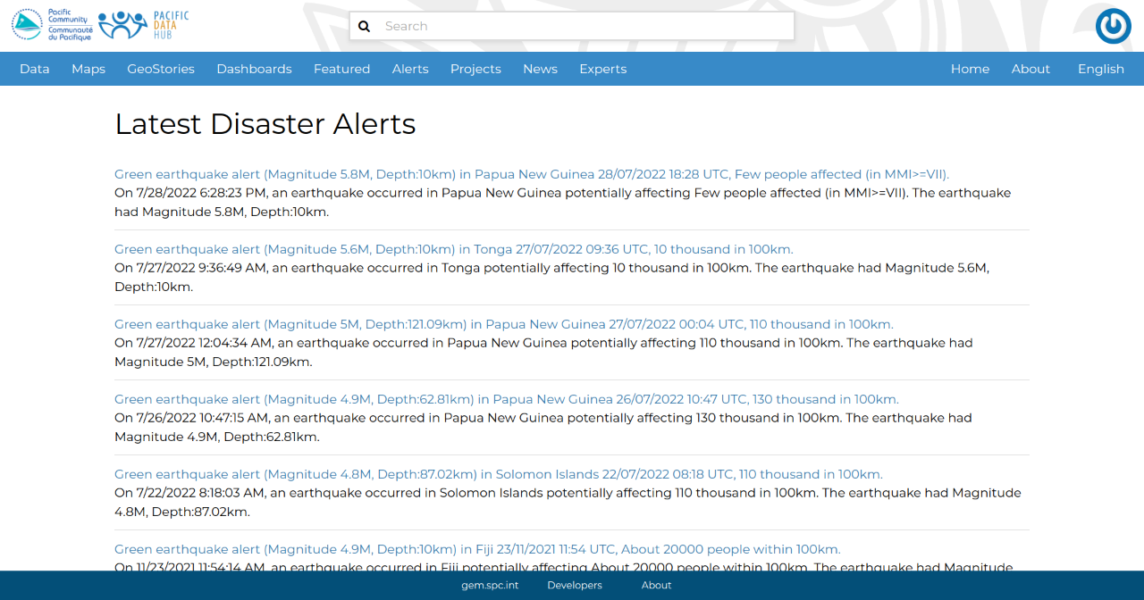
Features: Real-time Disaster Alerts

Slide 16
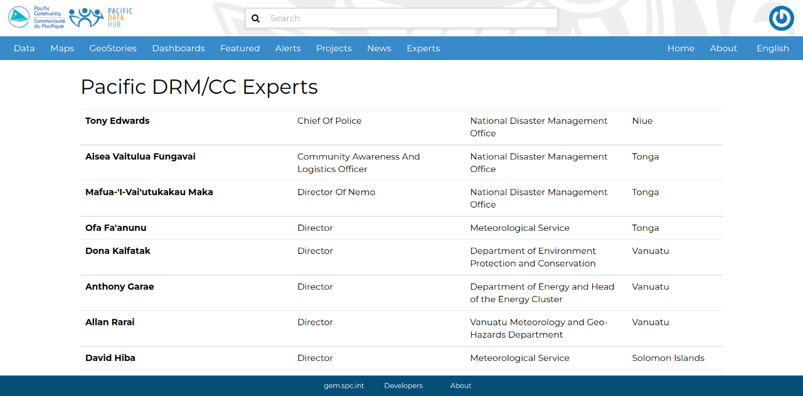
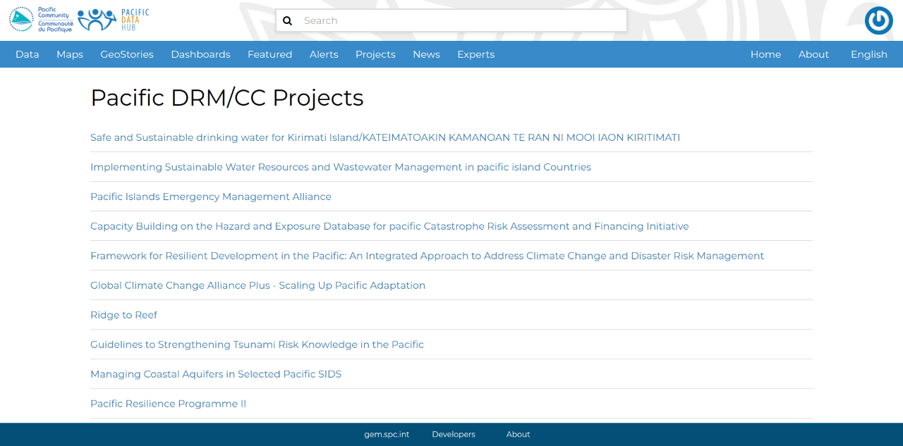
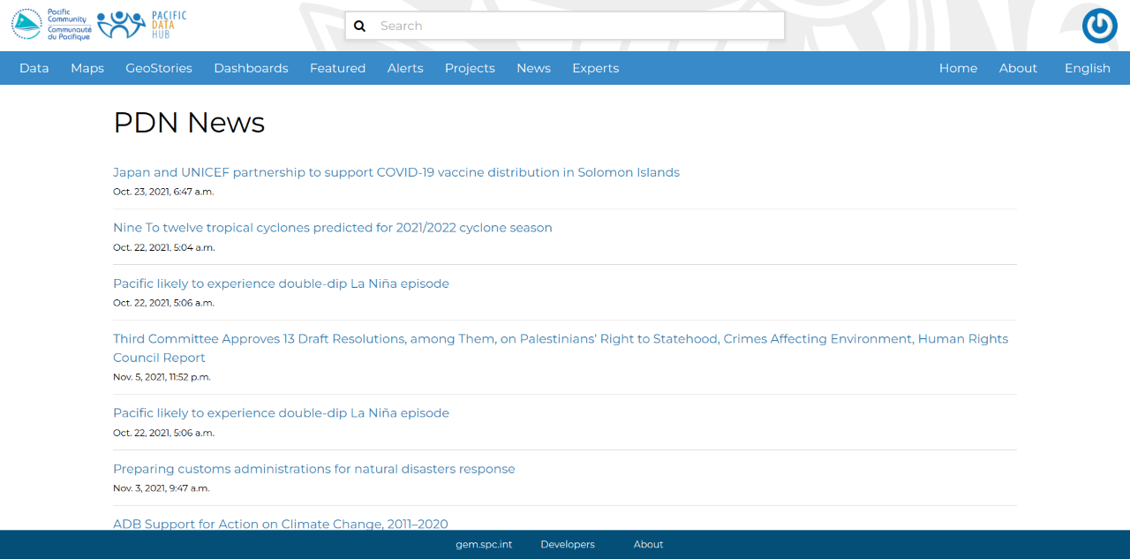
Features: Experts, Projects, News
User-collated listing and information about projects, news and experts

Slide 17
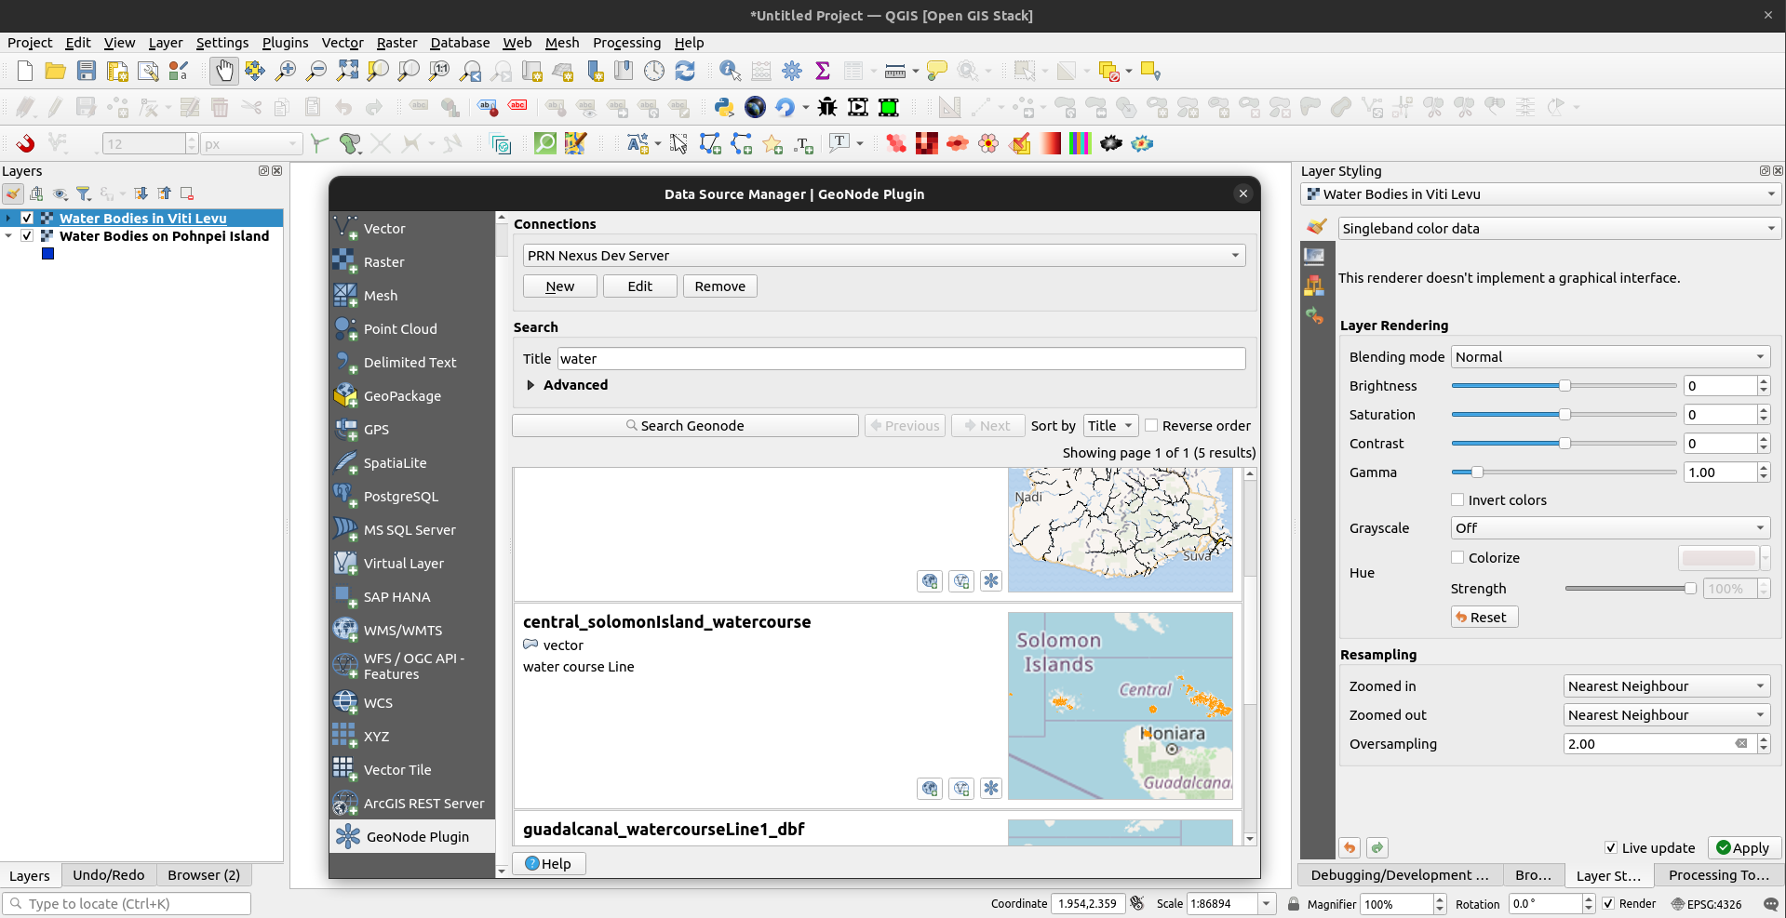
Features: Nexus QGIS Plugin
This plugin was being created as an activity of the PREP/Nexus project, commissioned by the The Pacific Community (SPC) and with funding from the [World Bank]. Its goal is to develop a QGIS-based client for Nexus that allows GIS users to more easily integrate GeoNode into their workflows.

Slide 18
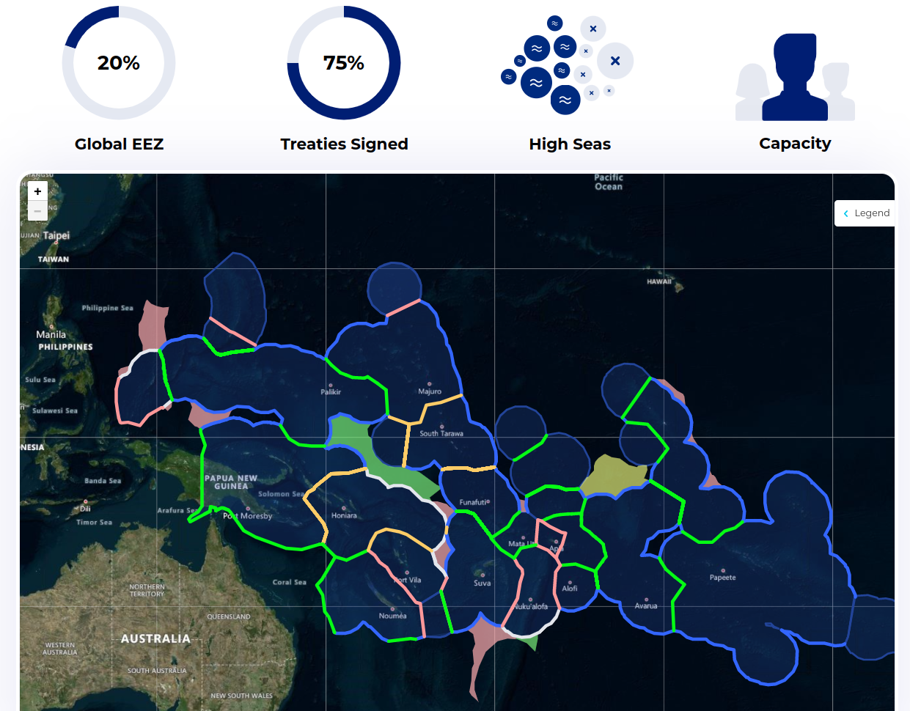
Data Foundation: Maritime Boundaries
https://pacificdata.org/dashboard/maritime-boundaries
Clearly defined maritime zones (boundaries, territorial waters, economic zones, extended continental shelfs) underpin the governance, peace and security, marine conservation, and natural resource management of the Blue Pacific.

Slide 19
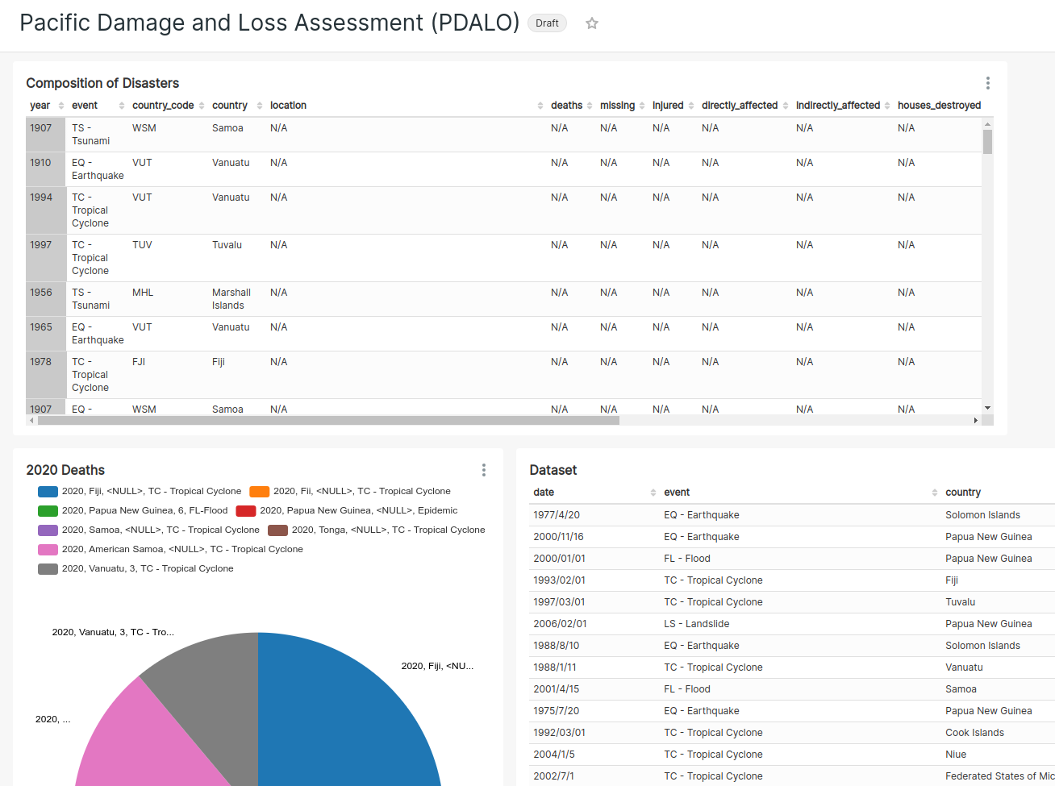
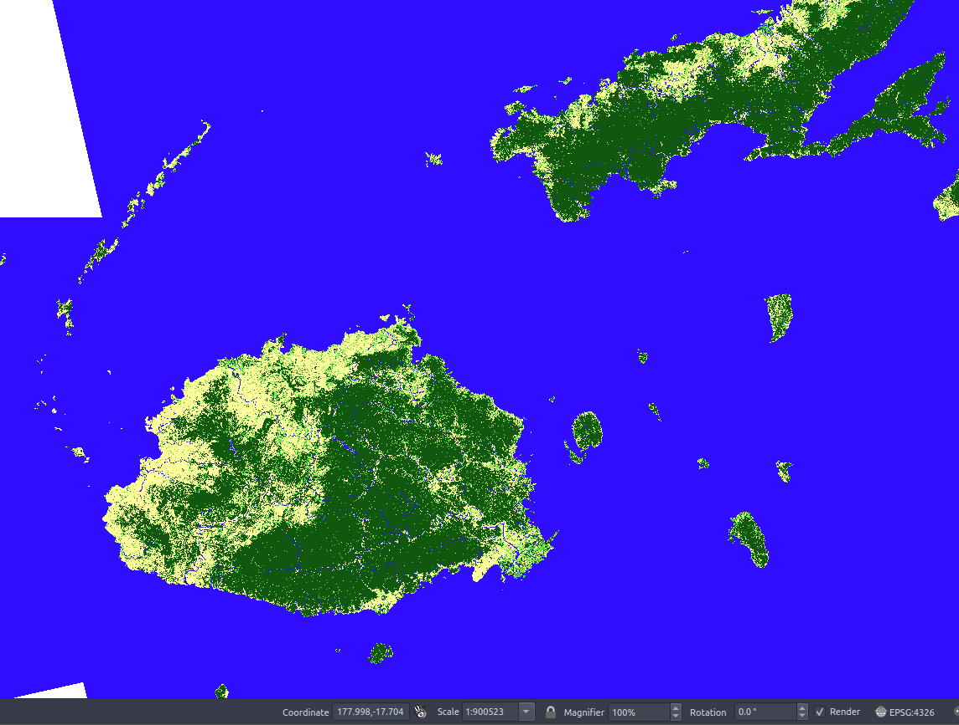
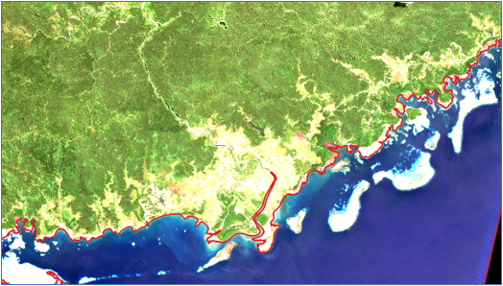
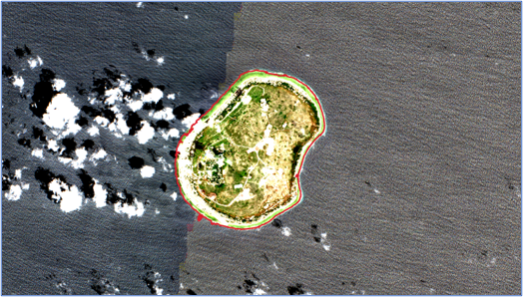
Future Integrations
Digital Earth Pacific outputs (eg: landcover, flood maps, building footprints, coastline change)
SPC Thredds (Ocean/Meteo Data Observations and Products)
UN HDX Data Integration (Disaster Response, Planning Data)
Integrating Pacific Data Loss Assessment and Analysis (PDalo)
Aggregrated Damage/Loss Models (PCRIC)

Slide 20
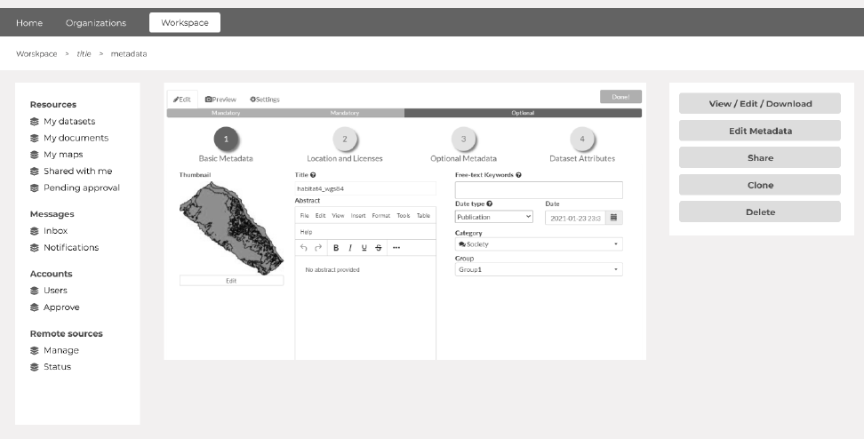
Merci
pacificdata.org
nexus.pacificdata.org

