Slide 1

Boosting Climate Monitoring Applications: The Space for Climate Observatory
OGS Symposium
01/12/2022
Frederic.bretar@cnes.Fr

Slide 2

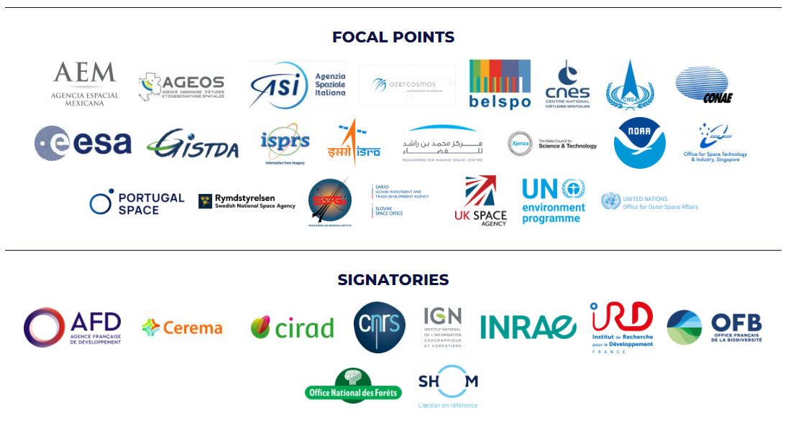


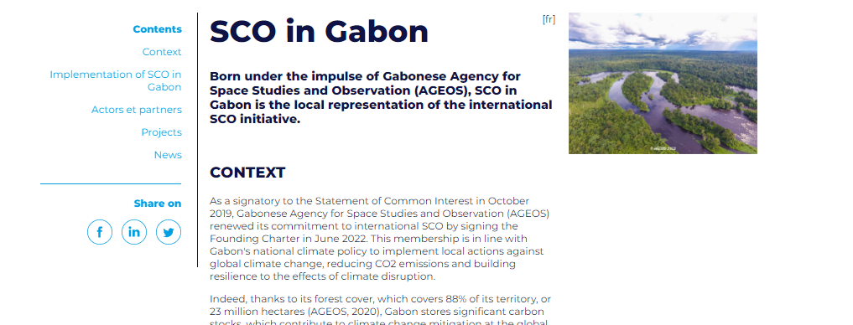
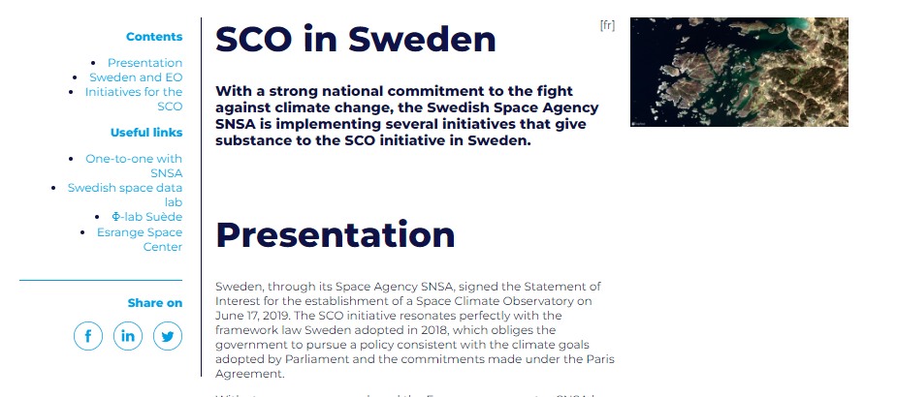
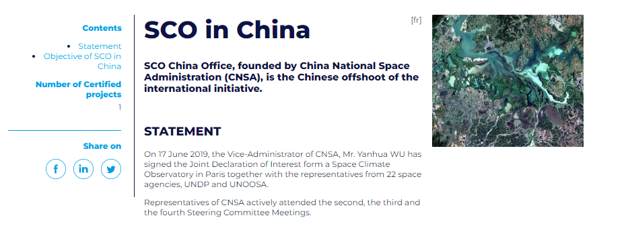
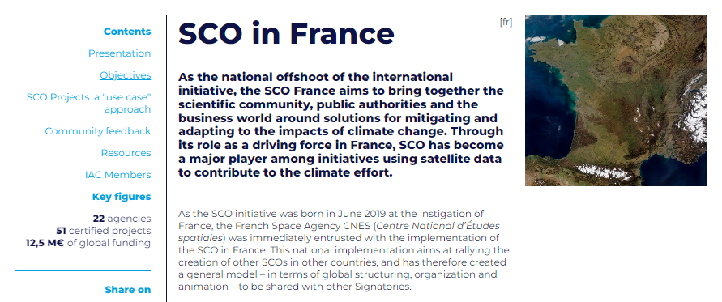
An international Alliance
Gather and Act for the Planet
Local implementations

Slide 3

operational tools for climate adaptation, mitigation and monitoring
Foster cooperation around these applications to favour their reuse and communicate on them
Build a network for space agencies and public and private entities involved in the use of EO data for operational climate action

Slide 4


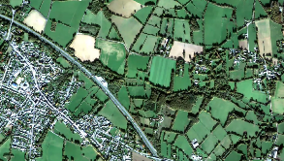
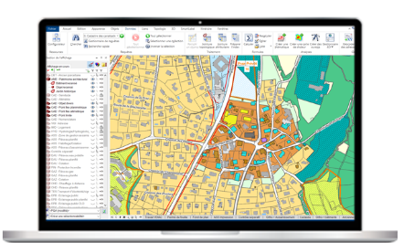
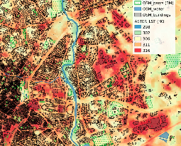

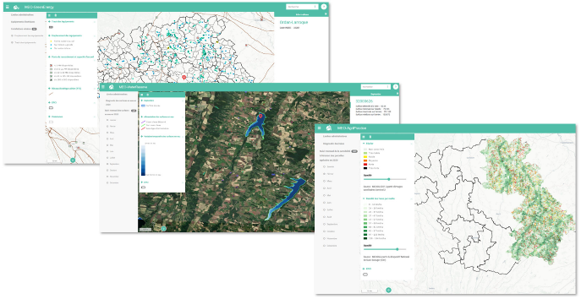
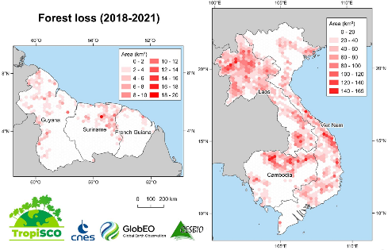
Users
Labs
Service Provider/Company
SCO Project
Operational Climate Service/Prototype
With High Techno/scientific content
Satellite Data
In Situ Data

Slide 5
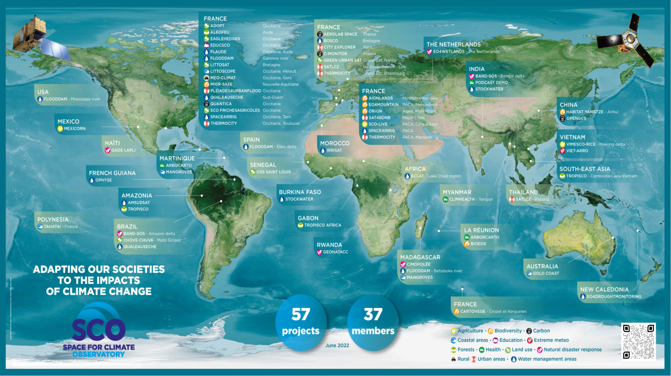

Mapping report du SCO
Des initiatives locales de grandes envergures
Notes:
Laurence

Slide 6
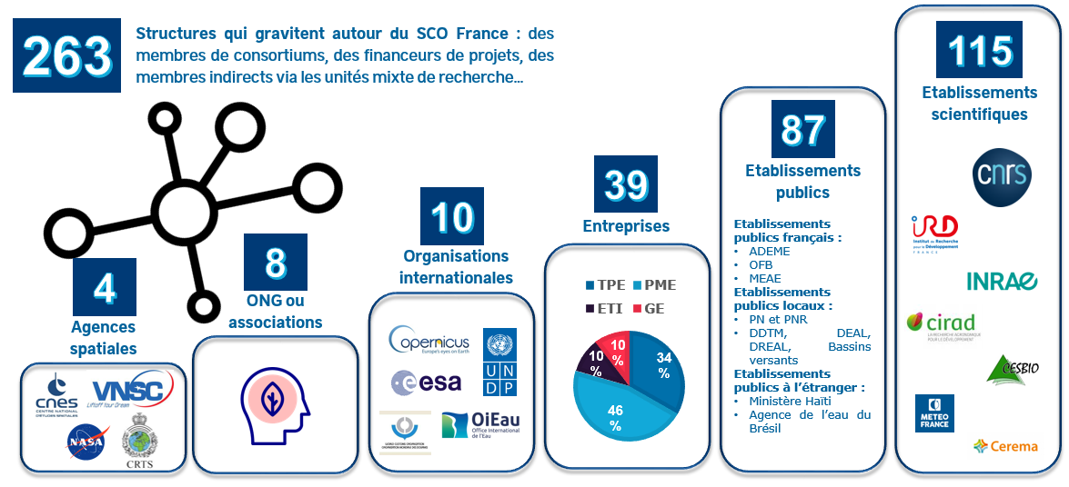

Slide 7
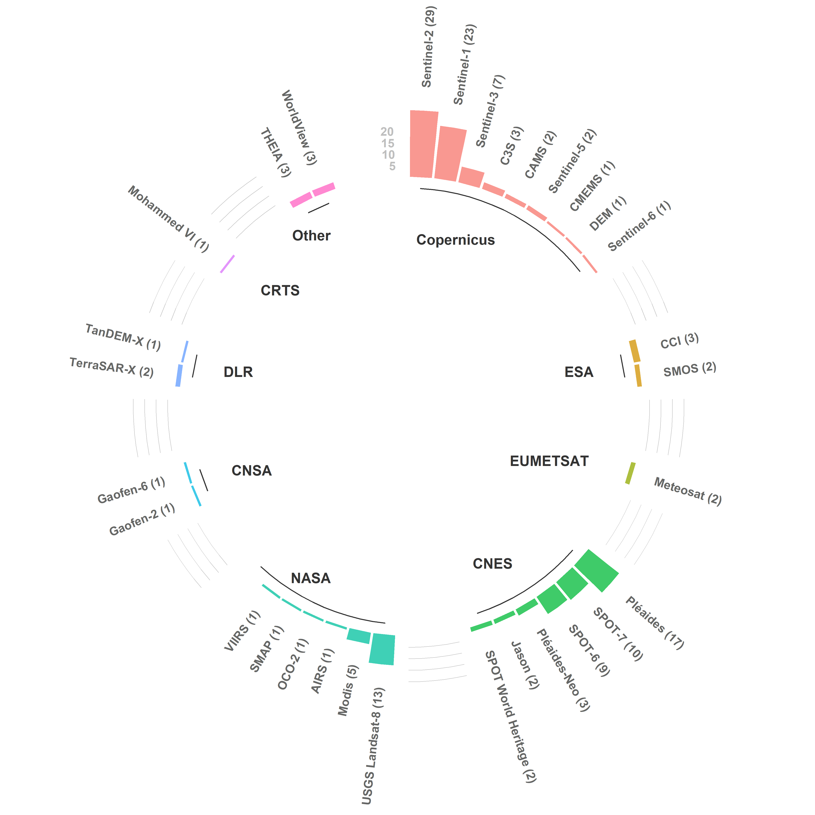
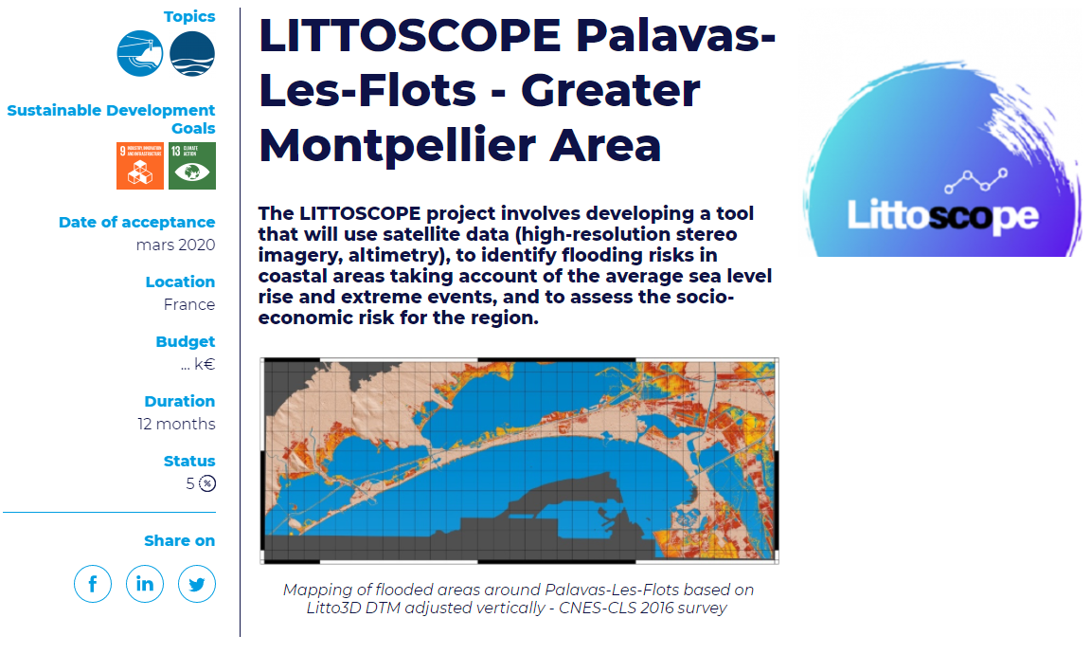
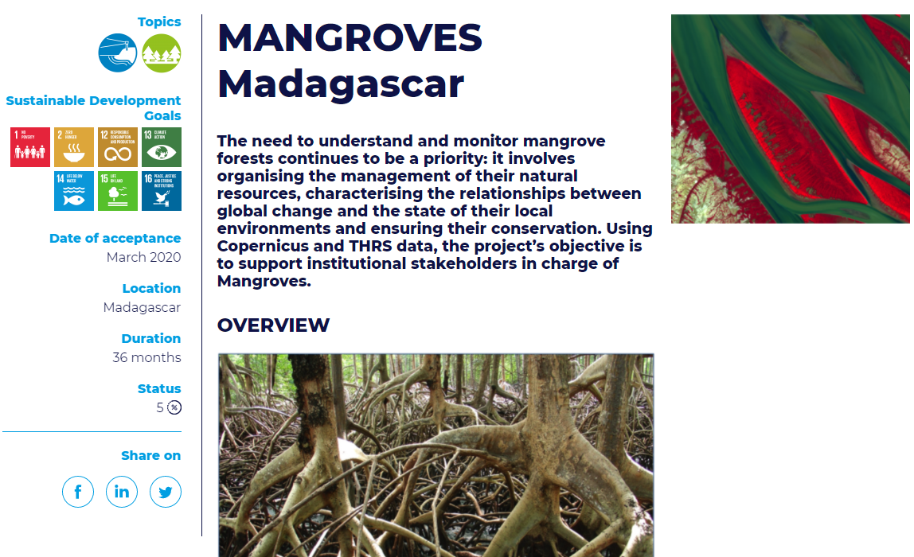
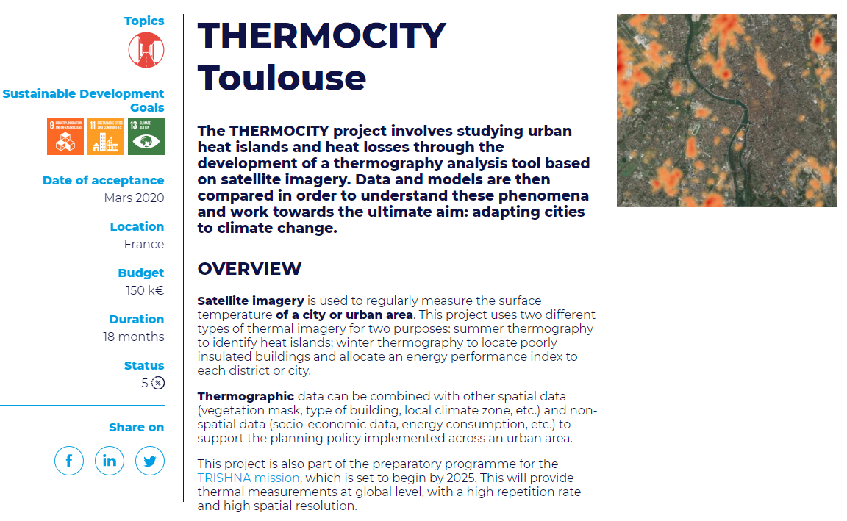
Today, the SCO is
A strong accreditation process
A portfolio of projects using a diversity of satellite data
A diversity of thematics
All around the world

Slide 8
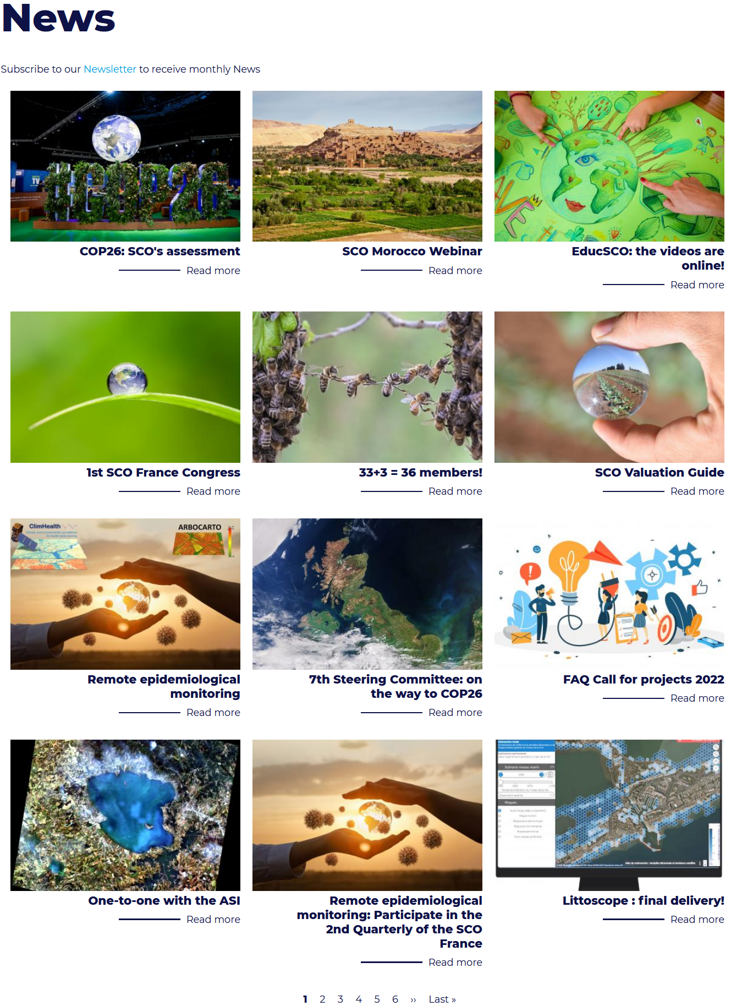
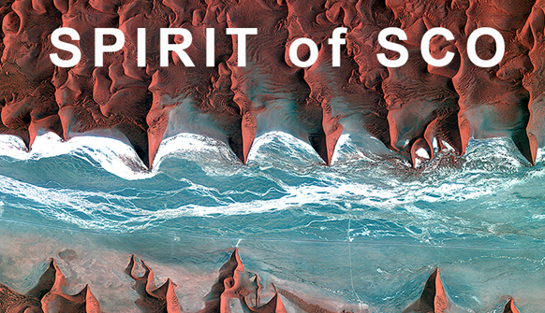

Subscribe to our newsletter:
www.spaceclimateobservatory.org/newsletter
www.spaceclimateobservatory.org
https://www.linkedin.com/company/sco-space-for-climate-observatory/

