Slide 1
The Mangmap platform prototype: mangrove monitoring assisted by satellite
Oceania Geospatial Symposium
28 Nov. – 04 Dec. 2022
Nouméa , New Caledonia
Jean-François Faure – IRD / UMR Espace-dev
Elodie Blanchard – IRD / UMR Espace-dev, LaTeleScop

Slide 2
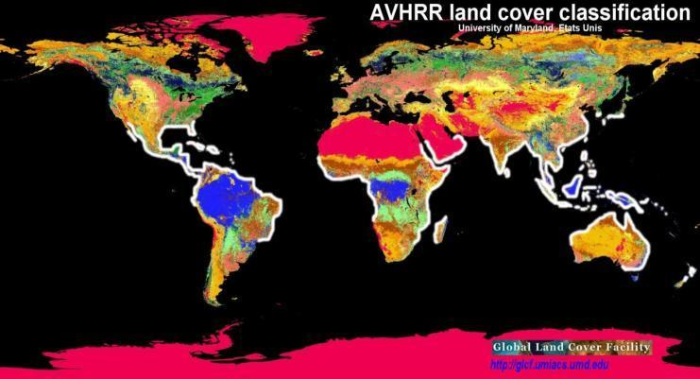
Mangrove ecosystems
¾ of all coastal intertropical areas
Intertidal forest ecotone
Ecosytems adapted to salinity, exposed to tidal balancing
Morphological adaptations
Naturally fragmented forests
Tropique du Cancer
Equateur
Tropique du Capricorne
Mangrove, 150 000 – 200 000 km²

Slide 3
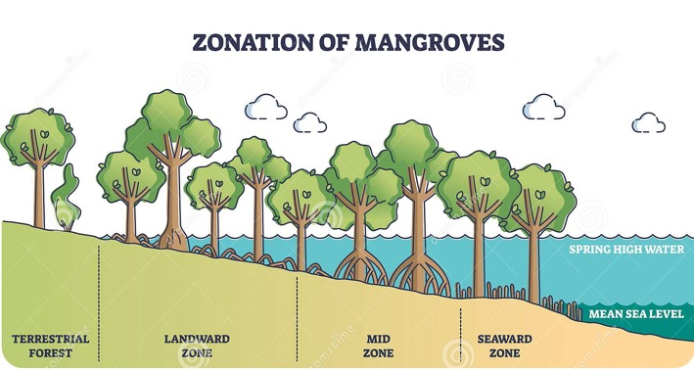
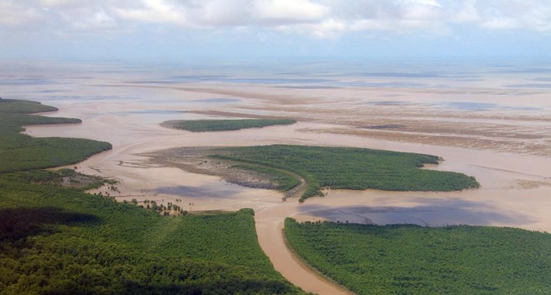
Mangrove ecosystems
¾ of all coastal intertropical areas
Intertidal forest ecotone
Ecosytems adapted to salinity, exposed to tidal balancing
Morphological adaptations
Naturally fragmented forests
© Vectormine
© IRD - C. Proisy

Slide 4
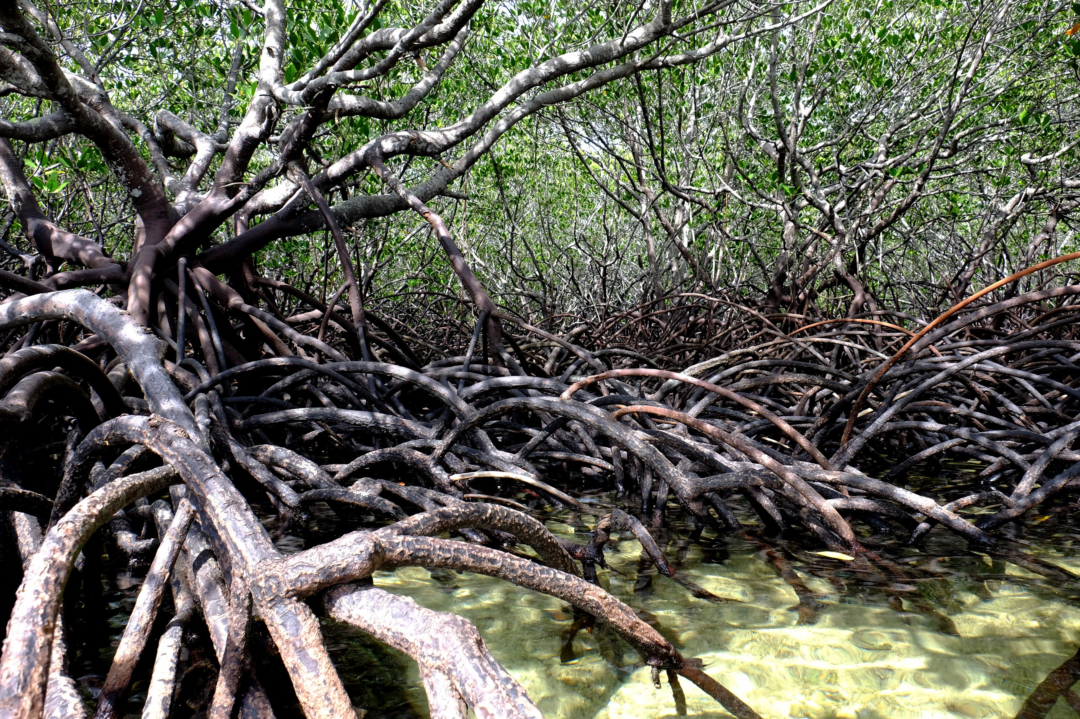
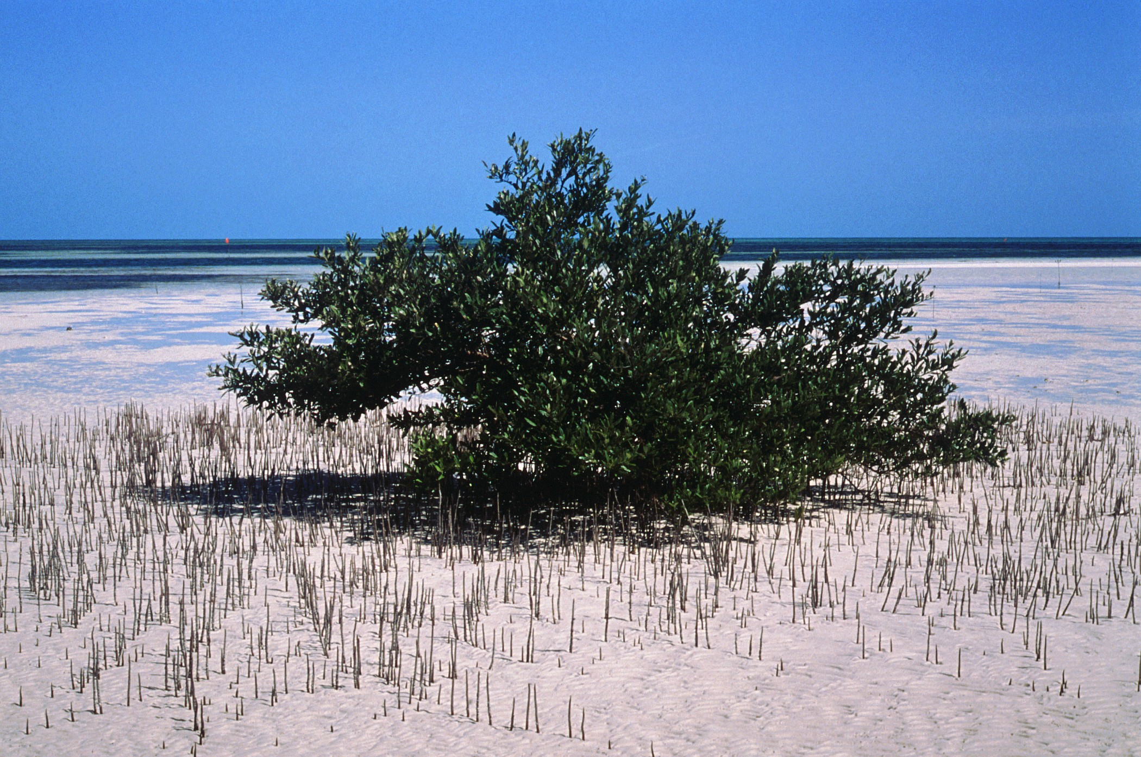
Mangrove ecosystems
Specy: Rhizophora
¾ of all coastal intertropical areas
Intertidal forest ecotone
Ecosytems adapted to salinity, exposed to tidal balancing
Morphological adaptations
Naturally fragmented forests
© IRD - C. Proisy
Specy: Avicennia
© IRD – B. Seret

Slide 5
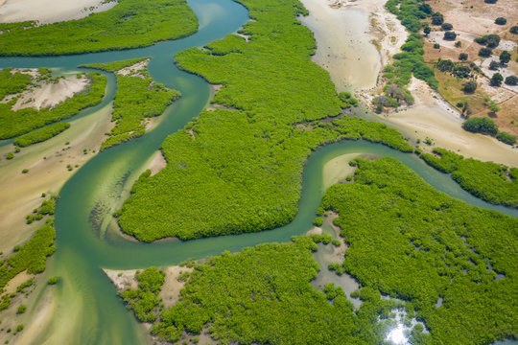
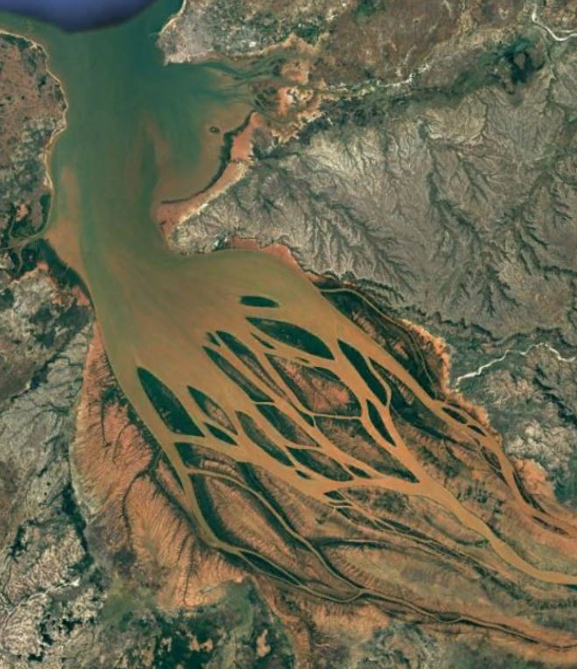
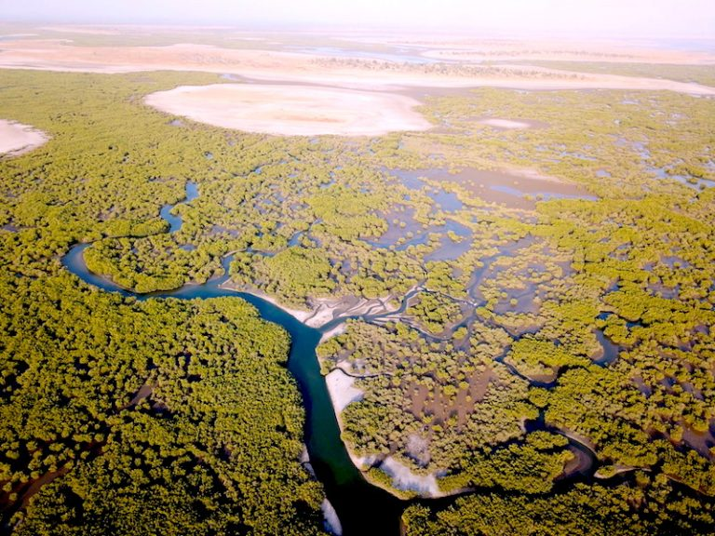
Mangrove ecosystems
¾ of all coastal intertropical areas
Intertidal forest ecotone
Ecosytems adapted to salinity, exposed to tidal balancing
Morphological adaptations
Naturally fragmented forests
Sine-Saloum, Sénégal © Curioso Photography
Ile de Mar Lodj, Sénégal
Baie de la Bombetoka, Madagascar

Slide 6
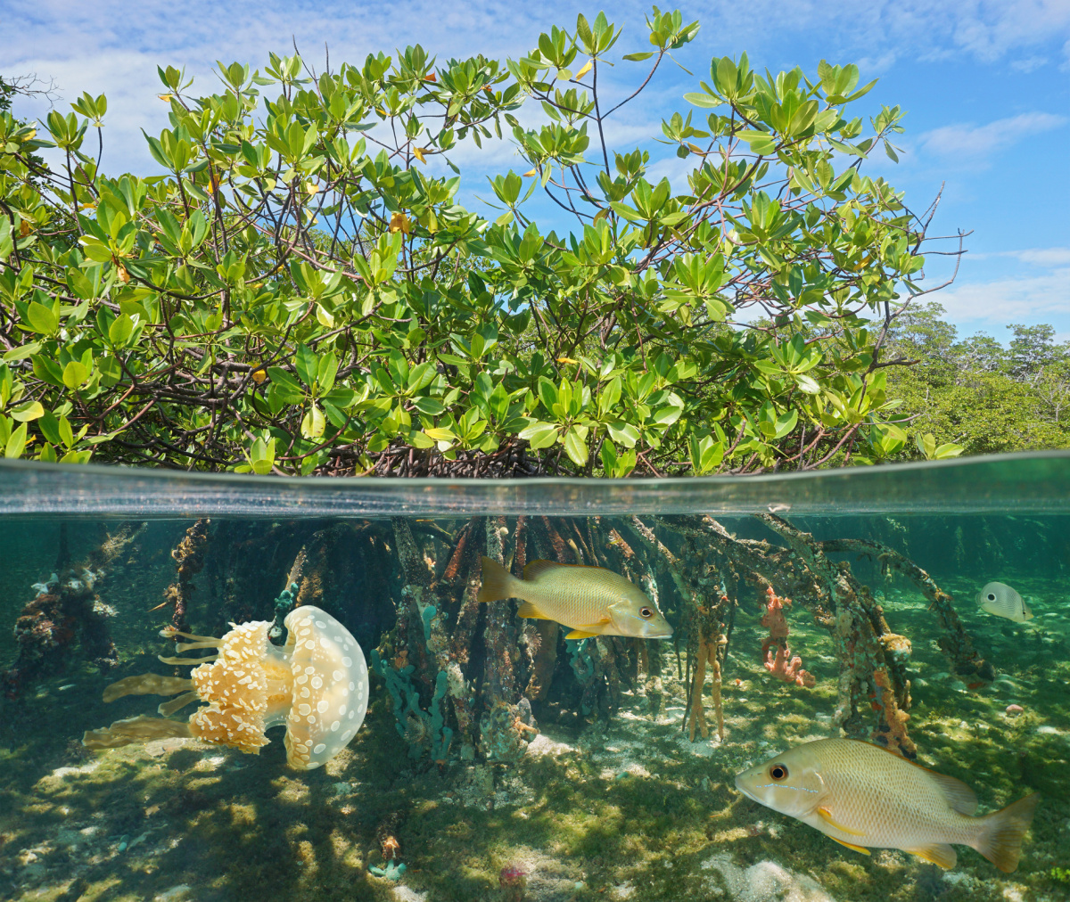
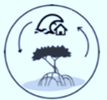
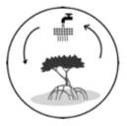
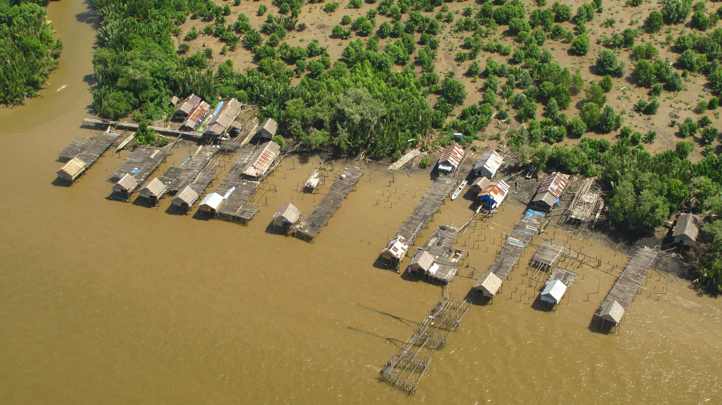
Importance of mangroves
Numerous ecosystemic services
Coastal protection
Biodiversity
Natural resources
Carbon
sequestration
“Blue Carbon”
Key asset to sustainable coastal livelihoods and for human subsistence in coastal areas, where population concentrates
© IRD - C. Proisy
Notes:
Fonctions écologiques
- Cycle des nutriments, production primaire
- Stockage de carbone
- Habitat et nurserie faune marine
- Biodiversité faune et flore littorale
Fonctions socio-économiques
- Protection du littoral contre évènements climatiques extrêmes
- Extraction de ressources vivrières (halieutiques, bois et miel sauvages, sel…)
- Eco-tourisme
Soutien le bien-être et les moyens de subsistance pour les populations qui se concentrent toujours plus nombreuses sur les côtes

Slide 7
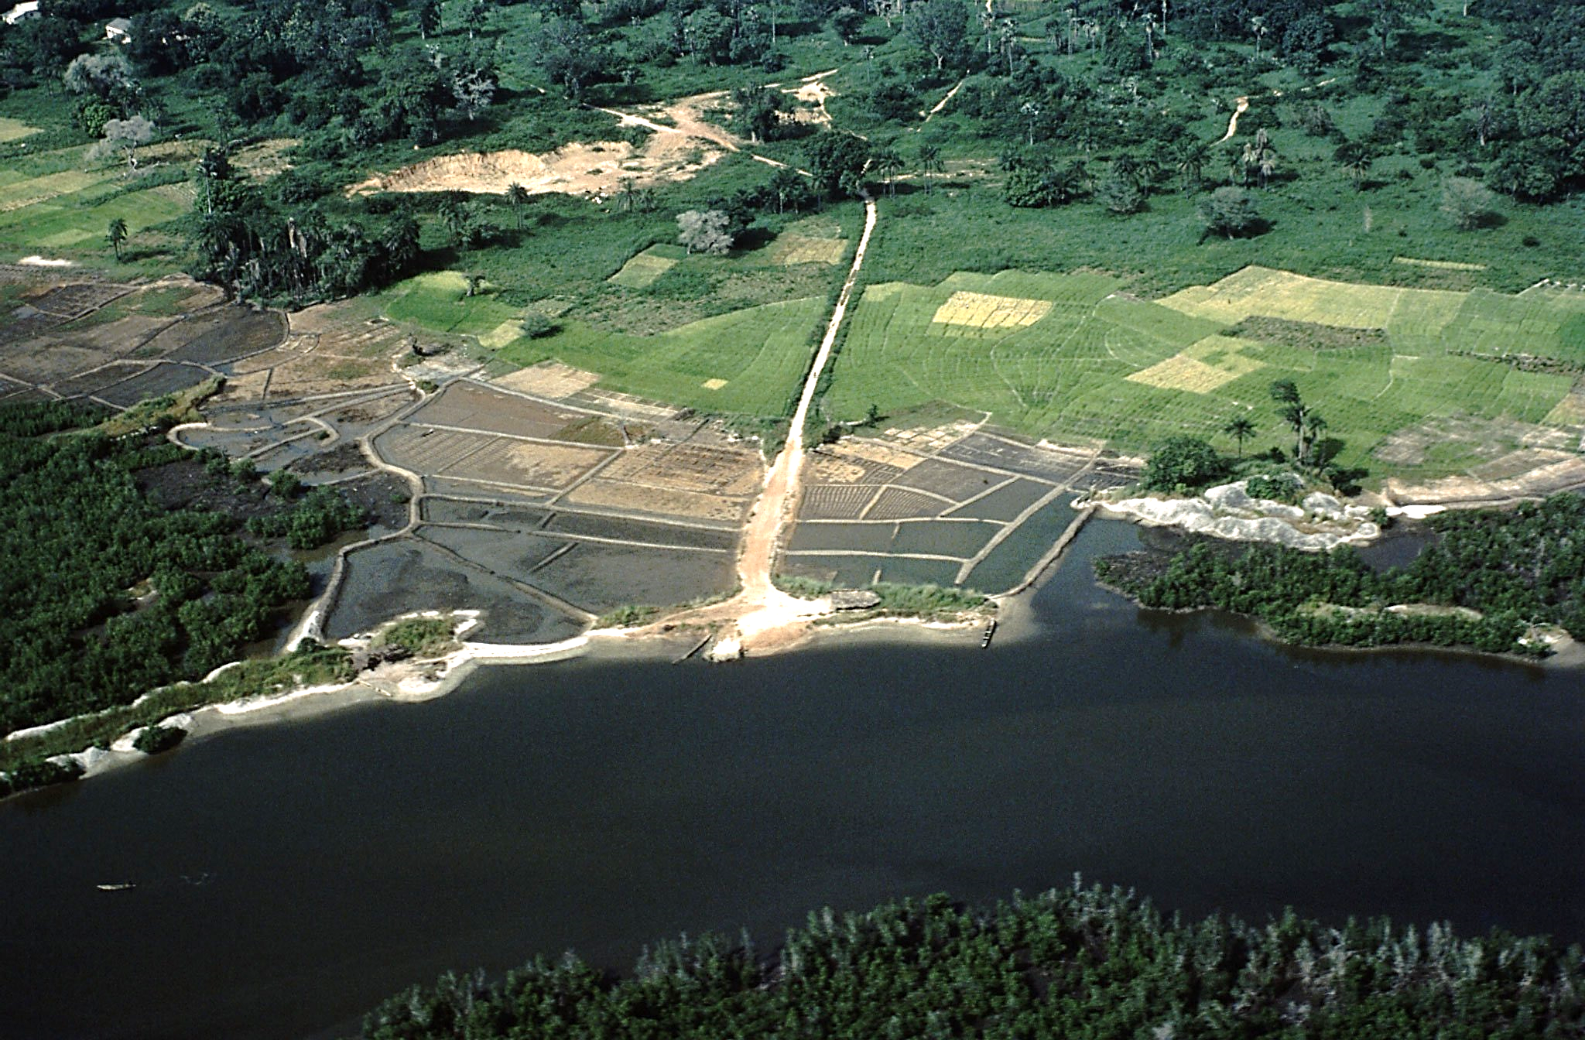
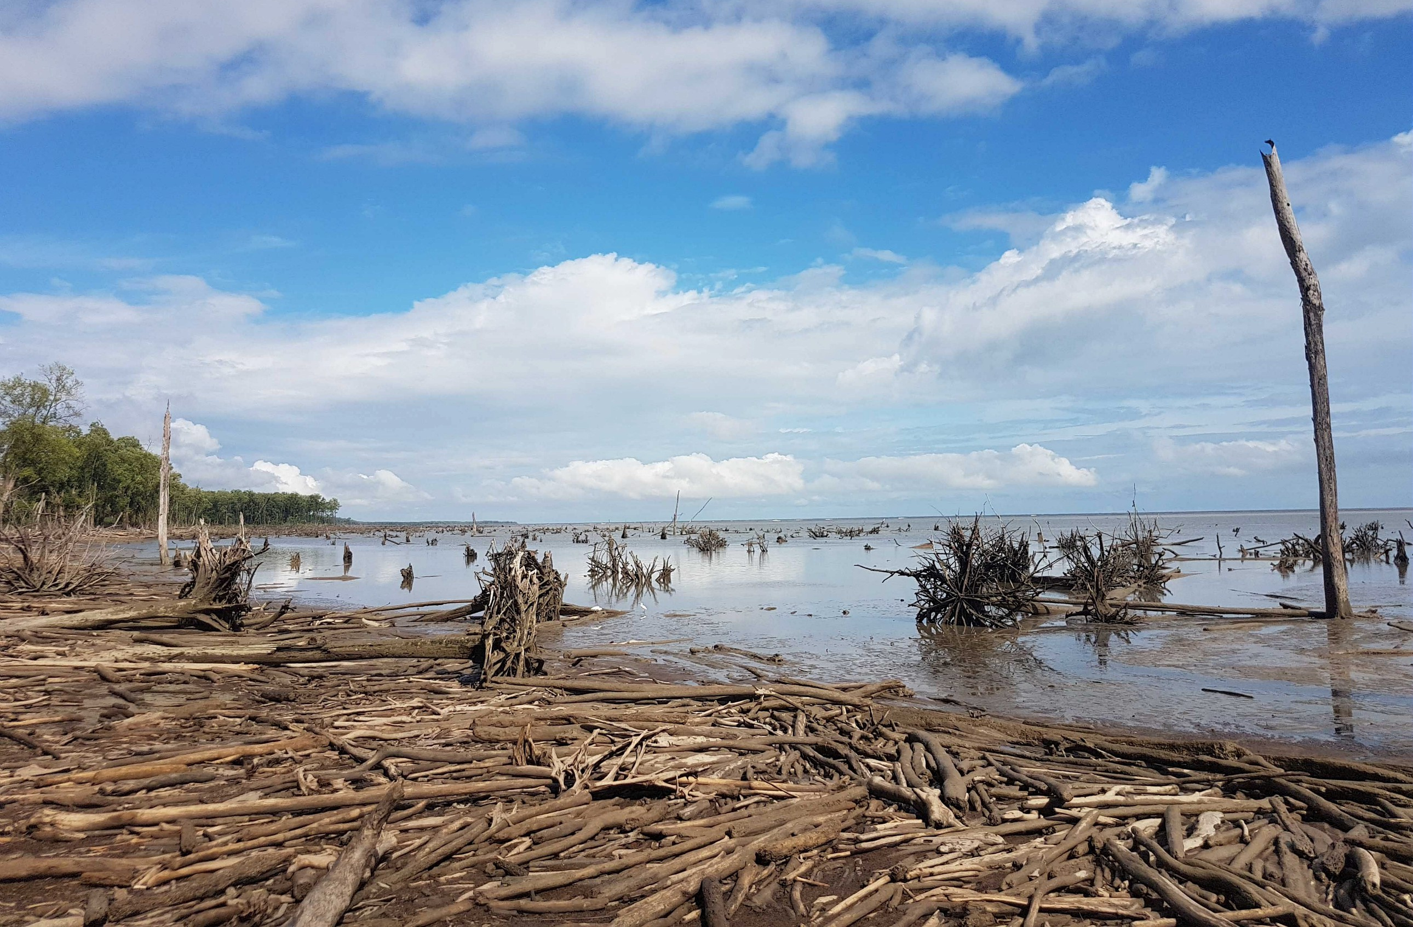
Threats and mangrove degradation
30 to 50 % of Mangroves have extincted during last half-century (Duke et al. 2007 ; Polidoro et al. 2010)
Human pressure & destruction
Natural / climate change impacts
© IRD – M.C. Cormier-Salem
© IRD - C. Proisy
Basse-Casamance, Senegal: dams and rice fields replacing mangrove ecosystems.
Guyane Française : coastal erosion impacts on mangrove.
Notes:
Pressions anthropiques
Conversion à l’aquaculture
Exploitation forestière non durable
Développement urbain
Changements climatiques
Elévation du niveau des océans
Augmentation des températures
Modification de la fréquence et de l'intensité des précipitations

Slide 8
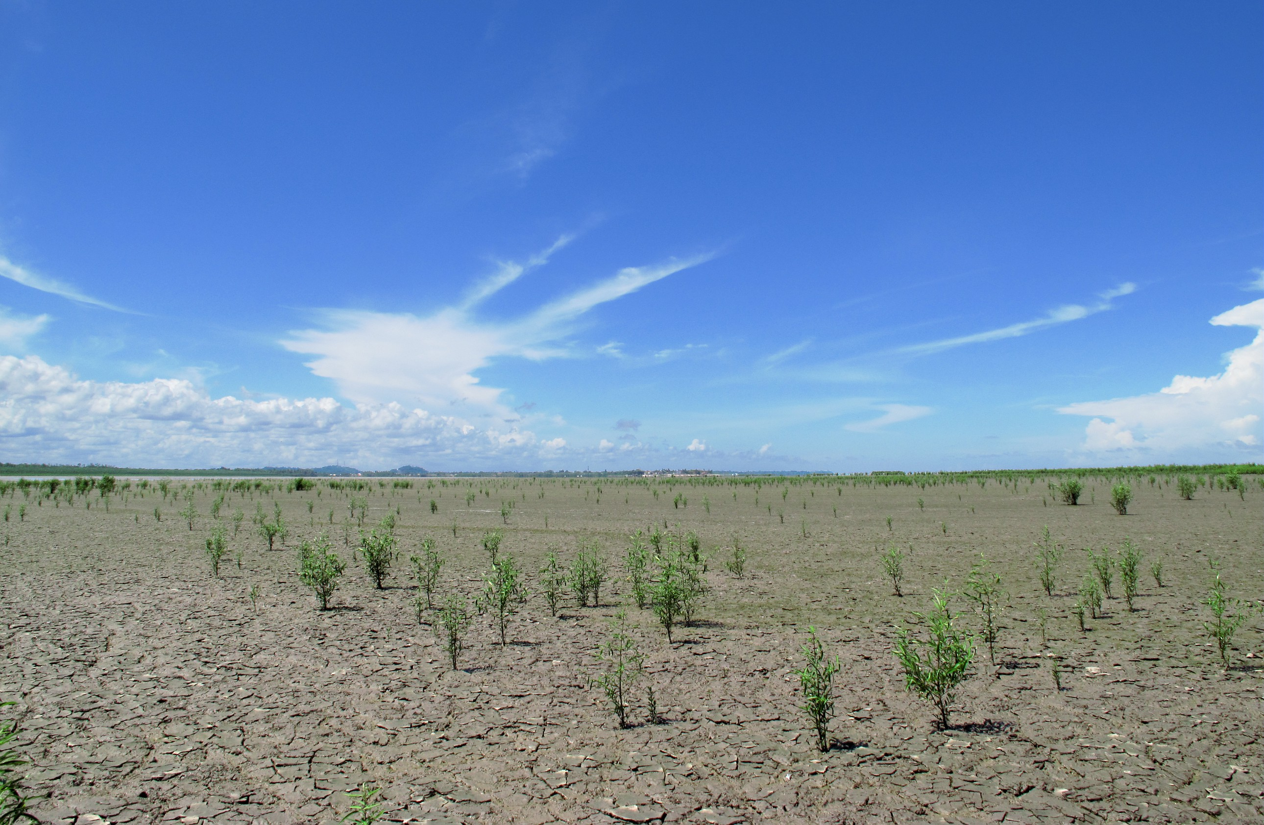
Stakes and issues: scientific knowledge, preservation, monitoring of mangrove distribution & health
Need to improve our understanding of mangrove ecosystemic functions, of mangrove dynamics in order to feed public policy making in favour of conservation and restauration.
Mangroves are superheroes, a triple dividend of resilience, biodiversity gain and people”, says Minna Epps, Director of IUCN’s Global Marine and Polar Programme. “Protecting and conserving them is essential for achieving multiple goals and targets towards the 2050 vision for biodiversity. They are our roots of hope - it is time that their importance is widely recognized.
© IRD - C. Proisy

Slide 9
The mangrove monitoring platform proposal
Imageries
Indexes, indicators
Statistics
Document and contribute to better understanding mangroves evolutions and impacts on mangroves
Complementarity with existing tools or products: monitoring mangroves in between available cartographies, with generic processing services exploiting standardized products
Enduser / endusage driven: easy to use free portal to consult, retrieve or produce informations useful to data analysts at local scales
Prototype - first step, to be up-graded with multiple imageries, indexes, new services and indicators feeding:
GIS applications for coastal management (territorial authorities, protection agencies, ngo…)
Scientific or institutional projects dedicated to mangroves studies, needing remote sensing inputs
Democratization of EO products for mangrove watch
Scientists & Territorial Agents,
all publics with remote sensing background
Notes:
Bien que la télédétection ne remplace pas le travail de terrain

Slide 10
The SCO project: initiating the Prototype
Phase 1 - Prototype development (2022)
Phase 2 - Qualification in pilot sites, networking of future endusers (Trim. 1/2 2023)
Phase 3 - Platform perspectives: Geographical extension, new contents and services
Notes:
Bien que la télédétection ne remplace pas le travail de terrain

Slide 11
Phase 1: building a Prototype
Phase 1 : Prototype development (2022)
First version focused on Sentinel 2 time-series analysis of images and indexes, initially designed to attend needs of Madagascar partners
Co-funding / /
Capitalization of existing algorithms & tools , development
Hosted by the French Theia Land data center
Delivery november 2022: ending development Phase / starting qualification Phase
Currently: software test / control & validation in 2 Sentinel2 test-tiles before ramping-up to progressive qualification in 16 pilot sites
Notes:
Bien que la télédétection ne remplace pas le travail de terrain

Slide 12
The Prototype: previsional contents to be qualified
Phase 1 : Prototype development (2022)
Platform Prototype – control / validation
Website - under construction
Streaming / processing of S2 niv. 2A time-series (Sen2Chain opensource)
Estimation of mangrove extent (quarterly, SWIR dynamic thresholds)
Standard indexes for each new image (x11- vegetation, soil, water/humidity…)
Temporal composites for all indexes (mm/trim/sem/yy)
Date to date differences in temporal composites values, on demand (raster)
Statistics processed on demand: evolutions in temporal composites values within enduser polygons, along transects
Estimation of spatial evolution (date to date) processed on demand within enduser polygons
All products / results downloadable
→ Platform’s Homepage
Information on the Projet and on the SCO
Technical insights
Imageries
Indexes, indicators
Data processing standards used
News feed on Mangroves & Earth Observation applications
Tutorials, educational kits
Notes:
Bien que la télédétection ne remplace pas le travail de terrain

Slide 13
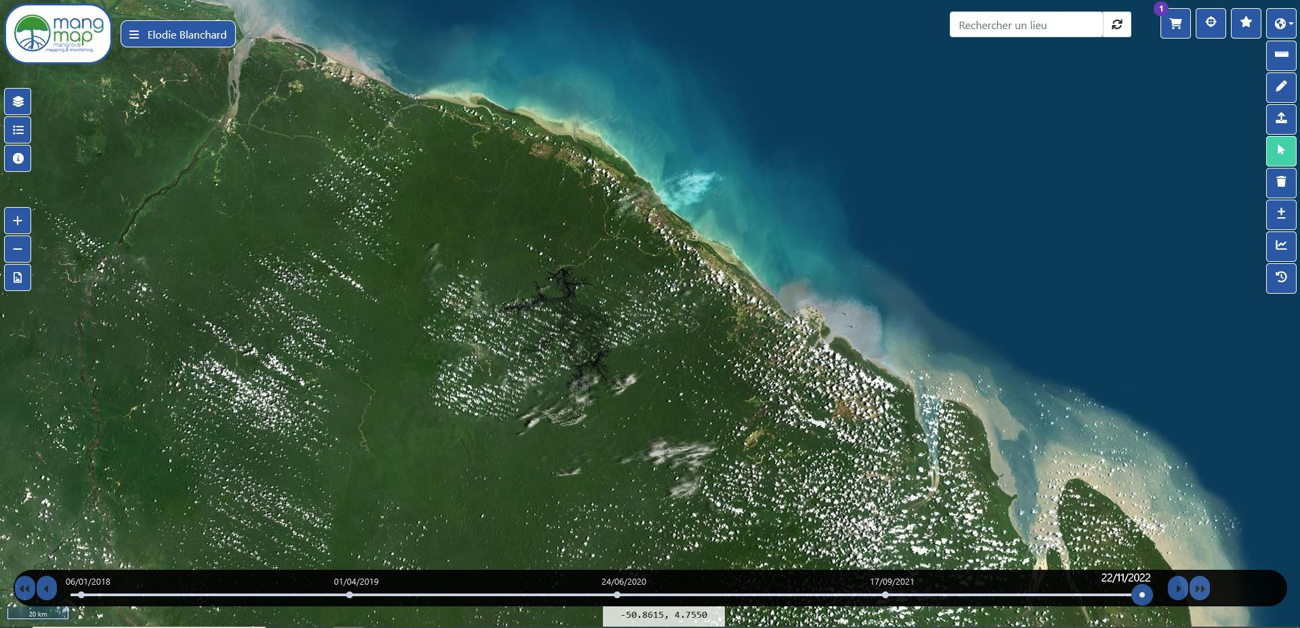
The prototype: general interface
Functional tests in progress

Slide 14
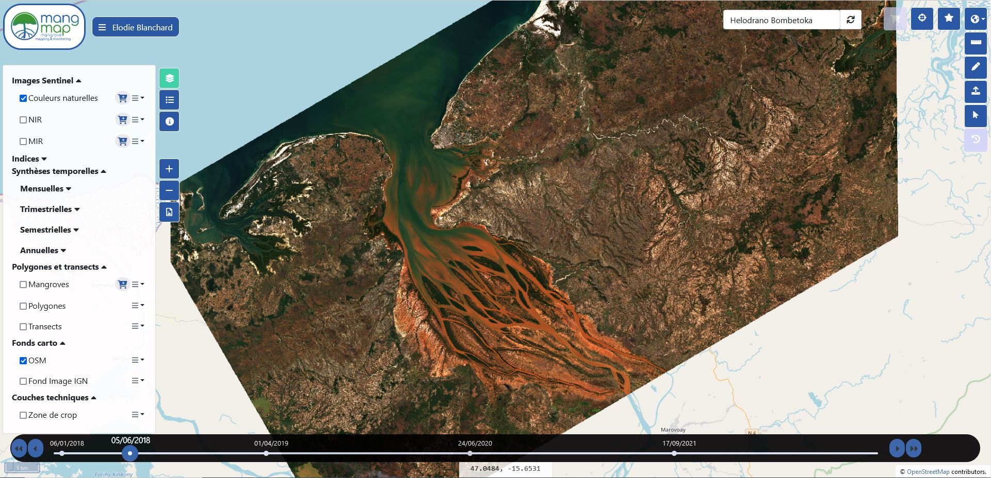
The Prototype : display of data in time
Functional tests in progress
Dynamic browsing using a temporal slider - L2A products

Slide 15
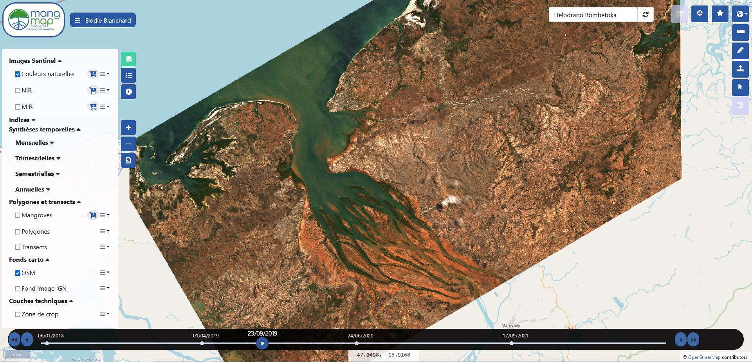
The Prototype : display of data in time
Functional tests in progress
Dynamic browsing using a temporal slider - L2A products

Slide 16
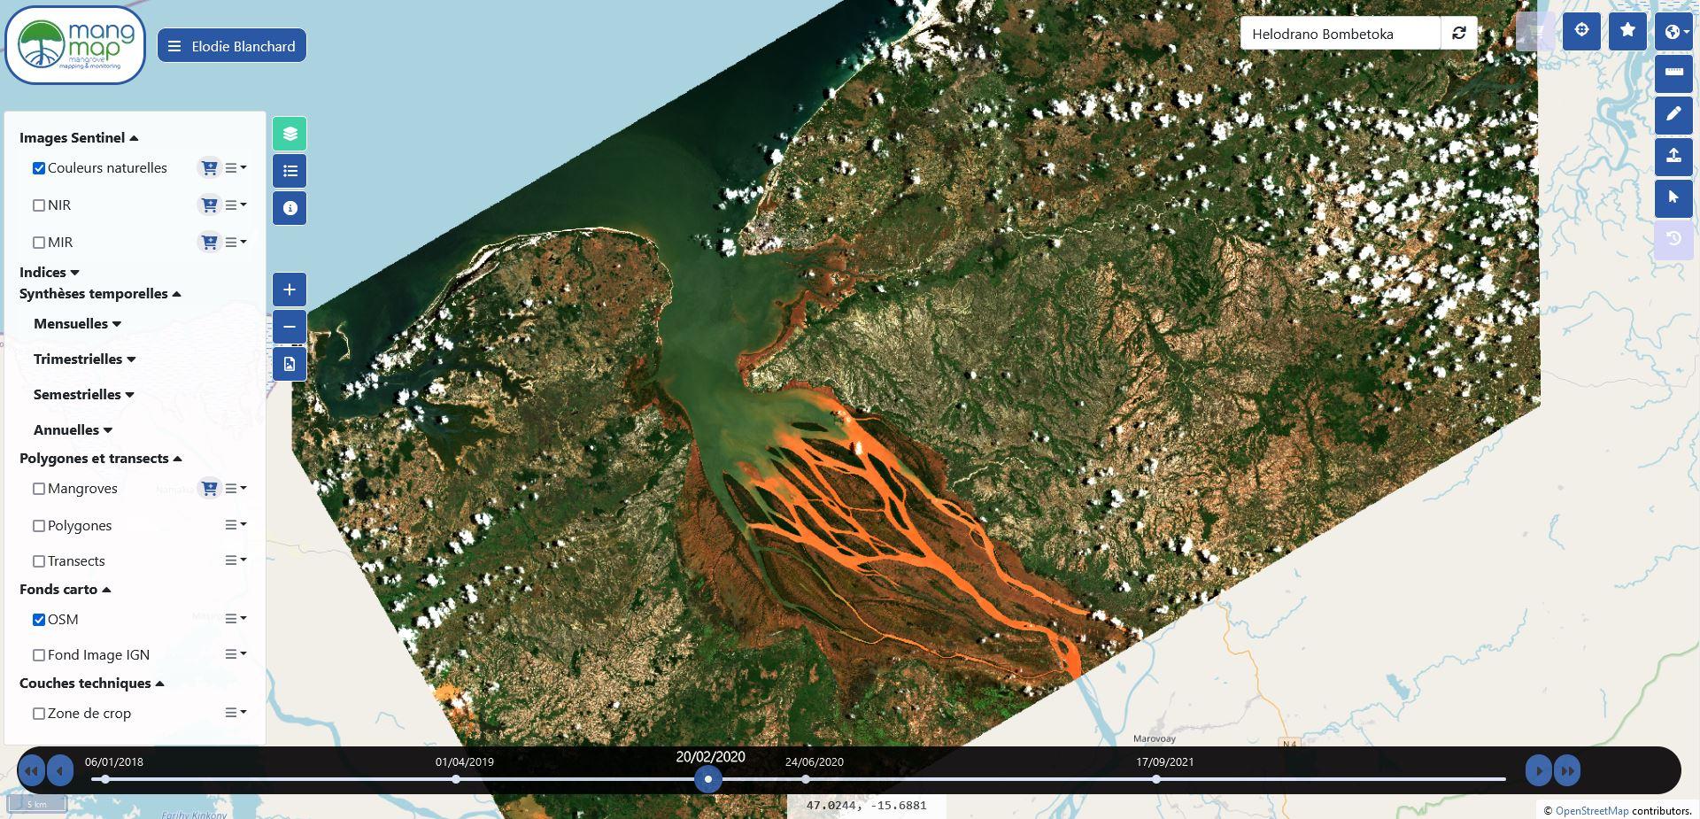
The Prototype : display of data in time
Functional tests in progress
Dynamic browsing using a temporal slider - L2A products

Slide 17
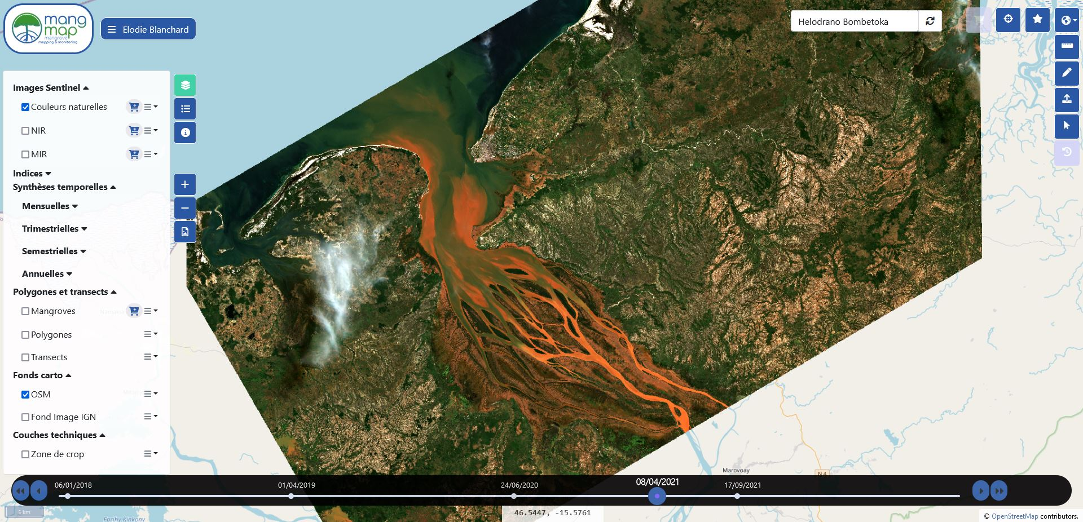
The Prototype : display of data in time
Functional tests in progress
Dynamic browsing using a temporal slider - L2A products

Slide 18
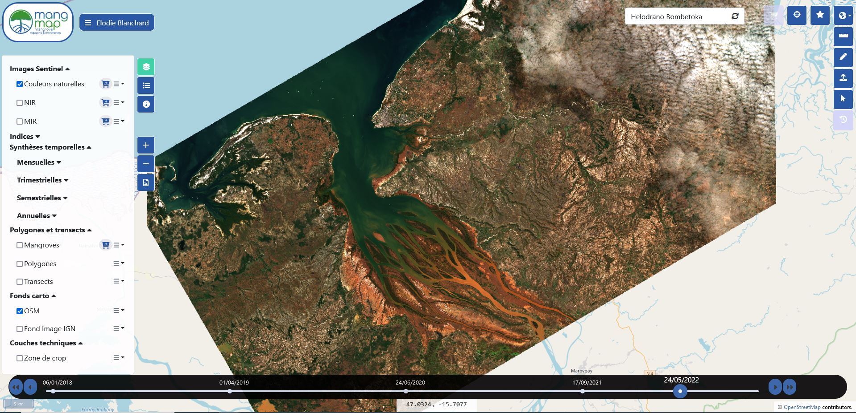
The Prototype : display of data in time
Functional tests in progress
Dynamic browsing using a temporal slider - L2A products

Slide 19
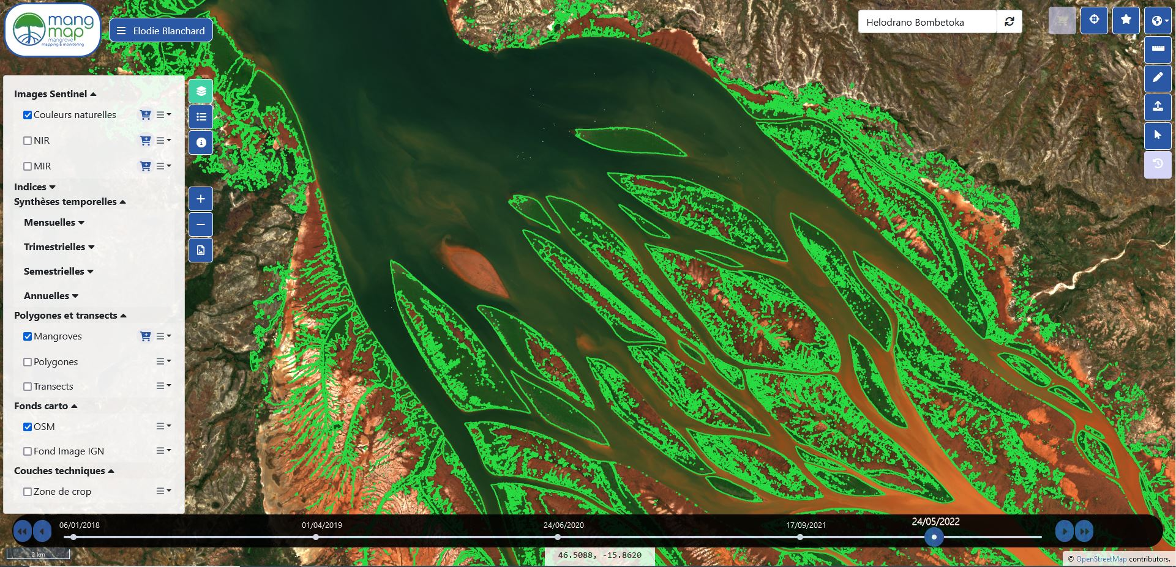
The Prototype: estimation of mangrove extent
Functional tests in progress
Automated quarterly vector estimating mangrove extent

Slide 20
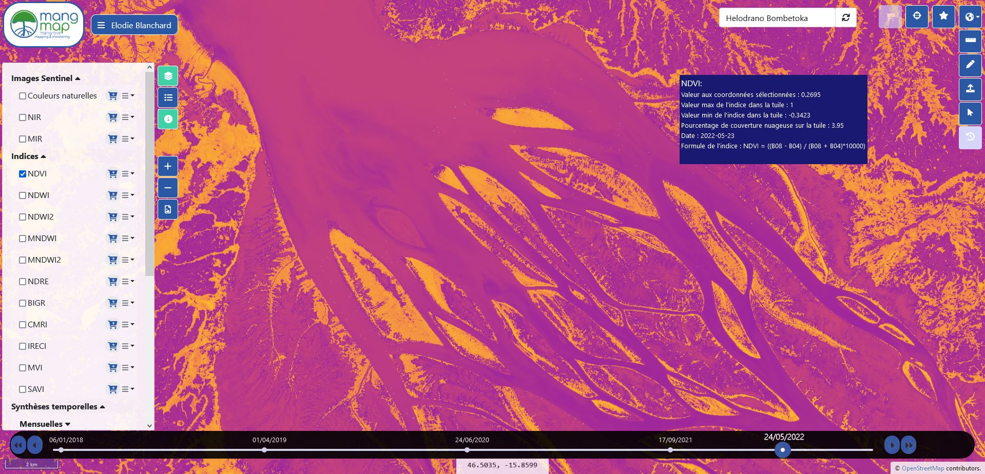
The Prototype: display of indexes
Functional tests in progress
NDVI (Normalized Difference Vegetation Index), processed for each new image streamed (5 days)

Slide 21
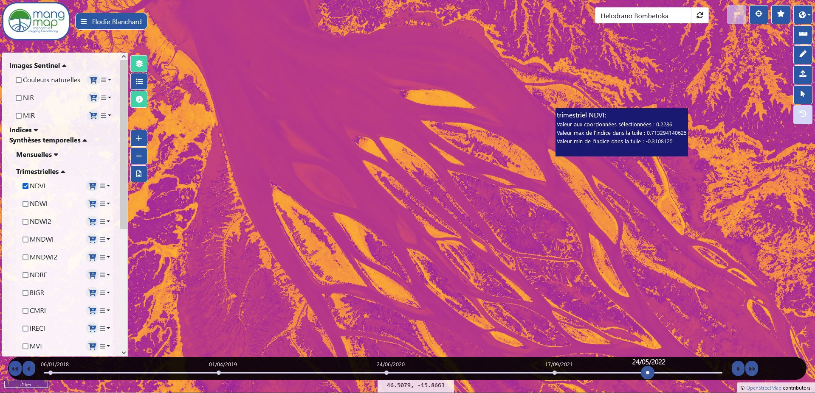
The Prototype: display of temporal composites
Functional tests in progress
NDVI (Normalized Difference Vegetation Index), quarterly composite

Slide 22
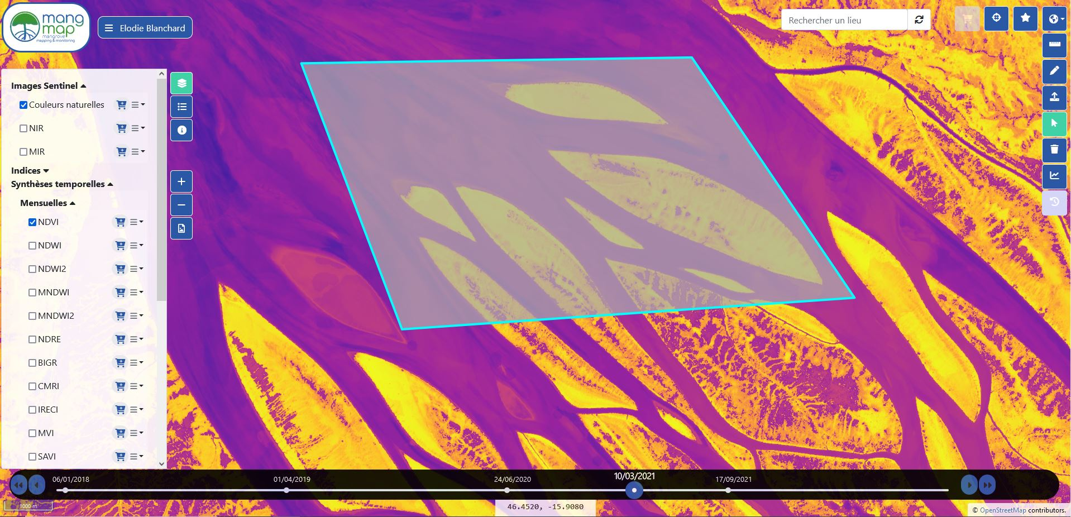
The Prototype: editing enduser polygons (aoi)
Functional tests in progress
Enduser aoi editing

Slide 23
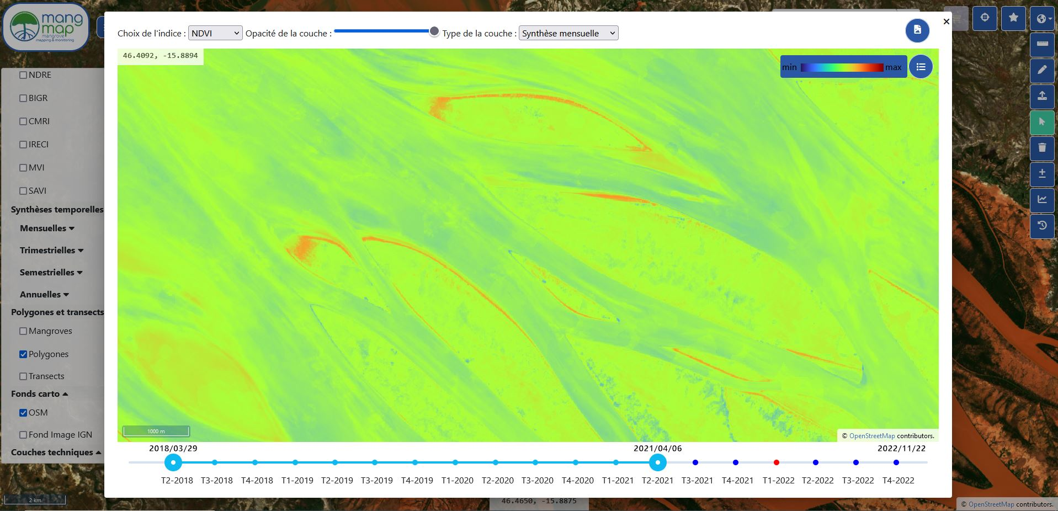
The Prototype: processing temporal differences
Functional tests in progress
NDVI (Normalized Difference Vegetation Index), temporal differences between monthly synthesis

Slide 24
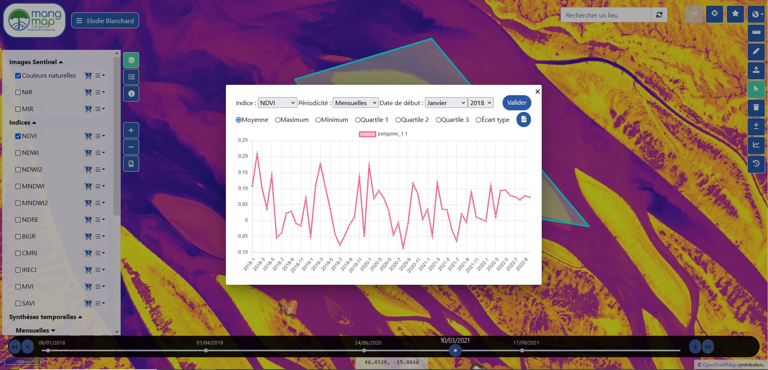
The Prototype: processing temporal statistics in aoi
Functional tests in progress
Enduser aoi: temporal evolution of composite index values within aoi area

Slide 25
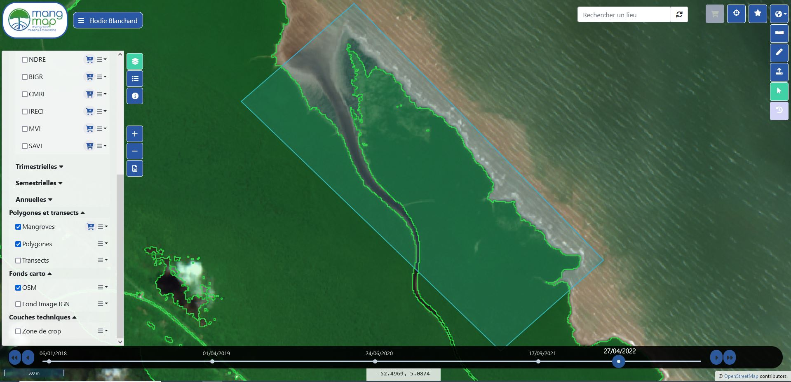
The Prototype: estimation of spatial evolution in aoi
Functional tests in progress
Estimation of spatial evolution in mangrove (date to date): gain-loss-stable

Slide 26
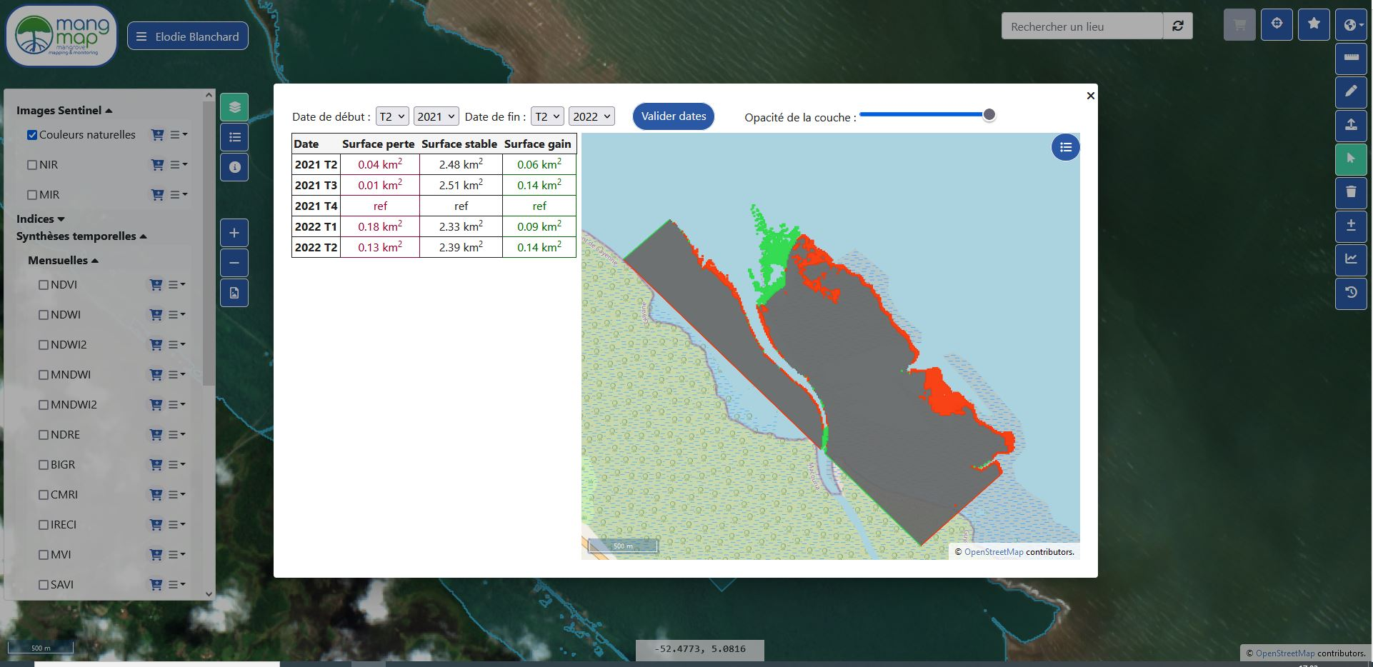
The Prototype: estimation of spatial evolution in aoi
Functional tests in progress
Estimation of spatial evolution in mangrove (date to date): gain-loss-stable

Slide 27
Phase 2: qualification in 16 pilot sites
Phase 2 : Qualification in pilot sites, networking of future endusers (Trim. 1/2 2023)
Experts: scientists and non scientists contacted on each pilot site, starting March 2022
Notes:
Bien que la télédétection ne remplace pas le travail de terrain

Slide 28
Phase 2: qualification in 16 pilot sites
Phase 2 : Qualification in pilot sites, networking of future endusers (Trim. 1/2 2023)
Progressive activation of 42 Sentinel2 tiles production & services, completion/activation of homepage website
Networking, Experts implication
Training to Platform handling / usage
Qualification of products and processes
Feedbacks collection
Communication and information relays
Targeting of future endusers communities
Identification of first software evolutions
Feedbacks analysis
Correction and resolution of potential anomalies
Collection of enduser needs and recommandations
Study and plannification of evolutions to enhance enduser experience
Opening services
in pilot sites
Notes:
une évolution possible sur certains des sites pourrait amener à prévoir/se lancer dans une interface tablette afin que la plateforme reçoive des données collectées par des partenaires (in-situ), les traite et leur restitue un traitement (type carto utile à un suivi de ressources particulières)

Slide 29
Phase 3: perspectives
Phase 3 : Geographical extension, new contents and services
Geographical extension
New specific pilot sites
Regional mangrove habitats
Global approach to be studied
In function of
Local or Transverse Partnerships
Funding capacities
Technical capabilties
New contents: potential products and services
- New data: very high resolution (optical, radar) in specific sites
- New indicators based on HR and/or VHR data: canopy height/compacity, mangrove sub-types, biodiversity indexes…
- Alert systems (deforestation, plagues), restauration follow-up
- Local indicators based on territorial contributors (in situ data) within cooperation projects: resources monitoring (smartphones / tablet)
Research activities and projects led by UMR Espace-dev and IRD, by partners and by Theia Land Data Center
Notes:
une évolution possible sur certains des sites pourrait amener à prévoir/se lancer dans une interface tablette afin que la plateforme reçoive des données collectées par des partenaires (in-situ), les traite et leur restitue un traitement (type carto utile à un suivi de ressources particulières)

Slide 30
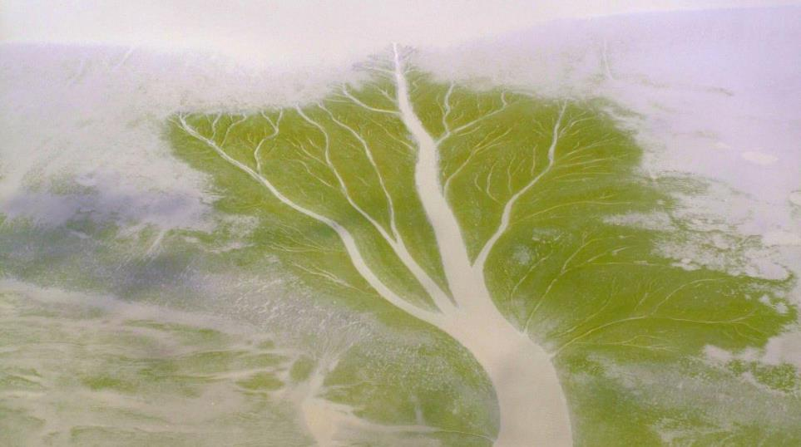
Merci de votre attention
Jean-francois.faure@ird.fr
Elodie.blanchard@ird.fr
« L’arbre de vase », biofilms sur vase nue, ~300m de large, Guyane Française, © C. Proisy, IRD, 2008

