Slide 1





OGS 2022
1st December 2022 – New Caledonia
Space for Climate Observatory session
Earth Observation For Drought Monitoring (EO4DM)
M. Neuhauser*, A. Peltier, C. Point-Dumont, T. Tilak, N. Sfaksi,
S. Lagarde, G. De Coudenhove, M. Le Page, J. Massenet, M. Despinoy
* Research Engineer (post-doctorate)
INSIGHT/IRD, Noumea, New Caledonia

Slide 2

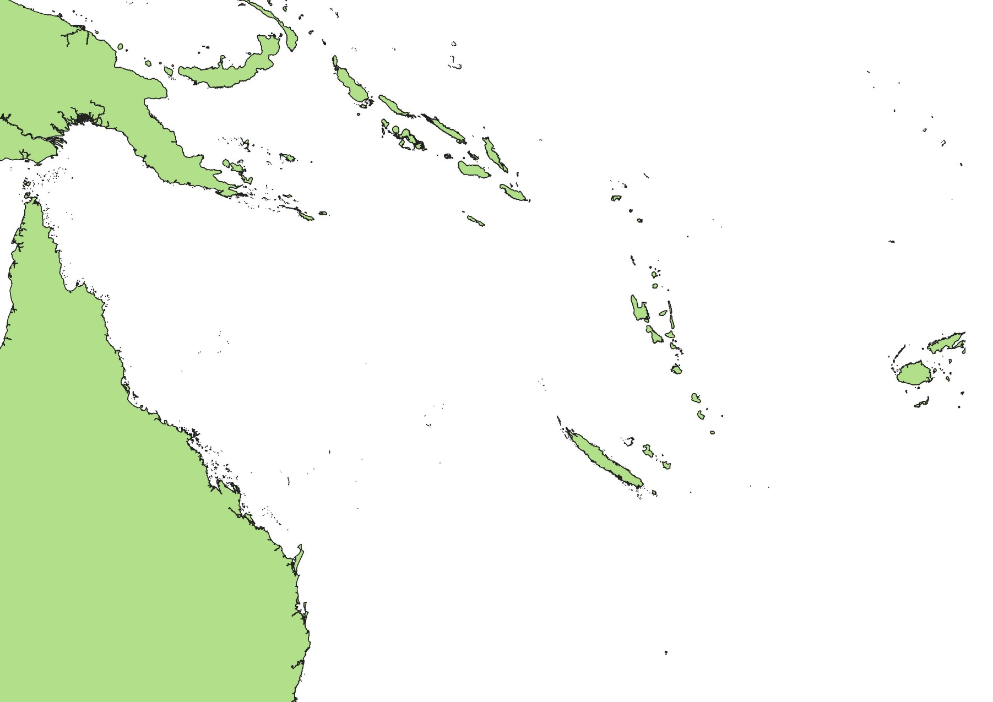



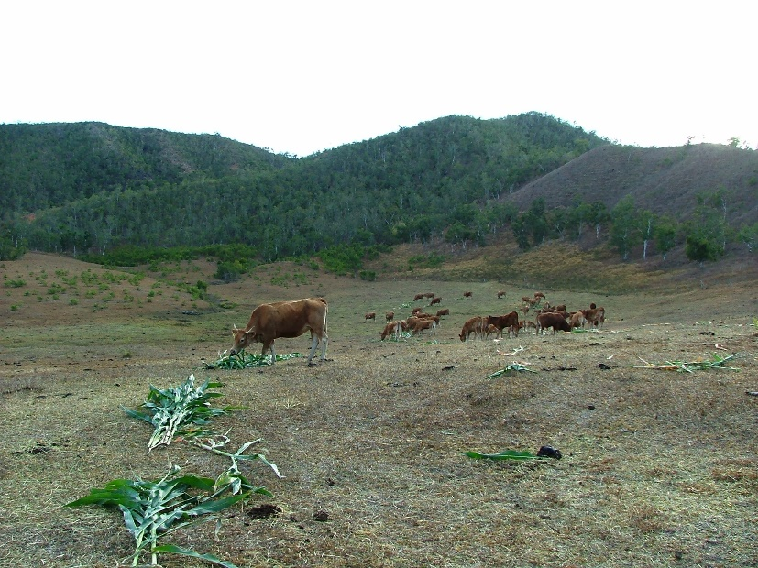

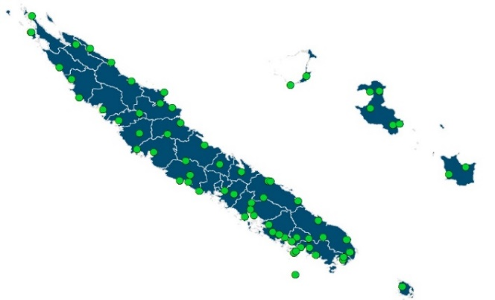

Drought and Resilience in
New Caledonia
The Rural Agency and Meteo France
facing the Drought Hazard :
Detection of meteorological drought
Purchase of drought food for farmers
Compensation for producers
Standardized Precipitation Index (SPI)
Compensation for producers
Longer and more intense Drought episodes
Météo-France NC, 2019
50 weather stations over the territory
BUT…
Incomplete spatial coverage
Rainfall deficit ≠ plant water stress
Impacts on :
Biodiversity
Agricultural crops
Water ressource

Slide 3

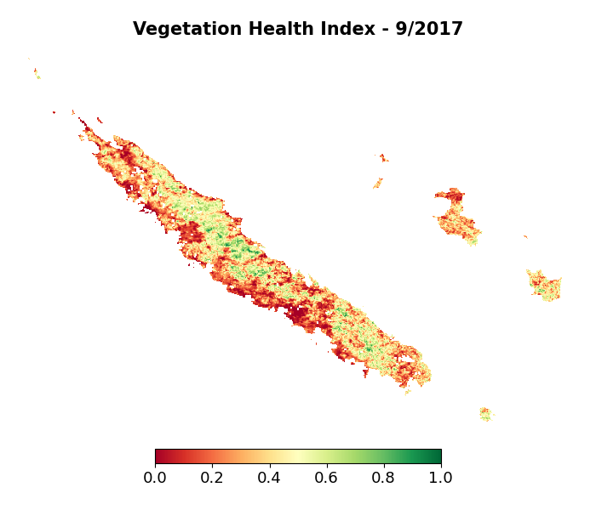


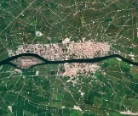
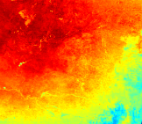
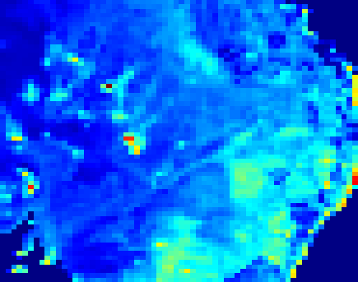


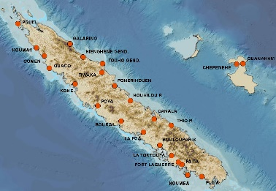

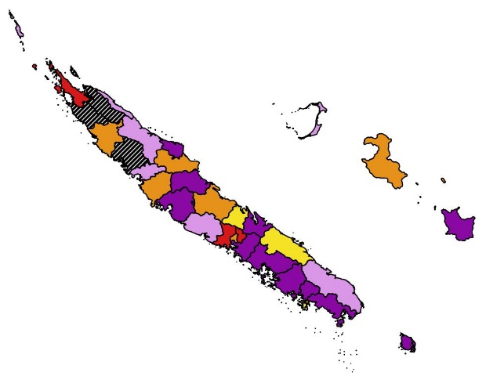
EO4DM system
The project
SCO-labelled project
April 2021 - July 2022
INSIGHT, Meteo France
Current Indicator
Anomalies of surface indices
Complementary Earth Observation data
SPATIALIZED = localization
User platform
Dry
Healthy
Vegetation
(Optical)
Surface Temperature
(Thermal)
Soil Moisture
(Microwaves)
HISTORICAL = quantification
Forecast Indicator
Long-range probabilistic forecast system
+1 month
+2 months
+3 months
Expert meteorological data:
precipitations, evapotranspiration
No Data
Stop
Decrease
Formation
Persistence
Increase

Slide 4
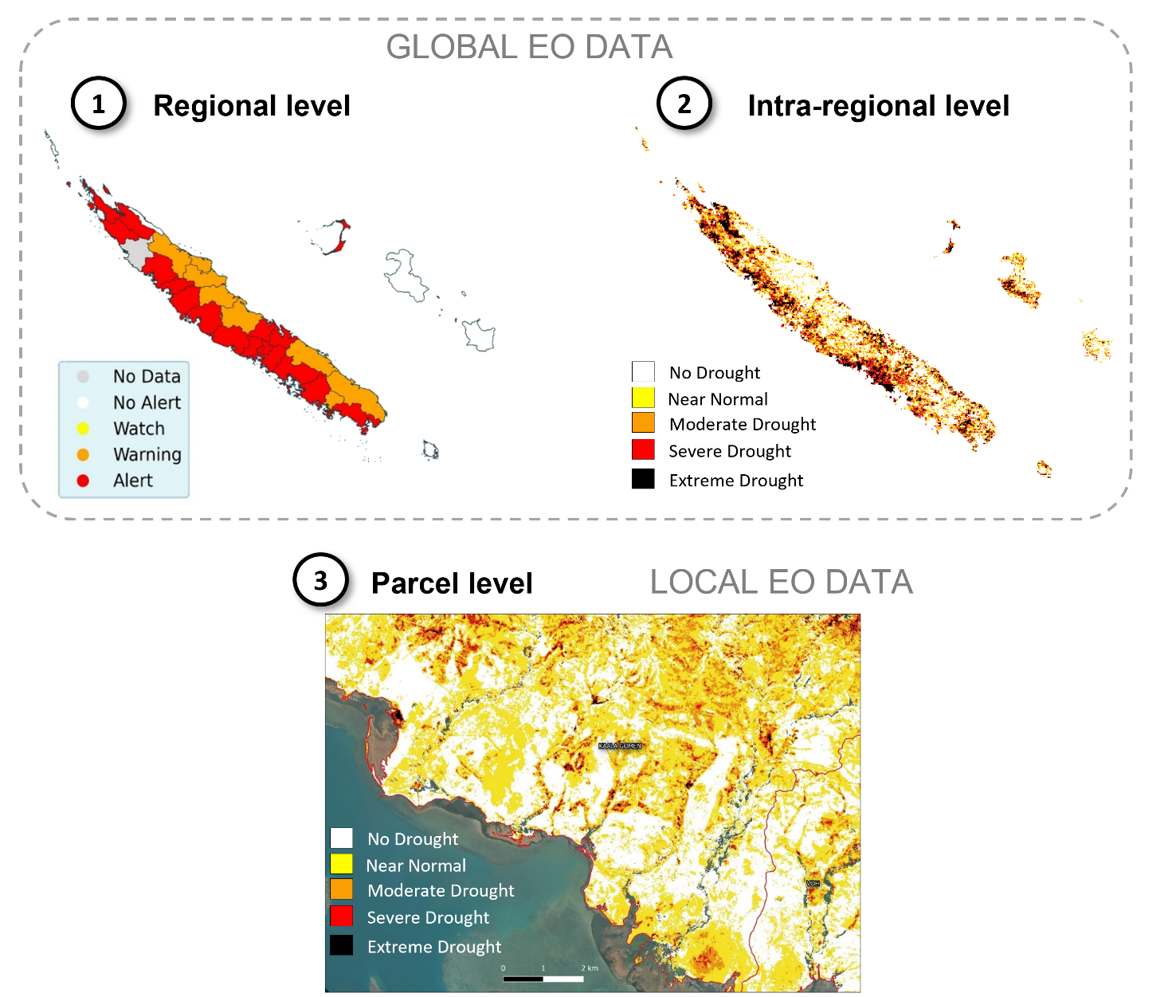
Products for current drought
Sectorization for producers compensation
Spatialization of water stress according to 3 levels :
AMINISTRATIVE SECTORIZATION
THEMATIC SECTORIZATION
INTRA-PARCEL SECTORIZATION

Slide 5

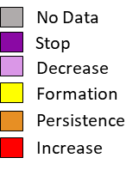
Products for forecast drought
Sectorization for producers compensation
Evolution trends of the 3-month SPI : meteorological "proxy" for vegetation drought
PROBABILISTIC FORECAST :
+1 month
+2 months
+3 months
ADMINISTRATIVE
SECTORIZATION
5 EVOLUTION CLASSES :

Slide 6

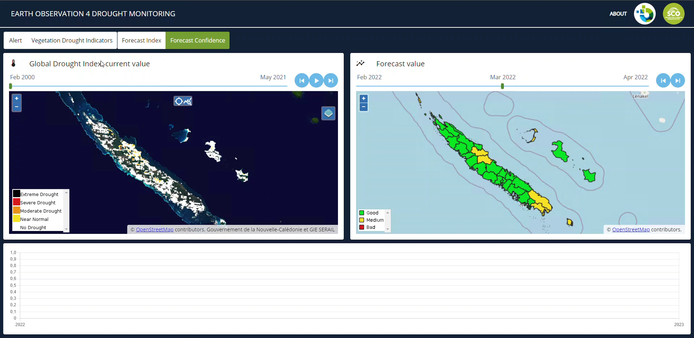
User Platform

Slide 7

Conclusion
TASKS | Developpements | Validation | User feedbacks*
CURRENT Indicator
FORECAST Indicator |  |  | Waiting for drought
PLATEFORM
* Test of the platform by the Rural Agency for the current indicator
Possible improvements :
Local indicator integrating radar (S1) and thermal products (Trishna)
Thematic validation with in-situ acquisition on canopy stress, soil moisture level, etc.
User platform (time steps, area selection, etc.)

Slide 8
















Externalities for valorization
EO4DM Project :
Global drought in NC
First local indicator
Plateform prototype
Industrialization & Pacific :
"Fonds Pacific" project
Operational production on NC
Adaptation to other Pacific islands
Valorization in agriculture :
Decision-making tool for water management
Projects in preparation with local and metropolitan partners
Field instrumentalization for local calibration and validation
?
2021
2022
Now

Slide 9
Thank you for your attention
Any questions ?

