Slide 1

SPATIAL INFORMATION PLATFORMS
02 December 2022
Noumea, New Caledonia
Secretariat of the Pacific Regional Environment Programme (SPREP)
Vani Koroisamanunu
Environment GIS Specialist
Notes:
Bula, Talofa Lava
My presentation today will focus on Spatial Information Platforms (available in the region) that will:
“Provide access to data for evidence-based decision making”

Slide 2
Presentation Outline
Background
SPREP Priorities
Data Management
Data Platforms
Challenges
Way Forward

Slide 3
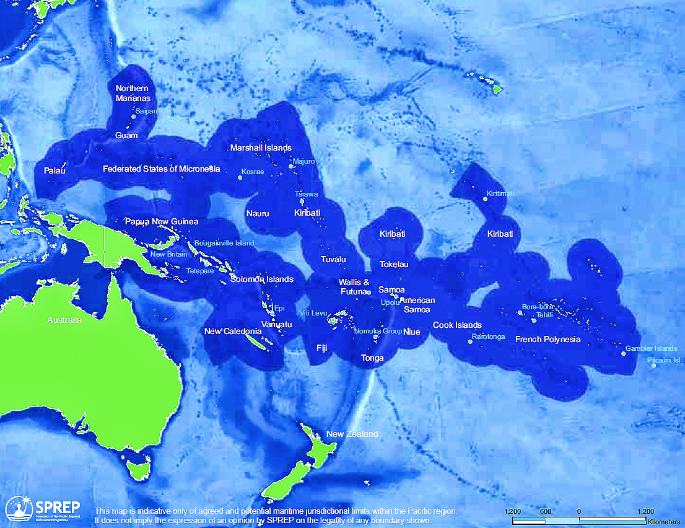
Region SPREP and CROP support
21 Pacific Island Countries and Territories
Land Area: ~553,000 km2 (~30,000 islands)
EEZ + Territorial seas area : 30,000,000 km2 (~10% of the World’s Oceans)
Notes:
With 21 Pacific island countries and territory members whom we support with technical backstopping along with our sister CROP (council of the regional organization of the pacific) agencies including SPC and USP.
SPREP also provides SDG reporting assistance and alignment with UN conventions including UNCC, CBD, CITEs, CMS, BRS waste cluster to name a few.
Will change this map !!

Slide 4

Pacific island land area 2%
Notes:
As discussed by some of our presenters this week, our Blue Pacific Continent consists of 98% ocean and 2% of our pacific land area, of which must take care of, as most of our coastal communities are greatly impacted by climate change.
We are small in size SCALE and have LOW human capacity or some have ZERO earth observation (EO) capacity.

Slide 5

SPREP Strategic Priorities
SPREP Vision: A resilient Pacific environment sustaining our livelihoods and natural heritage in harmony with our cultures.
Mandate – 1993 SPREP Agreement: To promote cooperation in the Pacific region and provide assistance in order to protect and improve its environment and to ensure sustainable development for present and future generations
Principal Mandates: Climate Change Adaptation and
Mitigation\Biodiversity Conservation
SPREP Strategic Priorities:
Climate Change Resilience
Ecosystem and Biodiversity Protection
Waste Management and Pollution Control
Environmental Monitoring and Governance
Notes:
SPREPs mandates rely on data governance which is a key for any organization to make informed decision making.
SPREP data policy…..recognizes that data can be a valuable resource that helps to protect the environment, grow the economy, improve services and produce better policy outcomes…
Scope
This policy applies to SPREP’s own data as well as data held by SPREP on behalf of government agencies and partners within the Pacific

Slide 6
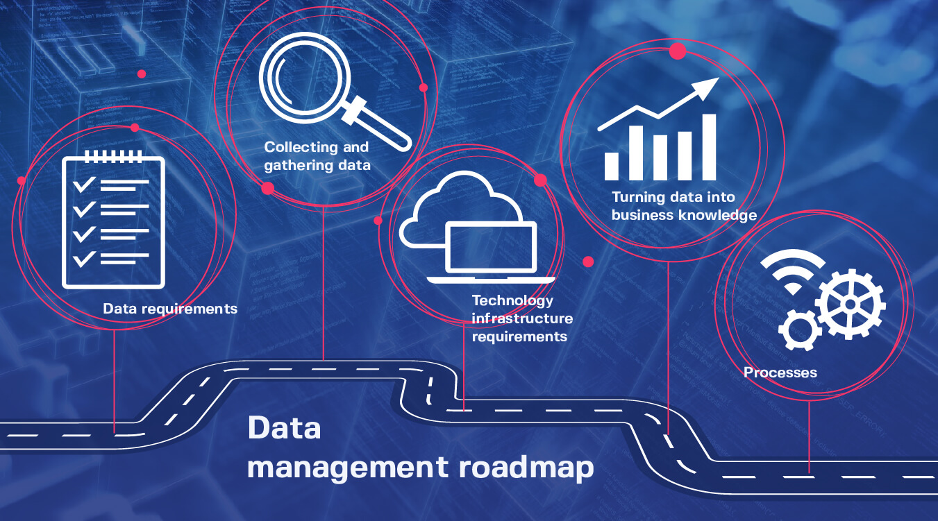
Data Management
Comprises all disciplines related to managing data as a valuable resource
A national and regional challenge
Notes:
This brings us to the importance of data and data management.
Globally, data is an important component of any analysis, project, policy and it is equally challenging for the region…
DATA is a vital component of data management process that involves gathering, validating and using data in a way that is secure, effective and efficient.
“…includes all information collected by government agencies for any purposes including government administration, research or service delivery as well as data provided by partners”
“It includes, but is not limited to, all datasets including maps, reports, statistics, and surveys (including backups, archive copies and derived data) in whatever format they are held (excel, GIS files, pdf, word etc) and whether in hard or soft copy”

Slide 7

Open Data
    Published and easily shared.
    Provided in a structured format.
    Guaranteed to be available.
    Traceable back to where it originates.
Notes:
What makes open data ‘open’?
Two words - Open data is about availability and accessibility.
Data should be:
Published in a convenient, modifiable form that can be linked elsewhere and easily shared.
Provided in a standard, structured format so that it is machine-readable.
Guaranteed to be available and consistent over time.
Traceable back to where it originates.

Slide 8
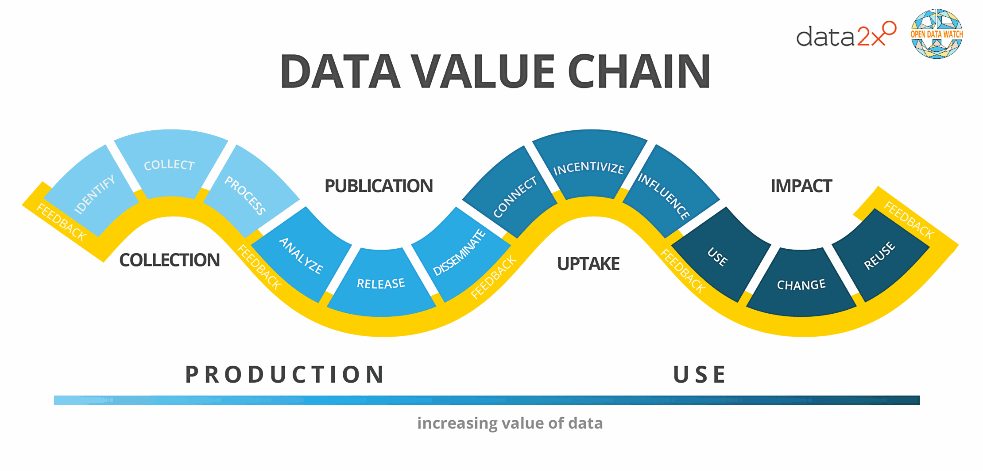
Notes:
Here’s an example of a data value chain that’s had a lot of airtime within international Data for Development and Open Data communities. I like this model because it can be applied to all types of data.
It has been created by a group called Data2X who work in identifying gaps in gender data and how this can be used to inform gender policy.
The data value chain describes the evolution of data from collection to analysis, dissemination, and the final impact of data on decision-making.

Slide 9



DATA PLATFORMS
Notes:
In this section, we will now be discussing the data platforms currently in place in the region with challenges and way forward.

Slide 10




Challenges
Coordination
Capacity, capability, and maturity
Sustainability
Access
Notes:
Throughout the data life-cycle and the data value chain we face a number of challenges in the Pacific. Some of the key challenges that we’ve come across in implementing data platforms within our organisations and in engaging with a range of stakeholders from across the development landscape in the Pacific.
Lack of coordination
Within or own organisations, between development agencies and within countries and government agencies
How do we avoid duplication and competition and encourage partnerships, collaboration and complimentary approaches
Data management capacity, capability and maturity is inconsistent across PICTs.
This impedes the ability to track and report against our commitments to national, regional and international development frameworks
Good data is not available to help tackle the development, environment and social challenges we face in the Pacific
Analysis, insights derived and knowledge products derived from data, is just not available to inform policy and decision making
Reduces the impact or effectiveness of development, public policy and social change initiatives
Sustainability is a constant challenge in the development world
Projects implement data initiatives that eventually fizzle and fade away when funding and interest dries up
Developing and retaining local capacity to support data management initiatives and platforms is a real problem for our countries. We train people who eventually move on for better opportunities. This churn has a real impact on the sustainability of solutions implemented in the Pacific.
Access to good data is a huge challenge
Contrary to some perceptions from outside the region – we are not data poor in the Pacific. Data exists but it’s hard to find and can be difficult to get to, for many reasons
They may be locked away on legacy systems, in formats that are unwieldy or just don’t have the necessary legal instruments or data access agreements in place to allow sharing
Sharing of data between sectors is also limited. We see this with our regional organisations and also at the national level between government agencies.
When we look at the challenges around capability, availability, utility for GIS & RS data - it’s the same problems we have with data management in the Pacific.
The specific challenges I’ve picked out here are not necessarily technical challenges, but more social and institutional challenges.
How do we create an environment for us to address these challenges?

Slide 11
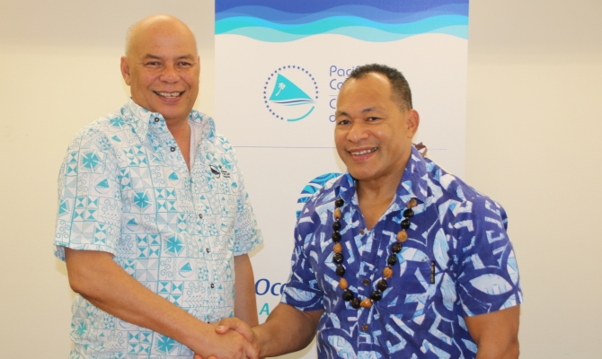
Crop Collaboration
SPREP-SPC partnership to improve Pacific data management and sharing
https://www.sprep.org/news/new-sprep-spc-partnership-to-improve-pacific-data-management-and-sharing
“The partnership highlights leadership in data management and sharing and strengthens the sustainability of Pacific information. It also promotes the use of open data, to ensure that public data is available, accessible and reusable”
Notes:
Through the CROP agency’s collaboration with the SPREP-SPC partnership the Pacific Data Ecosystem was initiated to improve Pacific data management and sharing.
- Most Pacific Island Countries have data storage management and use issues
- This became clear through some of the national processes such as the state of the environment reporting (SOE) process and others.
- Now in the context of the data platforms within our data ecosystem, we take a very broad position on what data is.
Yes, if it’s raw data, it’s tabular data, it’s time series data, it’s spatial data, satellite imagery, it’s real-time data. But because there are elements of Information and Knowledge Management that we also need to tackle, we’re also including.
- DM is many things to different people. There is often ambiguity and confusion about what DM actually means.
- DM encompasses all of the activities and interventions that take place throughout the data life-cycle.
It comprises all disciplines related to managing data as a valuable resource

Slide 12
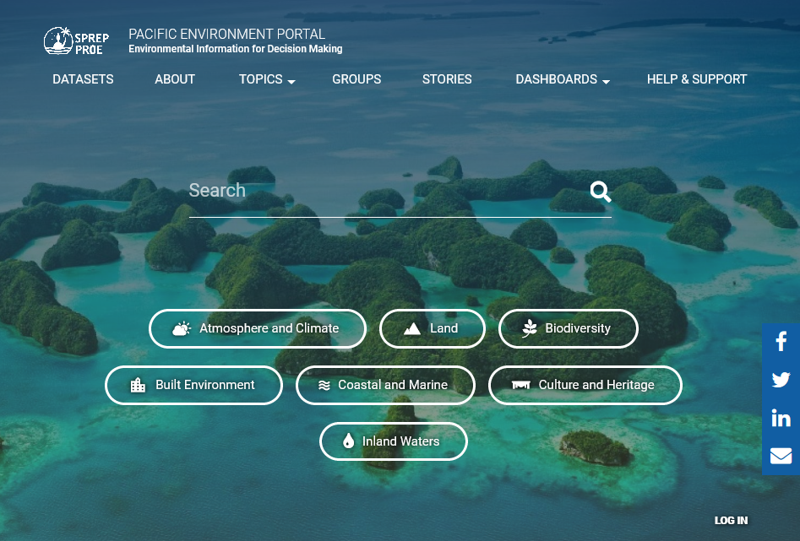
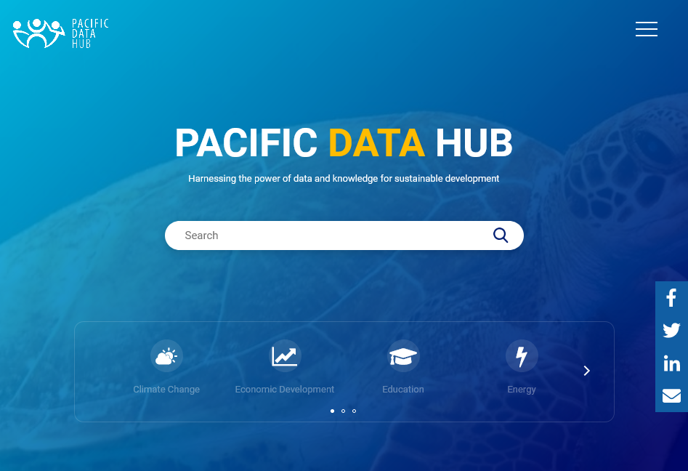
Pacific Data Ecosystem
https://pacific-data.sprep.org
https://pacificdata.org
Notes:
Pacific Data Ecosystem is a “Region-wide initiative between stakeholders to ensure that Pacific data is effectively managed, maintained and useful to the Pacific peoples.”
- The data ecosystem is made up of the PEDP (pacific environment data portal) and PDH (pacific data hub)

Slide 13
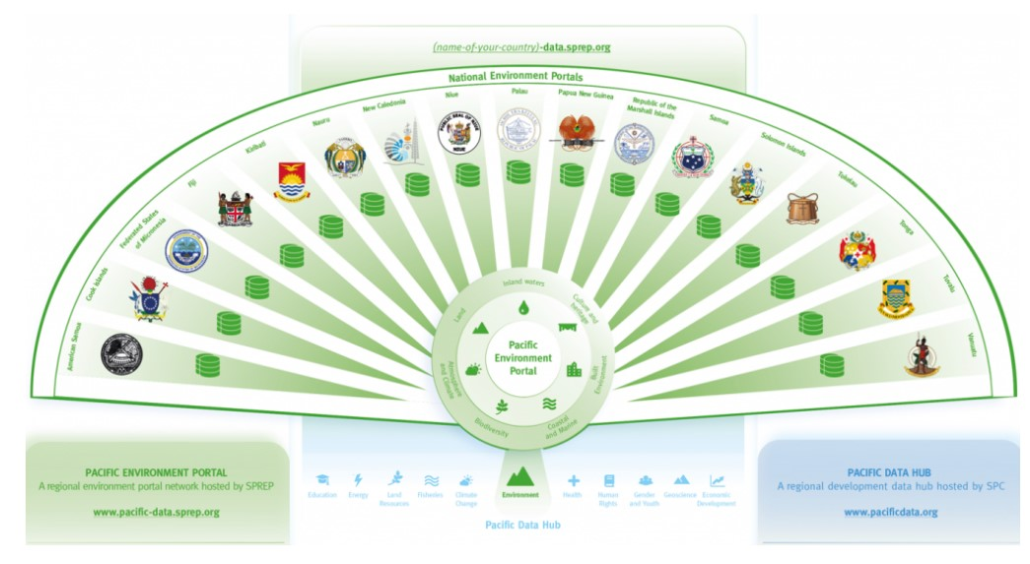
Pacific Data Ecosystem –
Data Management
https://www.sprep.org/inform/
Notes:
“ The partnership highlights leadership in data management and sharing and strengthens the sustainability of Pacific information.
It also promotes the use of open data, to ensure that public data is available, accessible and reusable”
Additionally, the data from the national Country portals is harvested by the SPC data hub

Slide 14
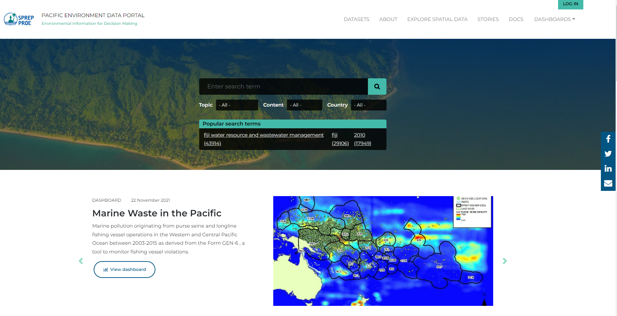
Pacific Environment
Data Portal
“…aims to improve national and regional access to data for monitoring, evaluation and analysis of environmental information in support of environmental planning, forecasting, and reporting requirements”
PEP Talk - https://pacific-data.sprep.org/
Notes:
The pacific environment data portal is one of data repository that stores both national and regional data:
The Pacific Environment Portal provides an easy way to find, access and reuse regional and national data.
In addition, it provides easy access and safe storage for environmental datasets to be used for monitoring, evaluating, and analyzing environmental conditions and trends to support environmental planning, forecasting, and reporting requirements at all levels.
The portal contains over 18,000 datasets, 2 dashboards and 13 data stories
- The Data Portal does not have the structure of a “classic” relational database. The way you upload and find data is by organizing it in themes and tagging it with keywords.
- Under datasets, left menu with drop-down arrows. Filtering options.
- Give examples of all categories.
The Pacific Environment Data Portal Networks is a
Can host spatial information AND we need more from users.

Slide 15
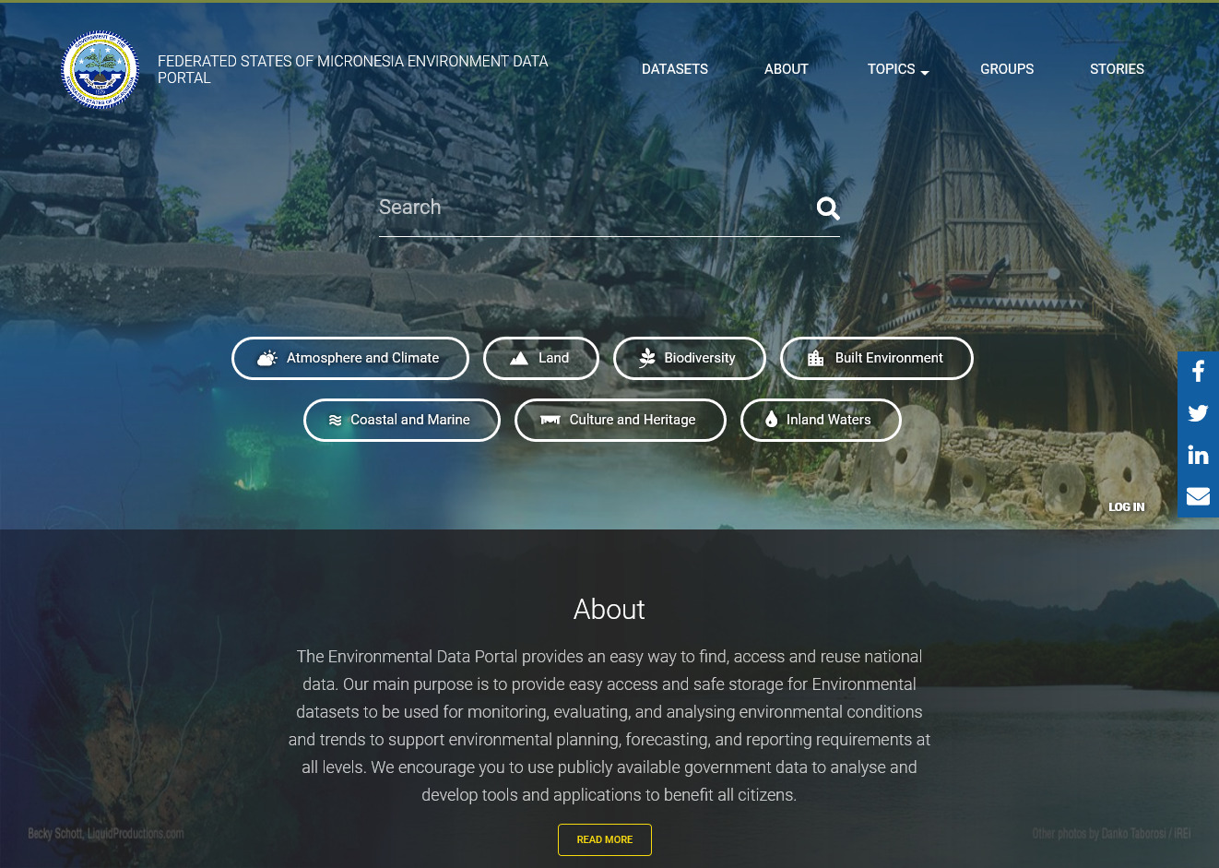
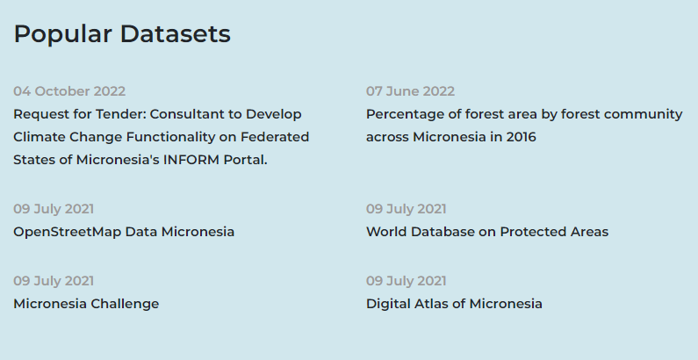
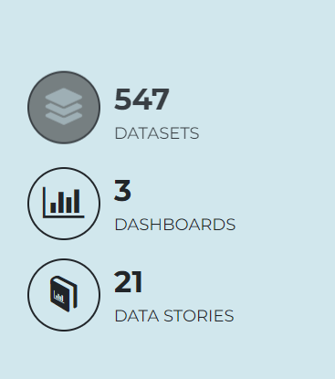
National Data portals
FSM Environment Data Portal https://fsm-data.sprep.org
Notes:
Built on Drupal DKAN Platform
Core Values:
Community and User Empowerment
Transparency and Openness
Collaboration and Creativity
Inclusiveness and Accessibility
Sustainability and Extensibility

Slide 16
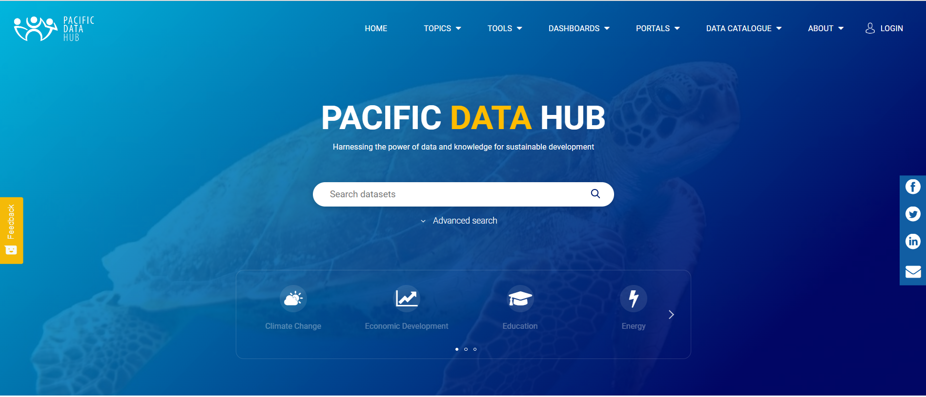
Pacific Data Hub
https://pacificdata.org/
Notes:
What is Pacific Data Hub?
The Pacific Data Hub is part of an initiative designed to improve access to Pacific statistics and data and is “A region-wide initiative between stakeholders to ensure that Pacific data is effectively managed, maintained and useful to the Pacific peoples.”

Slide 17
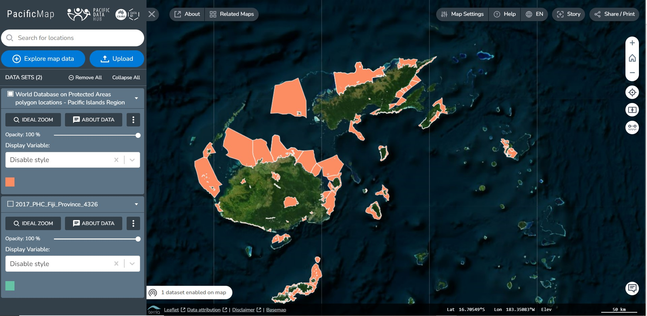
https://pacificdata.org/
Notes:
It also promotes the use of open data, to ensure that public data is available, accessible and reusable” to improve Pacific data management and sharing.
As you can see, from the mapping interphase shown that you can access the map viewer on this platform.

Slide 18



Way Forward
Encourage users to share spatial information.
Share datasets with countries and territories.
Continue to collaborate with existing and new partners working in this space.
Create Insights from the data
Pump out the products!
Notes:
We need more spatial data to be shared by users in our pacific region space.
Spatial Data to be shared and published on the data ecosystem.
Shared with countries and territories
Collaboration
Data insights
And create tangible outputs!

Slide 19


Vinaka vakalevu, Faáfetai, Merci

Slide 20
Proposed Project

Slide 21






Proposed Project
Ocean Governance
A marine space analysis implemented by multi-agency analysis to be conducted for ocean governance/use
Notes:
Project
Marine space analysis
Providing access to data for evidence-based decision making in the marine space.
This is a data gap that should happen.
Why do we want this?
To paint a picture of the complex and ever-changing administrative and area-based management environment in the Pacific Ocean.
Including area-based management (PAs), particularly sensitive areas (PSSAs), and fishing zones (12Nm buffer zones around islands), and PNEA and marine pollution (including Deep Sea Mining (DSM) tenement claims.)
-

