Slide 1
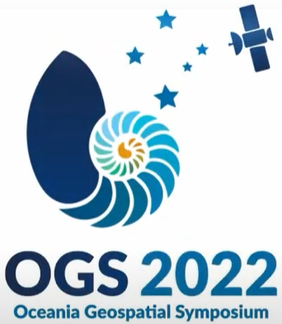
Space Geodesy Serving PICTs
OGS 2022
Felix Perosanz
Solid Earth programme manager CNES
Chair Governing Board International GNSS Service (IGS)
Oceania Geospatial Symposium, Nouméa, Nouvelle Calédonie, 28 novembre - 4 décembre 2022
Notes:
Dans une semaine ou il est surtout question de teledetection a base d’image spatiale je voudrais ouvrir une parenthese et vous parler de géodésir spatiale
cnes
IGS
Je vous remercie de me donner l’opportnuité de parler de l’intérêt de la GS pour le geospatial en général et pour les pays et territoires insulaires du Pacifique

Slide 2
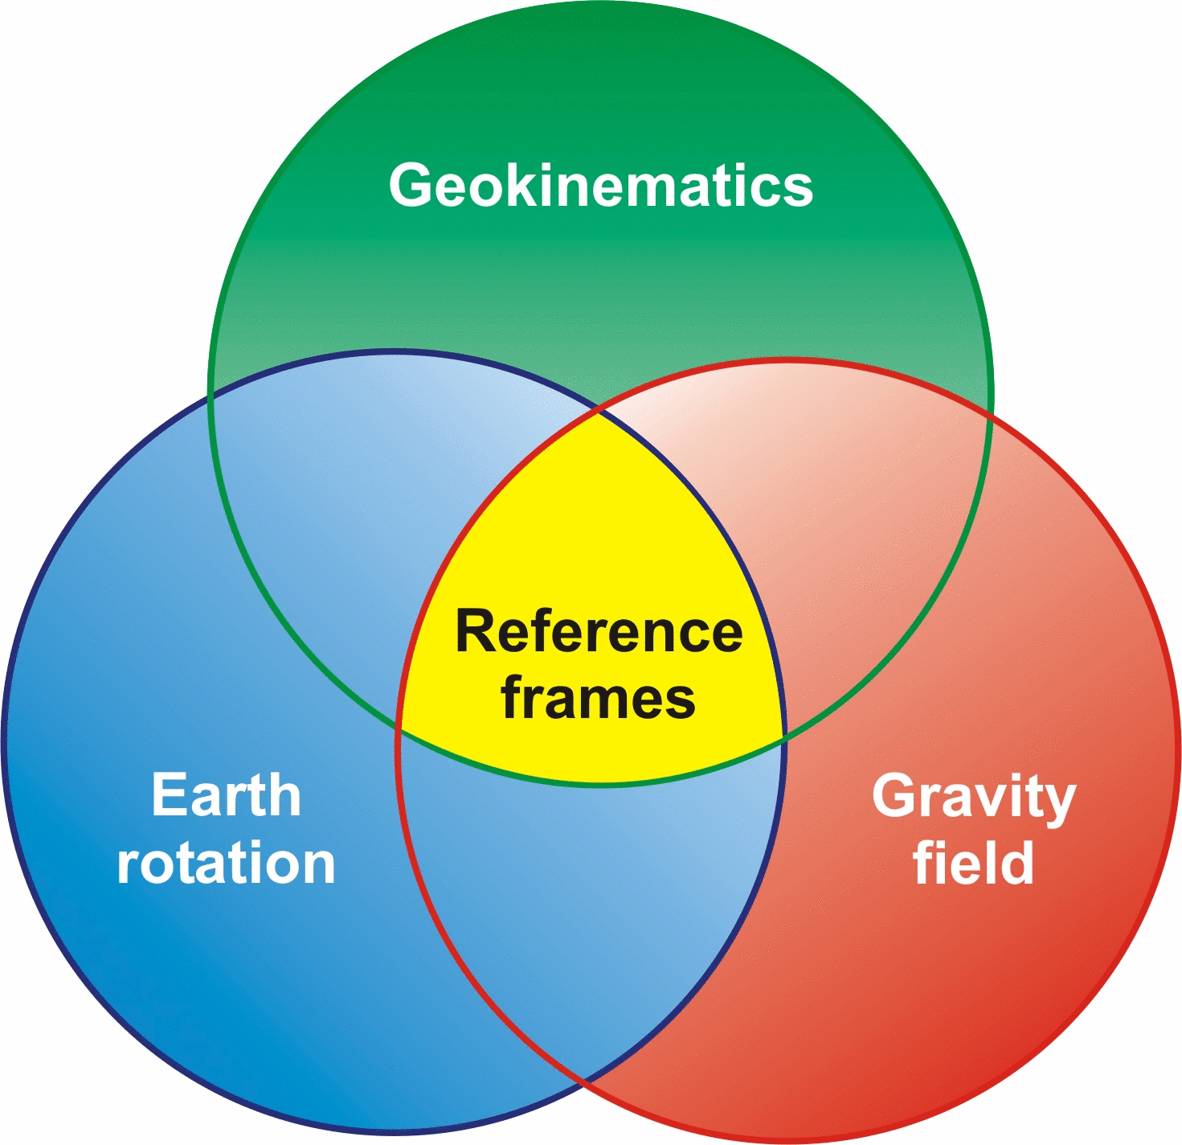
What is Geodesy ?
Geodesy = “measuring the Earth”
Need to define reference frames
To be able to measure the Earth ‘s:
  Deformation
  Rotation changes
  Mass distribution
In the context of
  global-change
  Using space techniques (GNSS, SLR, VLBI, DORIS)
Based on spatial and terrestrial geodetic infrastructures
Notes:
Global + intérêt regional

Slide 3
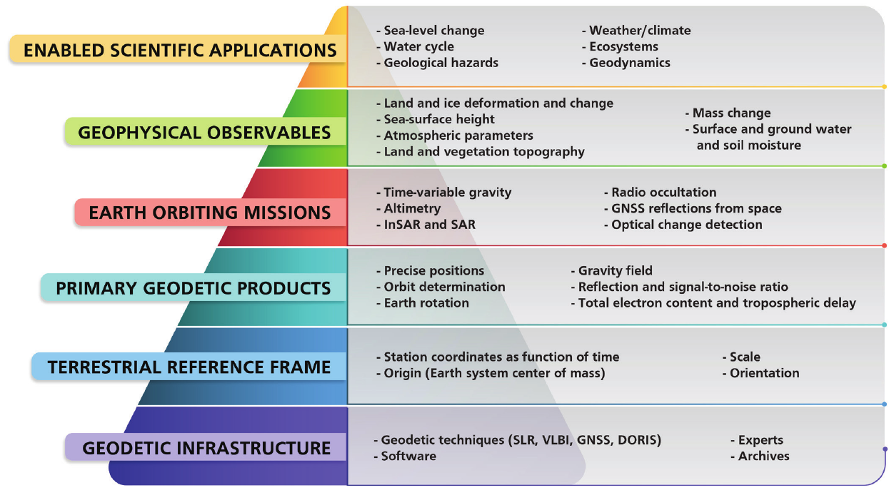
Geodesy and Geospatial
+ Tide gauge
Illustration of how the geodetic infrastructure is connected to enabled scientific applications (National Academies of Sciences, U.S., 2020).
Notes:
Ces infrastructure constituent en effet le socle sur lequel repose le geospatial et l’OT. Ce socle il est constitué…
Le repère
Les parametres…
Justement en parlant d’infrastructure gedesique…
Avant d’exploiter ces données comment la geodesie contribue à
La defoemation de la Terre
Le niveau de la mer
La meteo et le climat
La surveynace des tsunamis
Vegetation et d’humidité des sols
Pour montrer l’intérêt de la geodesie j’aime bien utiliser cette illstration AU cours de cette semaine il va beaucoup être question de teledetection a base d’images spatiales ce qui est naturel…
Je vous propose d’elargir la source d’observation de la Terre à la geodesie spatiale
Cette figure est tirée d’un rapport des USA et la communauté scientifique internationale adhere a cette vision
Qui
Les repères de references ont fondamentaux notamment pour
ON retrouve aussi un certain nombre de produit et d’observables sur lesquelles je vais revenir comme la deformation de la Terre, le niveau de la mer, la troposphere et l’inosphere, l’humidité des sols ou les risques naturels

Slide 4
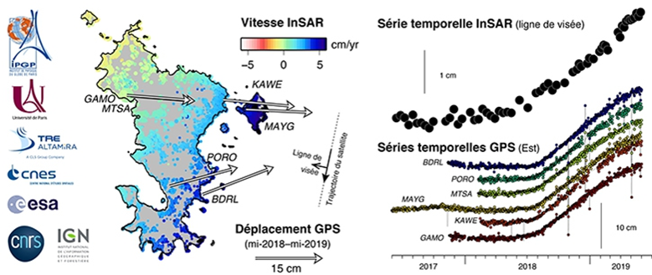
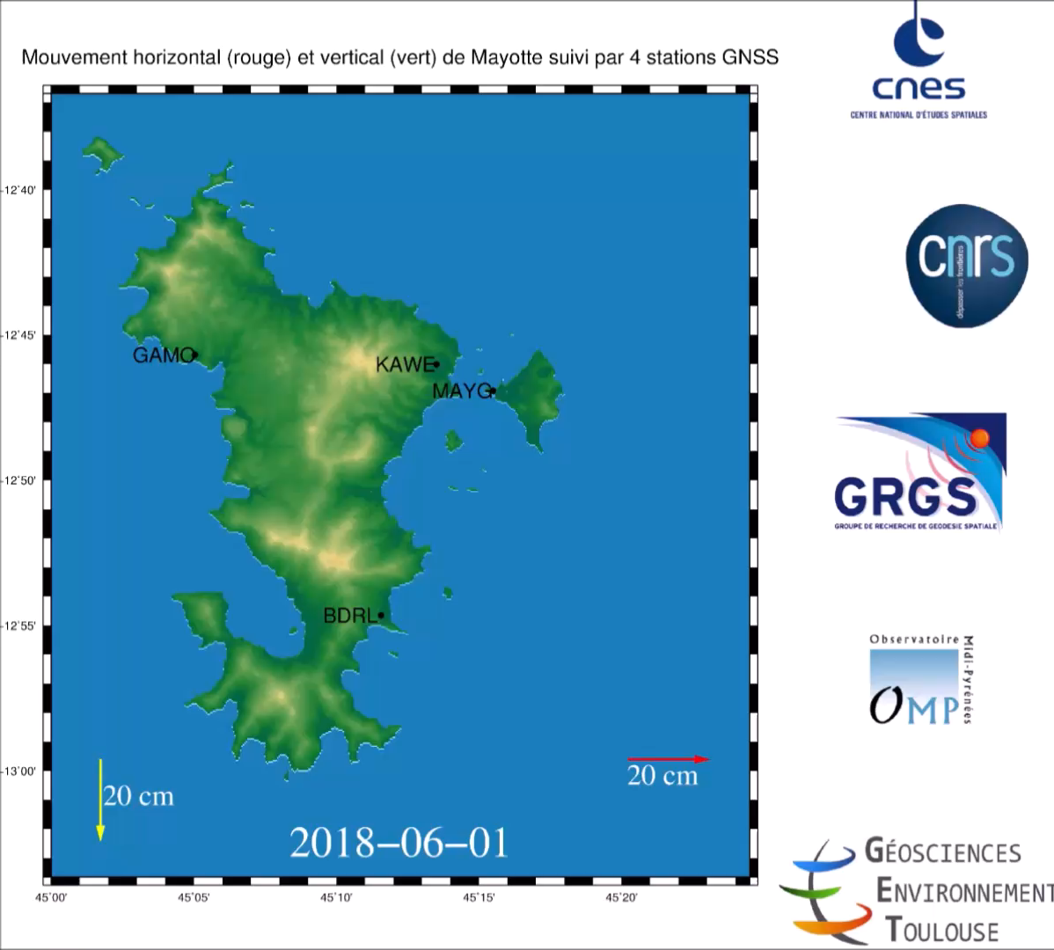
Mayotte Island deformation from GNSS and InSAR data
Seismic crisis starting in 2018
Horizontal and vertical deformation of the Island
Due to the drainage of a deep magma reservoir nearby
Notes:
Cette figure illustre les conséquences de la crise sismique exceptionnelle qui a frappé Mayotte récemment

Slide 5
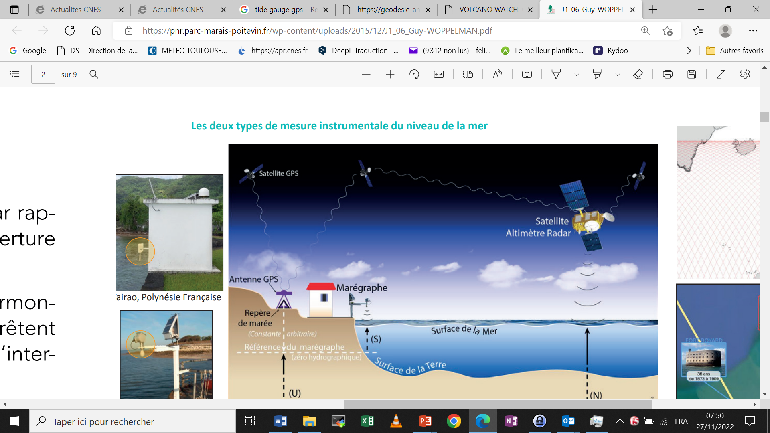
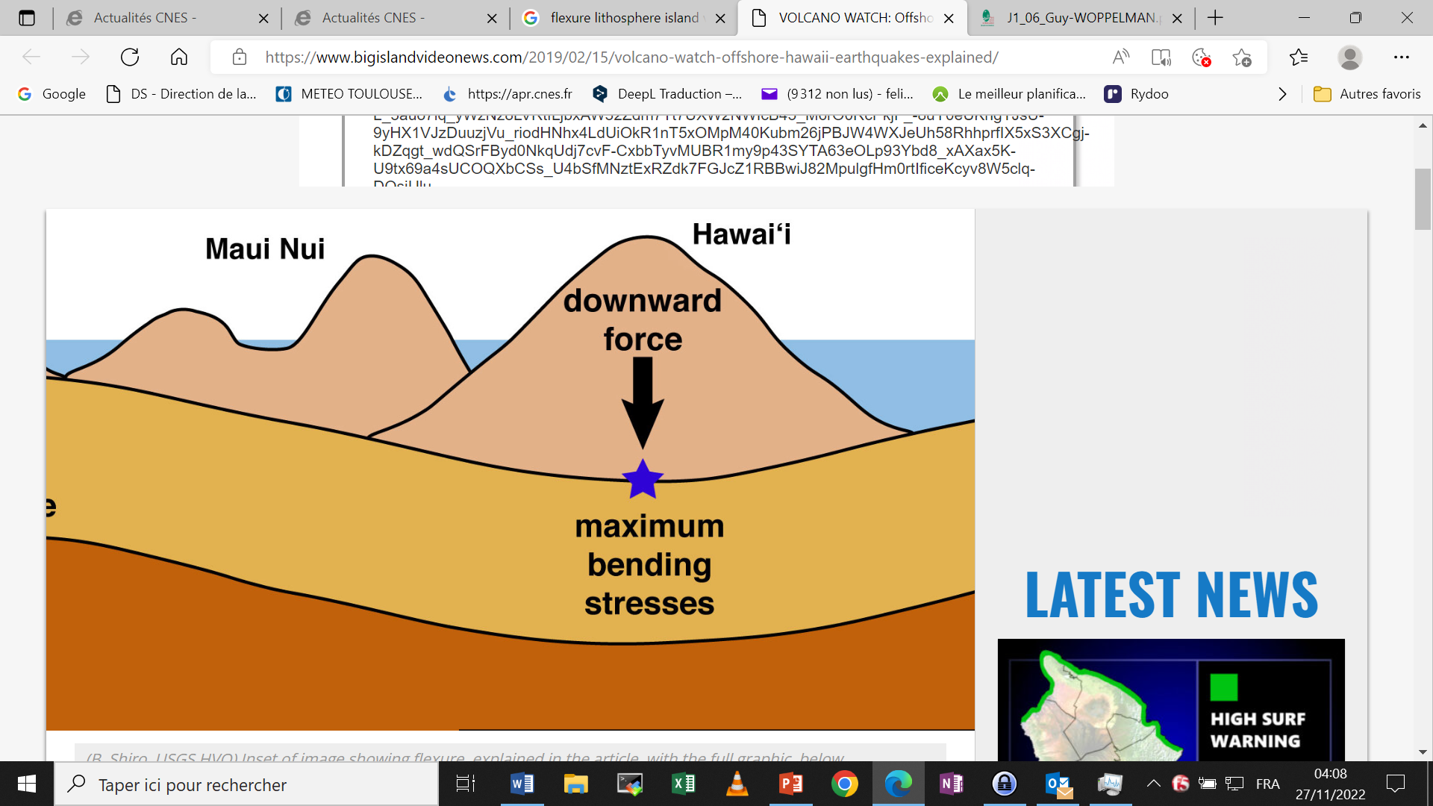
Geodesy and sea level rise
Space altimeter
Coastal areas are affected by:
Sea level rise + vertical land motion
Land motion may originate from :
volcanic subsidence
Anthropogenic activity (mining…)
GNSS receiver
Tide gauge
Subsidence
Lithosphere
Bending
Notes:
2 physical phenomenas

Slide 6
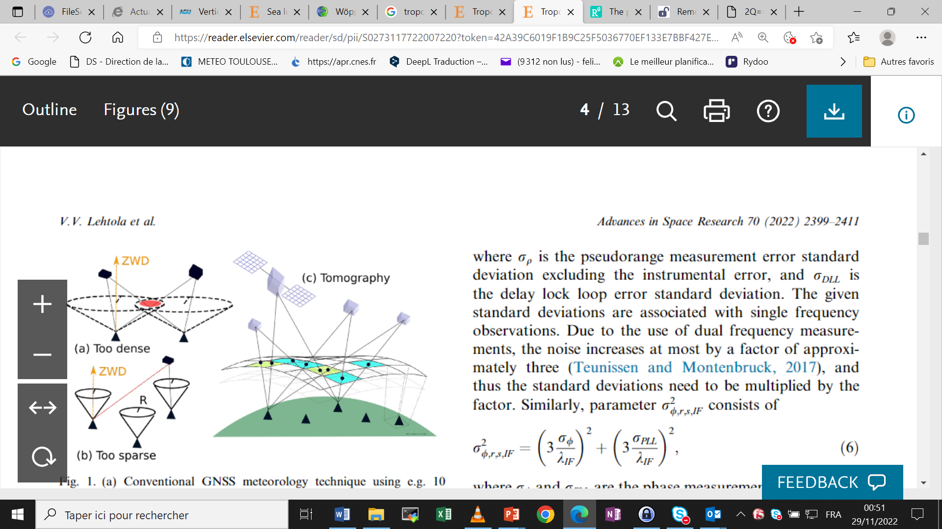
Sounding the atmosphere using a network of GNSS geodetic receivers
GNSS signals are sensitive to atmospheric effects:
In the troposphere (0-40km) the delay is a function of : Temperature, Pressure, Humidity
In the ionosphere (~400km) the delay is a function of the Total Electron Content
A ground network of GNSS helps in doing a tomography of the atmosphere
From V.V. Lehtola et al. ASR (2022)
Notes:
6
Refraction

Slide 7
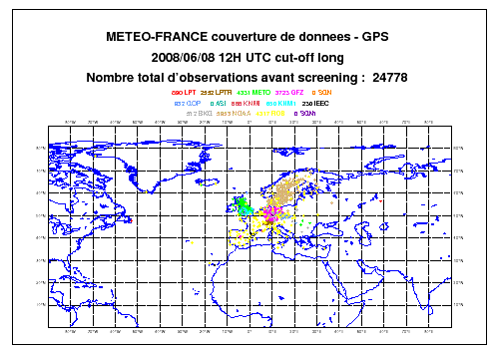
Weather forecast
GNSS data from ground and space receivers are processed to estimate tropospheric delays
assimilated into weather forecast
models for many years
Ground GNSS data
Courtesy Jean PAILLEUX, Météo France
Notes:
7
Using GNSS observations from ground stations and LEO satellites is common for weather forecast agencies

Slide 8
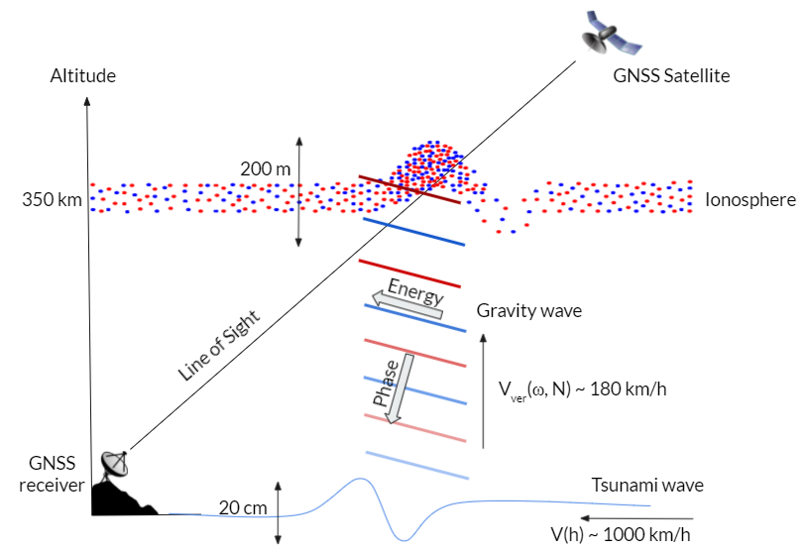
Tsunami signal in the ionosphere
Tsunamis as well as earthquake and volcano eruptions generate a signal into the ionosphere layer
that can be observed using GNSS receivers data
Piercing point
Tsunami signal in the ionosphere can be observer prior the arrival of the oceanic wave
Promising complementary technique to existing operational services based on seismic data + model
Munaibari et al. 2022

Slide 9
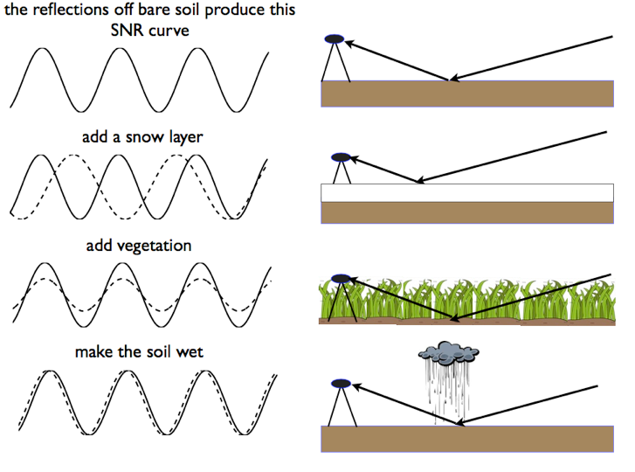
Remote sensing using GNSS Reflectometry (GNSS-R)
GNSS reflectometry is based on the changes in the interference pattern of the direct and reflected signals
This information is recorded in signal-to-noise ratio (SNR) data of a GNSS receiver
Can provide a measurement of a change :
the height of the antenna vs the reflected surface (flood…)
the vegetation
The soil humidity
water layer
Larson et al., 2008; Larson et al., 2009; Small et al., 2010
Notes:
GNSS receivers can also track reflected signals

Slide 10
Conclusion
Space Geodesy contributes to geospatial needs and applications
It is fundamental to:
  Densify geodetic infrastructures
  Maintain existing ones
  Share the data
Geodetic infrastructures:
  Are very useful locally
  Are opportunities for local capacity building and scientific research
  Participate in the international effort (ITRF, global change…)

Slide 11
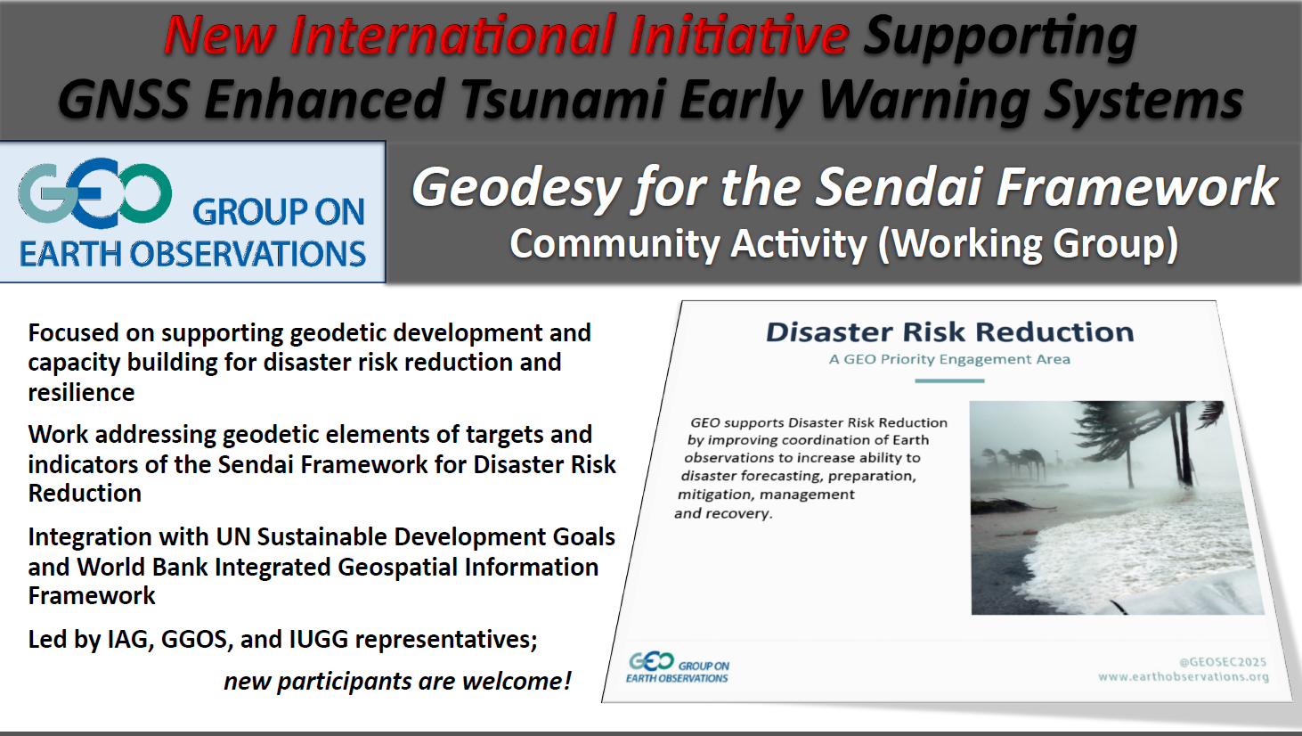
Ionospheric natural hazard early warning system
Existing international initiative involving several key institutions:
the International GNSS Service,
NASA’s Science Mission Directorate
IUGG’s/IAG’s Global Geodetic Observing System
the ITU Focus Group on AI for Natural Disaster Management
Geodesy4Sendai Pilot Initiative
ICG Task Force on Applications of GNSS for Disaster Risk Reduction

