Slide 1

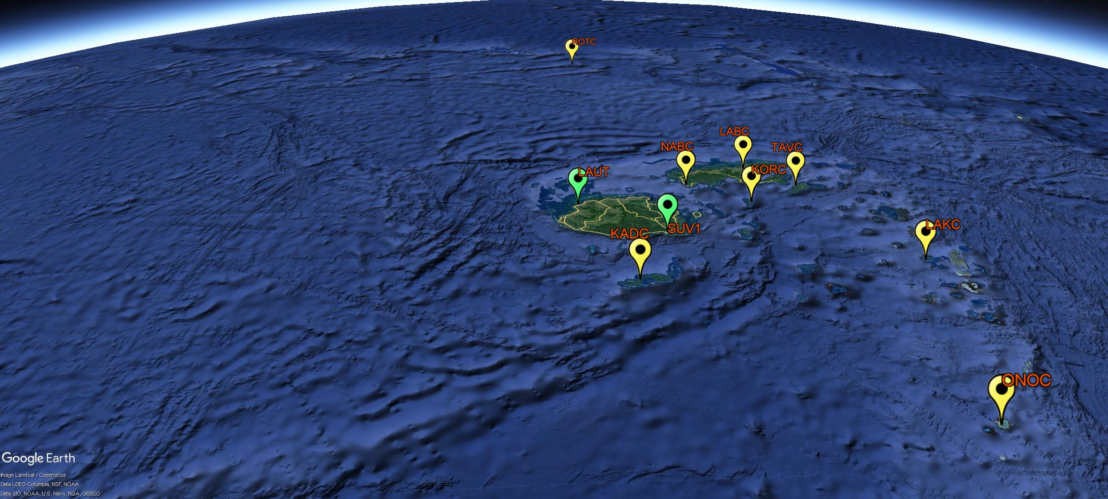




Geodetic Reference Frame of Fiji Islands
Control Section
Ministry of Lands & Mineral Resources
Government of Fiji
Oceans & Maritime Programme
Geoscience Energy Maritime Division
Pacific Community
Notes:
Fiji is an island country in Melanesia, part of Oceania in the Pacific Ocean. It lies about 1,100 nautical miles (approx. 2,000 km) northeast of New Zealand. Fiji consists of an archipelago of more than 330 islands of which about 110 are permanently inhabited and more than 500 islets.

Slide 2
Background
United Nations General Assembly 2015
  Resolution 69/266 – “A global geodetic reference frame for sustainable development”; was adopted in its 80th plenary meeting held 26th February 2015
Pacific Geospatial and Surveying Council Strategy Goal 2 (GGRF)
Cabinet Paper - CP(15) 169; 29th August 2015
Cabinet Decision 207 – Modernising Fiji’s Geodetic Datum; 29th August 2015
National Development Plan (November 2017)
2018-2022 Ministry of Lands & Mineral Resources Strategic Plan
Notes:
Fiji moved the motion at the UN General Assembly 2015 for a global geodetic reference frame for sustainable development and following the regional strategy for the
Pacific Geospatial and Surveying Council Strategy Goal 2; Countries across the region adopt a modern Geodetic Reference Frame (GRF) and improved technology underpinning geospatial systems and applications
And with approval from the cabinet and the national development plan and the Ministry of Lands && Mineral Resources Strategic Plan, the Control Section was able to implement the activities for the Global Geodetic Reference Frame.

Slide 3
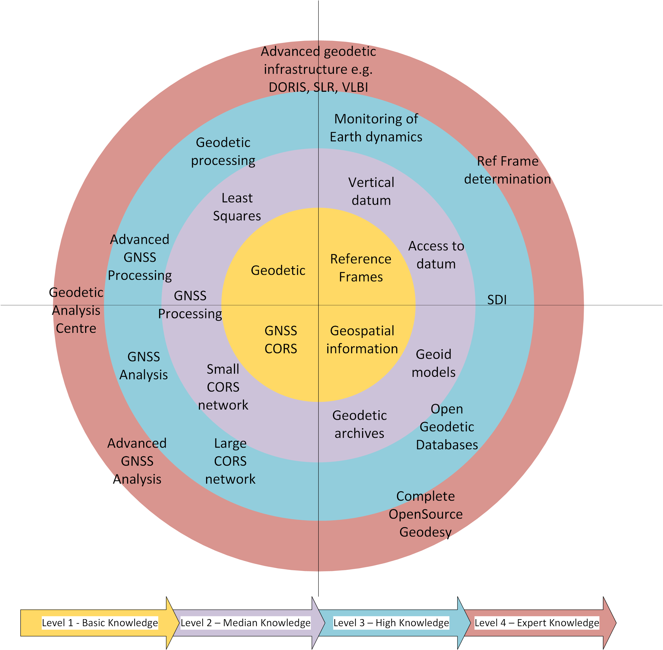
Purpose
Modernise Fiji’s Geodetic Reference Frame
Define the geodetic infrastructure aligned to Global Geodetic Reference Frame (GGRF)
Compatible with IGS and positioning technology
Near real time positioning for disaster risks and hazards
Monitoring Earth dynamics
Enhance geospatial capacity and capability
Notes:
Therefore the purpose of this project is align, adopt, access, compatible, monitor and enhance the Fiji’s Geodetic Reference Frame.
Fiji is currently sitting in the yellow region of the Global Geodetic Reference Target, and the move to purple is in good progress.

Slide 4
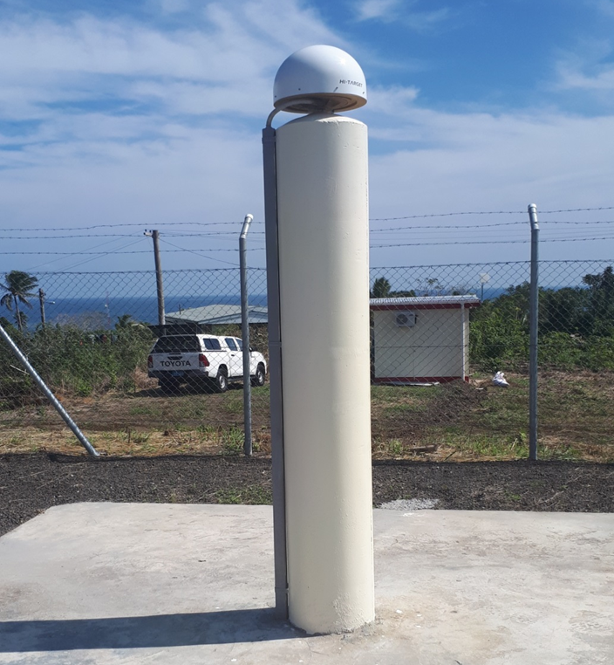
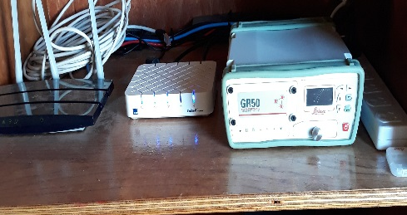
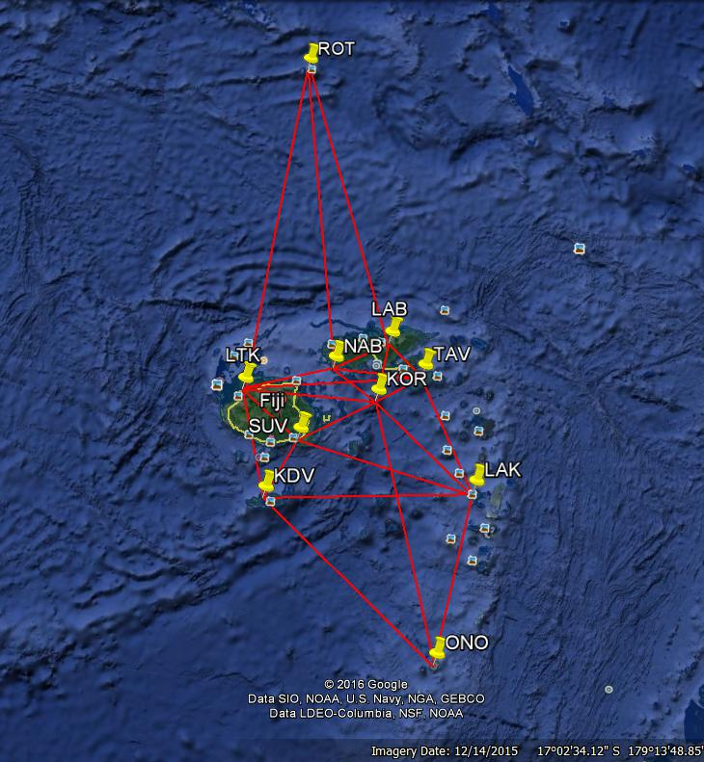
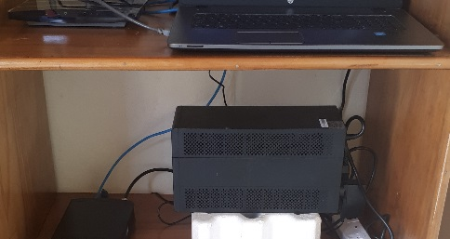
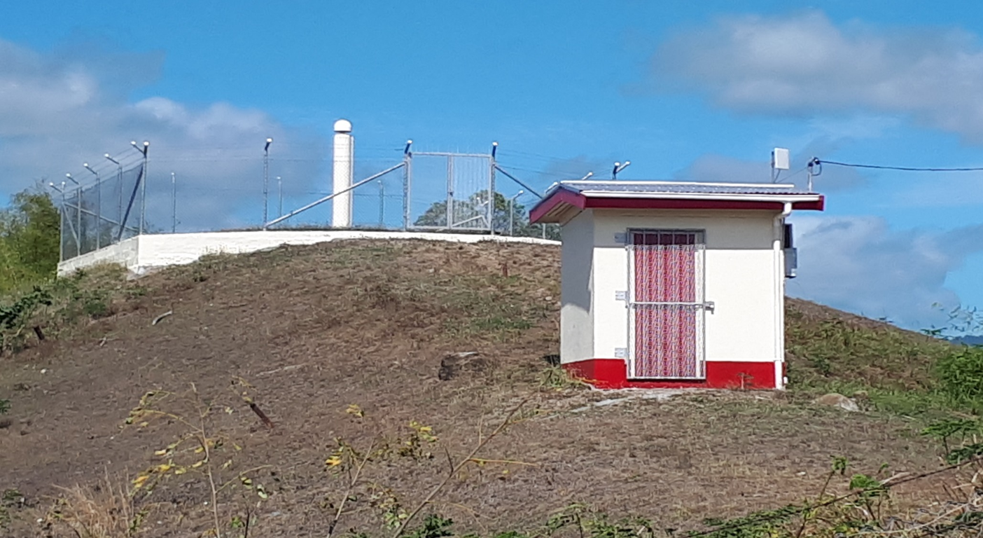
The Geodetic Infrastructure
Notes:
In order to define, establish, implement and the maintain the Global Geodetic Reference Frame, an integral component is the “Geodetic Infrastructure” where through the cabinet endorsement and the national strategic initiatives, eight GNSS CORS stations were established and managed by the Control Section with two additional GNSS CORS managed by Geoscience Australia and the Pacific Community.
The GNSS CORS meets the requirements of an APREF Station and the team is collaborating with Geoscience Australia for secured data sharing options and available for near real time positioning for geospatial applications.
PSLGM GNSS CORS Stations are the ONLY Stations to do this, and as such Fiji GNSS will adopt to align its functions and operations to this regional network and in 2022 will contribute to the regional network, this is possible with good collarborations with Geoscience Australia.

Slide 5
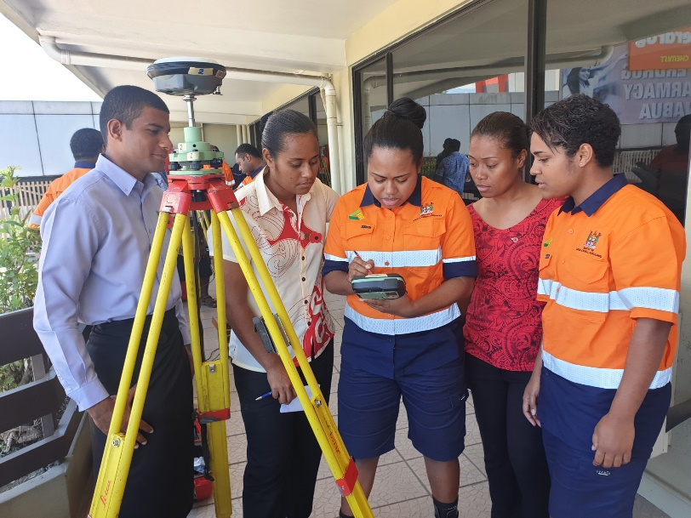
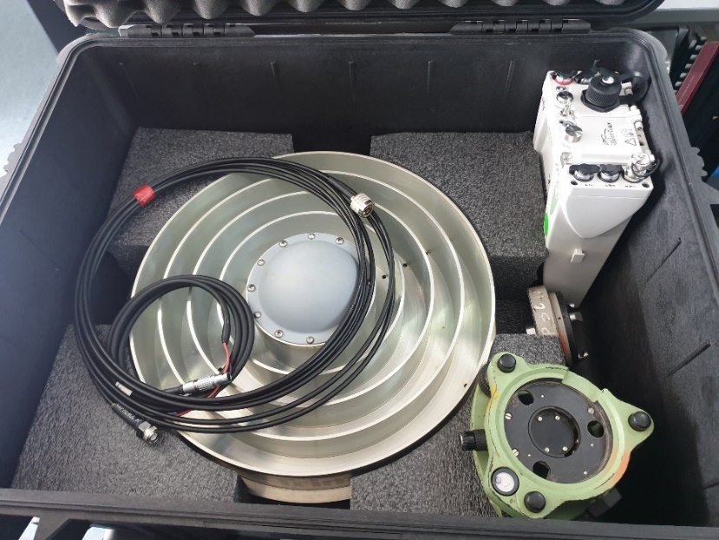
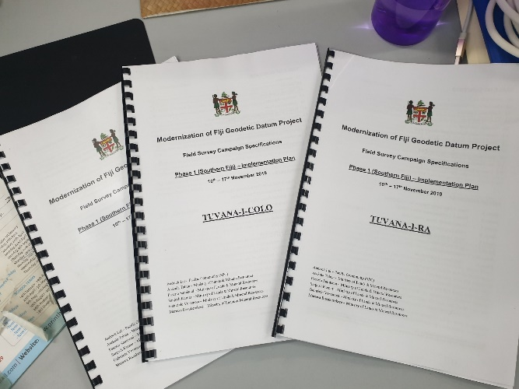
Geodetic Survey Operations
Notes:
65 survey personnel underwent Two-day Survey Operations Training coordinated by the PGSC partnership desk, as you could see, some of our female surveyors operating a Leica GS16.
Also 7 GPS Units was handed to SPC from Geoscience Australia for the PGSC members to be used for geodetic survey campaigns.
An operational manual and video was given to all the field parties.

Slide 6
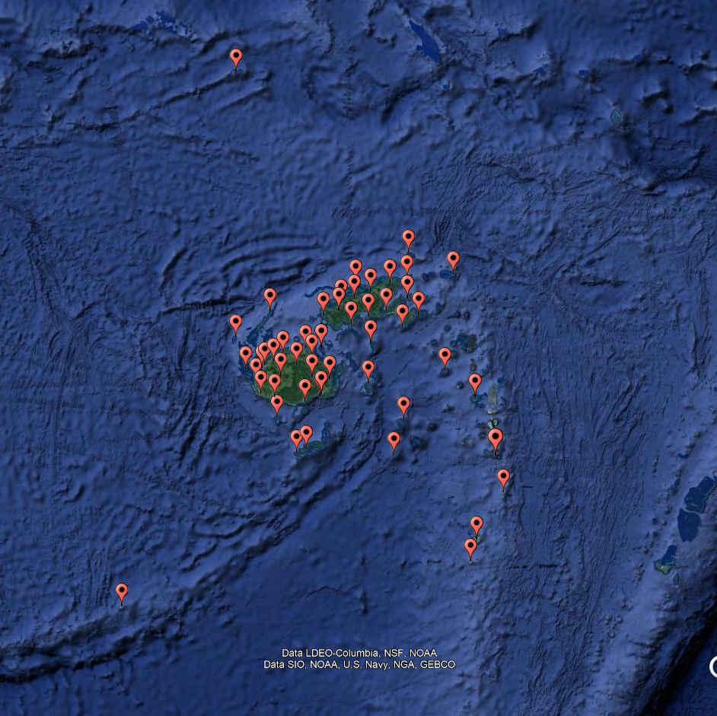
Geodetic Survey Activities
Three Phases
  10-16 November 2019
  7-15 December 2019
  26 January – 2 February 2020
GNSS Static Occupations
  51 Stations – 7 days
  104 Stations – 6 hours
  43 Stations – 1 hour
Survey Personnel
  65 (Surveyors/ Technicians/ Survey Assistant/ Casuals)
Survey Equipment
  Trimble (16) and Leica (11)
Transportation
  Naval Vessels/ Local Ferries/ Vehicles
Notes:
To define the geodetic reference frame, the geodetic network was operationalised with the existing geodetic stations occupied and new stations established.
Three phase geodetic survey campaigns was completed with 7-day occupation for 50 stations, 104 stations for 6 hours and 43 stations for one hour.
Total of 65 Survey Personnel from the Fiji Survey Office, Hydrographic Office and SPC, were deployed in the three phases.
Trimble and Leica Survey grade GPS/GNSS equipment were used to occupy the geodetic stations.
As for transportation, Naval Vessel with the crew were engaged, with local ferries used within the archipelago for the survey teams to outer islands. On main islands, vehicle was used predominantly.

Slide 7
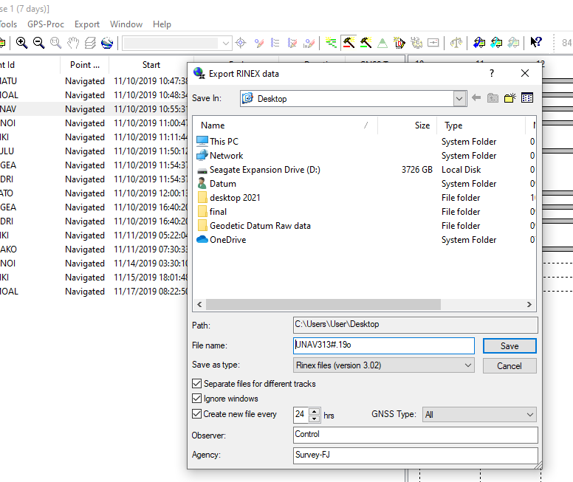
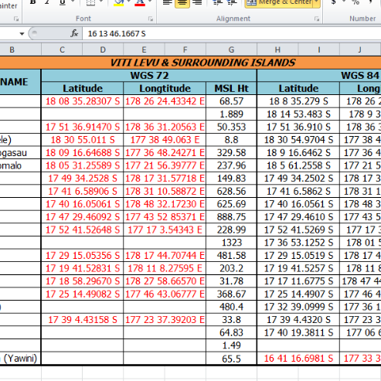
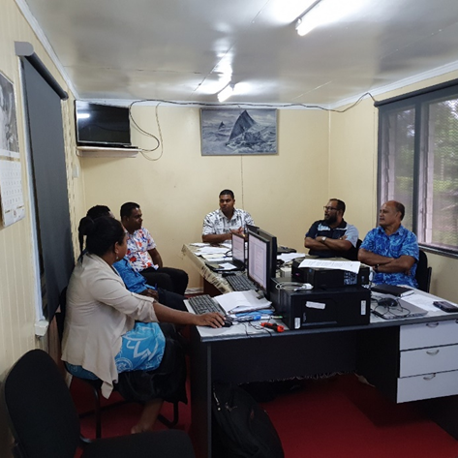

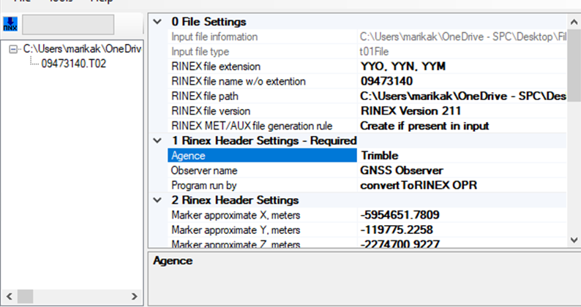
Geodetic Survey Data Preparations Capacity
Data Storage
Data Downloading
Data Conversion
Data format
GNSS Occupation Summary
Locality Diagrams
Field Survey Sheets
Data Source
Check and verify meta data
Notes:
Three Surveyors from the Fiji Survey Office were attached to SPC from Ministry of Lands & Mineral resources from 22nd March but after lockdown in April 2021, the work was done with online collaborations between the SPC Geodetic Team and the Control Survey Office Staff.
After the completion of the field surveys, Survey data was prepared for downloading, storage, conversion, and format.
All geodetic stations occupied during the survey campaign was defined, verified and validated.
All field survey sheets and locality diagrams were drawn in order for checking the meta data.

Slide 8
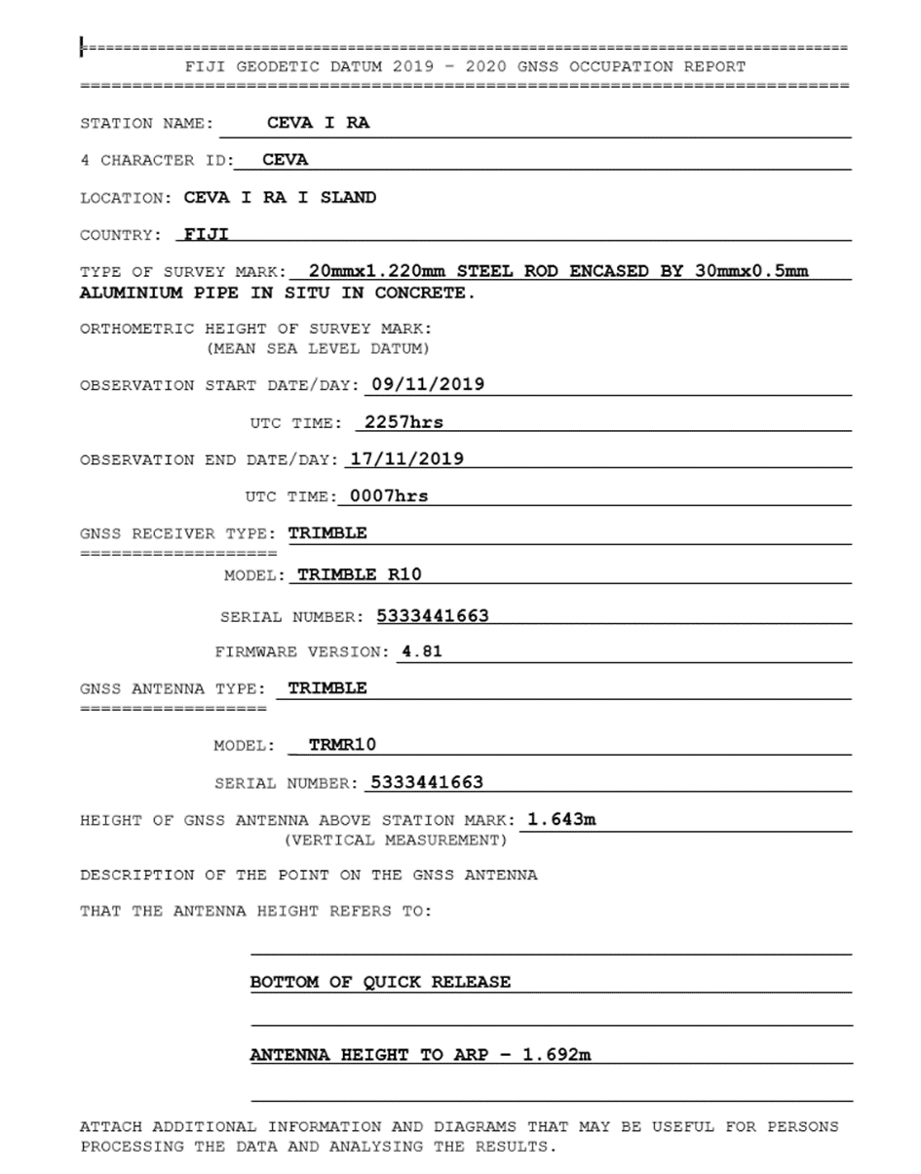
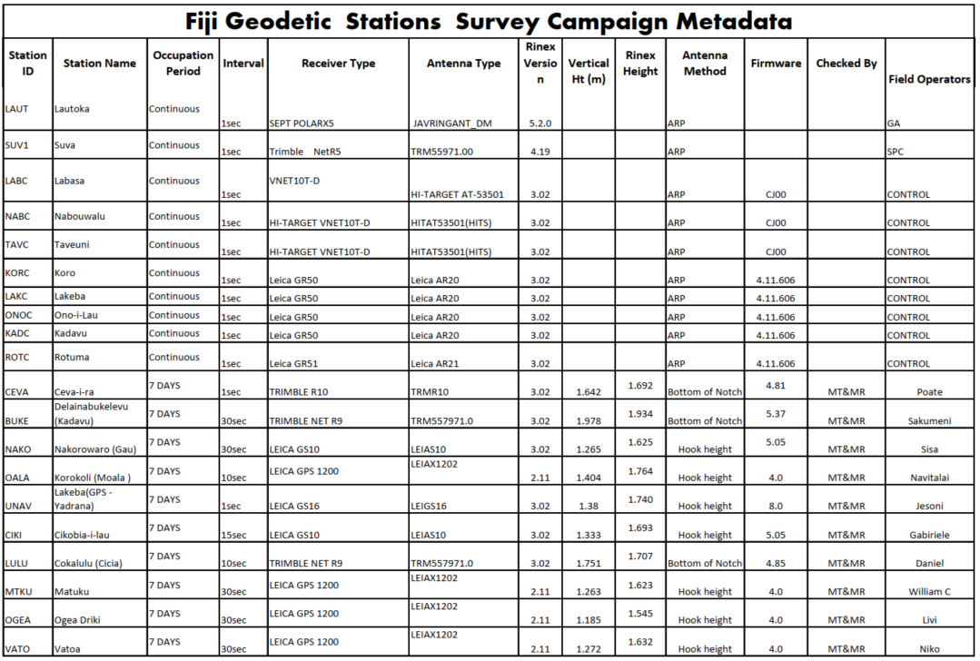
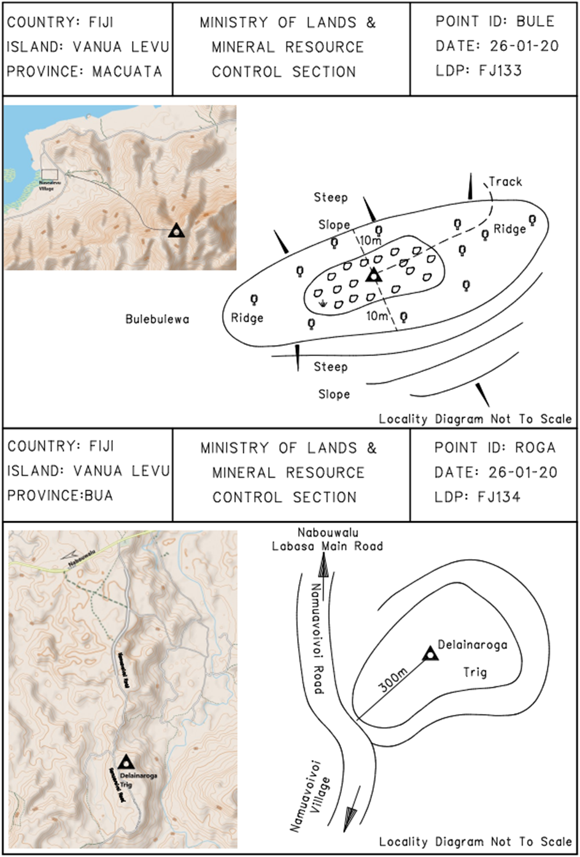
Geodetic Survey Data Preparations
Notes:
These are examples for Survey Campaign Meta data, Occupation Summary, Locality diagrams and field survey sheets.

Slide 9
Data Release Report
Notes:
A 310 pages of Fiji Geodetic Datum Data Release Report was published.

Slide 10

Benefits
Operational Capacity
Processing Capacity
Data Storage
Data Sharing
Data Downloading
Data Conversions
GNSS CORS maintenance and infrastructure
Data accessibility
COVID-19
Notes:
Some benefits identified during the campaign was individual operator capacity still lacked, the survey team lacked data processing skills.
As for data storage, downloading, conversions and accessibility, resources were limited.
And then due to COVID-19, there were delays in data compilation.

Slide 11

Country Workplan
Survey Data Processing and Analysis
Survey Results
Transformation Parameters
Transformation Tools
GNSS CORS infrastructure maintenance plan
Data Sharing and management
Capacity Building
More collaboration efforts
Monitoring GNSS CORS
Definition – Vertical Reference Frame
Notes:
The survey team in collaboration with regional anticipates to incorporate activities such as:-
Data Processing and Analysis
Publish results for the field survey campaign
Define Transformation Parameters from Local reference system (Fiji Map Grid 1986 to ITRF)
Develop Transformation Tools for use by the surveyors and geospatial experts.
Enhance the GNSS CORS infrastructure maintenance plan
Have a platform share and manage the data sets
Build and sustain good capacity in geodetic surveys
Engage collaboration with international, regional and national agencies
Monitor GNSS CORS for earth deformations
Establish link with the GNSS CORS to define the Vertical Reference Frame

Slide 12
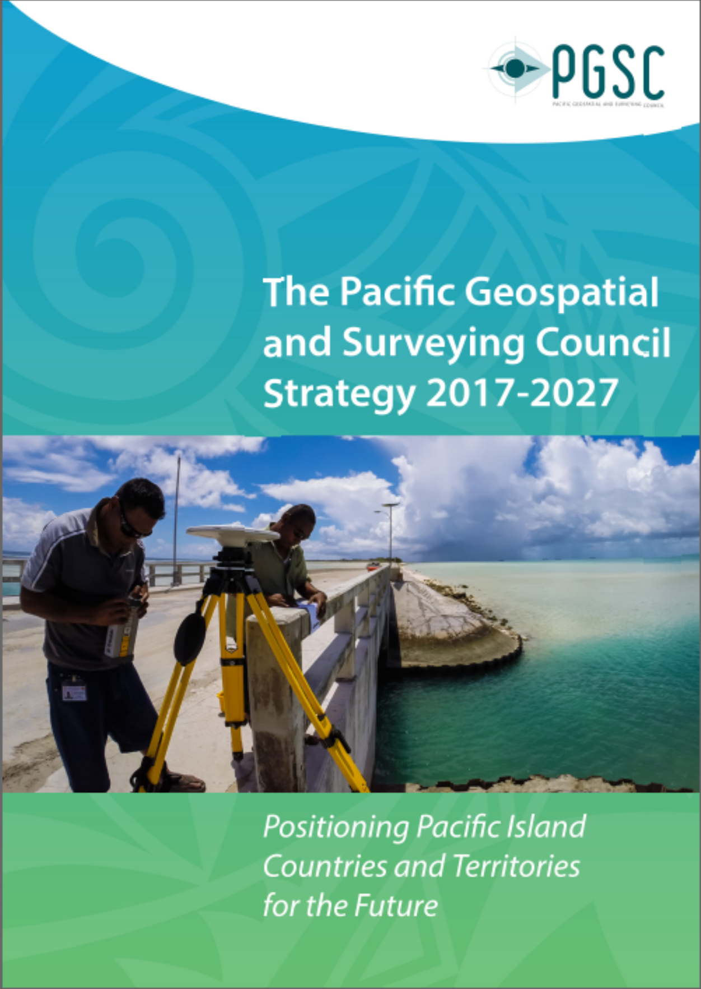
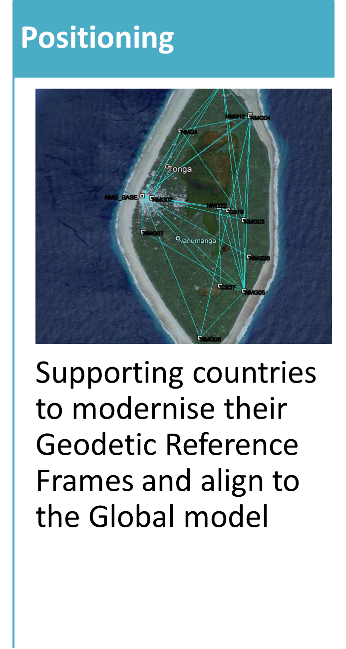
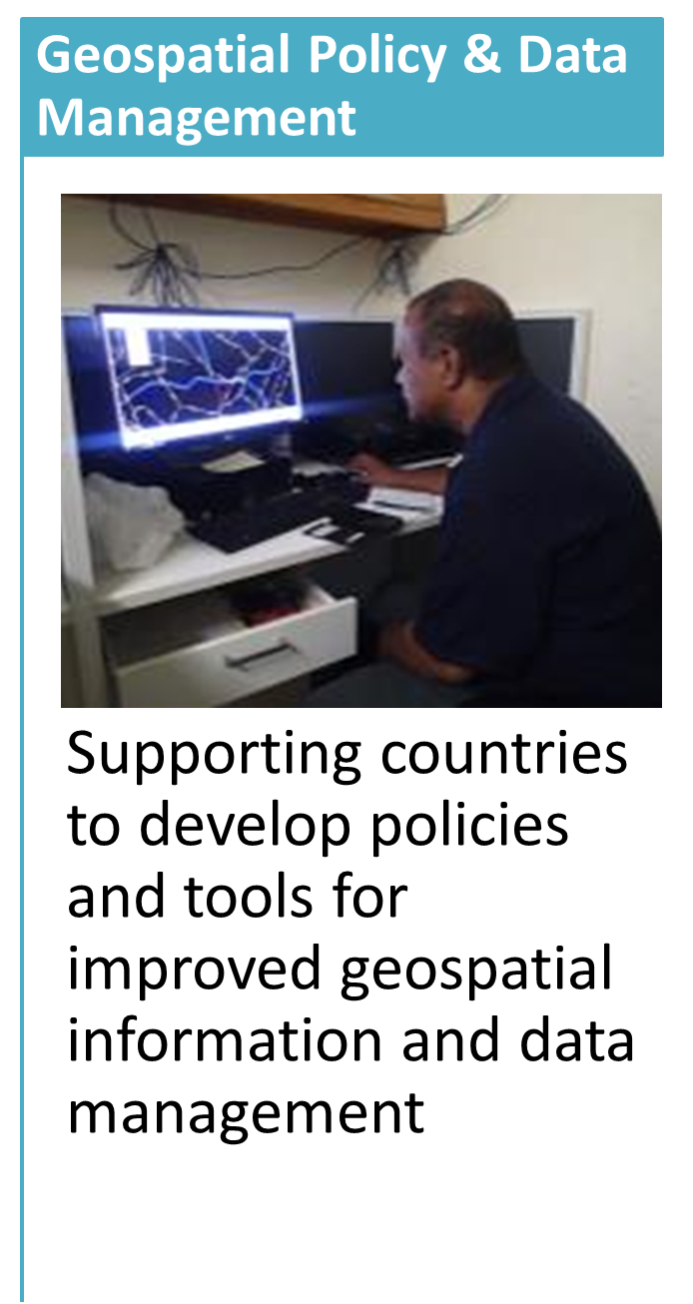
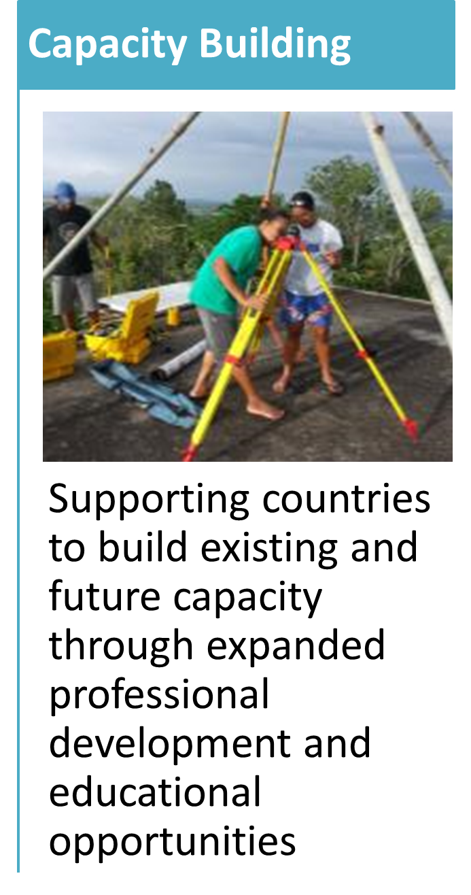









Regional Collaborations
Notes:
All of this possible only with good coordination and good collaboration; and on behalf of the Fiji government, I would like to acknowledge the Pacific Geospatial & Surveying Council, the SPC Partnership Desk supported by COSPPac, Geoscience Australia, LINZ, SSSi, S+SNZ, UKHO, USGS, FIG, UN-GGIM, UNOOSA and USP.
PGSC and the partnership desk would like to focus more on the functionality and the operationalisation of its working group.
The PGSC Strategy mid term review will be carried out this year together its Council Meeting in July 2022.

Slide 13
Vinaka and Thank You

