Slide 1
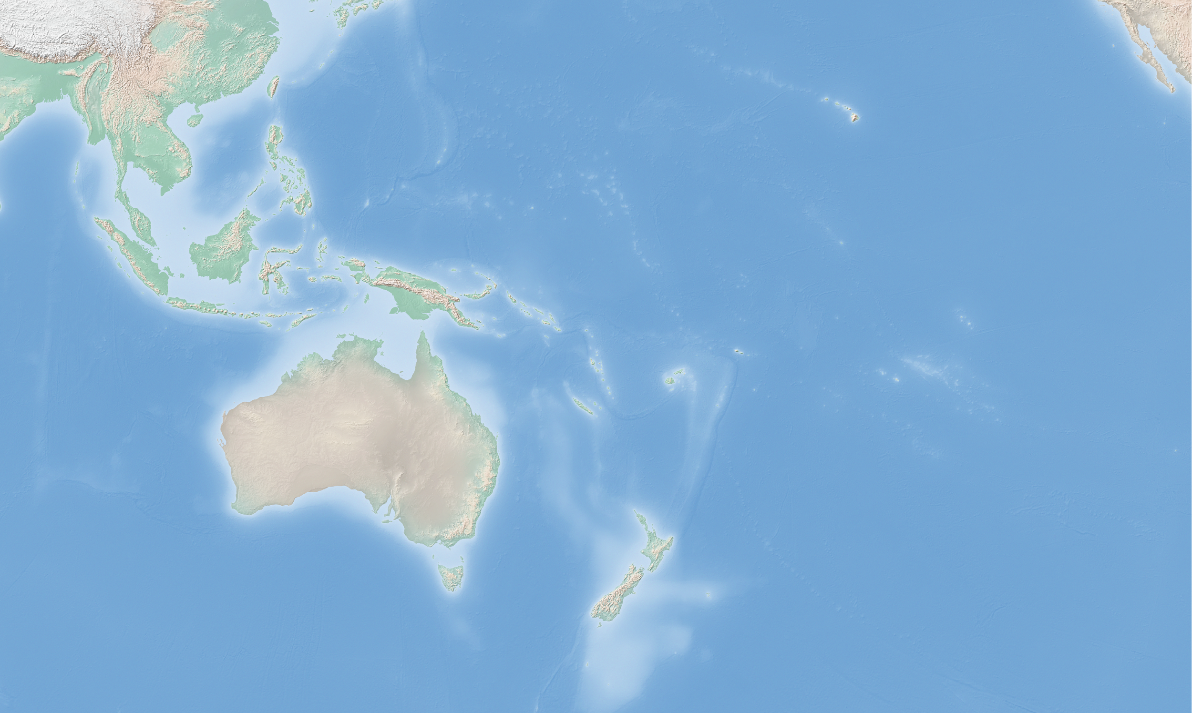
A worldwide community for open source geospatial
Made with Natural Earth. Free vector and raster map data @ naturalearthdata.com, rendered in QGIS.
Adam Steer, Oceania Geospatial Symposium, Noumea, New Caledonia, 2 December 2022

Slide 2
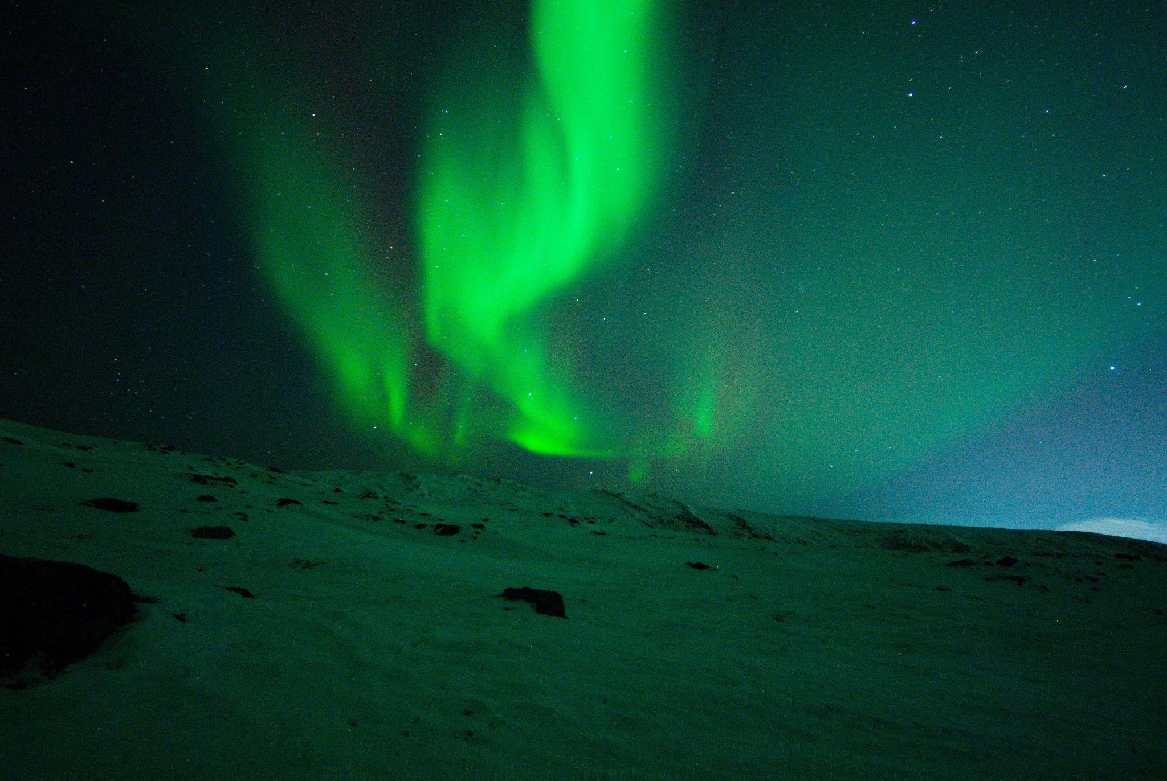
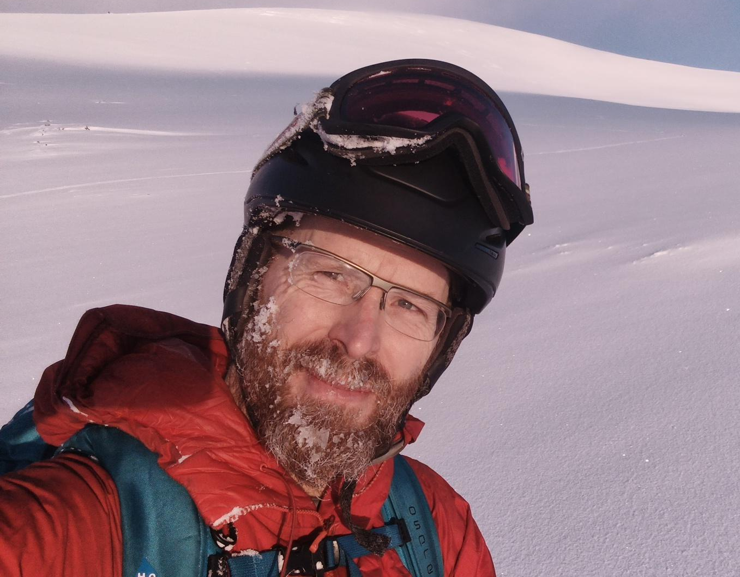
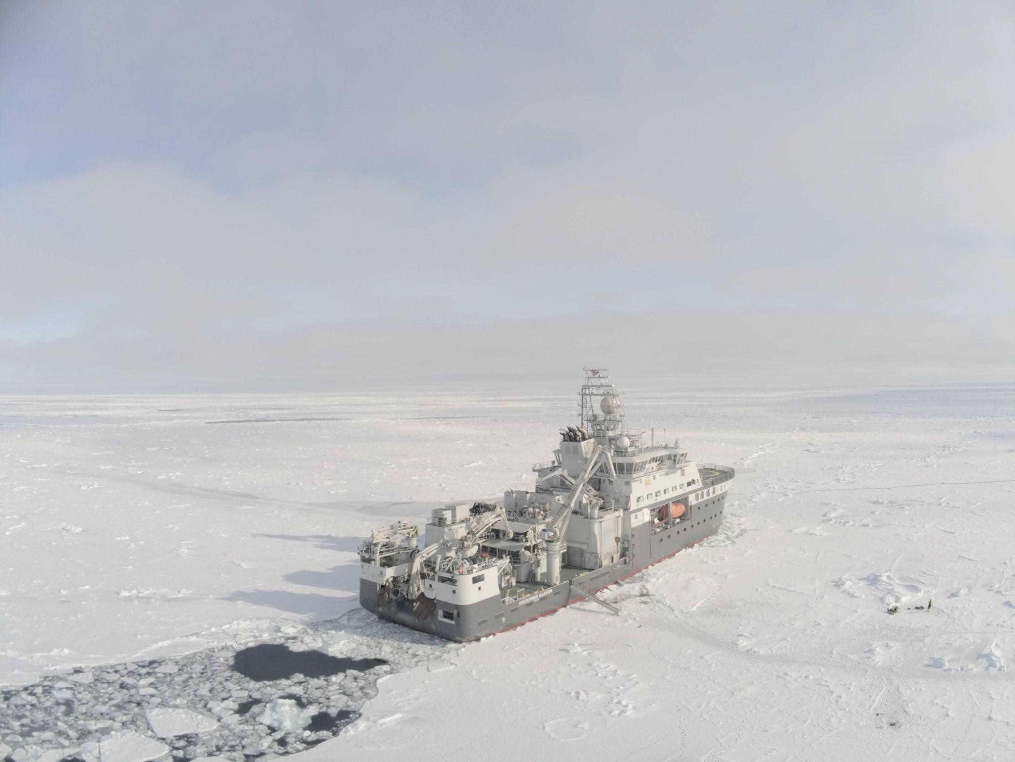
Salut! Hi! Hei!
Dr Adam Steer
Director @ OSGeo, 2022-2023 Director @ OSGeo Oceania, 2018-2020 Open source geospatialist since around 2005, starting with Generic Mapping Tools!
Polar researcher, geospatial consultant, drone pilot, open source advocate, mapmaker. Currently based in Tromsø, Norway.
www.osgeo.org
Adam Steer, Oceania Geospatial Symposium, Noumea, New Caledonia, 2 December 2022
Notes:
About me… at the time of writing working in Tromsø, Northern Norway, working on Arctic sea ice. Photos are Aurora Borealis (top), the Norwegian research icebreaker RV Kronprins Haakon in pack ice at about 82 degrees north (bottom left), and myself out ski touring near Tromsø (right)

Slide 3
Everything up front to explore yourselves
www.osgeo.org
www.osgeo-oceania.org
A quick overview of open geospatial communities in Oceania: https://tinyurl.com/y3rj4zrt
-John Bryant, Mammoth Geospatial, for Pista Ng Mapa 2022
www.osgeo.org
Adam Steer, Oceania Geospatial Symposium, Noumea, New Caledonia, 2 December 2022
Notes:
The one slide summary! Links to OSGeo, OSGeo Oceania, and finally a lighting talk by John Bryant about open geospatial communities in Oceania. I'm going to speak mainly about a global community, i invite you to also scan john’s summary while I'm talking.

Slide 4
What is OSGeo?
The Open Source Geospatial Foundation (OSGeo) is a not-for-profit organization whose mission is to foster global adoption of open geospatial technology by being an inclusive software foundation devoted to an open philosophy and participatory community driven development.
www.osgeo.org/about/
www.osgeo.org
Adam Steer, Oceania Geospatial Symposium, Noumea, New Caledonia, 2 December 2022
Notes:
What is OSGeo? This is the opening statement from our about page, which sums us up. How do we do this? OSGeo is a nonprofit company registered in the USA, which serves as a collective asset for the community to gather and distribute resources as the community needs. In short, we are the bankers for a global, diverse, community of open source geospatial developers, users, advocates. We also provide ongoing maintainability - we are a legal entity which can take ownership of open source projects to ensure they work with a strong governance model and a stronger chance of sustainability. In short we mitigate the risk of a business decision wiping out years of work, and ensure that tools are maintained for community benefit in the long term.

Slide 5
FOSS4G: Free and Open Source Software for Geospatial
www.osgeo.org
Adam Steer, Oceania Geospatial Symposium, Noumea, New Caledonia, 2 December 2022
Notes:
What do we do? Here are some example OSGeo projects that are hosted by OSGeo, at least partly funded by OSGeo, and have met some criteria around a governance model aimed at long term sustainability
These support a lot of geospatial infrastructure is open source - from low level geodetic transformation (Proj) to desktop GIS (QGIS) to cataloguing (GeoNode) to web mapping (leaflet / openlayers)

Slide 6
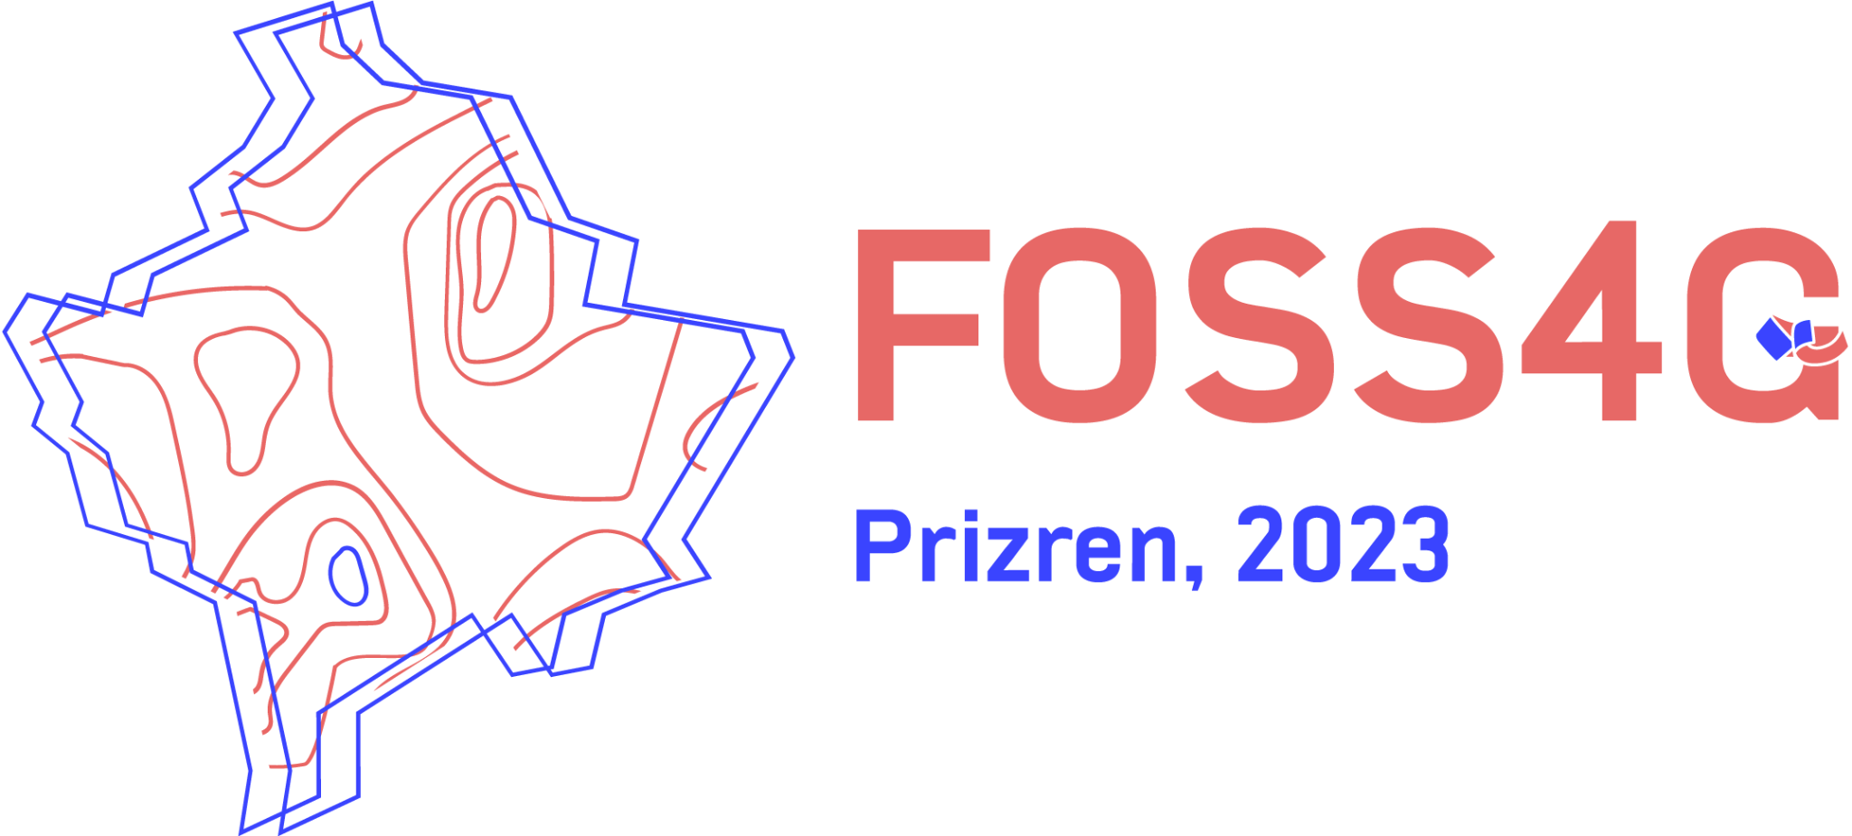
FOSS4G: a global conference series
Reproduced with permission from Codrina Ilie, The story of a compass.
Perspective on creating successful OS communities.Open Innovation for Earth Observation Programs,
www.osgeo.org
Adam Steer, Oceania Geospatial Symposium, Noumea, New Caledonia, 2 December 2022
Notes:
What else do we do? Seed fund th global FOSS4G conference series. OSGeo supports FOSS4G, a global conference on open source geospatial software and applications. It’s been running since 2006! In 2023, the global event will be in Prizren, Kosovo. It's our main funding source.
We also support travel.grant funding for conferences.. importantly each event is organised locally, OSGeo seed funds each event, takes on the financial risk. The rest? Mainly determined by a self-organised local committee with support/guidance from OSGeo as needed.

Slide 7
OSGeo provides a model for leadership
Leads with open-ness and transparency
Everything operates under a code of conduct
Aims for representation at all levels
Sets culture.
www.osgeo.org/about/code_of_conduct
www.osgeo.org
Adam Steer, Oceania Geospatial Symposium, Noumea, New Caledonia, 2 December 2022
Notes:
What else do we do? We innovate on open governance. OSGeo sets culture.
We don't just say “were nice” , we write down and commit to it. If this is uncomfortable, then take it on, it's how we any the world to be.
We heard how women have to put themselves out of their comfort zone in geospatial. So I ask the men, people in majority groups, people who hold privilege power, to put themselves out of their comfort zone.come to the table, do some work. Be outspoken, take risks, open doors for change, don't make other people do all the work. OSGeo has had strong gender-diverse representation at board level for some years, first female president in 2016
We're also not perfect - we got work to do - no female director nominees in 2022 meaning only 2/9 directors in 2023 will not be men! We do have one candidate from Argentina, so we expand our regional diversity a bit. Language around where we host FOSS4G events is very north centric (Europe, Asia, rest of world - what?)

Slide 8
What does OSGeo look like?
Community
[you!]
Members
www.osgeo.org/community/members/
Charter members
www.osgeo.org/about/charter-members/
Board / officers
www.osgeo.org/about/board/
Committees
www.osgeo.org/about/committees/
Initiatives
www.osgeo.org/initiatives/
Projects
www.osgeo.org/projects/
Local chapters
https://www.osgeo.org/local-chapters/
Sponsors
www.osgeo.org/sponsors/
Partners
www.osgeo.org/partners/
www.osgeo.org
Adam Steer, Oceania Geospatial Symposium, Noumea, New Caledonia, 2 December 2022
Notes:
The parts of OSGeo. All of them interact - the community is everybody interested in open geospatial tools and software - and its applications. Members are people who listed themselves as members. Charter members are nominated by members, and voted on by other charter members. These are akin to ‘voting members’, they can nominate for directorship, and vote for directors. The board is elected by charter members. Committees are where the action is - the board delegates most functional power to committees to get things done. Initiatives are relatively independent things OSGeo members want to do - again, they make their own decisions. Projects are a core product of OSGeo - software projects which have passed through an incubation / mentorship process, meet defined quality standards, have healthy communities around them, have a code of conduct, are run in a modern version control system, accepts contributions, has a formalised governance structure, are licensed properly, have quality documentation and release procedures. Community projects identify with OSGeo and have fewer requirements - have a code of conduct, have documentation, have an open source license, are version controlled, accept contributions
Local chapters are regional organisations run independently of OSGeo, which formally represent OSGeo and meet requirements around promotion of open source geospatial and community building.
Sponsors are financial supporters of OSGeo! Very important! Partners are organisations which OSGeo has entered into a memorandum of understanding with. These usually mean we agree to support open source software communities, support each other’s activities, cross promote events, and in some cases support delegates at each other’s events. Some (for example with OGC) tie closer bonds, and involve some work from both parties on collaborative projects.

Slide 9
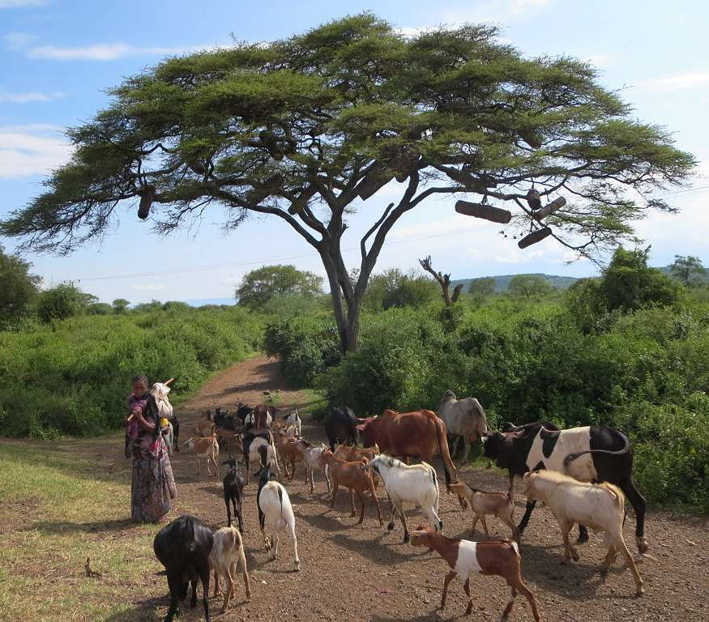
OSGeo is like a tree
All parts are needed!
All parts interact and support each other!
Leaves and flowers: things people do, users, advocates, outputs
Trunk: board, committees, charter members
Roots: developers, maintainers
Provides shelter for new communities which spring up
Provides services to a larger community!
David Stanley: https://www.flickr.com/photos/79721788@N00/with/11527335486/
www.osgeo.org
Adam Steer, Oceania Geospatial Symposium, Noumea, New Caledonia, 2 December 2022
Notes:
The OSGeo community is like a tree. It a healthy state it is nourished by the roots (software builders actually building and maintaining, volunteers supporting OSGeo infrastructure maintenance), supported by the trunk (people doing other core work, documentation) and needs its leaves and flowers (user cases, people doing amazing things with the tools). In this state it can sustain itself, grow, and help seed new sub-communities around it.

Slide 10
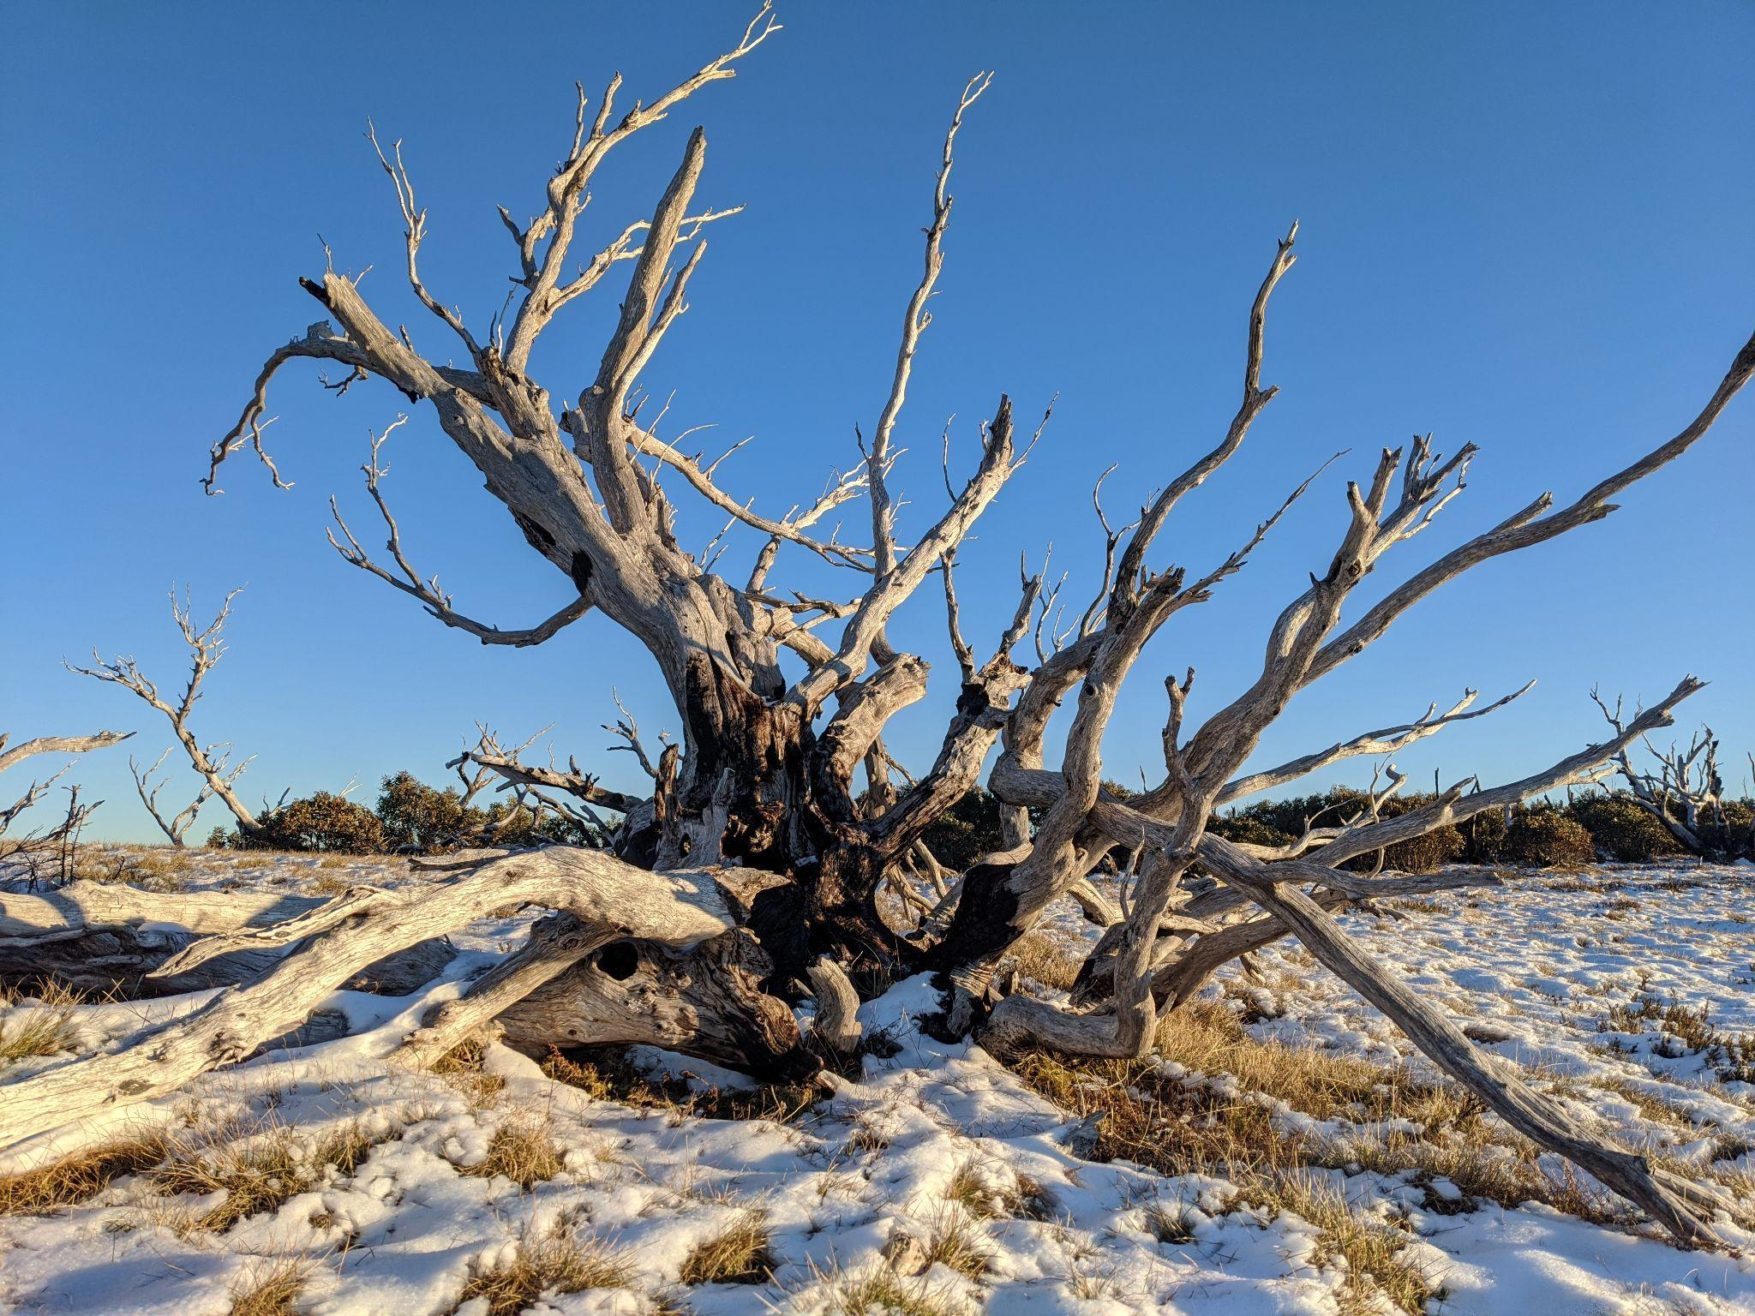
OSGeo is firewood
Remove the community, and the organisation OSGeo is only firewood*
*with apologies to dead trees, who are far more than firewood!
www.osgeo.org
Adam Steer, Oceania Geospatial Symposium, Noumea, New Caledonia, 2 December 2022
Notes:
The structure of the OSGeo organisation is only the cellulose, lignin. Without the community, it is only so much firewood…

Slide 11
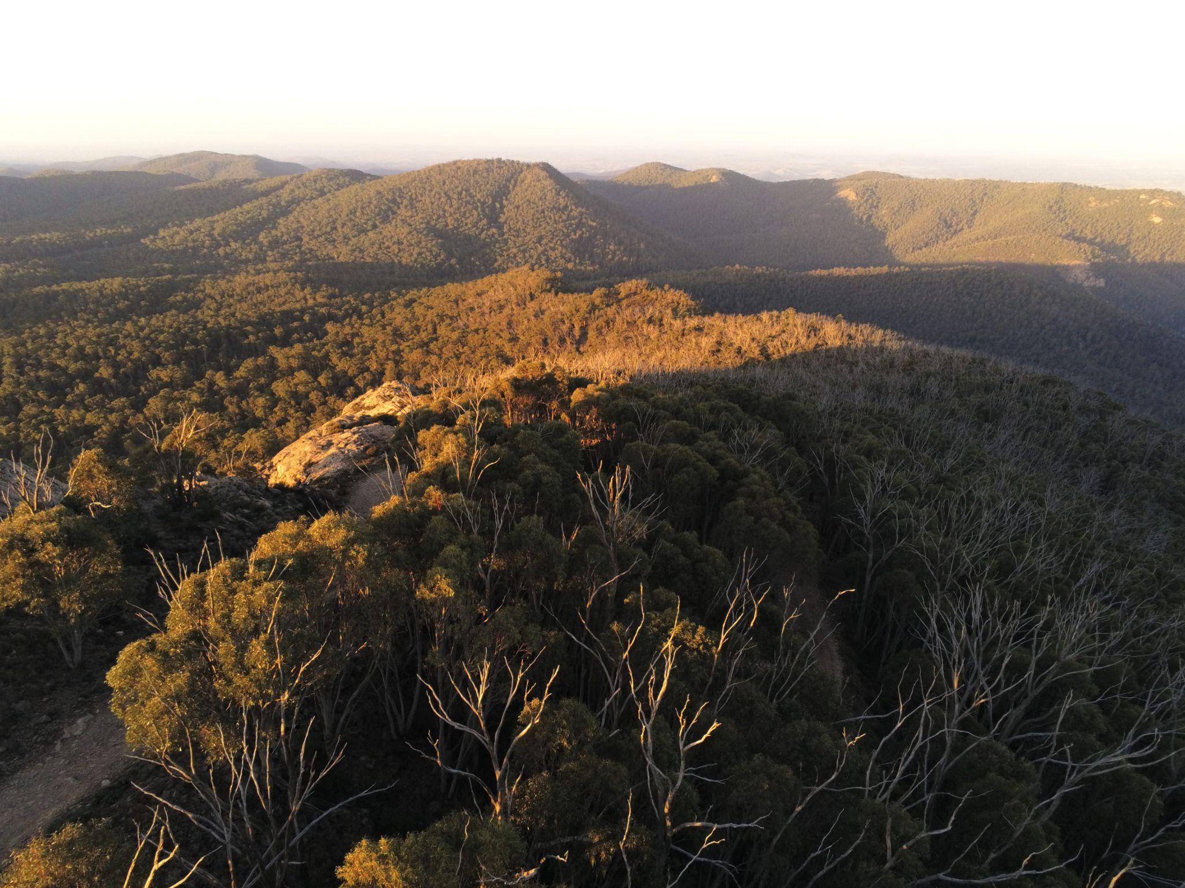
A tree needs a forest
OSGeo is a tree in a forest. It needs its support trees - related organisations and communities. A resilient geospatial forest needs a diverse community of organisations at all stages of life. Each organisation is the structure for the community around it!
www.osgeo.org
Adam Steer, Oceania Geospatial Symposium, Noumea, New Caledonia, 2 December 2022
Notes:
Trees can function on their own. They still need a forest. OSGeo needs to keep a forest around it, connecting to other organisations

Slide 12
[some of] the OSGeo forest
https://wiki.osgeo.org/wiki/Category:MoU
www.osgeo.org
Adam Steer, Oceania Geospatial Symposium, Noumea, New Caledonia, 2 December 2022
Notes:
One way of getting support trees is memoranda of understanding - agreements between OSGeo and its community. These set out ways the different groups support each other. MoUs are not essential for cooperation! another way in which we build the forest is declaring support for aligned organisations within the communty - for example we are a supporting organisation of GEO! OSGeo depends on organisations like the Open Source Initiative, some projects are also supported by NUMFOCUS, OSGeo sponsors are also part of the supporting forest - and anyone who funds people to work on OSGeo projects and initiatives. We feel this forest is pretty healthy - and recognise it still needs nurturing, we are always out there in the woods,

Slide 13
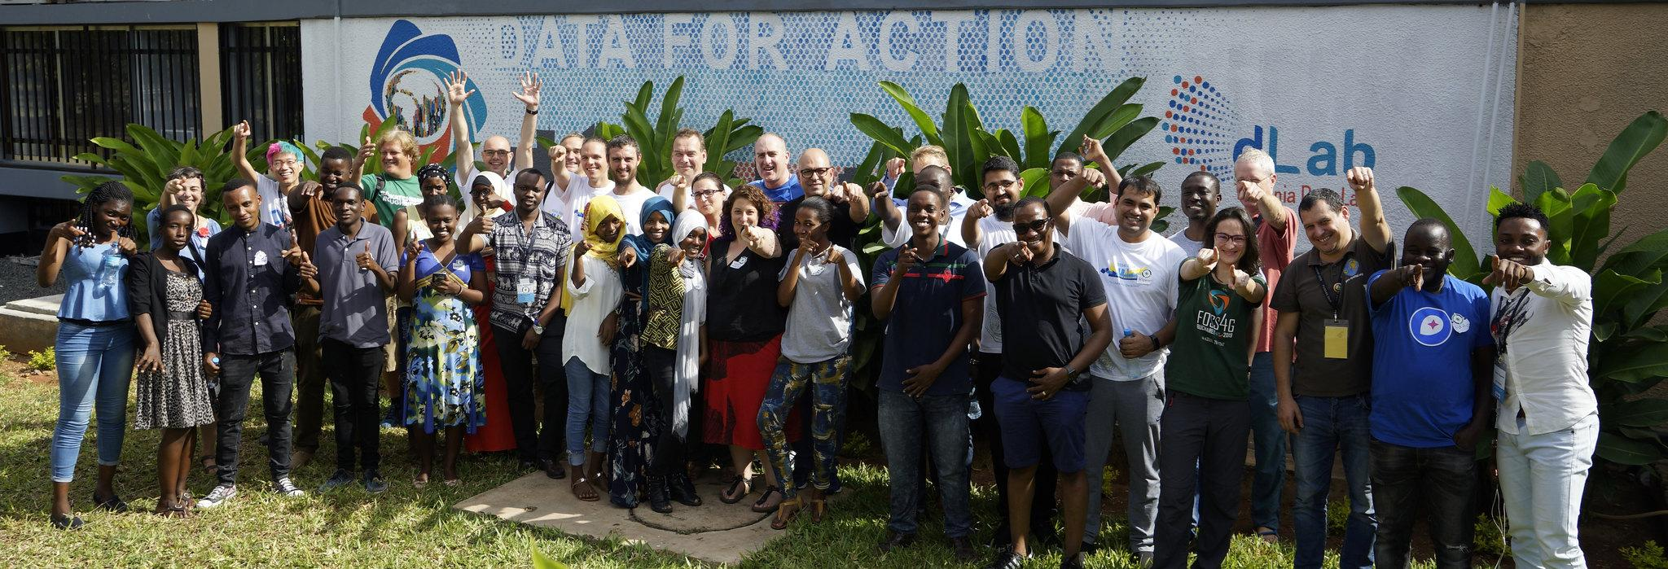
What kind of tree is OSGeo, in this forest?
OSGeo is whatever you, the community, make it
Photo by Jody Garnett, 2018 FOSS4G code sprint, Dar Es Salaam, Tanzania
www.osgeo.org
Adam Steer, Oceania Geospatial Symposium, Noumea, New Caledonia, 2 December 2022
Notes:
What kind of tree is OSGeo? That is up to you! How OSGeo grows and develops depends on the community

Slide 14
Sounds great! Now.. about Oceania
osgeo-oceania.org
Became a non-profit company in 2019, supports the FOSS4G SotM Oceania conference, microgrants, travel grants, local community initiatives. Including the Pacific Geospatial Conference in Suva, Fiji - right now!
osgeo-oceania.org/pacific-geospatial-conference/
www.osgeo.org
Adam Steer, Oceania Geospatial Symposium, Noumea, New Caledonia, 2 December 2022
Notes:
Ok the forest analogy is great and all, sounds cozy. How does it work for Oceania? OSGeo oceania is an OSGeo local chapter aiming to promote the open source geospatial community in this region. It started witb FOSS4G SotM 2018 in Melbourne, and became a legal entity in 2019. OSGeo Oceania have run FOSS4G SotM Oceania conferences every yeat since 2018 in some format! In Suva this week they are co-organising the Pacific Geospatial Conference.

Slide 15
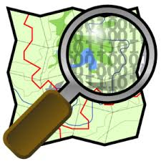
OSGeo in Oceania
Meetups
Mapathons
Slack groups
mailing lists
universities
institutions
companies
government agencies
NGOs...
www.osgeo.org
Adam Steer, Oceania Geospatial Symposium, Noumea, New Caledonia, 2 December 2022
Notes:
...and used/supported by a huge variety of locals as well. These are parts of the local ‘OSGeo forest’ in Oceania

Slide 16
How do we help to shape OSGeo?
Start doing things!
Become a member of OSGeo Oceania *and* OSGeo. Why not both?
Join/contribute to a Project: code, sponsorship, documentation writing, translations, presentations/workshops, bug reports, use in classroom etc.
Join a committee
Join an initiative (GeoForAll, GSoC, Travel Grant, Standards)
Host/organize events (code sprints, mapathons, hackathons)
Outreach: Help maintain the web site, contact governments/organizations to promote FOSS.
Get involved in Partnership buildup (e.g. Sponsorship, Standards, OGC, MOUs)
Join/build Local Chapters
www.osgeo.org
Adam Steer, Oceania Geospatial Symposium, Noumea, New Caledonia, 2 December 2022
Notes:
So how do we get into the forest to shape the tree?

Slide 17
Get involved: starting out...
www.osgeo.org/community/getting-started-osgeo/
help.openstreetmap.org/questions/6/how-do-i-get-started-with-openstreetmap
tasks.hotosm.org
Attend events: local informal gatherings, maptime, mapathons, FOSS4G conferences, code sprints…
Listen in: OSGeo and OSGeo Oceania board meetings are open for anyone to attend. Ask: just ask people like me! If you’re interested and don’t know where to start, we can help.
…challenge: how do we find out about all these events, who these people are?
www.osgeo.org
Adam Steer, Oceania Geospatial Symposium, Noumea, New Caledonia, 2 December 2022
Notes:
A list of things is nice, how do we start doing them? Listed here are resources for getting started. If you already do a lot of OSGeo things, nominate to be a charter member! Come talk to me, I’ll nominate you next year. Its free!

Slide 18
Talking with the open geospatial community
Discussion mailing lists:
OSGeo Oceania general discussion:
https://lists.osgeo.org/mailman/listinfo/oceania
OpenStreetMap list for the Tahiti / French Polynesia community:
https://listes.openstreetmap.fr/wws/info/local-polynesie
OpenStreetMap Australia general discussion: https://lists.openstreetmap.org/listinfo/talk-au
OpenStreetMap Aotearoa/New Zealand general discussion:
https://lists.openstreetmap.org/listinfo/talk-nz
OSGeo general discussion:
https://lists.osgeo.org/mailman/listinfo/discuss
www.osgeo.org
Adam Steer, Oceania Geospatial Symposium, Noumea, New Caledonia, 2 December 2022

Slide 19
Talking with the open geospatial community
Maptime Oceania slack channel
tinyurl.com/26jenv29
OpenStreetMap Oceania discourse
community.openstreetmap.org/c/communities/oceania/73
OSGeo chat on Matrix - bridged to Telegram matrix.to/#/#general:osgeo.org
OSGeo Telegram channel t.me/OSGeoorg
See also: www.osgeo.org/community/communications/
Your preferred channel is missing? You can make it happen!
Twitter @osgeo_oceania @osgeo @osgeolive @planetosgeo
Linkedin www.linkedin.com/company/osgeo/
Mastodon / fediverse
soon!
www.osgeo.org
Adam Steer, Oceania Geospatial Symposium, Noumea, New Caledonia, 2 December 2022
Notes:
...and here are some ways to talk to theopen source geospatial community in Oceania

Slide 20
Thanks - questions welcome!
www.osgeo.org/community/getting-started-osgeo/
www.osgeo-oceania.org/members/
Adam Steer
adam.d.steer@gmail.com
@adamdsteer
@adamsteer@mastodon.social
www.iamadamsteer.com
www.osgeo.org
Made with Natural Earth. Free vector and raster map data @ naturalearthdata.com, rendered in QGIS.
Adam Steer, Oceania Geospatial Symposium, Noumea, New Caledonia, 2 December 2022
Notes:
Thanks - and please ask us stuff

