Slide 1
Copernicus -
European Union Earth Observation Data and Services - Overview
Astrid – Christina Koch
International Relations
Directorate-General for Defence Industry and Space
OGS – 2 December 2022

Slide 2
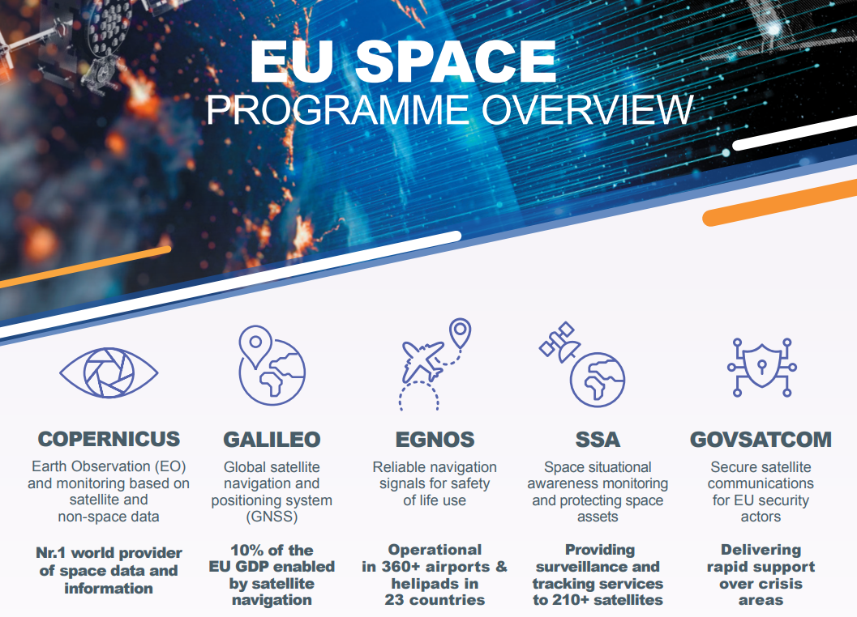

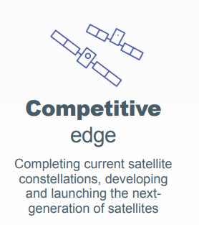
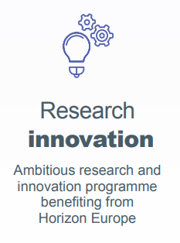
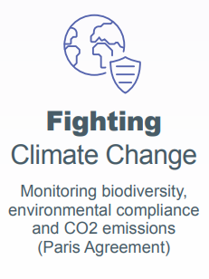
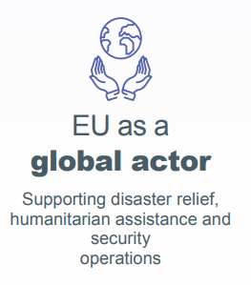
The EU Space Programme
Notes:
Note taking

Slide 3
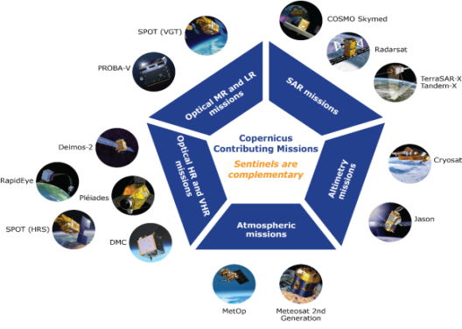
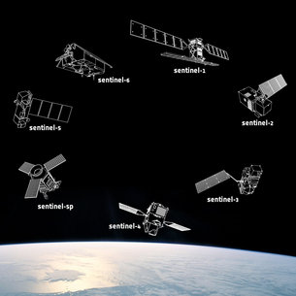
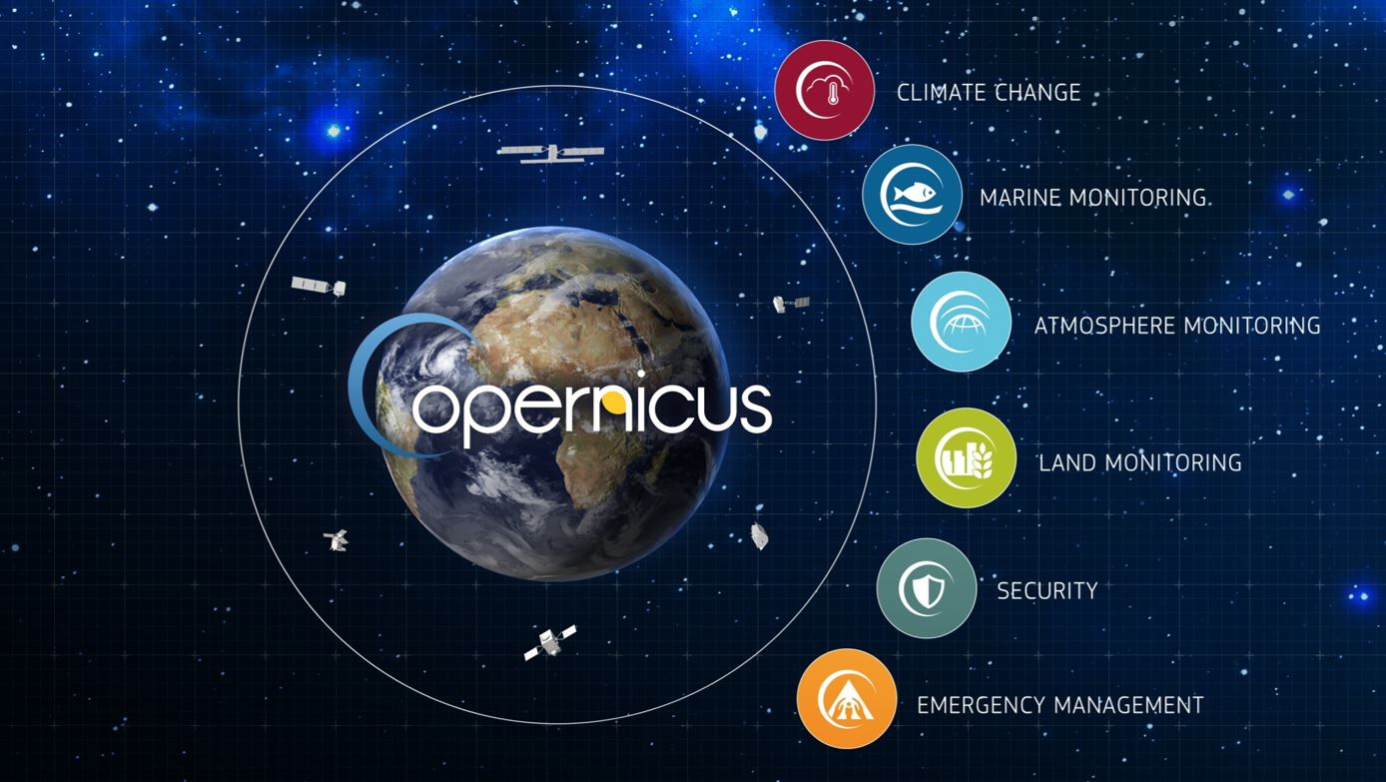

COPERNICUS ARCHITECTURE
FULL, FREE AND OPEN
6 services use Earth Observation data to deliver…
Contributing missions
Sentinels
…added-value products
Notes:
Copernicus was born as a tool for environment monitoring and as the EU’s contribution to global environment and climate change efforts (including international commitments such as COP21)

Slide 4
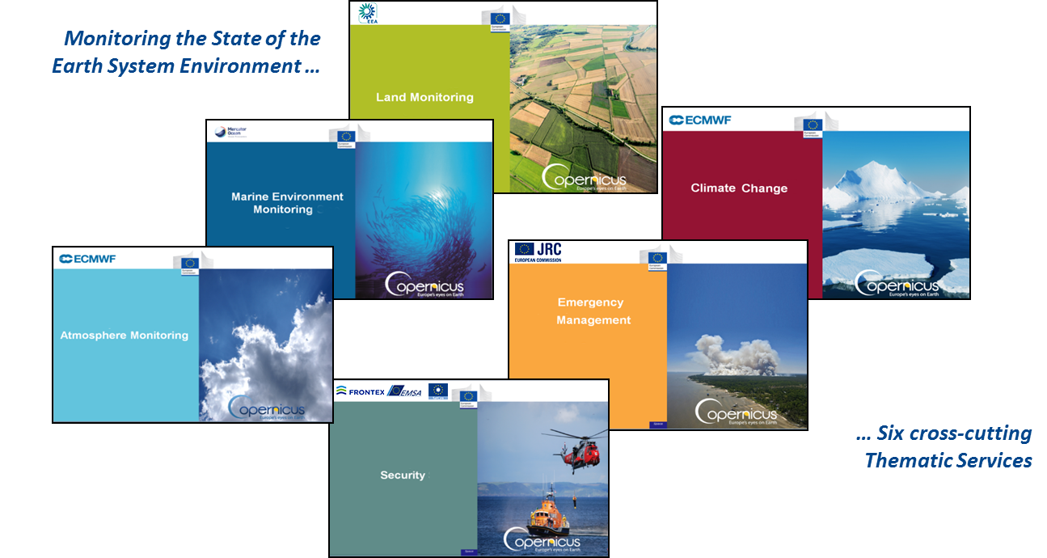






COPERNICUS SERVICES
COPERNICUS SERVICES

Slide 5
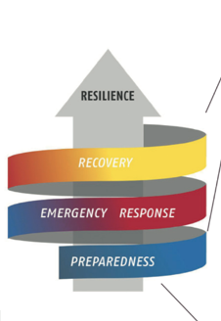
Benefit areas and products examples
Disaster Emergency Situations
Risk & Recovery Mapping:
Reference Maps
Pre-disaster Situation Maps
Post-disaster Situation Maps
Rapid Mapping:
Reference Maps
Delineation Maps
Grading Maps
Humanitarian Crises
Early Warning:
Floods: EFAS
Forest Fires: EFFIS
EFAS = European Flood Awareness System;
EFFIS=European Forest Fire Information System
Notes:
The Copernicus Emergency Management Service (EMS) has three main components, Early Warning andRapid Mapping, /risk and recovery mapping, as well as a dedicated component for the validation of the mapping products.

Slide 6

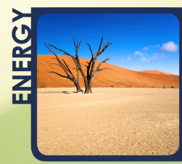
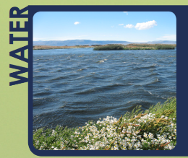
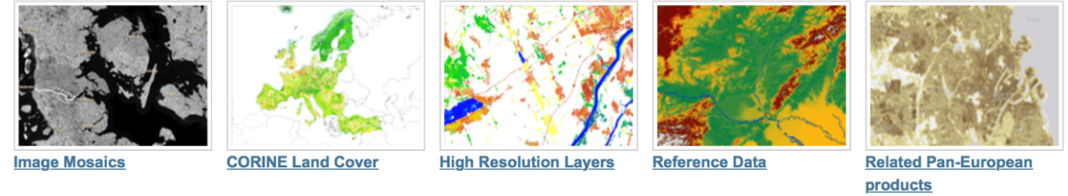
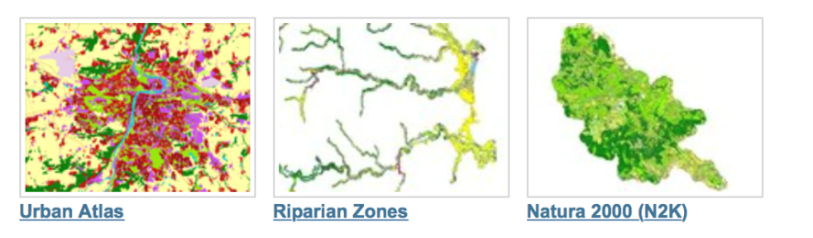
Benefit areas and products examples
Ecosystems
Biodiversity
Agriculture
Forestry
Energy
Natural Resources
Water
Urban planning
Global
Pan-European
EU Land Cover
Specific land cover info
Hydrographic and elevation reference maps
% of built-up area
Local
Notes:
The Land Service is divided into three main components:
Global Land Service (Providing bio-geophysical products of global land surface): is a component of the Copernicus Land service that provides a series of bio-geophysical products on the status and evolution of land surface at global scale at mid and low spatial resolution. Production and delivery of the parameters take place in a timely manner and are complemented by the constitution of long term time series. The products are used to monitor the vegetation, the water cycle and the energy budget.
Pan-European:
The pan-European component provides information about the land cover and land use (LC/LU), land cover and land use changes and land cover characteristics. The latter includes information about imperviousness, forests, natural grasslands, wetlands, and permanent water bodies.
Local:
The local component focuses on different hotspots, i.e. areas that are prone to specific environmental challenges and problems. This includes detailed LC/LU information for the larger EU cities (Urban Atlas), riparian zones along European river networks and NATURA 2000 sites. It will also include maps of coastal area
Note:
The CORINE Land Cover (CLC) inventory was initiated in 1985 (reference year 1990). Updates have been produced in 2000, 2006, and 2012. It consists of an inventory of land cover in 44 classes.

Slide 7
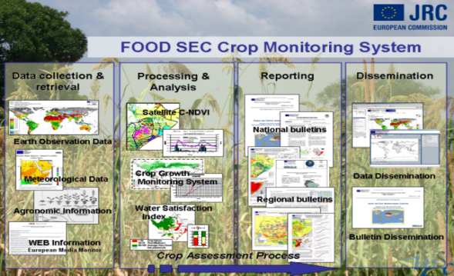
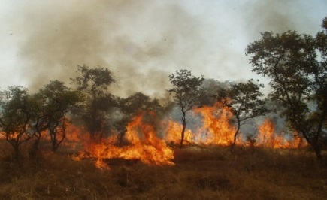
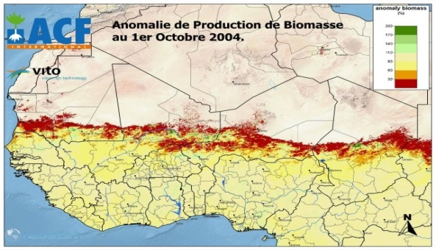


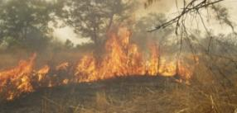
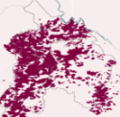
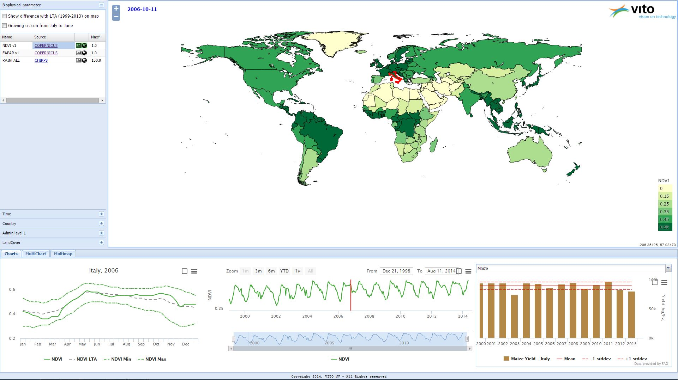
GLOBAL LAND Systematic Monitoring applications
Climate change
  Carbon flux forecast
Agriculture
  Crop monitoring
  Yield forecasting
  Biomass conditions
Monitoring extreme events
  Droughts
  Frost conditions
  Heat waves
Hydrology
  Water management
  River discharge
Fire ecology
Monitoring of fires and
burned areas on a
daily basis
Development of indices
of fire management and
efficiency
Bulletins developed at
national and PA level
Notes:
Some applications of these variables
7

Slide 8
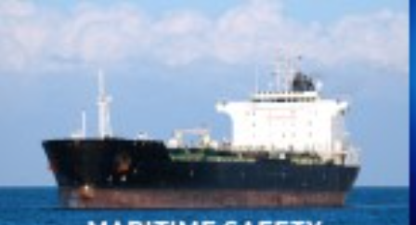

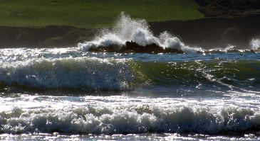

Benefit areas and products examples
Marine safety
Marine resources
Coastal and marine environment
Climate and meteorological forecasting
Other: Transport, Tourism, Environment, Pollution, Energy, etc.
Sea Level
Ocean Salinity
Ocean Temperature
Sea Ice
Wind
Ocean Currents
Ocean Colour / Biogeochemistry (e.g. optics, chlorophyil, biology, chemistry )
Notes:
The Marine Service provides core information related to 4 benefit areas
Maritime safety: CMEMS supports any safe activities at sea including ship routing services (currents, ice), offshore operations or search & rescue operations.
CMEMS products also contribute to oil spill response & remediation.
Marine resources:
CMEMS contributes to the protection and the sustainable management of living marine resources in particular for aquaculture, fishery research or regional fishery organisations.
Any ecosystem-based approach to fish stock management also benefits from CMEMS core information.
Coastal:
CMEMS offers a monitoring service at European and National levels.
Physical and marine biogeochemical components are useful for water quality monitoring and pollution control, in the context of the Marine Strategy Framework Directive in particular.
Sea level rise helps to predictcoastal erosion.
Sea surface temperature is one of the primary physical impacts of climate change and manymarine ecosystems in European seas are affected by rising sea temperature.
Weather
CMEMS delivers reliable and robust data to the European and national meteorological services.
Physical parameters of the ocean’s surface are used as boundary conditions for atmospheric models.
Changes in sea ice extent, concentration and volume are signals used to detect global warming for instance

Slide 9
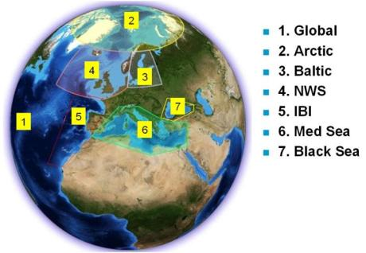
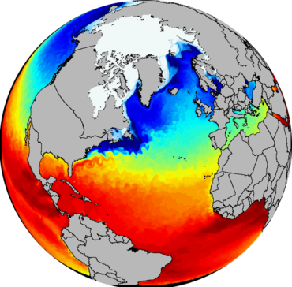

Marine Environment Monitoring Service
Ice
Sea Level
Currents
Biogeochemistry
Global and Regional
Real time and Reanalyses
Satellite & In Situ obs. and Models
Temperature
Salinity
A 3D and consistent
estimation of the ocean state
Notes:
The Copernicus Marine environmental service is providing a global model of the state of ocean, describing currents, sea-surface temperature and sea-levels at global and regional levels.
A seamless model covers the full global ocean, and regional seas under the strong influence of tidal dynamics and coastal boundaries.
These data are vital for understanding the ocean and many activities such as planning of shipping routes and fisheries.

Slide 10
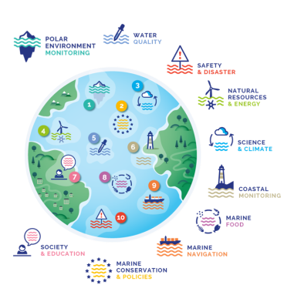
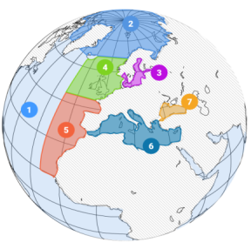
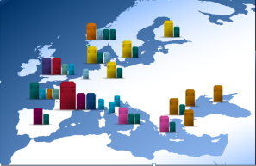
CMEMS in support of policies
ESSENTIAL OCEAN VARIABLES
Ocean state report - Ocean monitoring indicators
Physics
BLUE
Winds
Waves
Biology
Carbon
GREEN
Chemistry
Optical properties
White
(Sea Ice)
Green
(Biogeochemistry)
WHITE
Sea-ice
icebergs
174 product lines
Past 45 years Daily / hourly 2 to 10 days forecasted
2-7 km pan-EU 12 km global

Slide 11
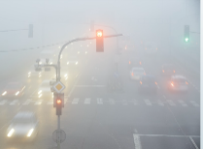
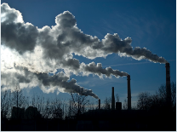


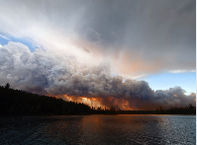
Benefit areas and products examples
Health
Environment
Pollution
Climate
Renewable Energy
Air Quality and Atmospheric Composition
Climate forcing
Ozone layer & UV
Solar radiation
Emissions and surface fluxes
Notes:
The Atmosphere Service addresses five main themes:
Air Quality: The Copernicus Atmosphere Monitoring Service uses a comprehensive global monitoring and forecasting system that estimates the state of the atmosphere on a daily basis, combining information from models and observations, and it provides a daily 5-day forecast. The global modelling system is also used to provide the boundary conditions for an ensemble of more detailed regional air quality models that are used to zoom in on the European domain and produce 4-day forecasts of air quality.
Climate forcing:
(CAMS) monitors the global CO₂ and CH₄ surface fluxes and therefore contributes to documenting the activity of the carbon cycle in the Earth system. CAMS also monitors the impact of aerosols on the Earth's radiation budget: estimates are provided for the period 2003 - 2012.
Ozone Layer & UV:
(CAMS) provides services that maintain and update the historical record of stratospheric ozone using available satellite observations from 1979 until the present with a special focus on the period 2003 - 2012. CAMS furthermore provides forecasts of stratospheric ozone concentrations up to 5 days ahead, and provides 5-day forecasts of UV radiation taking into account the effect of ozone, clouds, and aerosol particles.
Solar radiation:
CAMS) deals both with the ultraviolet part of the spectrum having impact on human health and with the visible solar spectrum being relevant for solar energy usage. Global and direct irradiances are provided for Europe, Africa, the Middle East and Asia providing the solar energy industry, the electricity sector, governments, and renewable energy organizations and institutions with suitable and accurate information of the solar radiation resources at the Earth's surface in easily-accessible formats and understandable quality metrics. A high-quality system of global ultraviolet (UV) irradiance monitoring constitutes a valuable tool to provide global coverage information for UV impact studies. Both services make use of the enhanced CAMS capabilities with respect to aerosols and ozone.
Emissions and surface fluxes
(CAMS) compiles emission inventories that serve as input to the atmospheric chemistry-transport models. It also estimates net fluxes of CO₂, N₂O and CH₄ at the Earth's surface using satellite and in-situ observations. CAMS estimates emissions of aerosols, chemical species, and greenhouse gases from wild fires on a daily basis. These are all used in the CAMS models, but also serve users around the world.

Slide 12
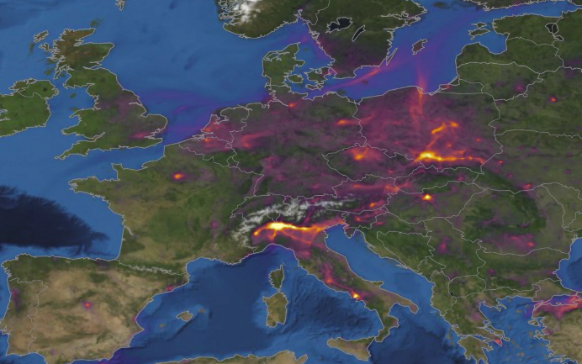
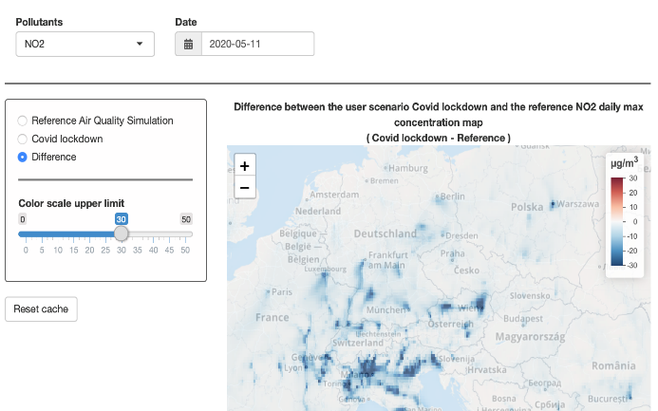
CAMS IN ACTION : CAMS COVID-19 MINISITE
https://atmosphere.copernicus.eu/european-air-quality-information-support-covid-19-crisis
Maps and animations of the latest situation in Europe.
Air pollution across Europe compared to 2017-2019 and as a function of lockdown measures.
Forecast model estimate of reduction in air pollution is expected on a daily basis accounting for weather effects.
How consistent are surface and satellite measurements?
CAMS currently contributes to a number of epidemiological studies trying to evaluate the links between air pollution and COVID-19 (effects of long- and short-term exposure; fine particulate matter as a potential vector in air for the virus?...)
CAMS regional air quality forecasts: Météo-France, Ineris (FR)
CAMS COVID-19 scenario forecasts: Ineris (FR)
CAMS website: ECMWF

Slide 13
Copernicus Climate Change Service (C3S)
Notes:
I will talk Copernicus Service that ECMWF has implemented on behalf of the European Commission, namely C3S the Copernicus Climate Change Service, which is about being an authoritative source of information about the past, present and future climate, as well as tools to enable climate change mitigation and adaptation strategies by policy makers and businesses

Slide 14
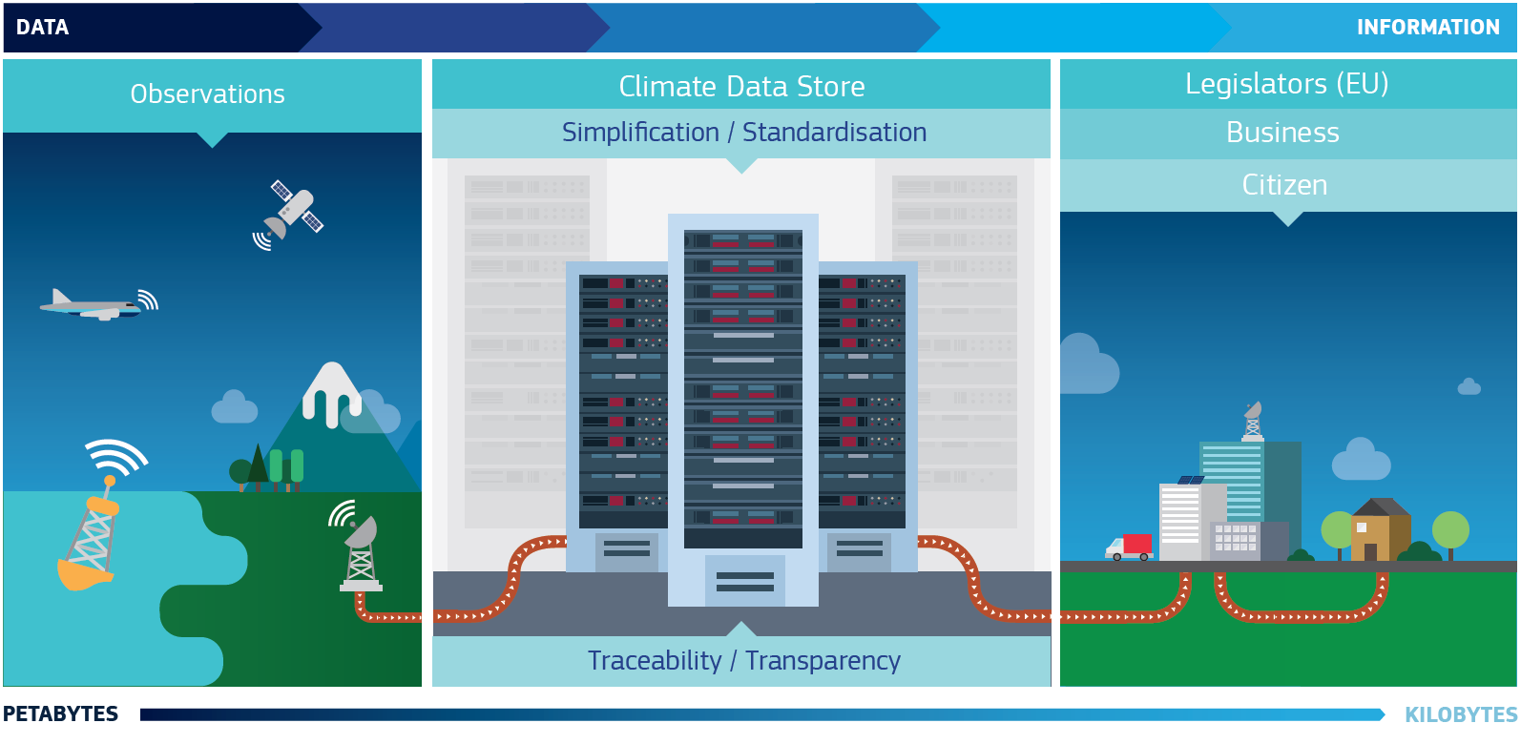
What is C3S?
cds.climate.copernicus.eu
Notes:
C3S provides:
authoritative information about the past, present and future climate
tools to inform climate change mitigation and adaptation strategies by policy makers and businesses
examples of best practice in the use of climate information
OPERATIONAL

Slide 15
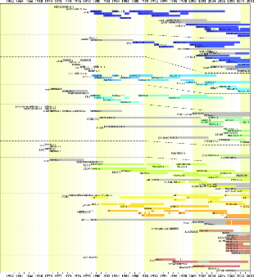
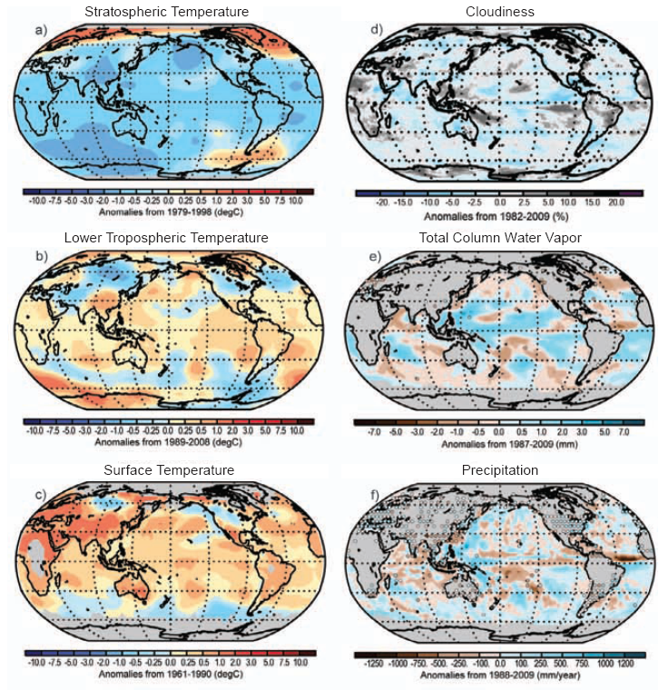

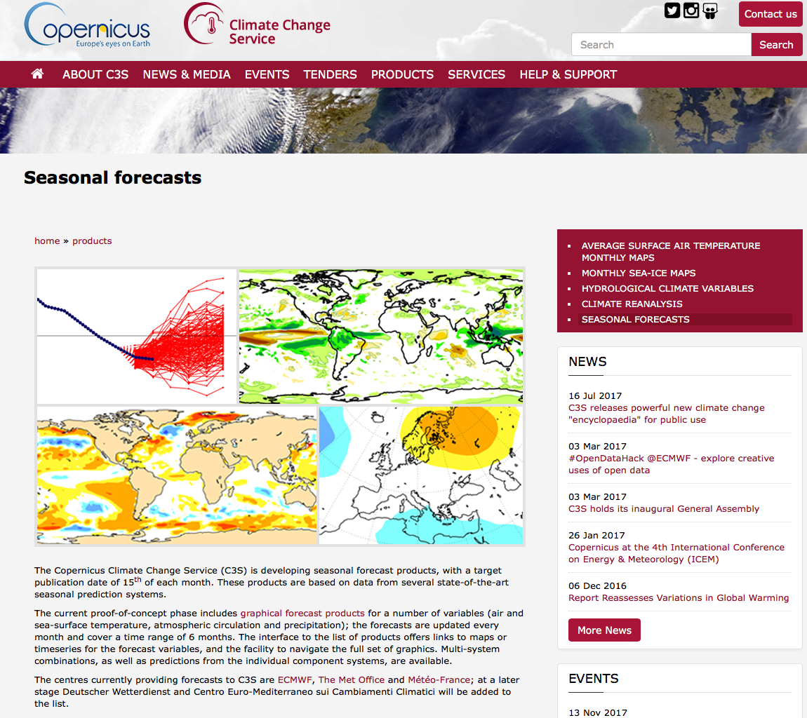
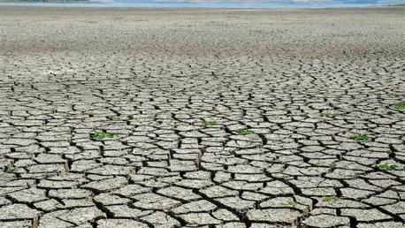
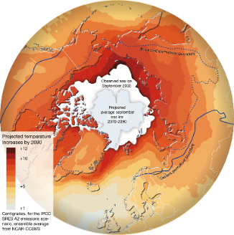
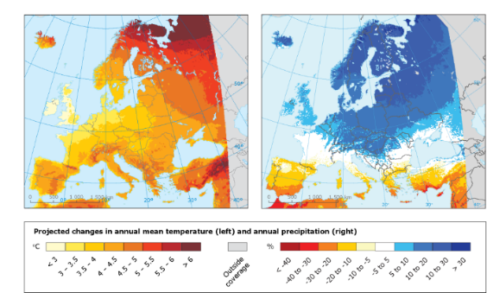
C3S portfolio: Access to past, present and future climate information
Observations and climate reanalyses
Seasonal forecast data and products
Climate model simulations
Sectoral climate impact indicators
Earth system models
One stop shop Climate Data Store
65 000 users
60 Tbytes/day
>80 datasets and 20 Apps
Notes:
The portfolio can be summarised very simply: it is about access to past present and future climate information.
This means Access to observations, climate data records of essential climate variables, and climate reanalyses to monitor climate change in near real time
Reanalysis: combines observations with models to give a complete picture of how the climate has evolved during the last few decades
As for the future climate, C3S provides every month seasonal forecast outlook out to 6 months as well as access to future climate scenarios (based on IPCC science) at global and regional – European – models
Last but not least, climate impact indicators relevant for a number of economic sectors (energy agriculture, tourism,..) are also available based on the authoritative data mentioned above.

Slide 16
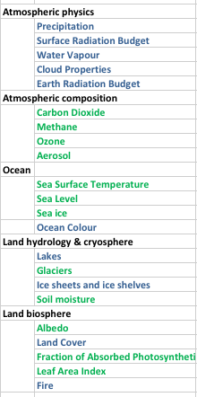
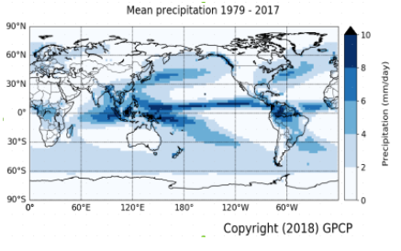
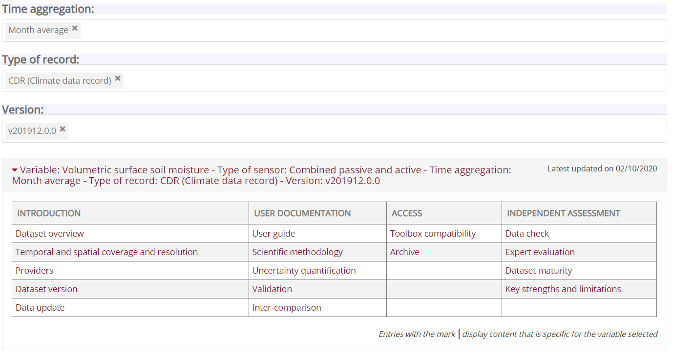
ECVs in C3S (satellite data)
C3S supports 22 ECV services grouped in 5 thematic areas:
New ECV products published recently
  Global GPCP precipitation dataset with monthly means since 1979 and daily means since 1996
  Tropospheric humidity profiles averaged monthly and zonally from 2006
  Sea ice products (thickness/concentration/edge/type)
New data added constantly to the catalogue
  S3-SLSTR extends Surface Radiation Budget CDR
  New GOMOS data for Aerosols
  Recent v5 of ocean colour added
Quality Assurance tab implemented for several ECVs (more to come)
  Transparency / traceability
  Uncertainty quantification
  Fitness for purpose
Enhancement of individual ECV services continues
  Toolbox applications submitted and will be integrated to the catalogue entries
  ECV products tutorials added
  Further evolution of catalogue entries

Slide 17
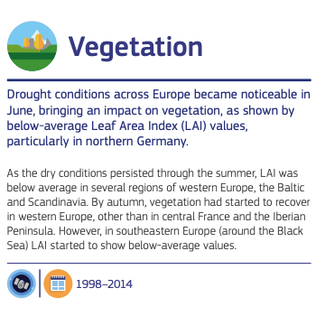
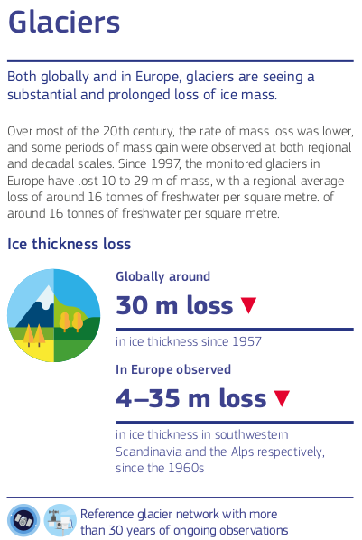
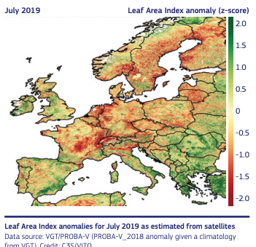
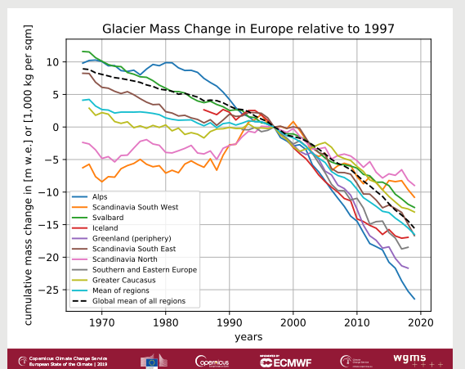
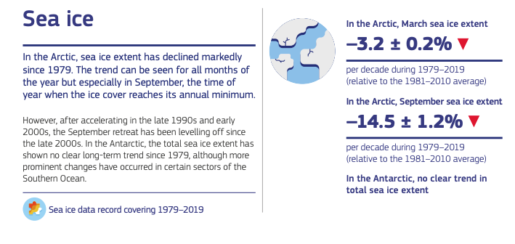
ECVs as climate indicators
C3S ECV products are being used in the European State of the Climate, as climate indicators and as a measure of the state of health of our environment.

Slide 18
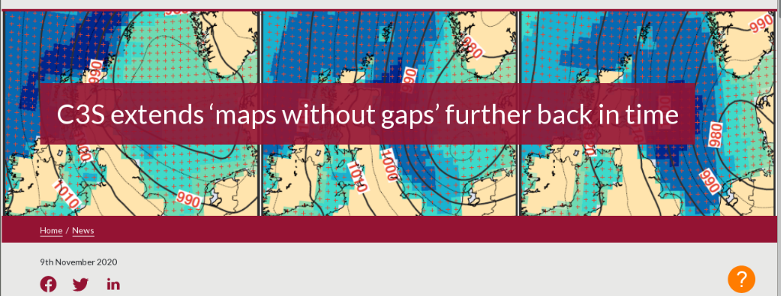
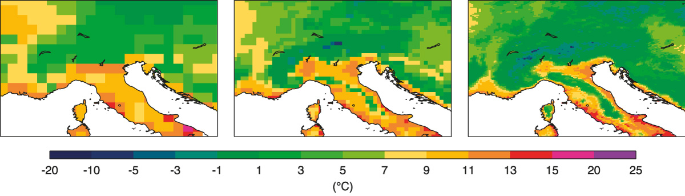
Global Reanalysis: ERA5 and ERA5-Land
Over 42,000 C3S Climate Data Store users; typically over 400 Tbyte of downloads per week
ERA5: A full-observing-system global reanalysis for the atmosphere, land and ocean waves
Daily updates 5 days behind real time
New:
Back extension from 1950 to 1978 is now available
Suitable for many users
However sub-optimal for tropical cyclones (extremes)
Production of an improved version is to start very soon
ERA-Interim
ERA5
ERA5-Land
ERA5-Land: a dynamical downscaling to 9km
Available from 1981, updates 2-3 months latency
Back extension from 1950 to complete in April
Timely updates 5 days behind real time in preparation
Notes:
User statistics based on splunk @24/02/2021.

Slide 19
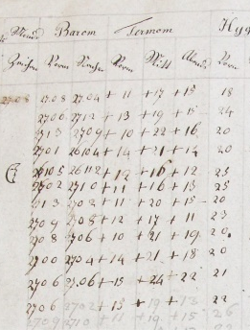



Collection and processing of in situ observations
Historical in situ observations play an important role
in C3S, e.g.:
for accurate climate monitoring,
as input to global and regional reanalyses,
as ‘ground truth’ for verification of ECV products.
C3S focuses on:
the facilitation of data rescue activities,
the improvement of historical records,
collection into well-maintained archives,
to provide access via the C3S Climate Data Store.
What C3S offers:
Data rescue service (linked with KNMI/WMO I-DARE)
  overview of data rescue activities
In-situ data deposit service
  allows uploads of additional collections
  e.g., Chilean data from EC cooperation agreement
Access of datasets via the C3S Climate Data Store
23000+
registered users
Notes:
The first datasets will be available soon in the CDS.
19

Slide 20




COPERNICUS DATA ACCESS: KEY LINKS
Access to Satellite data
FULL, FREE AND OPEN *
FULL, FREE AND OPEN *
  Copernicus Online Data Access (CODA)
  EUMETCast: www.eumetcast.com
Copernicus Space Component Data Access Portal*
CSC-DA
https://scihub.copernicus.eu/
  https://spacedata.copernicus.eu/
Needs to get a station and pay a yearly fee
Access to Copernicus Services Data
FULL, FREE AND OPEN
Land-related data: http://land.copernicus.eu
Atmosphere-related data: http://atmosphere.copernicus.eu
Marine-related data: http://marine.copernicus.eu
Emergency-related data: http://emergency.copernicus.eu
Climate change-related data: http://climate.copernicus.eu (Beta version)
* Not for Security Services
And
Data purchased from third
parties
(*) Includes instructions on how to access Contributing Missions data

Slide 21

CONCLUSIONS
www.copernicus.eu
Notes:
Copernicus is the Union Earth Observation and Monitoring Programme
As you can see from this slides, Copernicus helps the Union in fullfilling its policy obligations, such as improving environmental policies and helping people in disasters.
Increasing the knowledge on the state of the Planet facilitates better adaptation to climate change,
In the economic sphere Copernicus fosters downstream applications, thus contributing to growth and job creation

