Slide 1


Pacific Data Hub
Open Source and Open Data

Slide 2
The Pacific Community (SPC)
Who are we?
The Pacific Community (SPC) is the principal scientific and technical organisation in the Pacific region, proudly supporting development since 1947.
We are an international development organisation owned and governed by our 27 country and territory members.
We are mandated by our members to provide leadership in data and statistics for the region.

Slide 3
Pacific Data Hub
Goals
Build an online catalogue of datasets and publications
  By the Pacific, for the Pacific
  Datasets and publication search engine
Create dashboards
  Focus on a specific topic
  Provide high-level data visualization
Access data
  Download raw data
  Request permission to access
Provide support to divisions and programs
  Classification (not curation)
  Sustainable data storage

Slide 4
Pacific Data Hub
Why?
  Increasing demand for access to timely and reliable data.
  The need to improve data maturity to realise value form our data resources.
  Increasing need to manage rapidly growing volumes and greater variety of data, at higher velocity and with increased veracity.

Slide 5
Pacific Data Hub
Timeline
May
2019
June 2019
Mar 2021
Dec 2020
MFAT PSD Grant Agreement Signed
Data partnership signed with SPREP
Pacific Data Hub 1.0 Lunched
Pacific Data Talanoa series launched
Sep 2021
1 Million data observations reached in PDH.Stat
Mar 2022
Pacific Global Data Barometer survey
Jun 2022
1st assessment of data governance practice amongst CROP agencies
Oct 2022
1st Pacific Data Viz Challenge

Slide 6
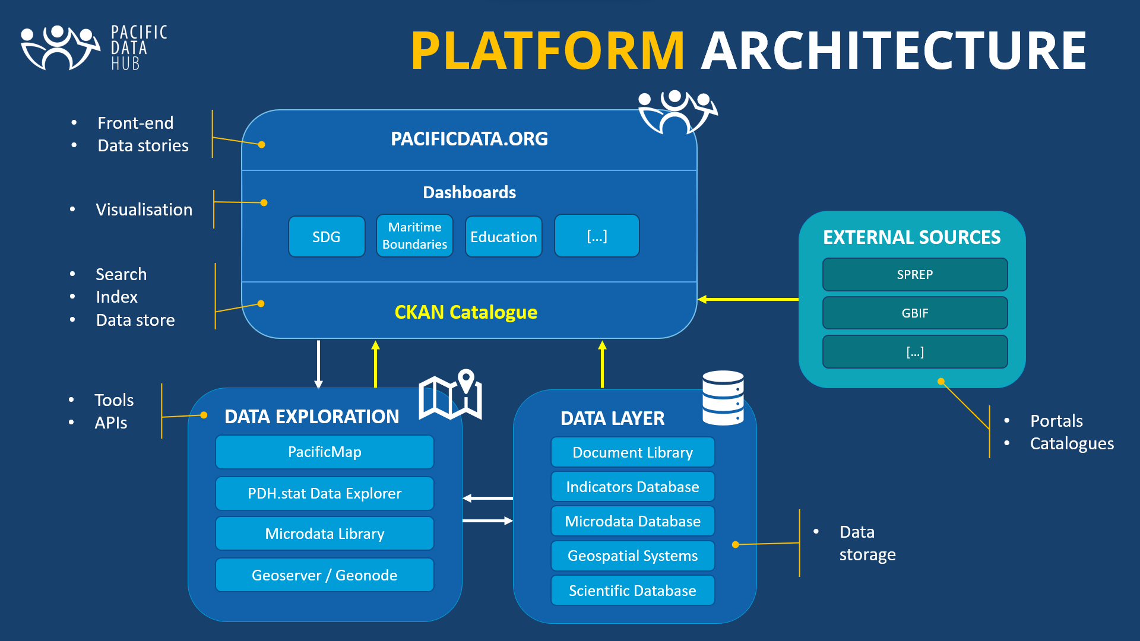
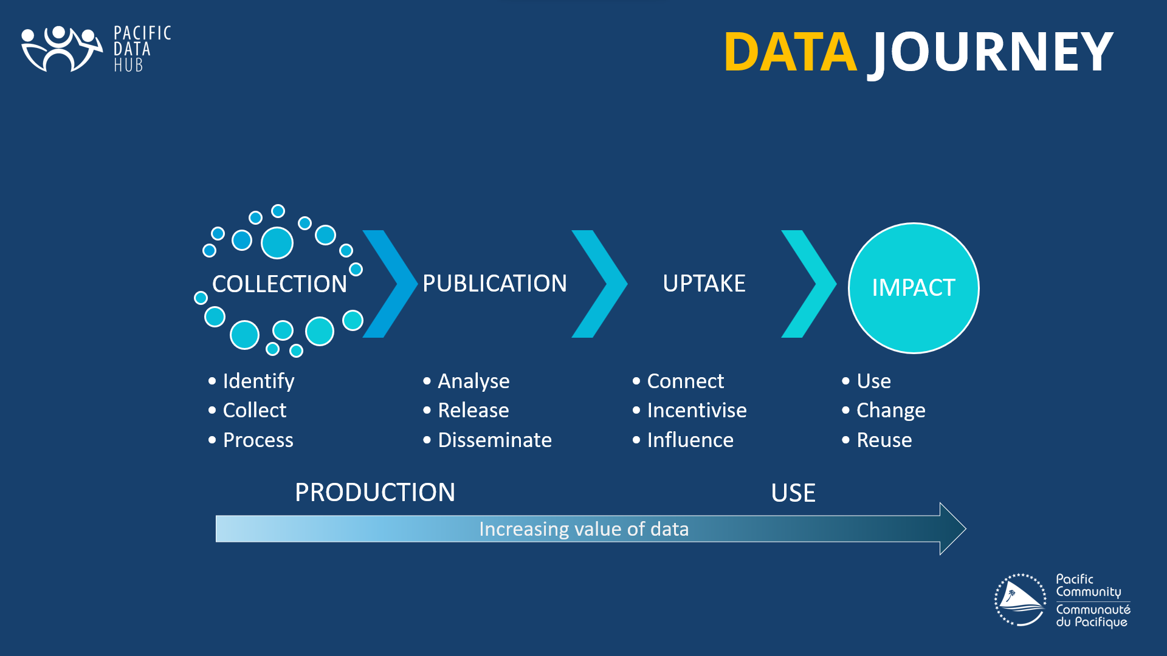
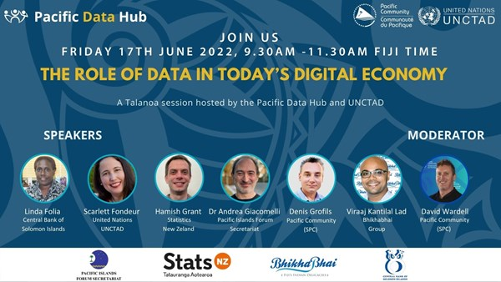
Pacific Data Hub
Data Platforms
Innovation, Outreach, Engagement
Leveraging partnerships to enhance coordination, build capability and accelerate impact
Strengthening data management and data governance practice
Improving access to data and information from the Pacific
A trusted source of Pacific data
Providing a sustainable data infrastructure as a regional public good
Data Management

Slide 7



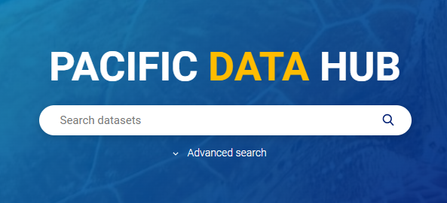




PDH Data Platform
Information
Dashboards
Portals
Internal Sources
Digital Library
PCCOS Catalogue
R2R catalogue
…
Data Exploration
Pacific Map (TerriaJS)
Geonode
PDH.stat Data Explorer
Microdata Library
https://pacificdata.org
External Sources
SPREP
World Bank
Open Data NC
Humanitarian Data Exchange
…
Data Layer
CKAN
Geoserver
NADA
SIS-CC .Stat
Open Source
Open Data

Slide 8
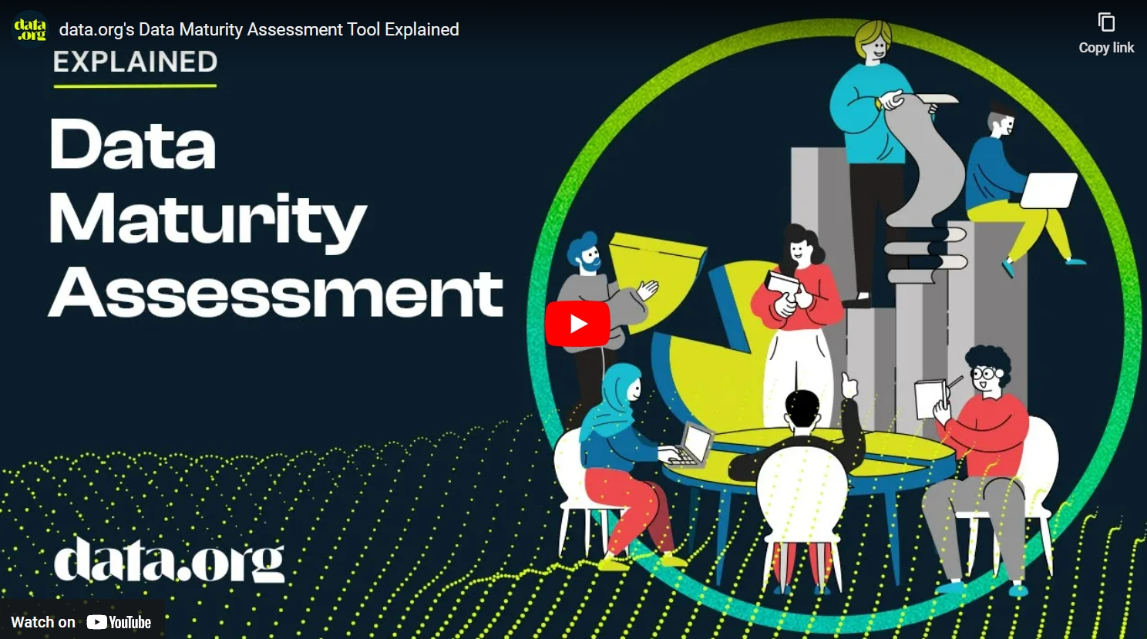
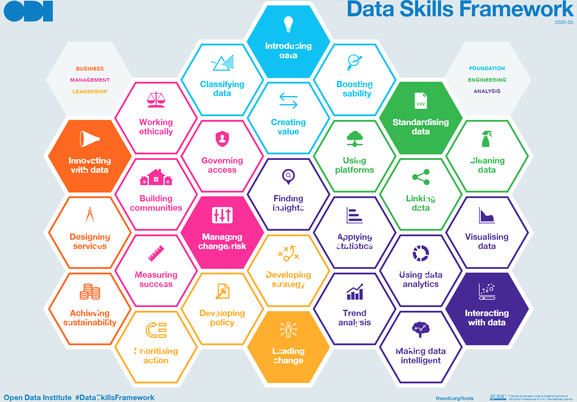

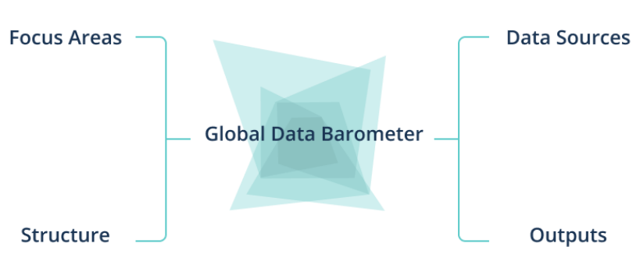

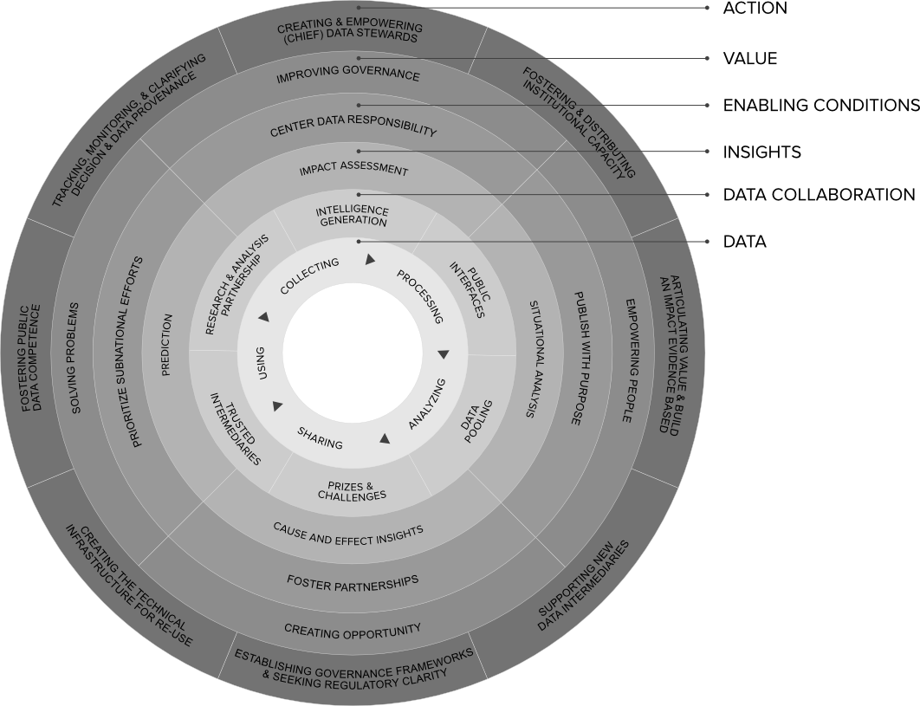
Challenges
DATA MATURITY
CAPACITY and CAPABILITY
A lack of coordinated investment in developing data management capability leads to duplication and unsustainable technology and unmanaged data sprawl.
Low levels of maturity in data governance and data management inhibit the ability to realise value from the region’s data resources
Developing and retaining staff
DATA SHARING & REUSE
Attitudes towards sharing of data and information often stifles the release and use of data for decision-making
COORDINATION & SUSTAINABILITY
Developing data literacy at all levels
Tools and enablers

Slide 9
Questions?
Merci
Malo
Vinaka
Thank you

