Slide 1
An open-source-based Geographic Information System
province Sud
Nouvelle Calédonie

Slide 2
ID Card
Sebastien Gueunier, Vice Director Information Services
«(La province) Sud » is a territorial administration :
3 000 users (50% teachers) ,
200 000 citizens,
+ 100 Applications
GIS usage : Land administration, Environment, Agriculture, Urban planning, Equipment, Hiking, Primary schools, …

Slide 3
Team and Tools
People :
3 Engineers at the GIS & DATA Office
10 Geomatic specialists
150 Agents regularly use GIS applications
Use :
39 applications connected to the GIS
400 maps (OGC compliant)

Slide 4
Framing
CAPEX
SAAS
OpenCore
Licence
Investment
Freeware
OpenSource
License to use
Cost to get In
OPEX
Open Standards
Proprietary software
Cost to get Out
governance
Direct and Indirect Costs
Interoperability
Vendor lock-in
on premise
We focus on Free / OpenSource Software and CAPEX assets.
Notes:
Je vais pas faire une présentation sur le droits et licences de copy, d’adaptation, d’interoperabilité, … mais simplement situer le cadre dans lequel la province se situe
https://merlcenter.org/guides/evaluating-open-source-vs-proprietary-software/
Open Core,

Slide 5
A very, very simple and very, very standard solution
1/ GIS Database :
POSTGIS
2/ Desktop solution for expert :
QGIS
3/ Business application development framework :
QGIS Server as map server
Java / Web / Javascript / OpenLayer
4/ Centralized access management system & Single Sign On (SSO)

Slide 6
Product and consume Datas
Product
Diffuse
Consume
Geomatic specialists
QGIS
Working
DataBase
GeoCat
data description
Citizen
POSTGIS
GeoPortail
GeoData
J2EE, OpenLayer
Share
DataBase
QGIS SERVER
POSTGIS
Agents
App
DataBase
Agents
Applications
Applications
POSTGIS
J2EE, OpenLayer

Slide 7
QGIS Integration
Dec. 4th
Workshop
Session à UNC
Standard functionalities :
Create and Edit GIS data in PostGis (and other)
Execute Geo Treatment (Large OpenSource Plugin)
Create maps (symbology, import map services)
Adaptations :
Automatic deployment to all users
Direct access to all available Databases and map services
Integration of security, the connected user only has access to their data

Slide 8
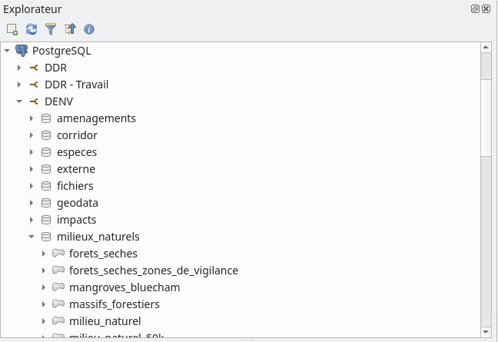
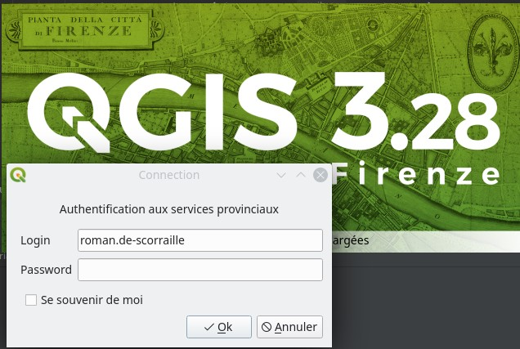
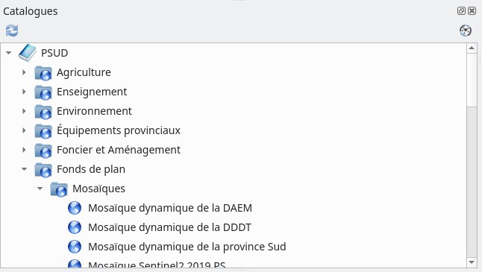

Slide 9
QGIS Server Intégration
Standard functionalities:
Publish OGC Standard web service (WMS, WFS, WMTS)
Publish QGIS map projects
Fully compatible
OpenLayer
Leaflet Javascript map visualisator
Integration :
PSUD Security management
Notes:
OGC : Open Geospatial Consortium,
WMS (Web Map Server)

Slide 10
App Intégration 1/2
Initially hybrid architecture :
Business WebApp Server : Java
Map server : “Well-known” proprietary solution
Bad Solution :
The proprietary solution do not support integration with custom java development
Difficulty in automating the deployment

Slide 11
App Intégration 2/2
Server side :
Full JEE standard application : Java
Native hibernate spacial (ORM) intégration
Map server: QGIS Server
Client side :
Ready to user component for Front developers

Slide 12
Valuing and capitalizing on data
GIS
DataBase
Big
DataBase
Open Data
Secured Data
REST API
DataLog
Plugin
postgREST…
App
DataBase
Data Analyst
Data Mining
DataLog
Plugin
DashBoard
POSTGIS
MetaBase, …

Slide 13
Références
POSTGIS (GIS Database ): https://postgis.net/
QGIS / QGIS Server (GIS Desktop and Server) : https://www.qgis.org
OpenLayer ( JAVASCRIPT GIS Client ) : https://openlayers.org/
Leafletjs ( JAVASCRIPT GIS Client ) : https://leafletjs.com/
API (Open API ): https://postgrest.org/
Metabase (DashBoard): https://www.metabase.com/
KeyCloak (SSO) : https://www.keycloak.org/

Slide 14
Question 1 : On Premise / Service SAAS
On Premise :
+ CAPEX Cost, Marginal Cost to scale
+ EZ Interoperability and customize
= Good expert needed
- Need time..
- Good IT infrastructure
Software As A Service :
+ Fast to deliver
= Proportional Cost (Scalable but $$$)
- « Slavery » Price UP! Exit Cost ! Version upgrade!
- « Steam » Information System, Shadow IT effect !
- Need a good and reliable network
Limited HR, Hurry, Limited IS capacity, Well connected => GO SAAS
Sufficient IS capacity, long-term vision, built over time, skilled team => On Premise

Slide 15
Question 2: Free/OpenSource vs Proprietary/Closed In an OnPremise Context
Context :
The OpenSource solution in SAAS mode does not make much sense.
"OpenSource" does not mean "Free", but frequently OpenSource vendors publish a free Community version
The "Free" world is usually "OpenSource"
Criteria to analyze :
License management
Existing documentation on the solution
Entry cost and exit cost
Ability to integrate with the IS (API?)
Specific development needs
Competence/Competition available to support the project
Companies are dealers… don’t be too dependent..

