Slide 1
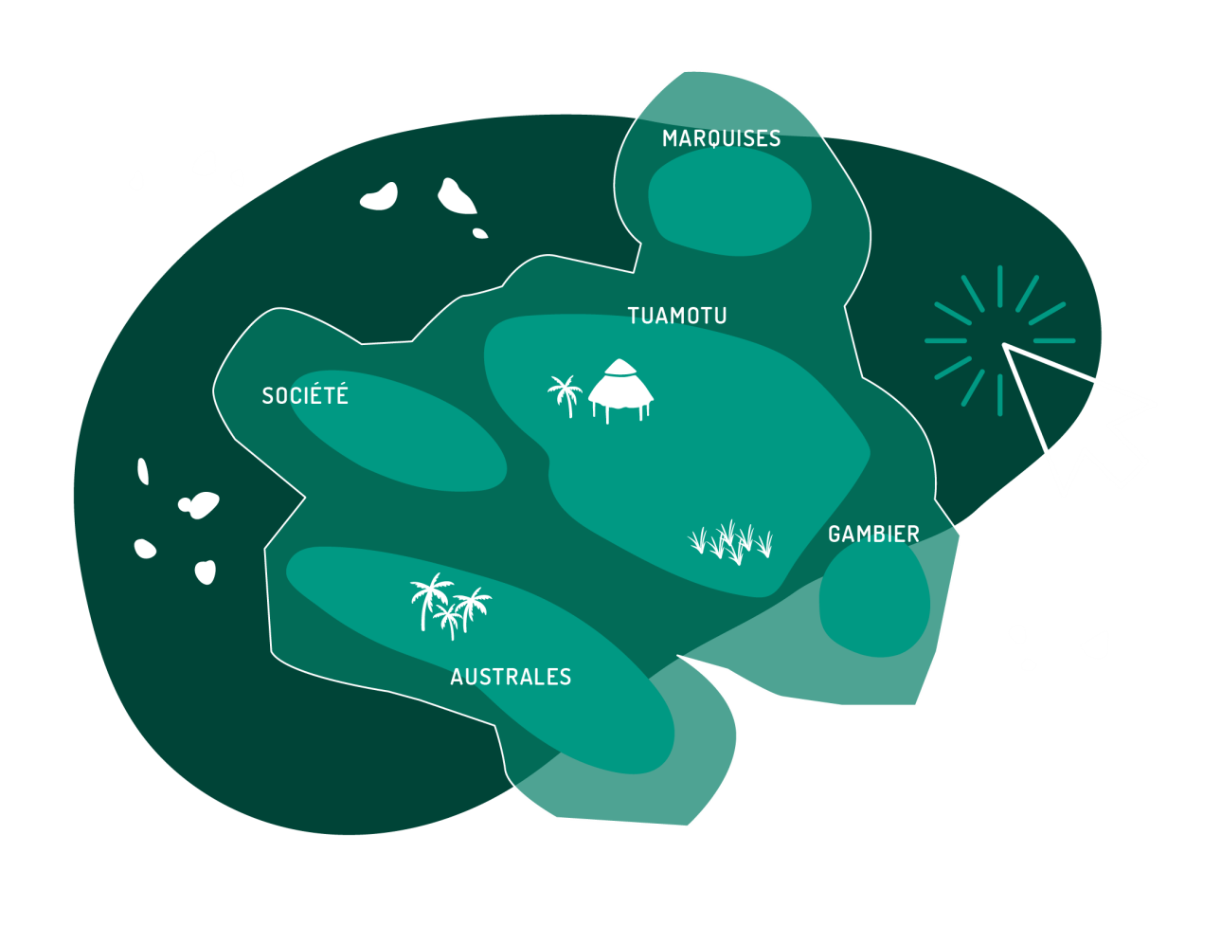


Building the Geospatial strategy of French Polynesia
Bureau of Land Affairs
French Polynesia
Christophe Lapierre
Senior GIS Consultant
Alexandre AMARY – Head of cadastral and topographic agency
alexandre.amary@administration.gov.pf
https://www.linkedin.com/in/christophelapierre
christophe.lapierre@gmail.com
Notes:
We are pleased to be here to represent French Polynesia.

Slide 2
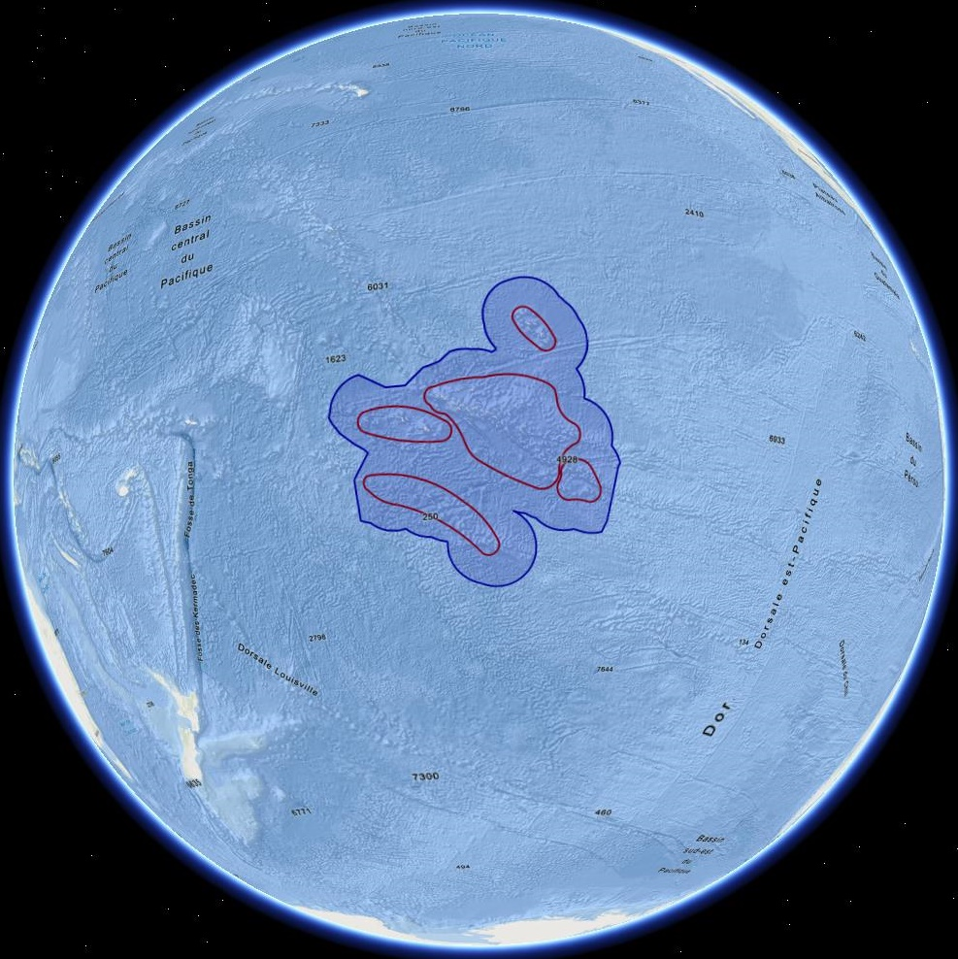
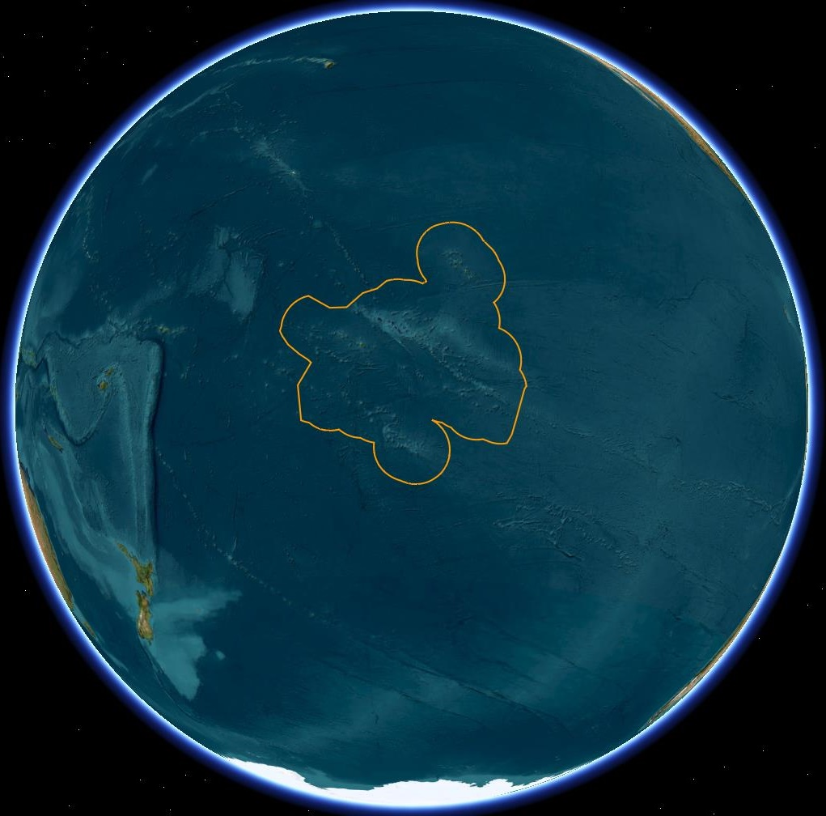
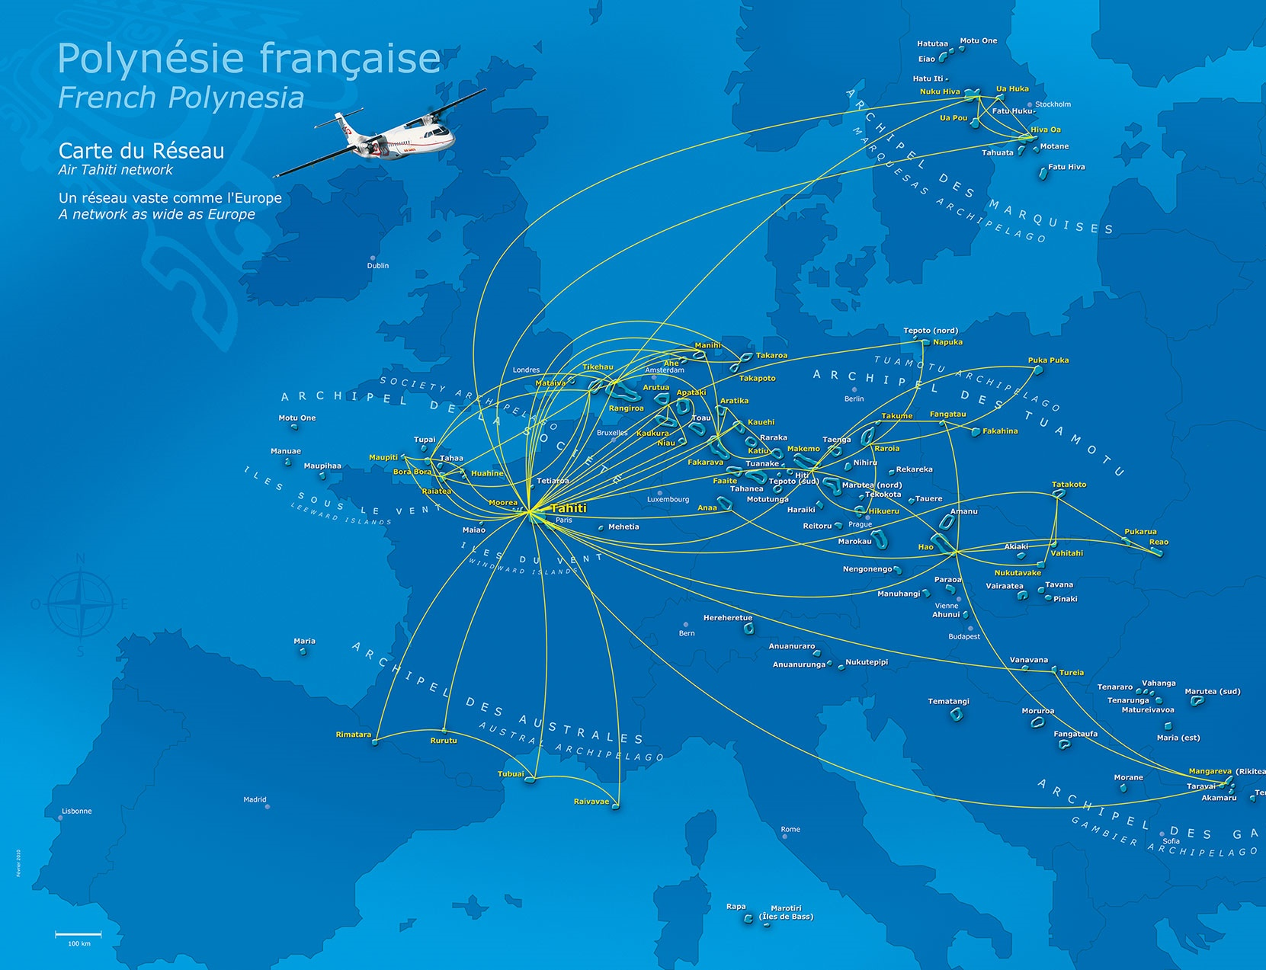

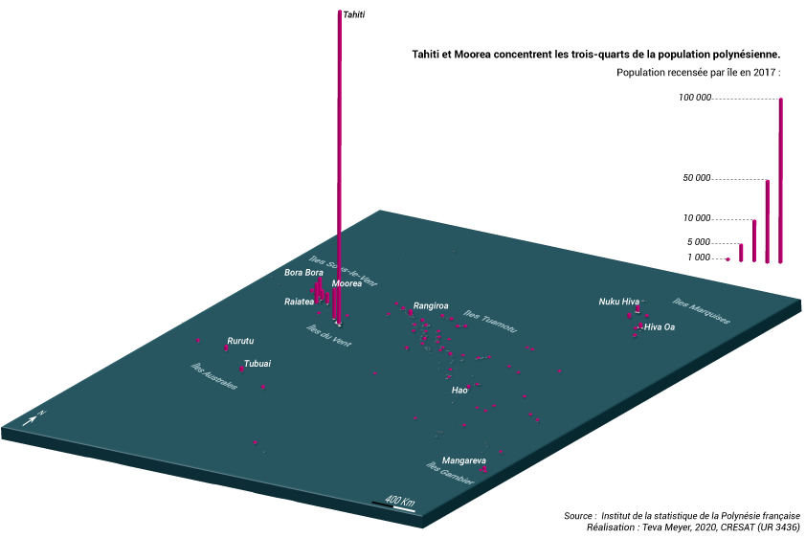
French Polynesia
Geographical key figures
Population : 280 k
121 islands / 75 inhabited
Extent : 2.5 million km²
Land surface : 4 000 km²
Exclusive Maritime Zone (EEZ) :
  4,8 million km²
  45 % of France EEZs
Notes:
These figures highlight the singularity of the french polynesian territory.
A territory the size of Europe.
Few land surface for a vast maritime domain
A small population which is very concentrated in the main islands of Society islands
A strong responsibility for France and the government of Polynesia to manage this large Exclusive Maritime Zone

Slide 3
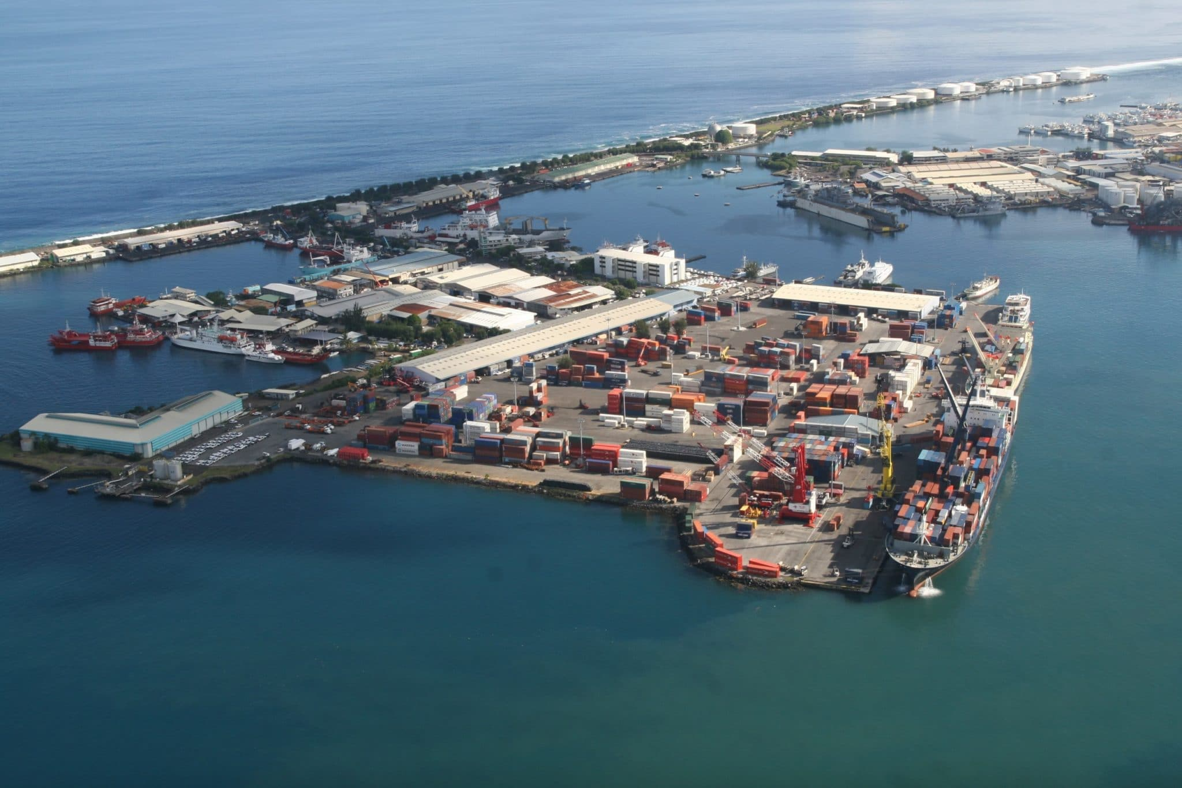
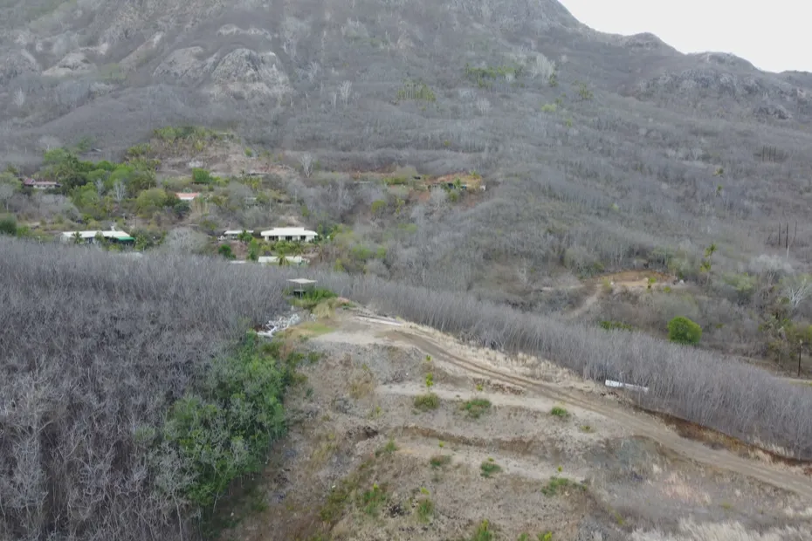


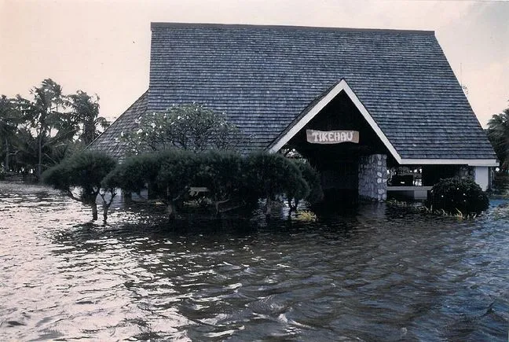
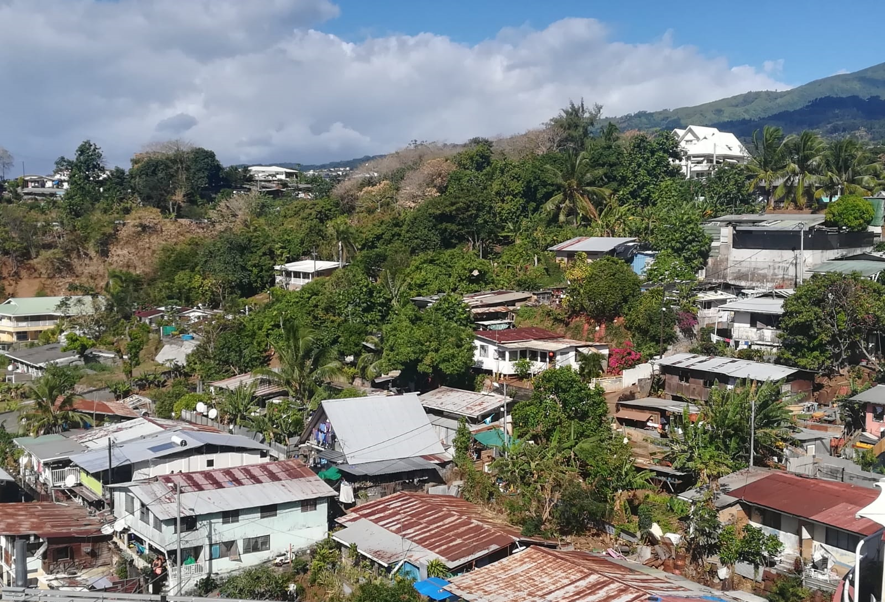
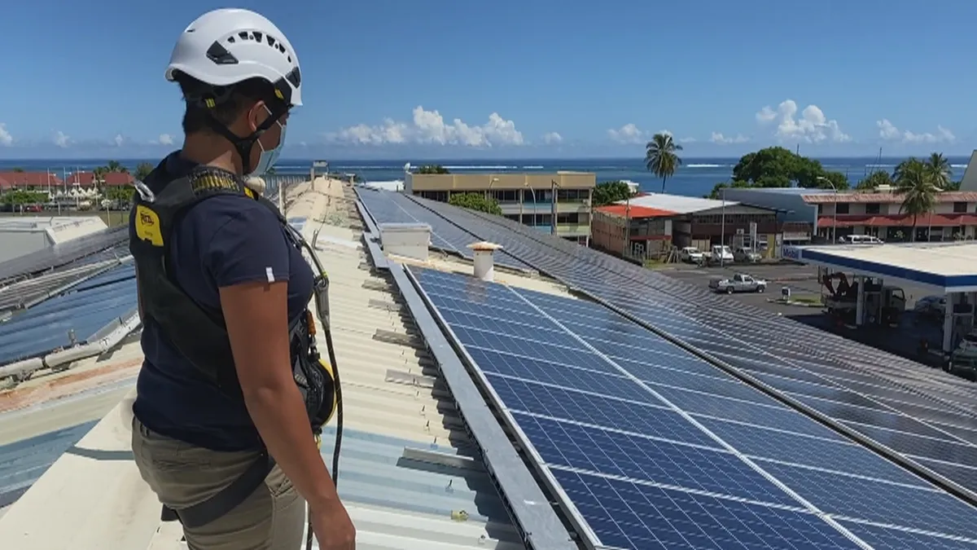
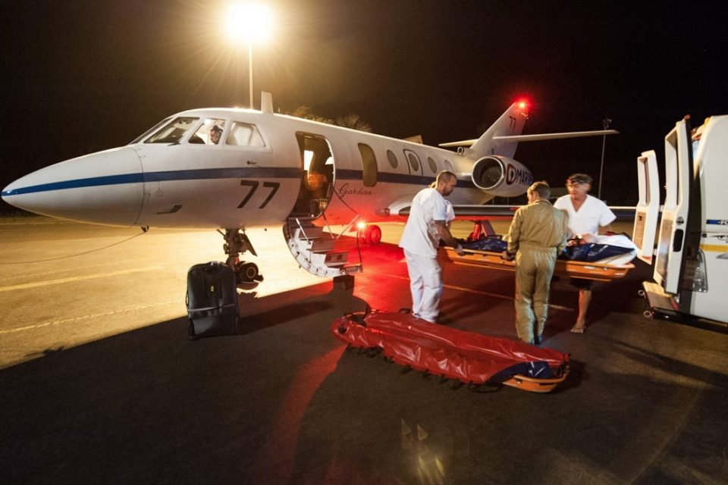

Geospatial to meet the challenges of French Polynesia
Essential Public Policies :
  Meet the vital needs of the population
  Protect ressources
  Adapt to climate change
The opportunity and benefits of geospatial and location data are everywhere
Infrastructure and Transport
Drought, Wild Fires
Agriculture, self-sufficiency
Maritime Ressources
Marine submersion
Housing - Land planning
Energy Transition
Public Health
Coral bleaching
Notes:
Geospatial data and processes are essential assets to support the services to the real world challenges
Epecially
Public health
Infrastructure Transport
Housing and Land planning
Agriculture and food self-sufficiency
Development of renewable energies
Ocean economy
Environment
Geosptial technology is also key to assess, prepare and organize response to the increasing risks due to climate change.
Most critical in French polynesia are drought, fires, marine submersion, heavy rains and impacts on the biodiviersity.

Slide 4





Unlocking location data : the geospatial strategy for French Polynesia
Awareness :
  Needs and benefits of Geographical Information Systems
  Geomatics to leverage geography in coordination with IT
1
2
Setting up a governance :
  Getting support from decision makers
  Stakeholders Comitee (CIG)
  Working groups (actors of the geospatial information )
Build a geospatial capacity :
  Promote and secure the use of location data
  Improve access to better location data
  Enhance capabilities, skills and awareness
  Enable innovation
Develop an active geospatial community
  Communicate, Learn, Share, Experiment
3
4
Notes:
The need and benefits of GIS could be identified in several .
The strategic reports emphasizes the importance of geographical informations systems in order to deliver the actions.
Our objective : unlock the potential of location data. Setting up such an organization requires a strategy
It follows the following stages :
Governance
Building capacity
Develop an active community

Slide 5
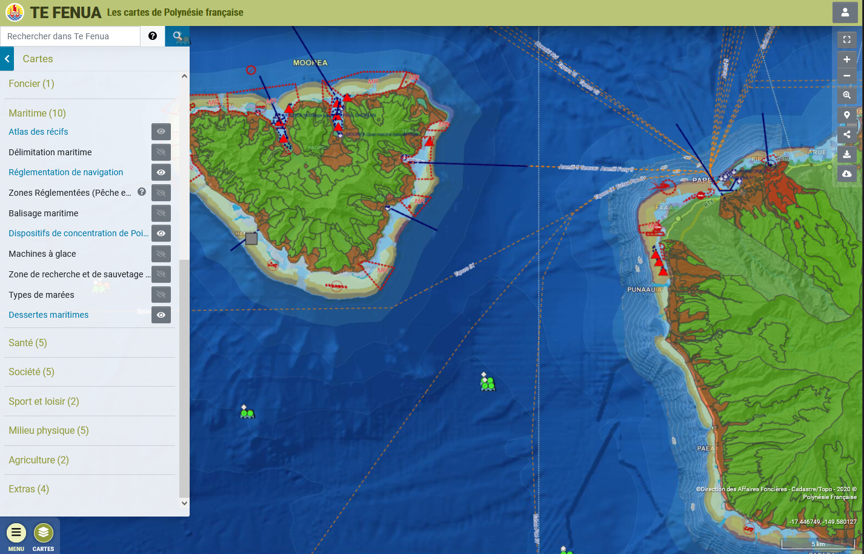
Open geospatial data platform of French Polynesia : first assets
Visualize data
  Responsive Web Application : https://www.tefenua.gov.pf/
  Designed for the public
  Display the main geographical data managed by FP public administration (50+ layers)
  Ad-hoc Background maps (tiled)
  Many tools : search, calculate route, draw, add your own data, measure, offline use…
  OGC compliant services (WMTS, WMS) and open API
  Designed and maintained by the IT department of gov.pf
  Leveraging Open source technologies
  Created in 2001, initially on the intranet, on the internet since 2015.
  On active maintenance.
TeFenua
Notes:
[christophe], j’interviens en assistance technique et conseil en géomatique pour les services de l’administration de la PF.
Pour présenter quelques éléments de contexte de cette stratégie géospatiale, voici un état des lieux des outils disponibles sur les aspects d’ouverture et de partage de l’information géographique, .
Nous voyons ici l’outil mis en place par l’administration pour visualiser les données géographiques du Pays au travers d’une application cartograpahique : Tefenua
Plusieurs themes de données, des fonds de plan, des outils sont disponibles.

Slide 6
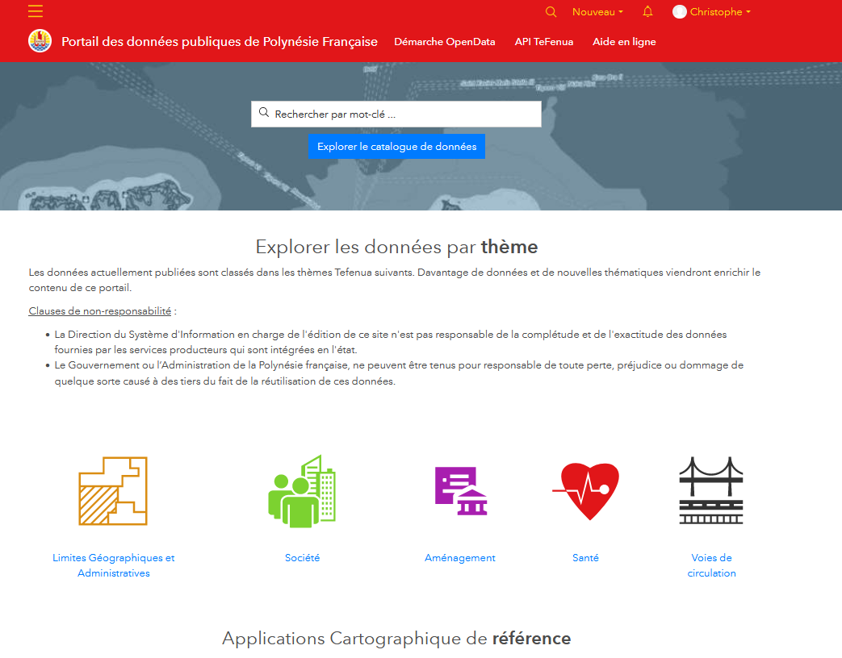
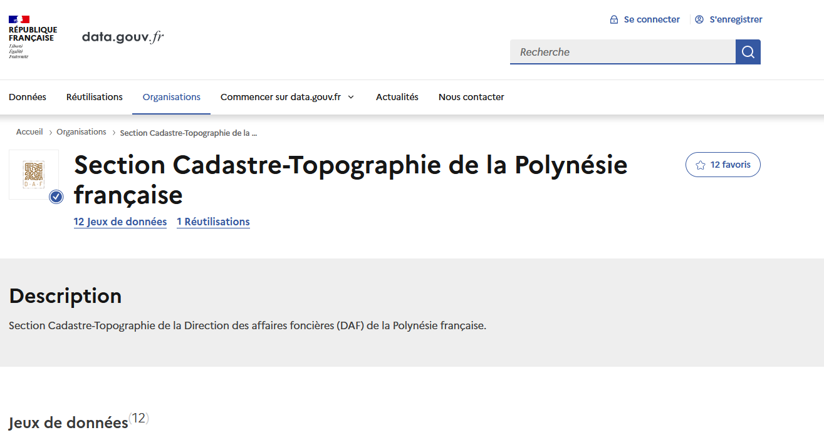
Open geospatial data platform of French Polynesia : first assets
Download data
  Tefenua Open Data Catalog : https://www.tefenua.data.gov.pf/
  Status : Prototype (not opened to public yet)
  Designed to share data and metadata of the Tefenua map viewer to the public.
  Include Map preview
  Built with ArcGIS Hub maintained by gov.pf
  National OpenData portal : https://www.data.gouv.fr/
  Data providers in French Polynesia :
    Land Affairs (DAF) : Cadastre, Carto DB, sat. imagery
    Census Bureau (ISPF) : demography, socio-eco.
  Generic Data Catalog : geo and non geo data
  No Map preview
Notes:
More recently, the data has been opendeup to the public.
At first by publishing datasets to the french data portal
Lately a prototype has been built to focus at first on the data already published in the Tefenua portal

Slide 7
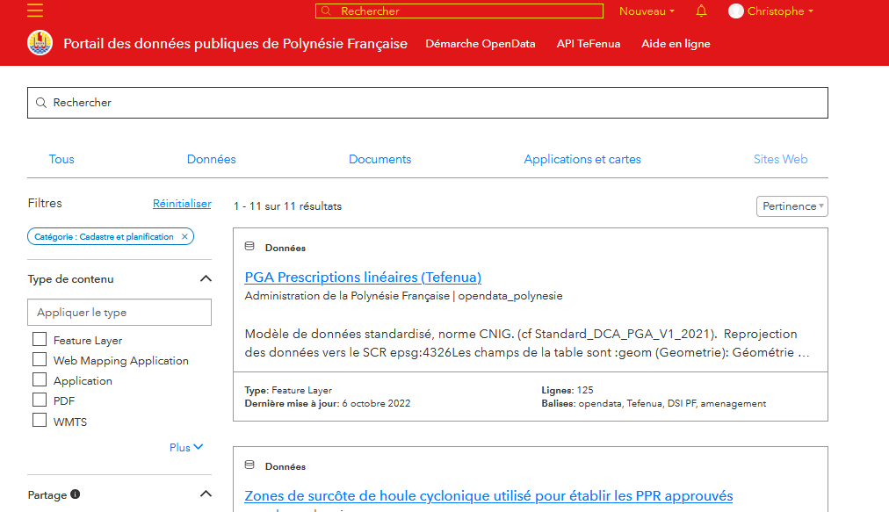
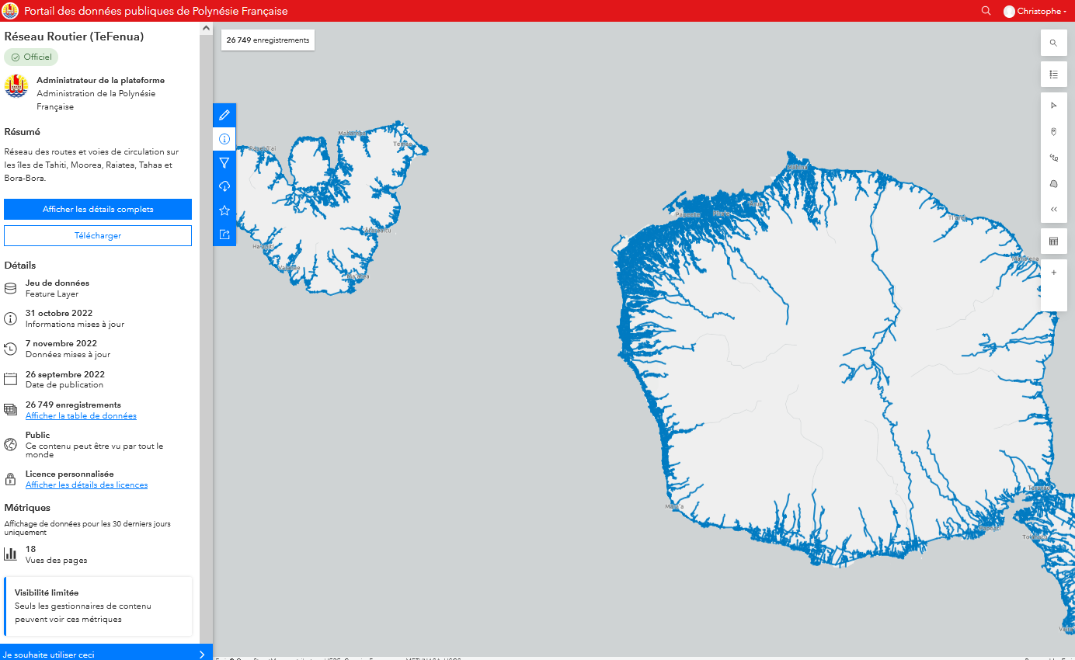
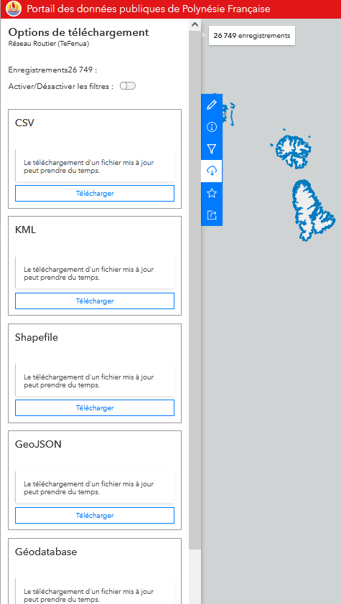
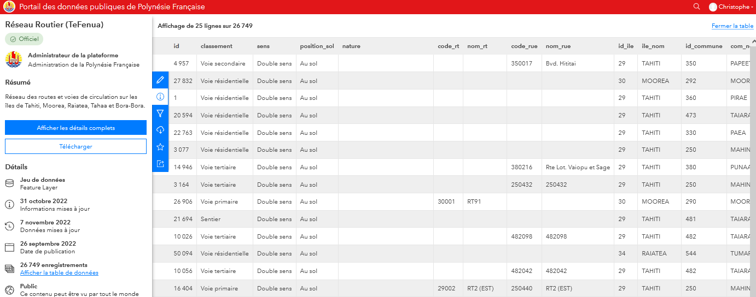
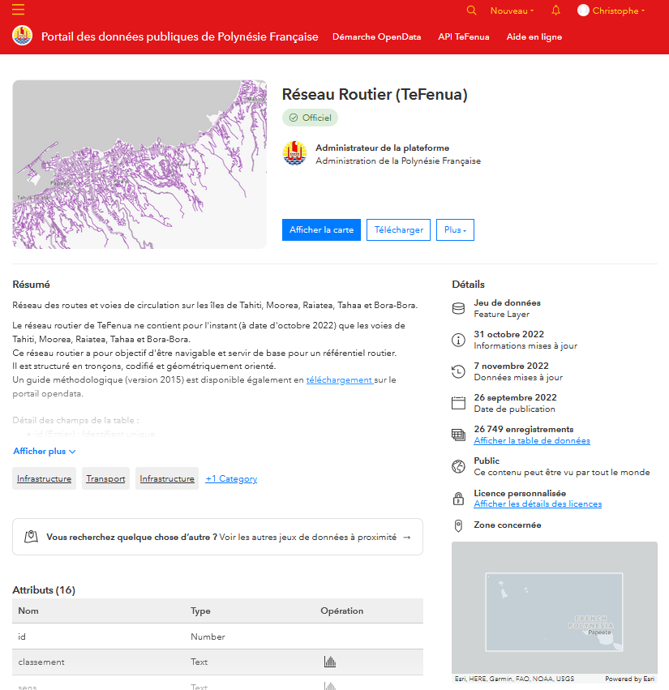
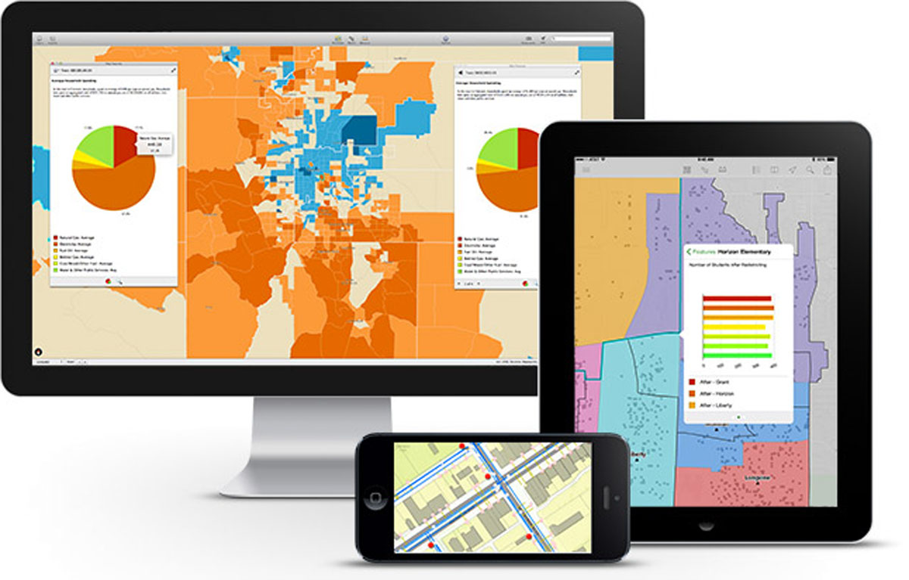
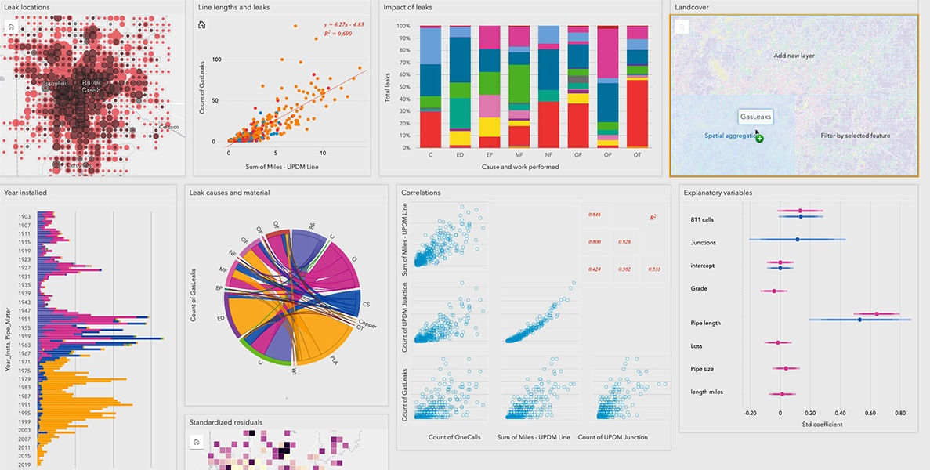
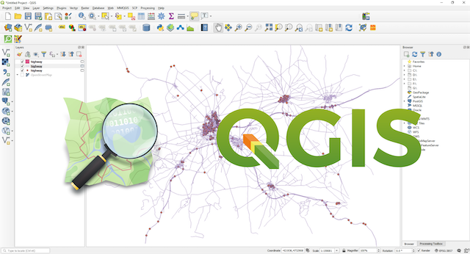
Focus on the OpenData Portal
3
Preview Data
4
Download Data
1
Search the Catalog
2
Explore the MetaData
5
Use the Data
In your GIS
Build Web or mobile apps
Create DataViz

Slide 8
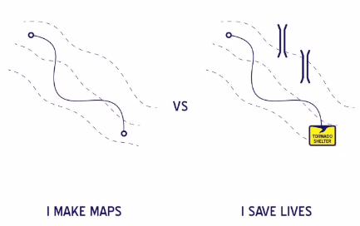
Turning Data into Action

Slide 9

The Road Ahead
Setting up the GIS Platform for the administration of French Polynesia
  Providing the set of tools to allow gov.pf agents to :
    Produce and manage the geospatial reference data : ensuring quality
    Create applications to enhance geographic data : enabling innovation
    collaborate on projects by sharing and disseminating data : breaking-up silos
  Change management : explain, help, support, transfer know-how
Promote the development of the geospatial ecosystem in French Polynesia
  Animate and participate in the geospatial community
  Include all stakeholders : public and private organizations, individuals
  Getting inspired and learn from others (Geospatial Pacific Community …)
  Exchange on best-practice, experiences
  Working together
Notes:
La participation de la Polynésie à cette conférence démontre la volonté de participer au réseau et à la communauté du geospatial dans le Pacifique

Slide 10






French Polynesia to integrating the network of ART Geodev
Polynésie Française
Coming Soon !
Notes:
La participation de la Polynésie à cette conférence démontre la volonté de participer au réseau et à la communauté du geospatial dans le Pacifique

Slide 11
Thank you !
Bureau of Land Affairs
French Polynesia
Christophe Lapierre
Senior GIS Consultant
Alexandre AMARY – Head of cadastral and topographic agency
alexandre.amary@administration.gov.pf
https://www.linkedin.com/in/christophelapierre
christophe.lapierre@gmail.com

