Slide 1
Building a geospatial strategy to support our operations from space
02/12/2022 – Oceania Geospatial Symposium

Slide 2
General context and historical uses
A geospatial sector in structuration

Slide 3
Where do we start from?
Fragmented supports
Pilote ARB+EAA
Widespread roll-out
Socio-economic support
May 2019
Seminar
Accountability
of CA
2021
New partnerships: European Space Agency, France 2030, KFW, DINAMIS ...
2019
2017
2015
2011

Slide 4
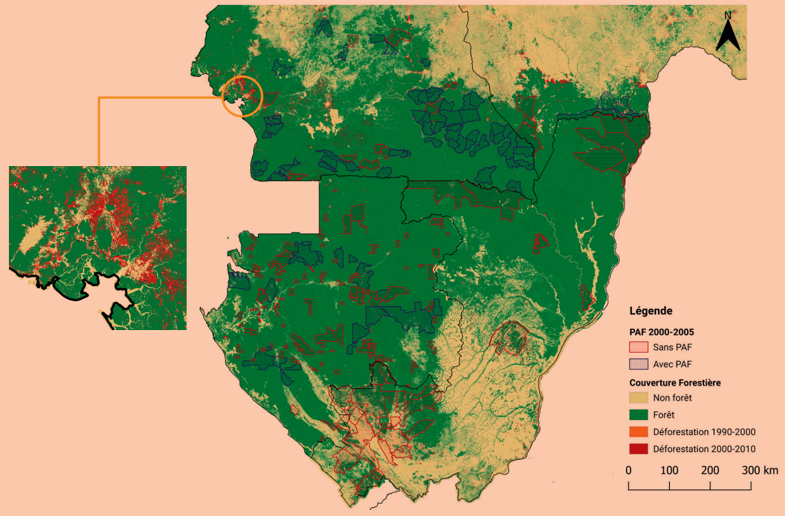
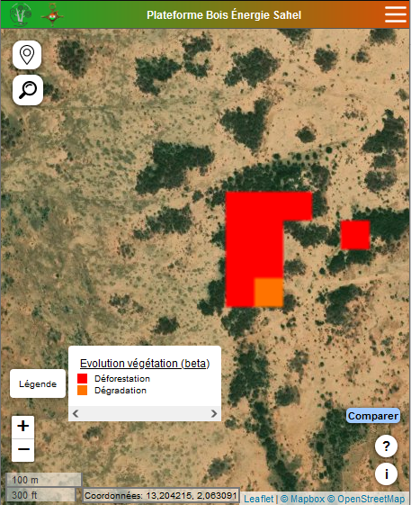
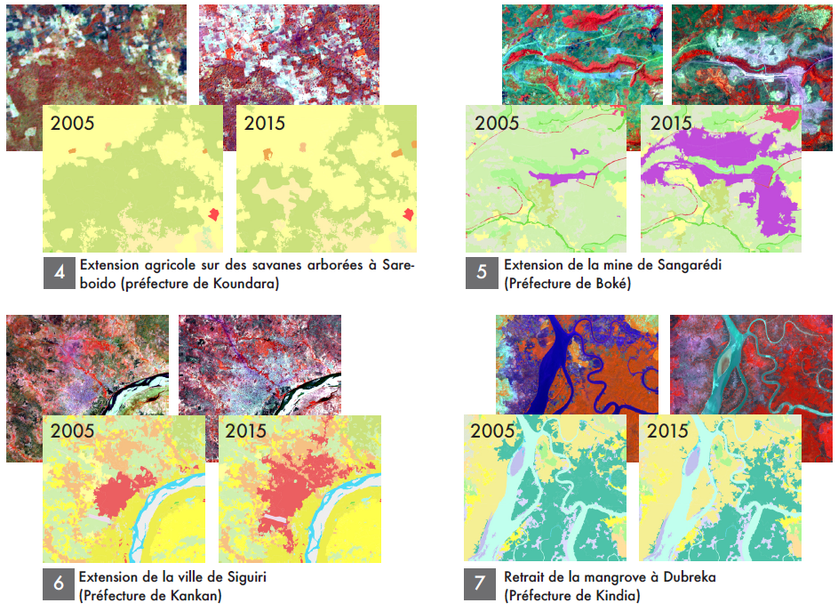
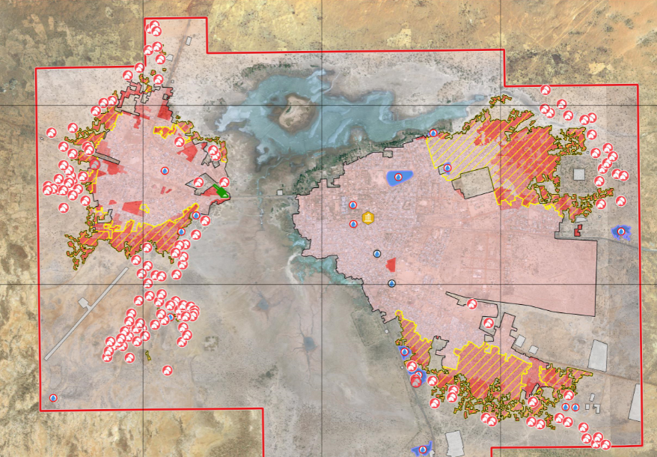
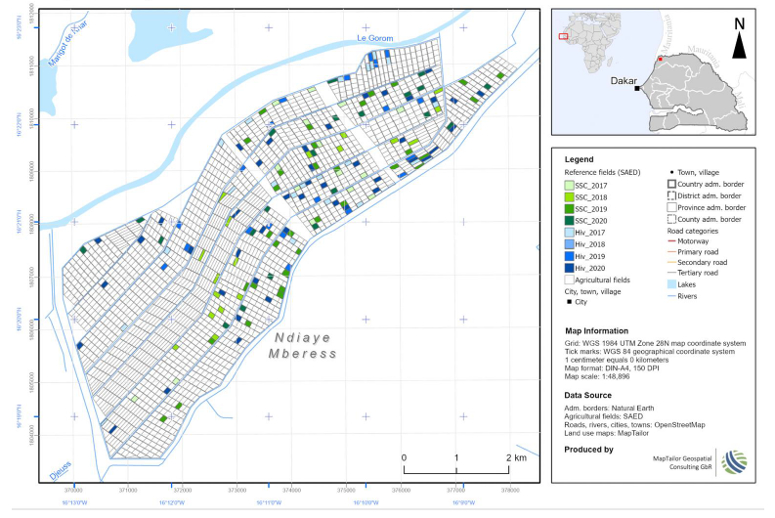
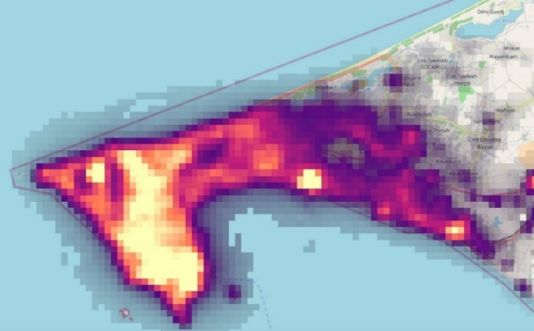
Emblematic uses since 2012
Historical use on natural resources, infrastructure projects, and impact evaluation: tropical forest monitoring, hydrology and spatial altimetry, coastal erosion, agricultural yields, land use, etc.
Multi-criteria assessment
Mainly: impact measurement, retrospective evaluation, implementation of replicable methodologies, projects that are difficult to access or geographically dispersed, construction support, monitoring & evaluation of projects in execution

Slide 5
Why is geospatial use increasing?
Baselines of indicators improving the construction and monitoring of projects, more easily comparable from one geography to another
Adapted to new challenges: monitoring, analysis, evaluation, communication
Complement to more traditional ways of data collection on the field
Money and time saving, especially over large geographical areas
Efficiency and quality compared to traditional methods
Adoption of geographical intelligence should allow a better response to the nature of new needs
Notes:
Impacts observables du ciel
Complexe ou couteux pour obtenir des indicateurs
Zone d’intérêt vaste ou difficile d’accès
Intervention ayant déjà eu lieu et évaluation a posteriori
Mesurer l’impact d’une intervention rétroactivement
Combinaison avec d’autres jeux de données
Gain économique face aux méthodes habituelles

Slide 6
AFD in the Pacific
First intervention in PICTs in 1947 (New Caledonia, French Polynesia) and operation in Vanuatu starting 1960
€ 3 billion total portfolio in loans in the French Pacific;
€ 57 million grants over the last decade in regional projects;
A regional office created in 2018 to further support PICTs in their sustainable development goals and promote regional cooperation on climate change adaptation, mitigation and biodiversity conservation;
Notes:
Impacts observables du ciel
Complexe ou couteux pour obtenir des indicateurs
Zone d’intérêt vaste ou difficile d’accès
Intervention ayant déjà eu lieu et évaluation a posteriori
Mesurer l’impact d’une intervention rétroactivement
Combinaison avec d’autres jeux de données
Gain économique face aux méthodes habituelles

Slide 7
Construction of a
“France’ space offer”.
To be internally more efficient and with our beneficiaries

Slide 8
[Achieved] Improving the attractiveness of space
Signature of a research partnership agreement with CLS for an R&D study to gather geospatial needs, support for 6 projects to be integrated into a centralized geospatial analysis tool, etc.
Addition to the AFD training catalogue of a course dedicated to applications linked to Earth observation satellite technologies
Signing of the international charter of the Space Climate Observatory (SCO), joining with its members a network supporting more than 50 projects focusing on adaptation, mitigation and monitoring of climate change
Joining the DINAMIS consortium to support the creation of the DINAMIS SOUTH component
Notes:
En filigrane, ces actions ont pour objectif de faire la promotion des applicatifs spatiaux dont la majorité étaient jusqu’alors peu connus des agents de l’AFD, et de faire partager une certaine expertise sur le spatial dont l’écosystème français est l’un des plus compétitif au niveau mondial.

Slide 9
[In progress] Improving the attractiveness of space
Providing training and advice to our clients, building a training module within the AFD Campus as part of the Group University, dedicated to Earth observation
Provision of a centralized operational tool to deliver geospatial services internally and to our counterparts.
Setting up a contractual and legal vehicle to offer preferential pricing for the acquisition of satellite imagery to AFD's counterparts during their projects in execution
Establishment of thematic framework contracts to facilitate the use of AFD teams with companies specialized in spatial data processing
Notes:
MC thématiques : mieux orienter les besoins AFD vers les privés FR les mieux qualifiés à proposer des prestations de qualité, à des tarifs les plus compétitifs possibles, et avec des délais de passations de marchés réduits

Slide 10
Space Climate Observatory (SCO)
CNES initiative in which we are involved, and which funds small operational demonstration projects attractive to the fight - adaptation to climate change
SCO projects can be taken over (methodologies, deliverables, data...) free of charge to scale them up in our operations, if we are interested
https://www.spaceclimateobservatory.org/

Slide 11
Privileged access to imagery for our counterparts...
AFD has access to the DINAMIS scheme, which provides access to very high resolution commercial imagery for archival and programming purposes, at prices 10x lower than the market (1.2 - 1.8 €/km²).
However, the system is only eligible for the appraisal of AFD projects, or for their execution subject to implementation by a consortium player (CIRAD, IRD, INRAE, CNES, CNRS, IGN).
Need to find a legal and contractual way in order to offer preferential rates for our counterparts
Notes:
Face au coût élevé des images satellitaires à haute résolution et de la situation financière des contreparties de l’AFD, la mise en place d’un mode opératoire permettant à l’AFD de proposer à ses bénéficiaires une tarification privilégiée dans l’acquisition d’imagerie satellitaire est élément central de l’offre spatiale que l’AFD cherche à construire.
AC Airbus : difficile face aux statuts de l’AFD (aide délié, mise en concurrence…)

Slide 12
Support from the European Space Agency
Subscription in 2022 - 2025 of France to the "GDA" programme; dedicated to development banks
Facility giving among other things, the possibility for AFD to benefit from fast-track co-financing from ESA for the development of deliverables and services related to Earth observation
Agile and rapid production of earth observation services
Notes:
La souscription de la France au programme GDA de l’ESA serait un autre effet levier économique grâce
à la capacité des fournisseurs de service à répondre aux projets GDA
à la possibilité de la composante GDA-FFF qui permet un cofinancement entre l’AFD et l’ESA pour des projets de développement avec à l’appui des services fournis dans le cadre d’AO sur le programme GDA
GDA est un levier économique pour l’écosystème FR au global : AFD et fournisseurs de services.

Slide 13
PASSDEF platform
Development of a shared tool for the
visualization and analysis of geospatial data

Slide 14
AFD-CLS-CNES partnership
Objective | Supporting the deployment and adoption of geospatial technologies within AFD
Duration and phasing | Total duration: 2021-2023 2021-22: Needs’ collection 2022-23: Prototyping implementation
External input | 2 CNES - CLS contracts: 420 k€. Substantial contributions from CLS
AFD contribution | One FTE 3 AFD - CLS contracts: 250 k€
1
2
Services d’analyses
Démonstrateurs
Sensibilisation
Formation
Recueil des besoins
3
Prototype d’un outil de suivi centralisé

Slide 15
Geospatial analysis demonstration platform
Respond to the diversity of use cases within AFD
AFD group holders: VIL, ARB, EAA, MOB, CLN, EVA, CCC, AES, EF
6 projects supported : Burkina, Chad, Cambodia, DRC, West and North Africa region, Ivory Coast
Strong awareness of AFD standards among CLS teams
Objective: test the robustness of the platform in the demonstration phase. What is done in 2022 should prepare the commissioning in 2023
Notes:
PASSDEF : Plateforme d'Aide par le Spatial au Suivi du Développement Durable en Environnement Fragile
1) Burkina, VIL (+CCC), étalement urbain et déplaces internes dans les villes secondaires, ciblage points d’intérêts
2) Congo RDC, ARB (+AES), suivi de la déforestation combinant THR et HR, système d’alerte, front de déforestation THR (camps illégaux etc ?)
3) Tchad, ARB (+CLI+EVA), suivi des réaménagements, surfaces cultivées et rendements agricole, bilan carbone, évaluation phase 1
4) Cambodge, ARB+EAA (+AES+CLI), suivi complet des ressources naturelles (dégradation sol, eau, biodiv…), occupation détaillée des sols,
5) Afrique de l’Ouest et du Nord, Expertise France - P2S, suivi des risques industriels
6) Côte d’Ivoire, réseau routier et exposition aux innondations

Slide 16
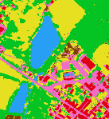
6 demonstrators for the M&E of AFD projects
FINALIZATION
FINALIZATION
FINALIZATION
Bahr Linia
TCHAD
National Park
RDC
Svay Chek
CAMBODGE
Geo-services derived from satellite Earth Observation for sustainable resource management
Current and retrospective mapping of land use and occupation
Spatial and statistical indicators of the dynamics and performances observed on the territories in terms of agricultural, forestry and water resources
Derived analyses from the impact of implemented projects
Continuous monitoring and projections
Sustainable resource management
Monitoring of agricultural practices and performance
Sustainable Resource Management
Deforestation monitoring and early warning
Sustainable management of resources
Dynamics and uses of the water resource

Slide 17
6 demonstrators for the M&E of AFD projects
DELIVERED
INITIALIZATION
INITIALIZATION
Secondary cities
BURKINA FASO
NRBC – NORTH AND WEST AFRICA
Connectivity NORTH - IVORY COAST
Geo-services derived from satellite Earth Observation for risk and crisis management
Mapping of built-up areas and economic development indicators by cross-referencing data
Monitoring of IDPs / refugees in support of humanitarian crisis management
Risk assessment and prevention (floods, critical infrastructures...)
Evaluation of the impacts of a crisis (conflict, natural disaster, etc.)
Monitoring the reconstruction and restoration of ecosystem
Risk Management
Critical infrastructure monitoring and prevention
Risk Management
Impact analysis of the renovated road network and exposure to flooding
Crisis management
Urban dynamics and migration flows

Slide 18
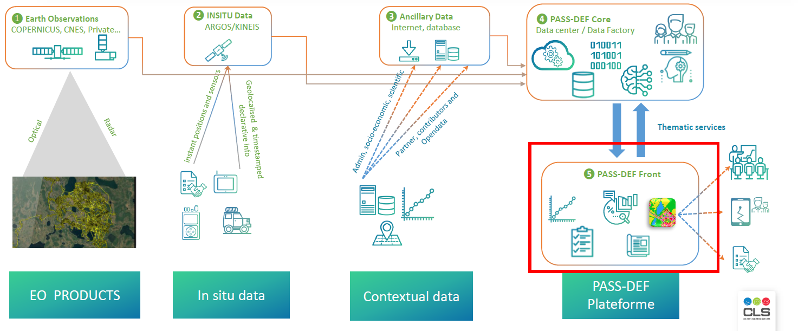
Prototyping of a geospatial analysis tool

Slide 19
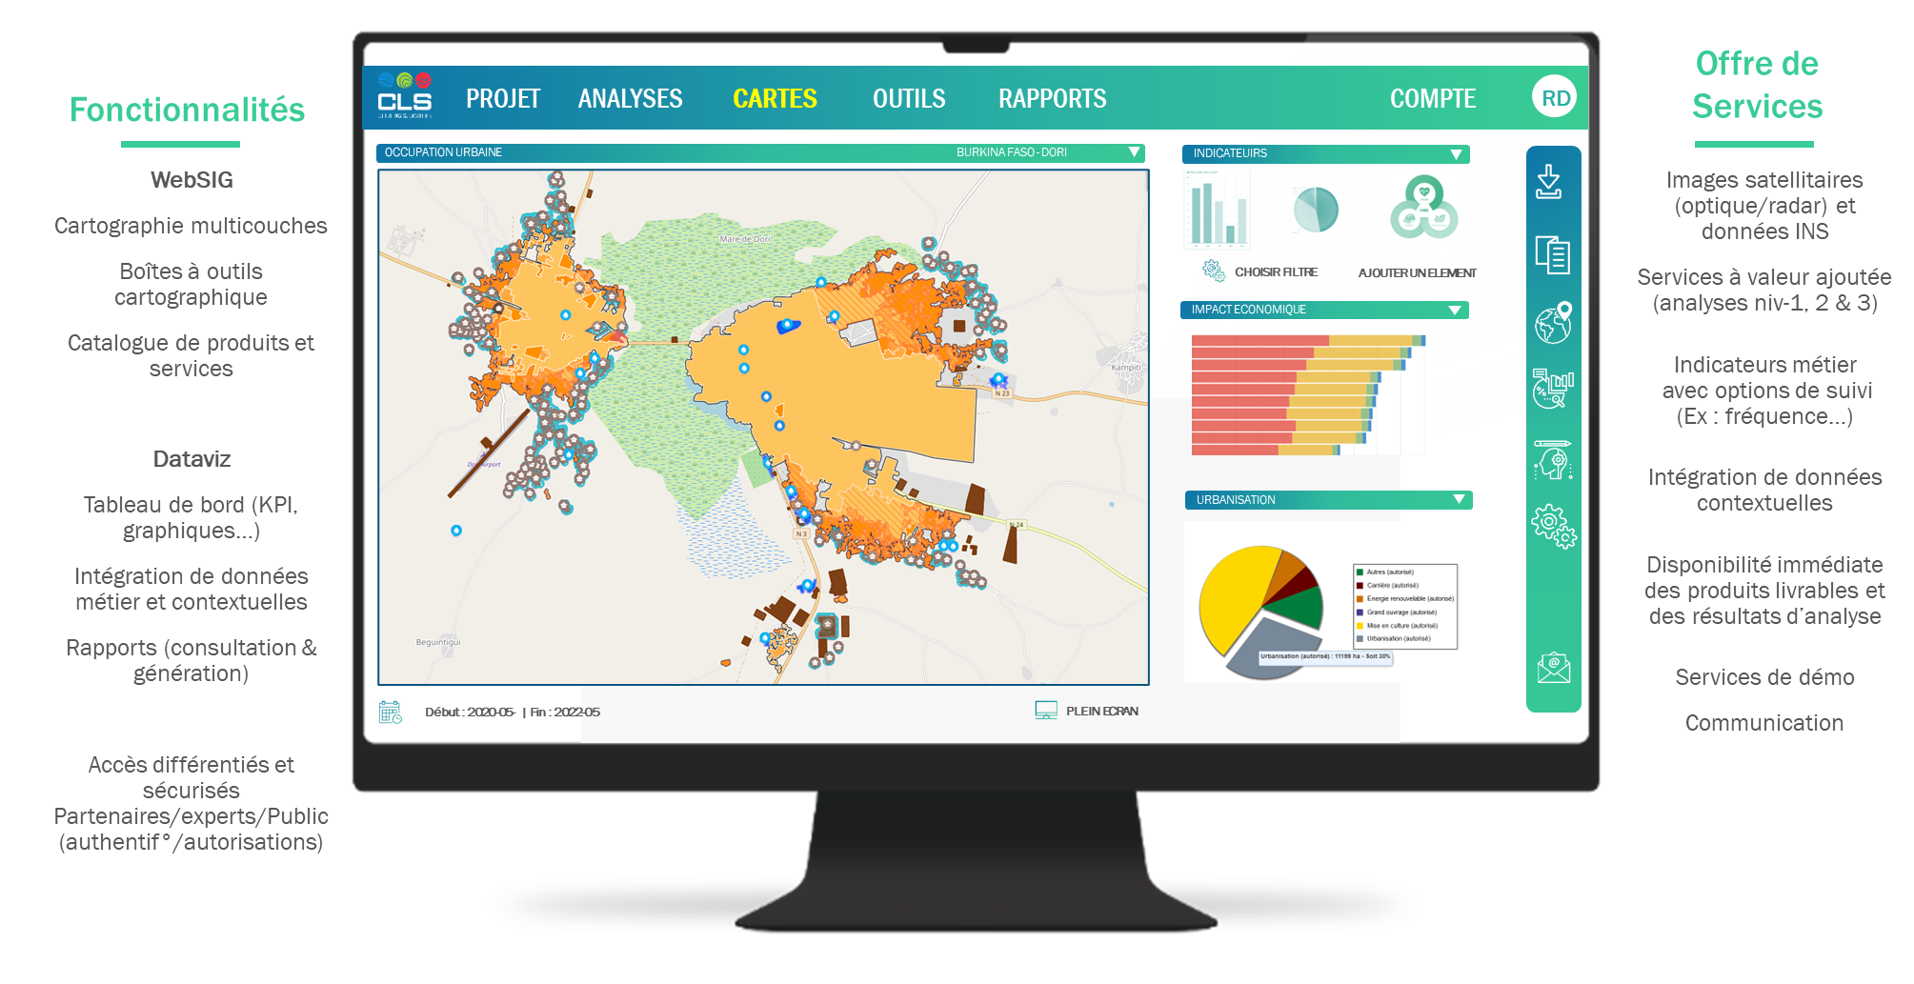
A single portal to access geospatial data

Slide 20
Need to centralize geospatial data and services
Lack of an operational tool for geospatial data exploitation
Need to develop a tool that centralizes a maximum of data and services, and that allows access to these services according to the type of data and users (different levels of sharing and access, from open source to a project level)
Need for our counterparts to be able, if they wish, to also integrate the geospatial services developed in their projects (by AO) into the tool, thus allowing them to benefit from substantial savings related to the development of this digital infrastructure and to the analyses already developed-hosted there

Slide 21
Thank you for your
attention!

