Slide 1

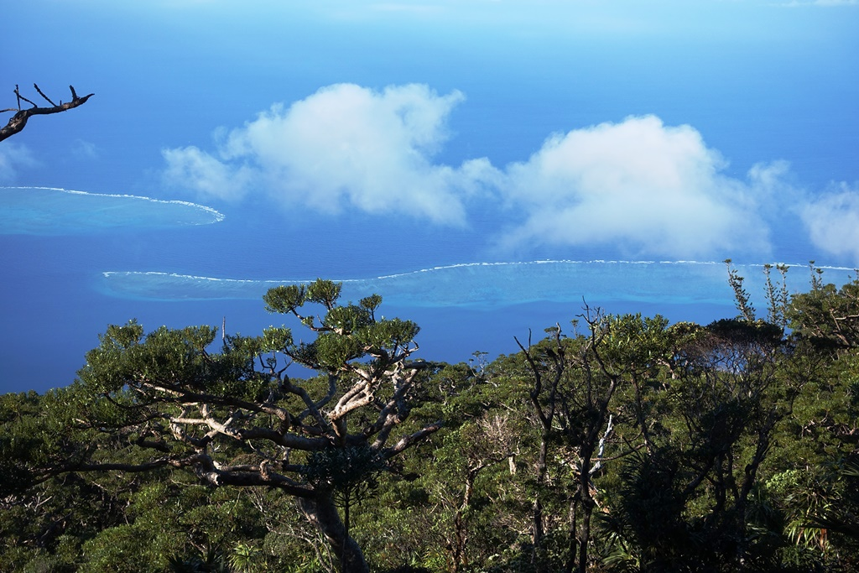
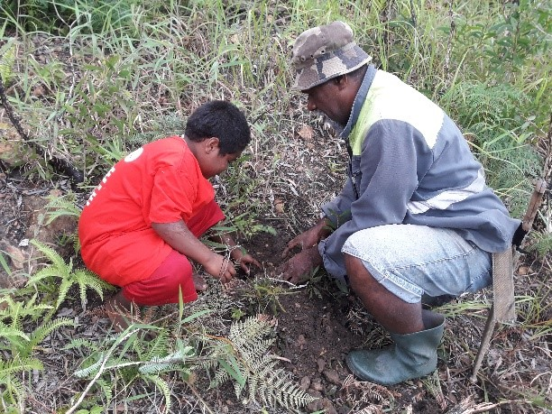
pacific people are part of a vibrant nature
remote sensing can help to unlock carbon finance 4 people
François Tron

Slide 2
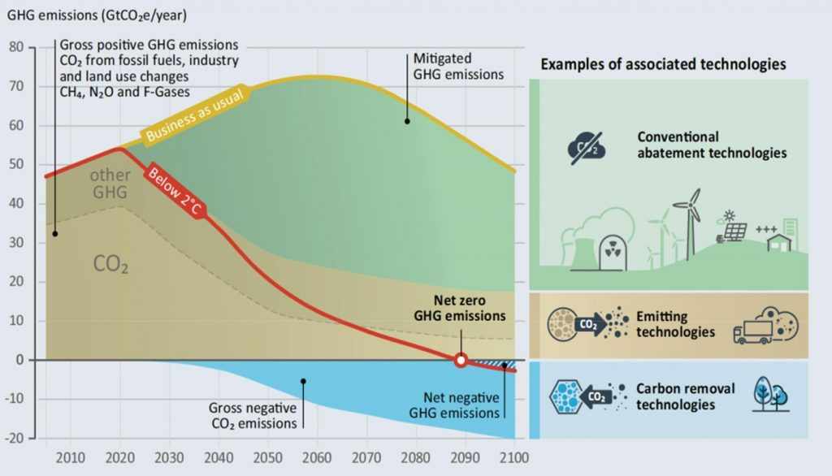
« 14% of landmass host 45% of irrecoverable carbon
& 91% of biodiversity.
Indigenous people play a key role there. »
France President E. Macron
December 1st, 2022 @ Capitol, Washington DC

Slide 3
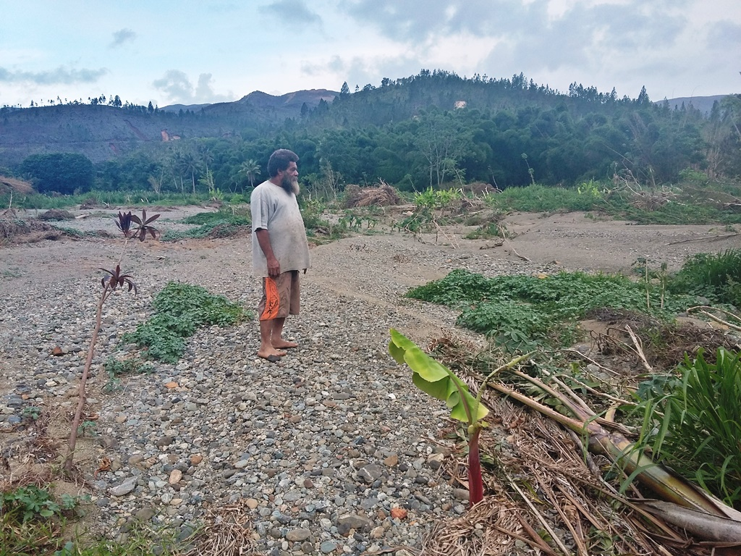
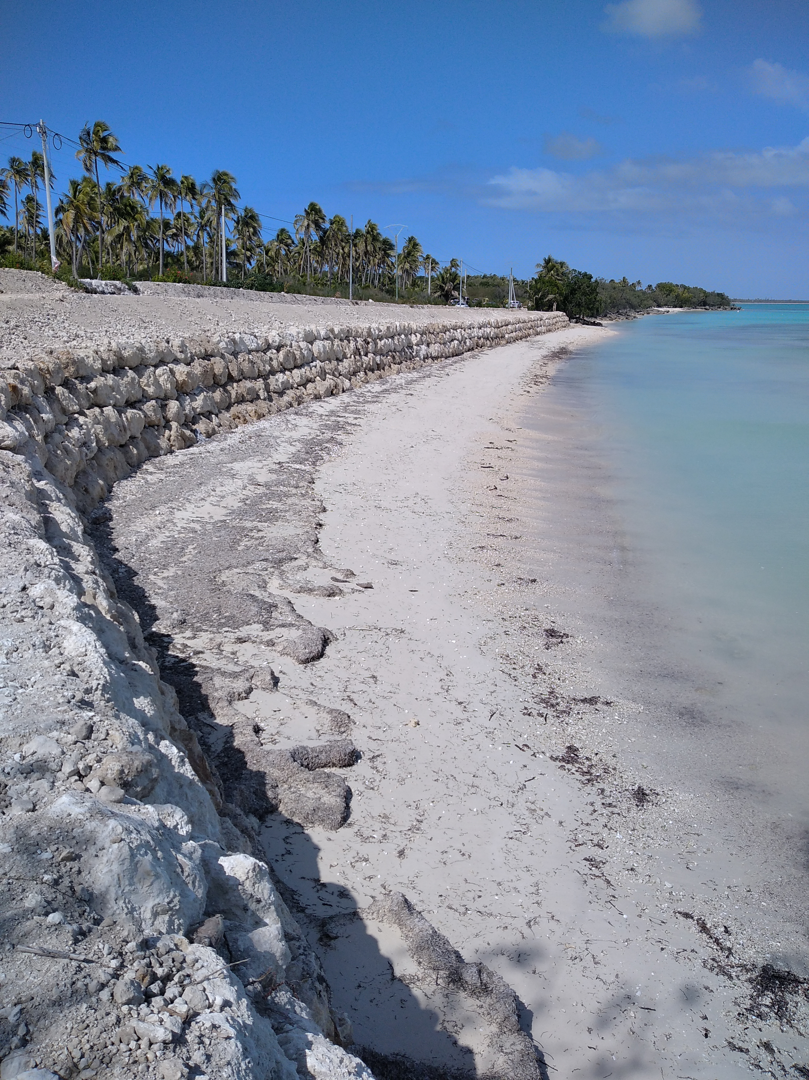
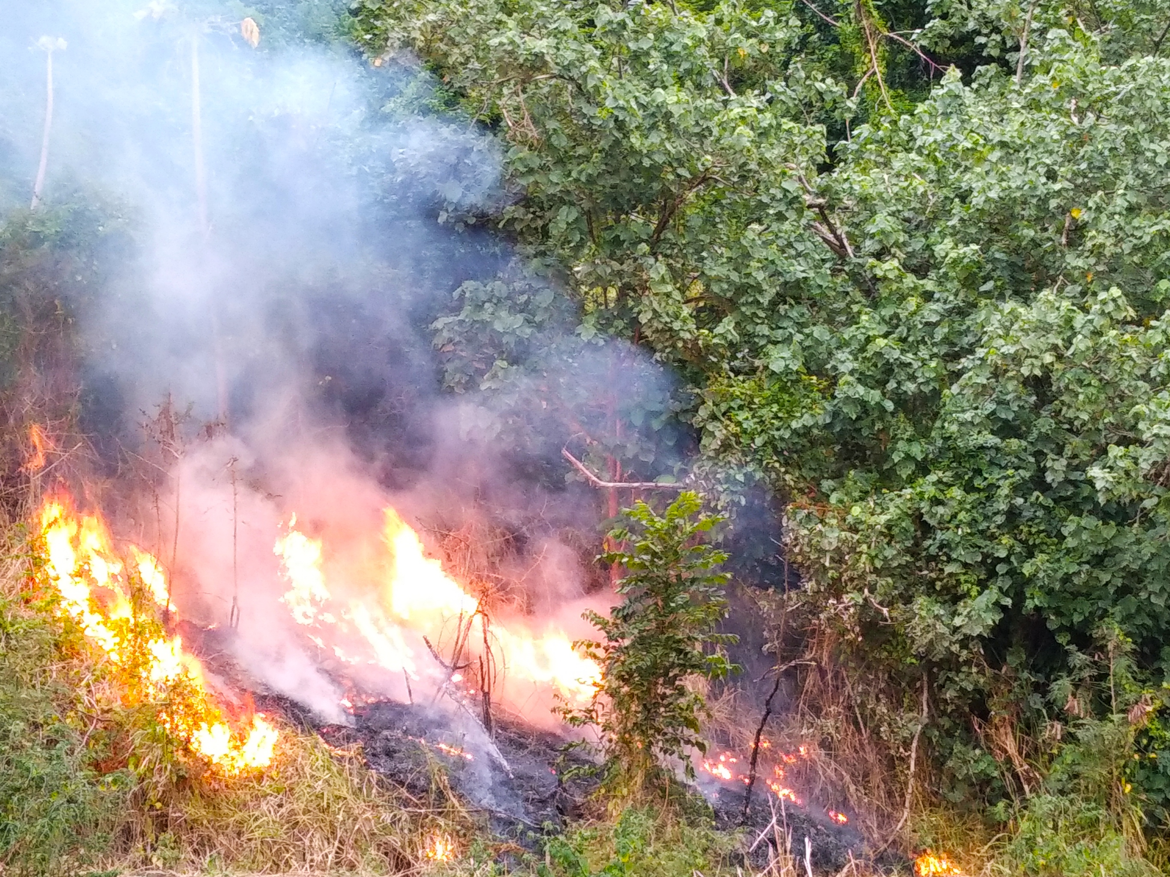
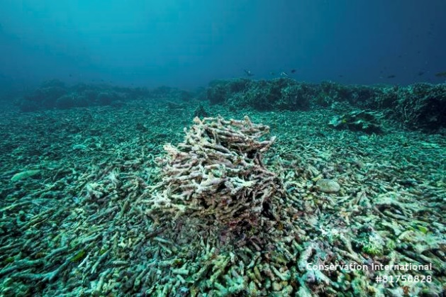
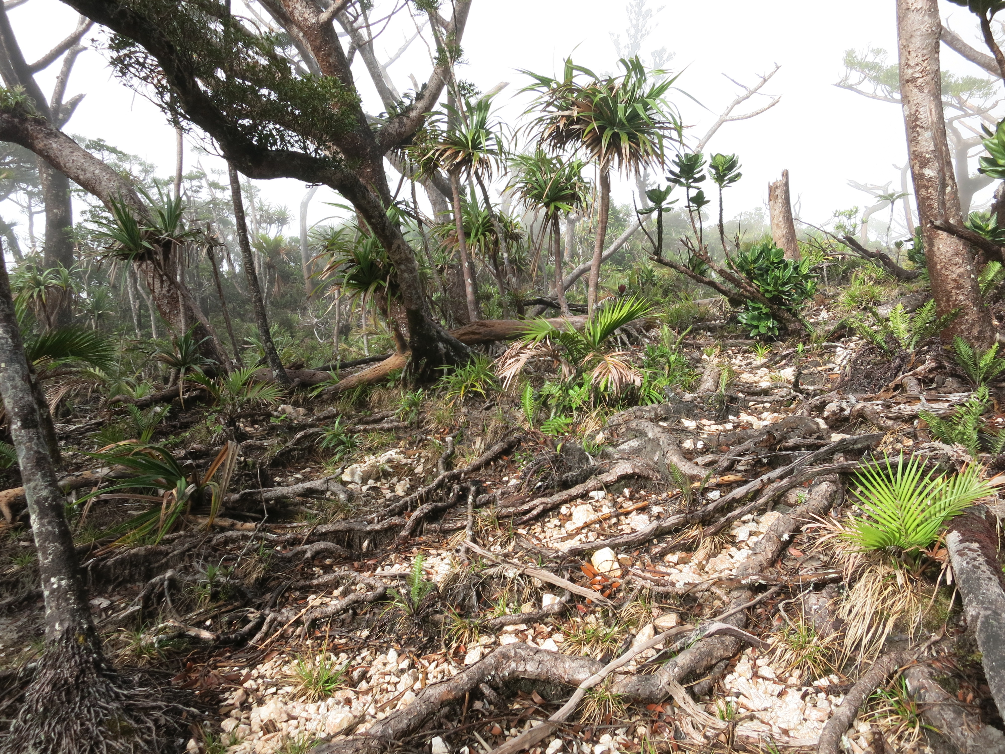
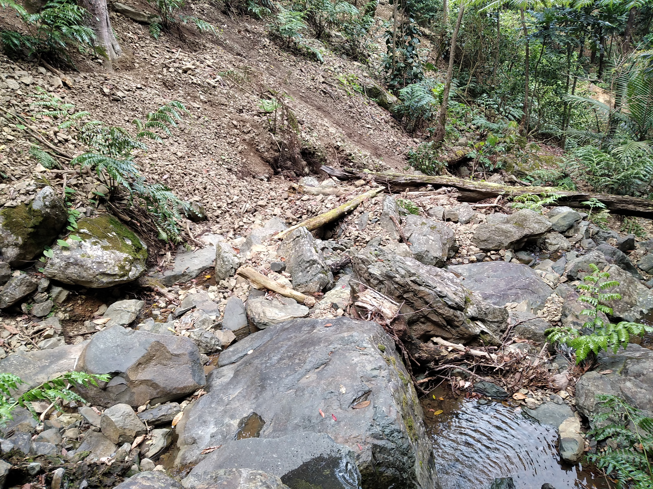
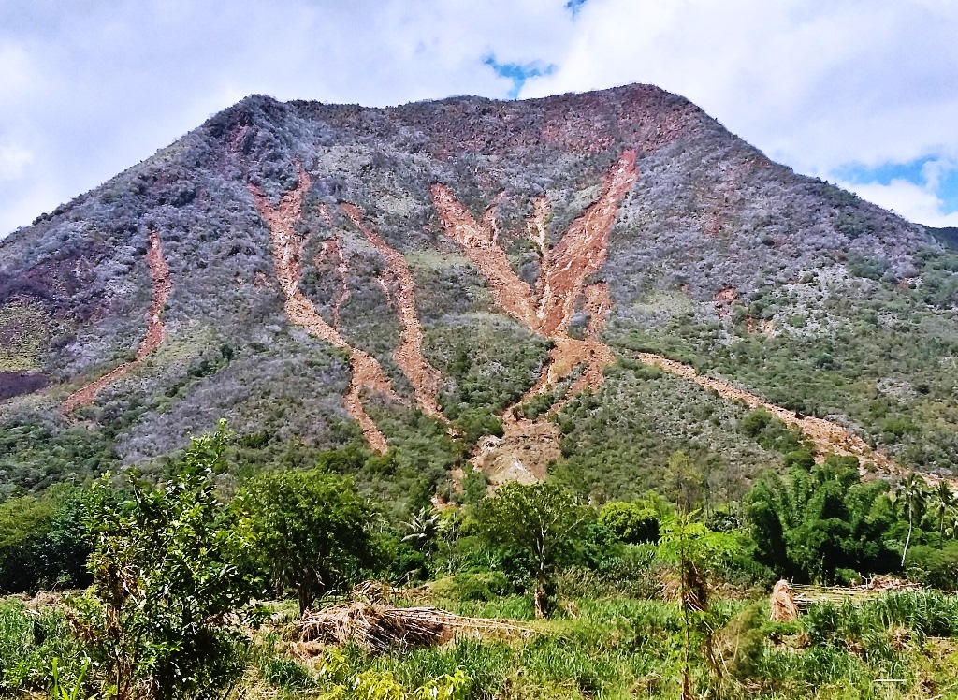
1 - People need nature to thrive :
Water, Food, timber, fiber, medicine… provision
Clean Air
Climate change adaptation
Vibrant culture
Most healthy ecosystems are Carbon rich
Most local communities & individuals aspire to protect, restore & regenerate nature but lack funding…

Slide 4
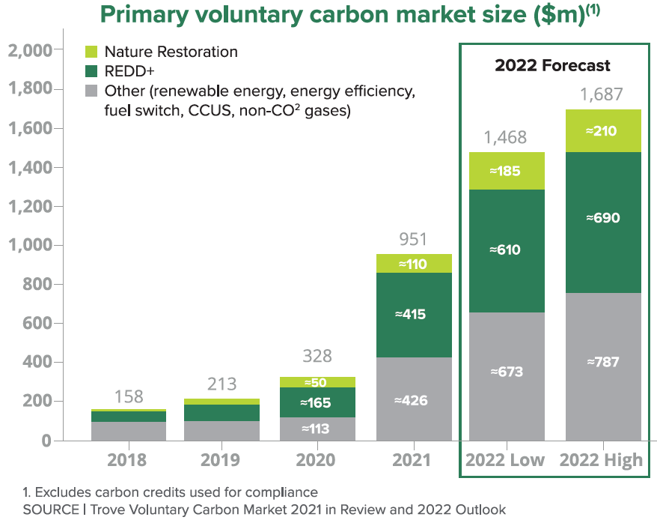
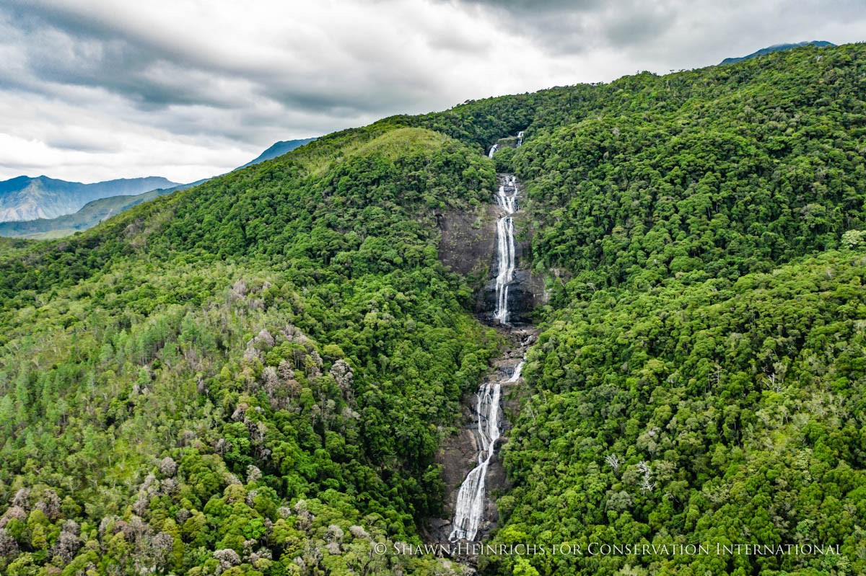
2 – Carbon finance can support people’s vision & aspiration :
3000 hectares Forest loss per year
1 million hectares of « degraded land » that is little/not used that can be restored/regenerated at little opportunity costs.
> Multi-million tCO2e/year potential @5-10USD/tCO2e > 100s of jobs
Carbon finance is a rapidly growing market
Multiple Co-benefits :
  Climate change adaptation
  Biodiversity conservation
  Cultural benefits

Slide 5
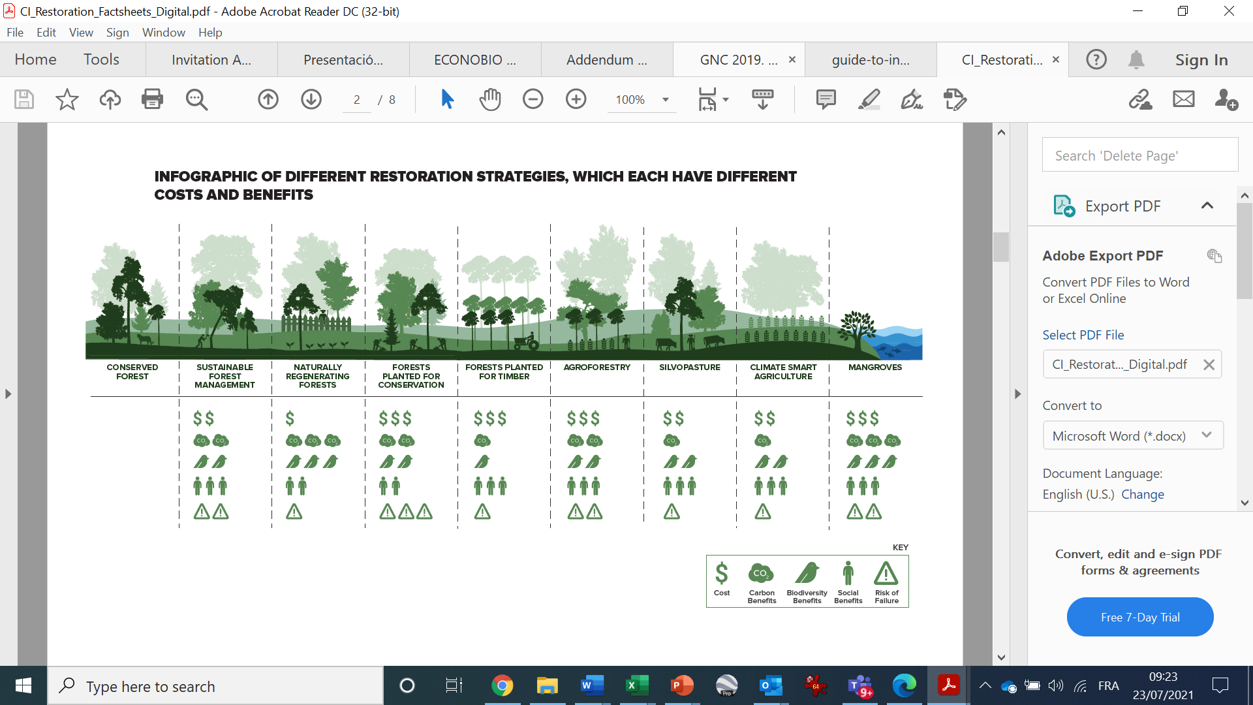
3 – Value proposition (TBD!) :
Offer : Create to living lab/team/cluster to foster local communities vision & aspiration for nature
Services : Listen & Develop Carbon proposals to unlock large scale Carbon funding + Provide technical assistance for implementation
RS & IT can help for strategic analysis & planning with(in) local communities for PDD dvpt, effective implmentation, MRV & shared learning

Slide 6
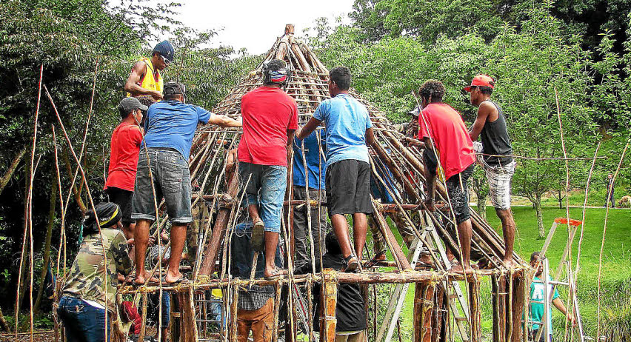
Olé, Merci, Malo, Vinaka lava, Mauruuru, Thank you !
Collaboration is key to success

